Slide 1
Humanities Data Analysis
mike.kestemont@uantwerpen.be
MA DTA | 2003FLWDTA | 2023-2024

Slide 2
Overview
Introduction to statistics for Humanities students
Focused on intuition and understanding (rather than on mathematics and derivation)
“Traditional stats 101”: basic procedures, no fancy statistics
Pragmatic analysis of engaging, real-world datasets from the Humanities
5 sessions (3 ECTS) :
Session on Tuesday (obligatory), 09:30-12:30, S.K.203
18/10, 25/10, 08/11, 10/11, 15/11
1 extra session (proposal): 10/11, 13:00-16:00 [?]
Format
Interactive, modular
Divided in “sprints” (20-25 minutes), each followed by short break
Slides session (theory) or notebook session (practice)
Homework exercises: optional, highly recommended (but not graded)

Slide 3
Evaluation
Final evaluation: written exam
During January exam sessions
Open book: all resources allowed, except for external help (Chat(GPT), discussion, etc.)
Additional analysis of known and unknown datasets
Very similar to homework style
See test exam from last year (!)

Slide 4
Software
Install R (if you haven’t already): e.g. from
https://lib.ugent.be/CRAN/
Jupyter notebooks:
https://docs.anaconda.com/free/navigator/tutorials/r-lang/ (Step 12 and following not essential)

Slide 5
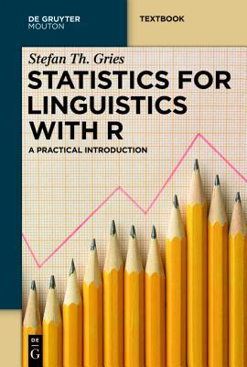

Handbook [optional]
Stefan Th. Gries, Statistics for Linguistics with R. A Practical Introduction. 2nd ed. De Gruyter Mouton (2013)
Well-known text book by leading figure in the field of corpus linguistics
Complementary with teaching materials (but different order and emphases)
I will refer to it in a consistent way
Gries more verbose: no manual recalculations (due to lack of time)
We will do more than just linguistics
Focus: class materials (Gries = optional background reading)

Slide 6
How to structure your course folder?
HDA2324_public (top directory)
-> shorturl.at/bsETU (Dropbox)
Session 1 (shared weekly)
slides, notebooks, ...
Session 2 (shared weekly)
slides, notebooks, ...
datasets
arthur
manuscripts.csv
manuscripts.xlsx
chat
chat.tsv
readme.txt
Relative paths from within the notebooks:
‘../datasets/subfolder/...’

Slide 7
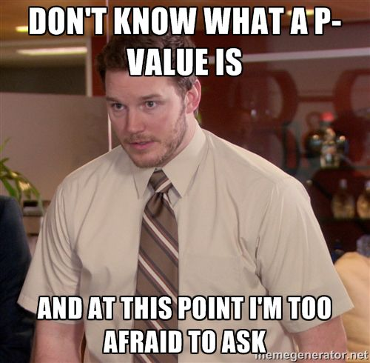
Course materials
One folder per session:
Slides (PDF)
Class notebooks (.ipynb)
Homework notebooks (.ipynb)

Slide 8
What is statistics (not)?
And how is it different from machine learning?
The application of quantitative (computational) methods to (observed) data, to make scientifically informed claims about a phenomenon in the real world
Our data is typically a (noisy, imperfect) sample from a larger population
Because we work with a sample, there will be uncertainty
We have to acknowledge that uncertainty when formulating claims
Statistics is scientific, precisely because it gives us a nuanced way to describe uncertainty

Slide 9
Similarities between statistics and machine learning?
Although they adopt different goals and terminology, both are essentially about fitting a function fΘ that maps an input (X) to an output (Y), using parameters Θ:
fΘ(X) -> Y (or Ŷ)
In statistics, we mostly care about the parameters Θ used inside f: these are what we want to “estimate”, these are what we would like to “infer” from the observed sample (X, Y). In machine learning, we mostly care about the predicted Ŷ (and how different it is from Y). Which precise Θ is used for this, is less important.

Slide 10
Differences machine learning and statistics?*
(*This is a caricature)
Machine learning | Statistics
Emphasis on prediction of unseen, out-of-sample data | Emphasis on description of observed, in-sample data
Emphasis on performance | Emphasis on understanding
Lots of code | Not so much code
Complex models (e.g. neural nets) | Simple model (e.g. linear regression)
Results more essential than theory | Theory more essential than results
Terminology (e.g. categorical feature) | Terminology (e.g. factor)

Slide 11
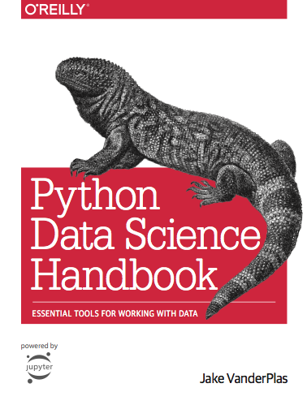
Definitions
Statistics is (a part of) data science
“Data science is statistics on a Mac” (recent term!)
Data science = visualization + statistics + machine learning (cf. content of Jake van der Plas, Python Data Science Handbook)
The practice (art?) of reasoning in the absence of (complete) certainty
Inference from observed data: infer a set of “explanations” for the data that can be ranked by plausibility

