Slide 1
Watershed Delineation in R
Brady Nahkala, Amy Kaleita
Code modified from Andrew Murray, UNC PhD Candidate
ABE 431/531: Design and Evaluation of Soil and Water Conservation Practices
Fall 2020

Slide 2
Watershed Background
First, understand watershed delineations using topographic data via Lab 1.
This is accompanied by the reference: Delineating a watershed.

Slide 3
Delineating Watersheds Using Software
By using elevations, determine which direction water flows
Digital Elevation Model (m)
Flow Direction
297 | 298 | 302
300 | 305 | 299
301 | 300 | 298

Slide 4
Delineating Watersheds Using Software
Flow Direction
Flow Accumulation
4 | 1 | 1
2 | 1 | 1
1 | 1 | 3

Slide 5
Stream Network and Pour Point
Streams are defined based on the number of cells that drained to it, based on a certain threshold value (e.g. 4…)
Users select a pour point, which snaps to a stream network, and then the watershed is delineating by following the flow upstream
4 | 1 | 1
2 | 1 | 1
1 | 1 | 3

Slide 6
Watershed Delineation in R
R does not have a GUI for spatial data like ArcGIS or QGIS, etc.
However, it can accomplish the same data processing
(Good) visualization requires more intentional action by the user

Slide 7
‘whitebox’ Package
The whitebox package is a geospatial and hydrologic toolset developed for R (https://giswqs.github.io/whiteboxR/). This is a great toolbox for processing raster data and is the workhorse of this module.
For a brief overview of R packages: http://r-pkgs.had.co.nz/intro.html

Slide 8
ACTIVITY
Delineate a watershed in Story County using R

Slide 9
Download:
Download R (free)
https://cloud.r-project.org/
Download R Studio (free)
https://rstudio.com/products/rstudio/download/

Slide 10
Provided files
ABEDelineationModule.Rmd
R Markdown Files help you build and organize reproducible, manageable code chunks and create word/pdf/html documents from the code itself.
For more information on Rmd: https://rmarkdown.rstudio.com/articles_intro.html
dem_story.tif
This is the elevation dataset for Story County at a 3m resolution.

Slide 11
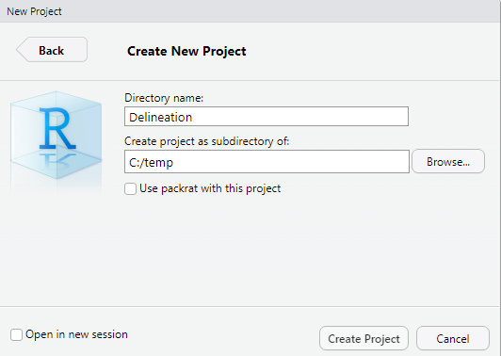
In RStudio
File -> New Project -> New Directory -> New Project ->
Copy provided files to the same folder as the project you just created
Create a subfolder called ‘data’ (C:/temp/Delineation/data)

Slide 12
The Rmd file:
Header.
Title of document.
Author.
Date.
Output file type.
---
title: "ABE 531 Watershed Delineation Module"
author: "Brady Nahkala"
date: "7/27/2020"
output: html_document
---
```{r setup, include=FALSE}
knitr::opts_chunk$set(echo = TRUE)
```
# LIBRARY
```{r, warning=F, message=F}
library(raster)
library(here)
library(whitebox)
library(mapview)
library(sf)
library(rayshader)
library(av)
```
File setup.
The echo command tells the file to display both the code and its result in the output file.
Library.
The library function tells R to load functions from downloadable packages that other users have built to extend the functionality of R.

Slide 13
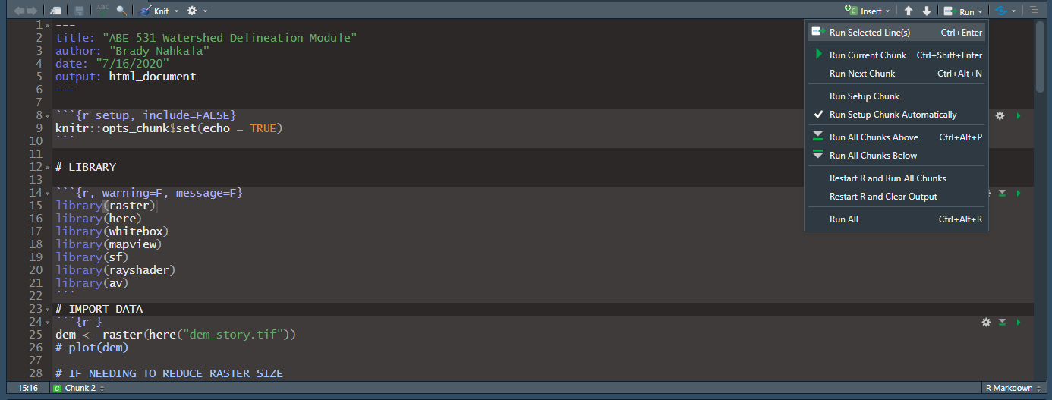
To delineate the watershed:
Open the file:
ABEDelineationModule.Rmd
Run the script by clicking Run -> Run All or by the keyboard shortcut Ctrl+Alt+R.

Slide 14
Output
Output is displayed directly below the code chunk, but only if the results of a process are not saved to an R object.
Output can also be aggregated into a single presentable output file (Word, html page) by using the ‘knitr’ package. Examples are in the following slides.

Slide 15
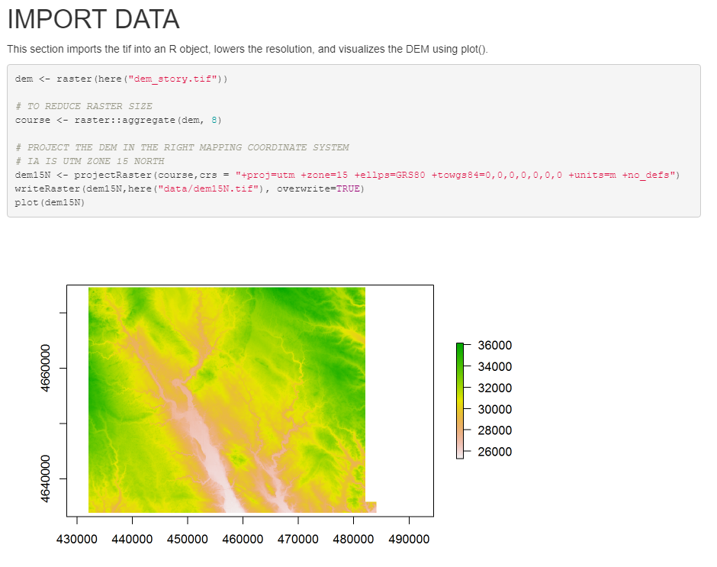
HTML (webpage) Output

Slide 16
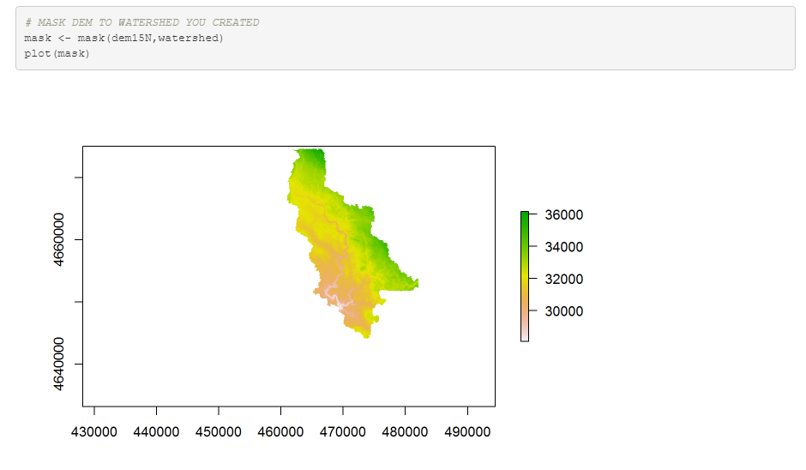
HTML (webpage) Output

Slide 17
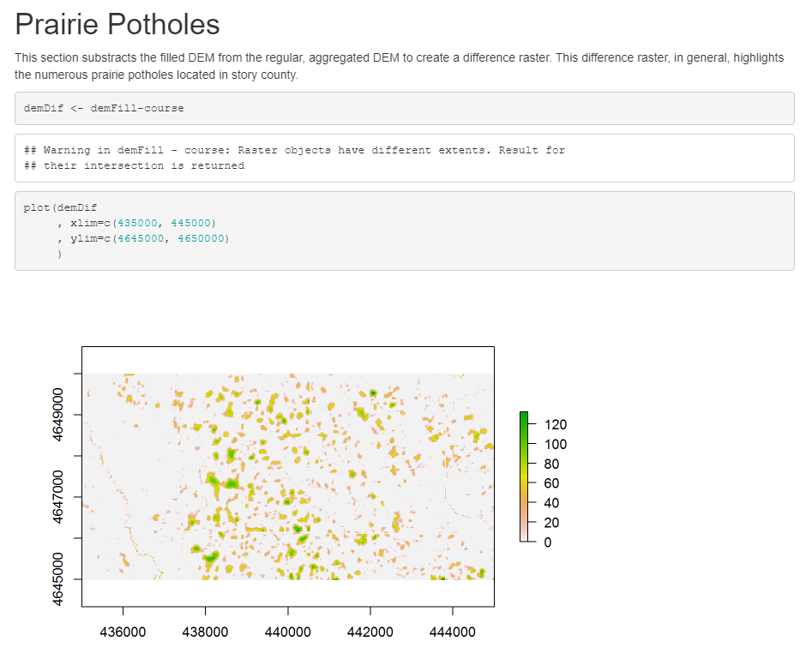
HTML (webpage) Output

Slide 18
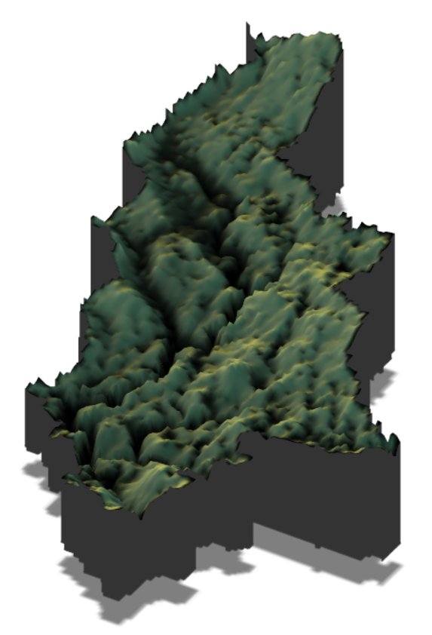
Other fancy things…
‘rayshader’ package allows 3D rendering
https://www.rayshader.com/index.html

