Slide 1
Finding the sweet spot: The intersection of lexical breadth and depth in a learner corpus
Ben Naismith
University of Pittsburgh
Linguistics Department Colloquium
March 20, 2020
Notes:
Pic 02

Slide 2

PELIC
University of Pittsburgh
English Language Institute Corpus
Notes:
Cathedral logo from http://www.ieee-iri.org/studentaffairs_subdomain/occlogos.html
Pic 04

Slide 3
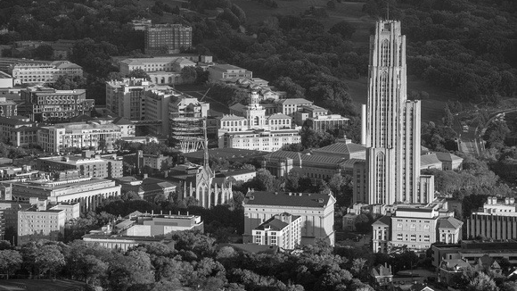
Naismith, B. and Kanwit, M. (2020). A Corpus Study of the English Suffixes -ness and -acy: Productivity, Genre, and Implications for L2 Learning. Canadian Journal of Applied Linguistics.
Notes:
Pic 06

Slide 4

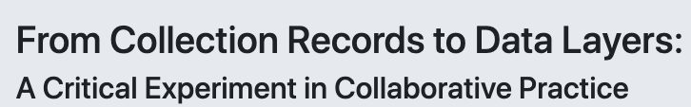
Notes:
Pic 09

Slide 5
