Slide 1

Open Studio Project
Energy and environmental technologies for building systems
Bocchi Valentina Moret Giulia Nunziata Angela
POLITECNICO DI MILANO

Slide 2

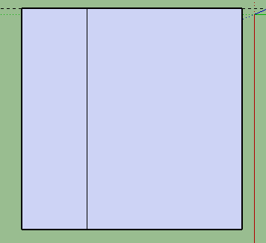
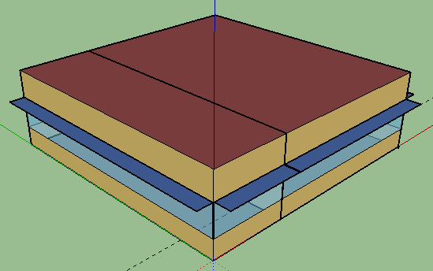
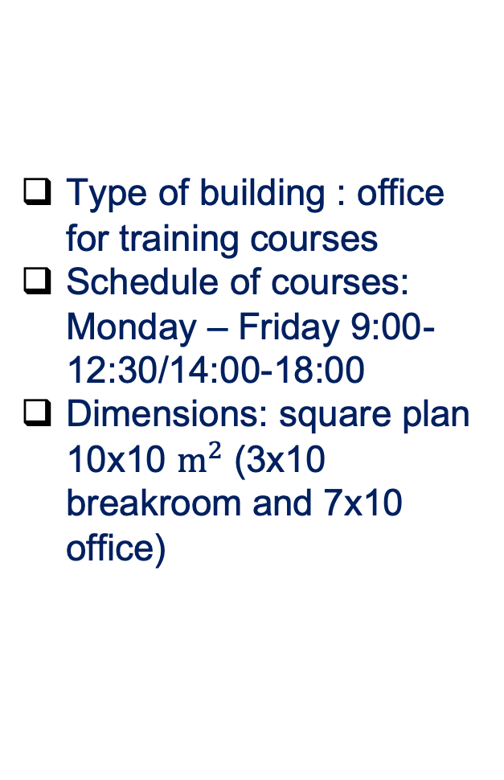
Background
Energy and environmental technologies for building systems
Type of building : office for training courses
Schedule of courses: Monday – Friday 9:00-12:30/14:00-18:00
Dimensions: square plan 10x10 $m^{2}$ (3x10 breakroom and 7x10 office)
POLITECNICO DI MILANO

Slide 3
Construction details
Energy and environmental technologies for building systems
Internal Wall Layer
13mm 1/2IN gypsum
19mm gypsum board
F16 acoustic tile
19mm gypsum board
13mm 1/2IN gypsum
Exterior Wall Type 1
25mm 1/IN stucco
M11 100mm lightweight concrete
F04 Wall air space resistance
13mm 1/2IN gypsum
Exterior Wall Type 2
25mm 1/IN stucco
M11 100mm lightweight concrete
F04 wall air space resistance
34mm wall insulation
13mm 1/2IN gypsum
Window Type 2: Theoretical glass 221
Window Type 1: Clear glass 3mm
Fenestration
POLITECNICO DI MILANO

Slide 4
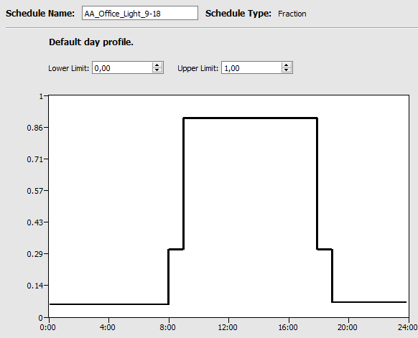
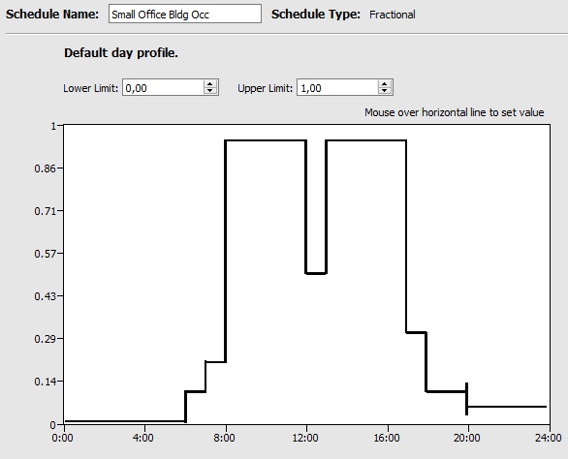
Schedule sets
Energy and environmental technologies for building systems
Schedule for the open office:
small office activity: 70 W/person (people stay sit for most of the time)
small office building equipment: default values
office work occupancy: default values (it is reasonable to set 0 from 00:00 untill 6:00 and maximum in working hours)
office lights: turn on the lights a little bit before cleaning (30%) and 90% from 9:00 to 18:00, than regulate back to 30% untill 20:00
POLITECNICO DI MILANO

Slide 5

Schedule sets
Energy and environmental technologies for building systems
Schedule for the breakroom:
small office activity: 70W/person (people stay sit for most of the time)
small office building equipment: default values
office work occupancy : assumption of high occupancy at 8:00, during the lunch break and near the closing time of the office
office lights: same as open office room
Space type: conference room
People definition:
Breakroom: default value
Open office: conference
POLITECNICO DI MILANO

Slide 6
Simulation 1
Energy and environmental technologies for building systems
Milan
Exterior Wall Type 1
Window Type 1
Annual overview:
End Use | Consumption (kWh)
Heating | 11666,67
Cooling | 9172,22
Interior Lighting | 3795,3
Exterior Lighting | 0
Interior Equipment | 7782,73
POLITECNICO DI MILANO

Slide 7
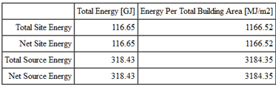
Simulation 1
Energy and environmental technologies for building systems
Monthly overview: electricity consumption
Interion Lightining total energy: 3795,3 kWh
Interior Equipment total energy: 7782,73 kWh
POLITECNICO DI MILANO

Slide 8
Simulation 1
Energy and environmental technologies for building systems
District cooling and heating consumption
POLITECNICO DI MILANO

Slide 9
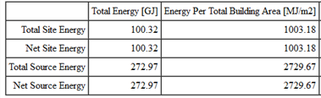
Simulation 2
Energy and environmental technologies for building systems
Milan
Exterior Wall Type 1
Window Type 2
Annual overview:
End Use | Consumption (kWh)
Heating | 8597,22
Cooling | 7700
Interior Lighting | 3795,3
Exterior Lighting | 0
Interior Equipment | 7782,73
POLITECNICO DI MILANO

Slide 10
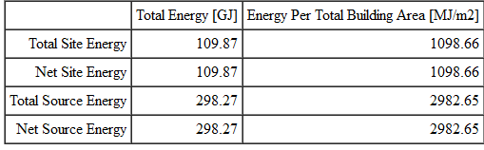
Simulation 3
Energy and environmental technologies for building systems
Milan
Exterior Wall Type 2
Window Type 1
Annual overview:
End Use | Consumption (kWh)
Heating | 10250
Cooling | 8700
Interior Lighting | 3795,3
Exterior Lighting | 0
Interior Equipment | 7782,73
POLITECNICO DI MILANO

Slide 11
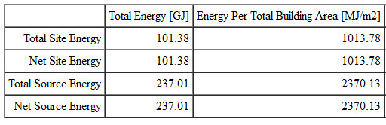
Simulation 4
Energy and environmental technologies for building systems
Rome
Exterior Wall Type 1
Window Type 1
Annual overview:
End Use | Consumption (kWh)
Heating | 4563,89
Cooling | 12030,56
Interior Lighting | 3795,3
Exterior Lighting | 0
Interior Equipment | 7782,73
POLITECNICO DI MILANO

Slide 12
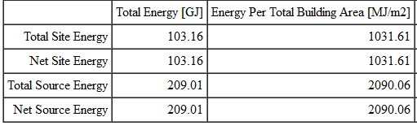
Simulation 5
Energy and environmental technologies for building systems
Palermo
Exterior Wall Type 1
Window Type 1
Annual overview:
End Use | Consumption (kWh)
Heating | 1313,89
Cooling | 15769,44
Interior Lighting | 3795,3
Exterior Lighting | 0
Interior Equipment | 7782,73
POLITECNICO DI MILANO

Slide 13
Simulation 6
Energy and environmental technologies for building systems
Palermo
Exterior Wall Type 1
Window Type 2
Annual overview:
End Use | Consumption (kWh)
Heating | 852,78
Cooling | 13391,67
Interior Lighting | 3795,3
Exterior Lighting | 0
Interior Equipment | 7782,73
POLITECNICO DI MILANO

Slide 14
Simulation 7
Energy and environmental technologies for building systems
Palermo
Exterior Wall Type 2
Window Type 1
Annual overview:
End Use | Consumption (kWh)
Heating | 1141,67
Cooling | 14891,67
Interior Lighting | 3795,3
Exterior Lighting | 0
Interior Equipment | 7782,73
POLITECNICO DI MILANO

