Slide 1
Techinical Environment Systems
Openstudio Thermal Analysis
Prop.Behzad Najafi
Zhou,Yuhan | Zhang,Yawen | Ni,Jingjing | Kou,Yu

Slide 2
Catalogue
- Base case
Building analysis
Energy simulation
- Different cities analysis —— Piacenza | Haikou | Merlbourne
Location and Weather Data
Energy Simulation
- Exterior wall analysis —— Concrete | wood | metal
Wall components and U-Value
Energy Simulation

Slide 3
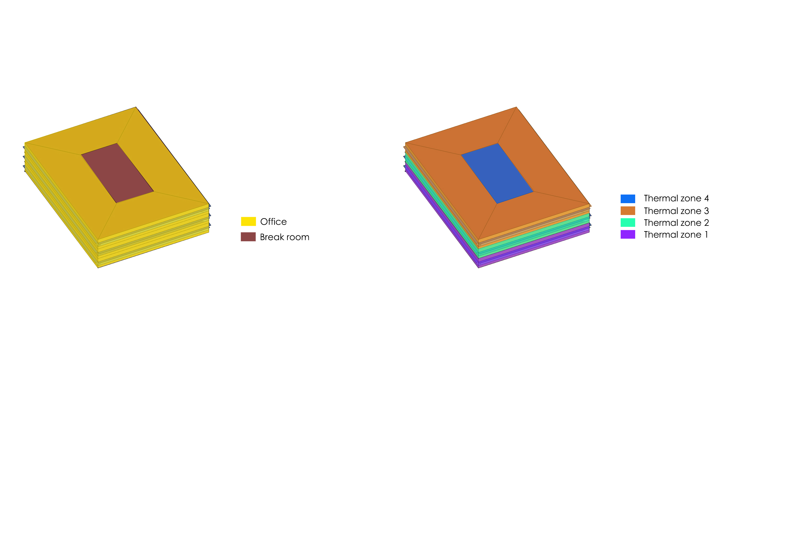
1.Base case
-Building analysis
Describe
- The building is a 3-level office located in Piacenza, With open office and break room.
- Every area of floor is 30m*40m
- Facede at Open office area has windows at 0.8m
- Except the windows on the North, having shading overhang extruding 500mm

Slide 4

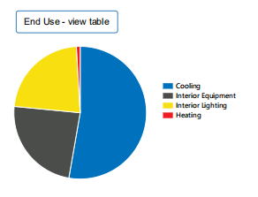
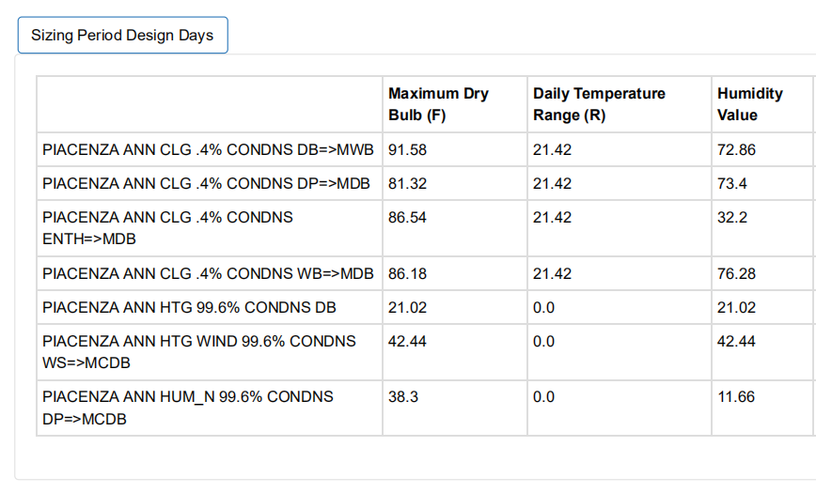
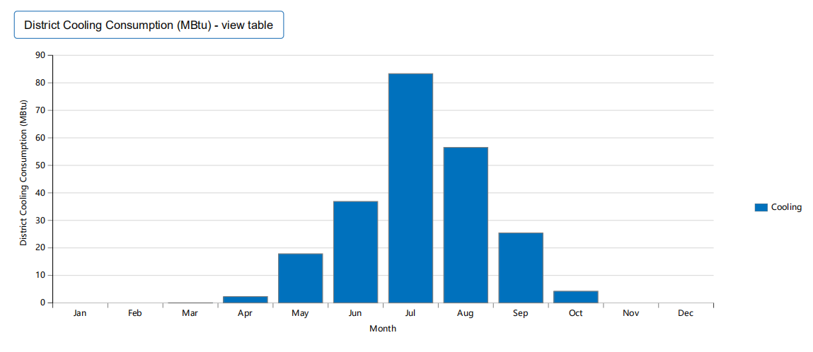
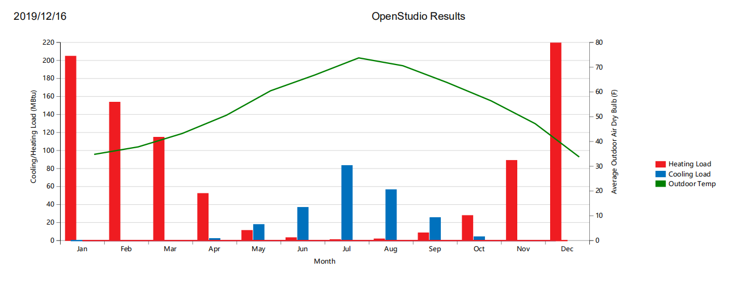
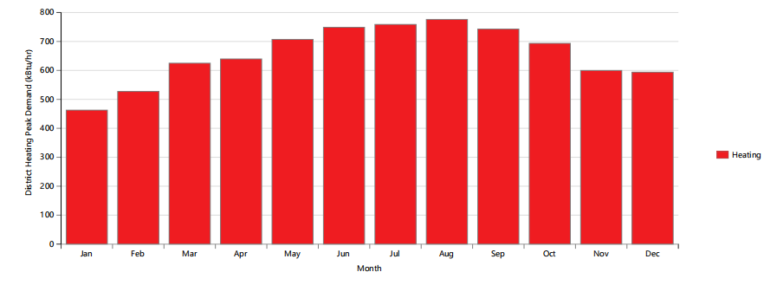
1.Base case
-Energy simulation

Slide 5


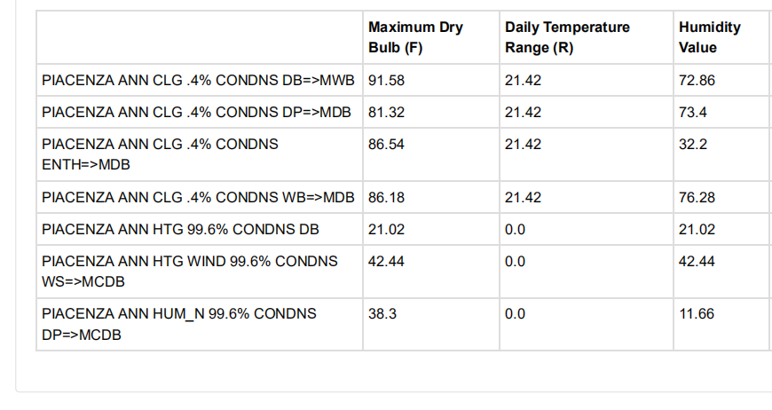
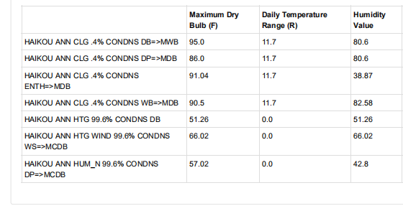
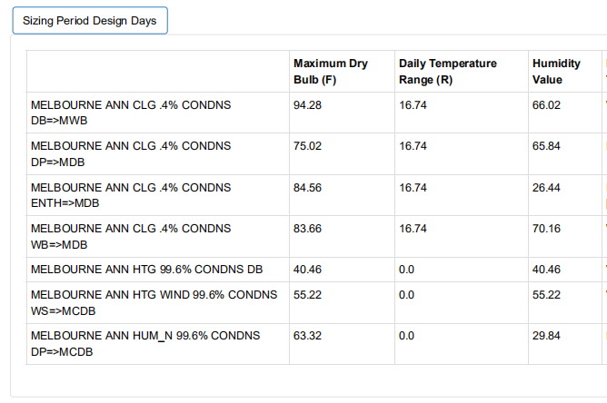
2. Different cities analysis
Location and Weather Data

Slide 6



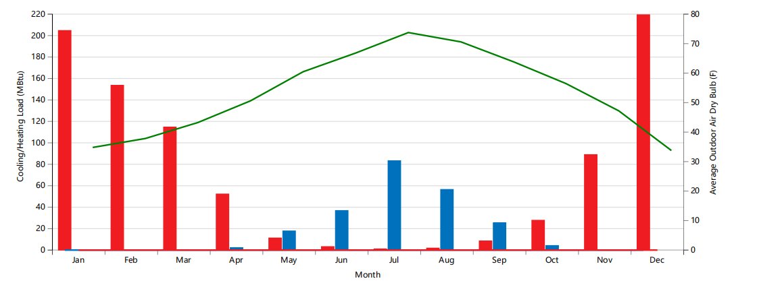
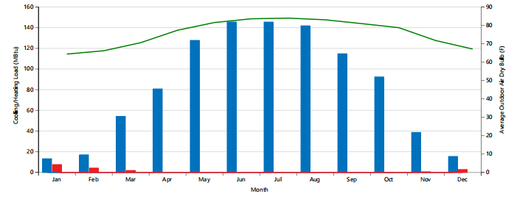
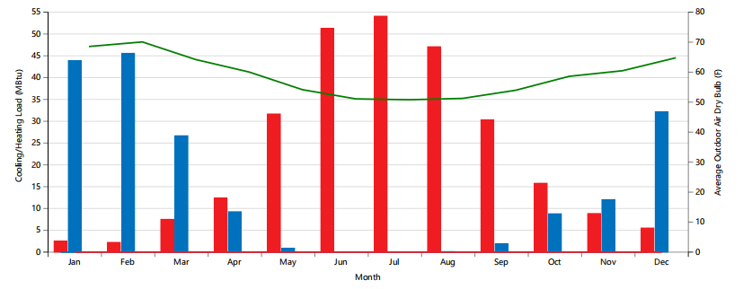


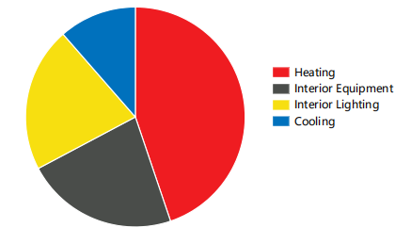
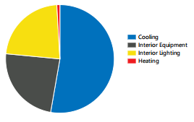
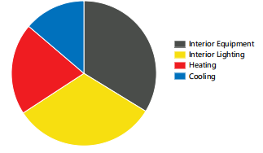
2. Different cities analysis
Location and Weather Data
Couclusion
The energy use, cooling consumption and heating consumption of the same wall are different in Piacenza, Haikou and Melbourne. The differences between statistics are basically the reason of different locations.

Slide 7
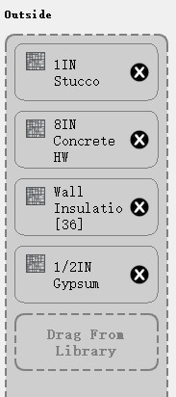
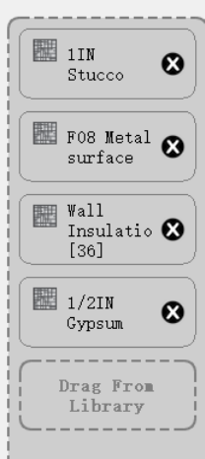
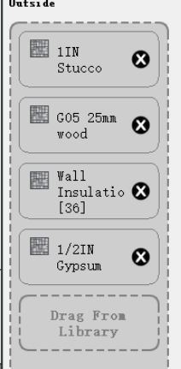
3. Exterior wall analysis
Wall components and U-Value
Wall-Concrete
Wall-Metal
Wall-Wood
R value=5.76
R value=8.10
R value=9.06
 | R value(ft²·h℉/Btu) | R value(m²·℃/W) | U value(W/m²·℃)
Concrete | 5.76 | 1.029 | 0.972
Metal | 8.10 | 1.446 | 0.692
Wood | 9.06 | 1.618 | 0.618

Slide 8
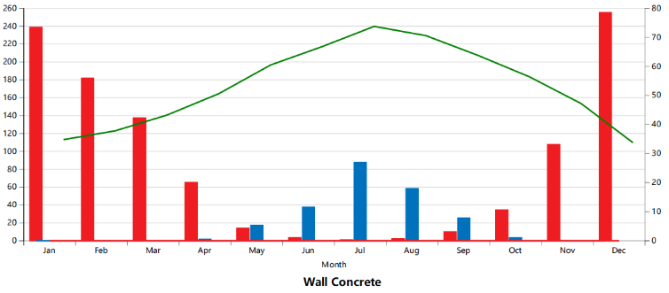
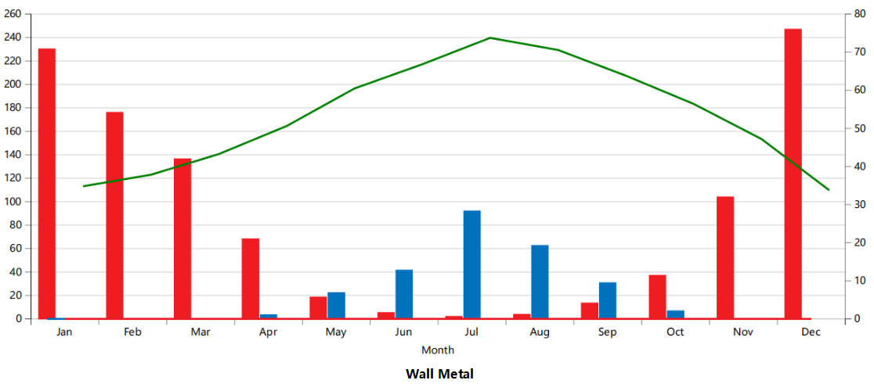
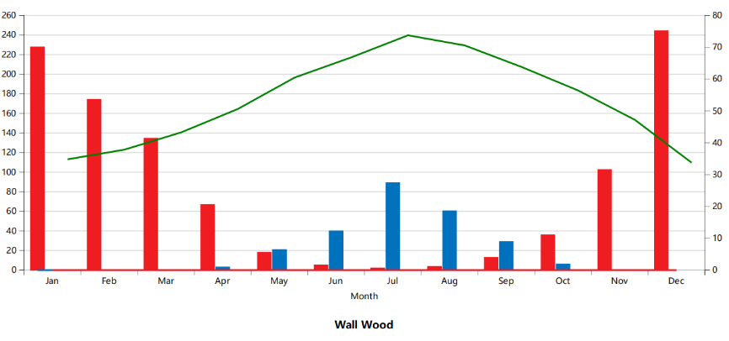
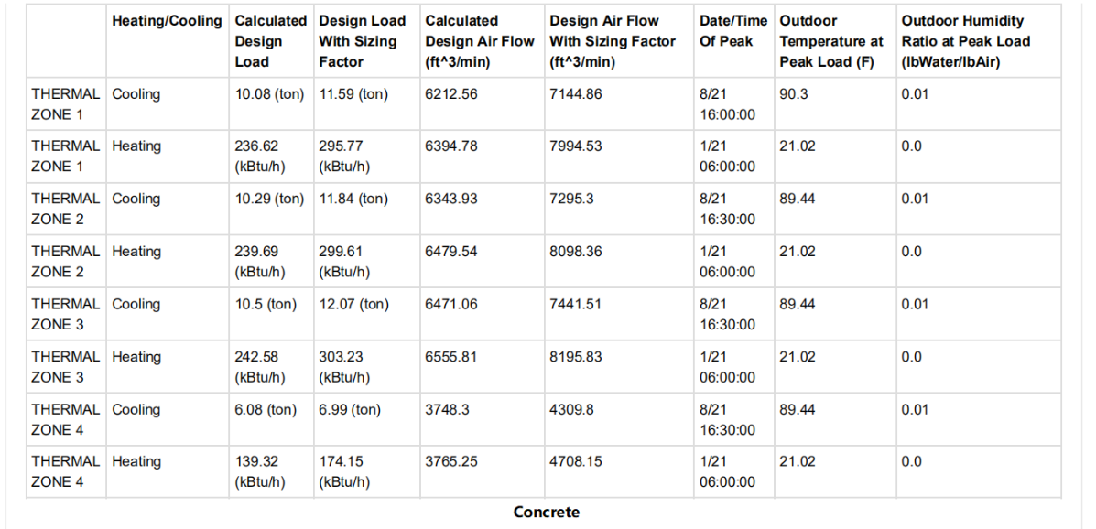
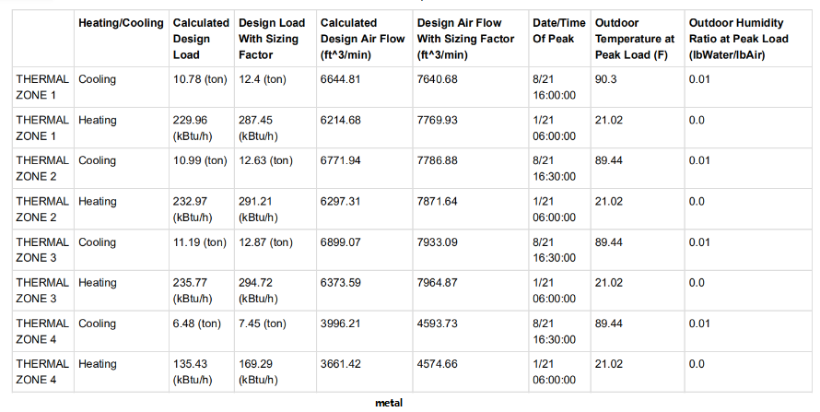
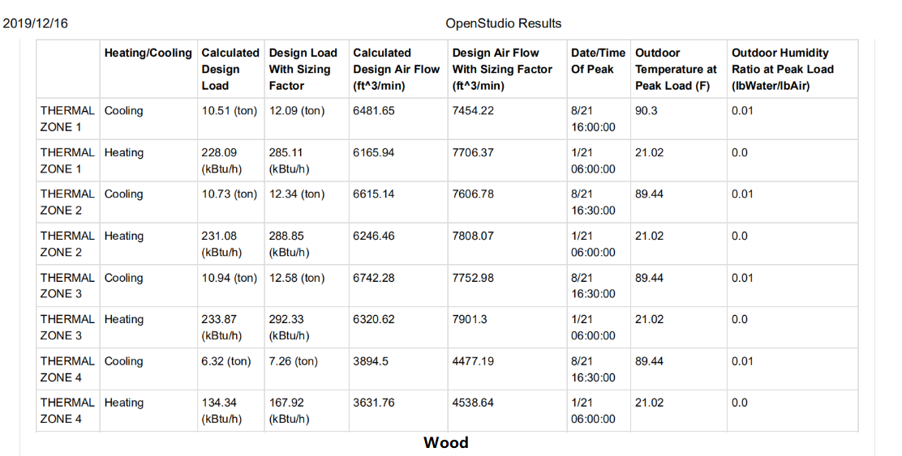
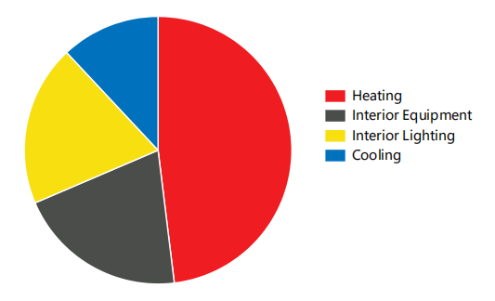
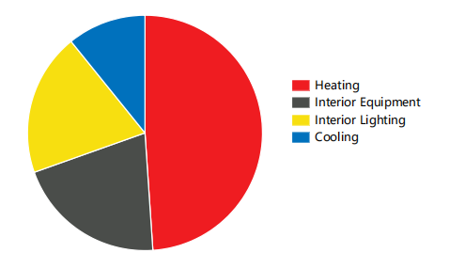
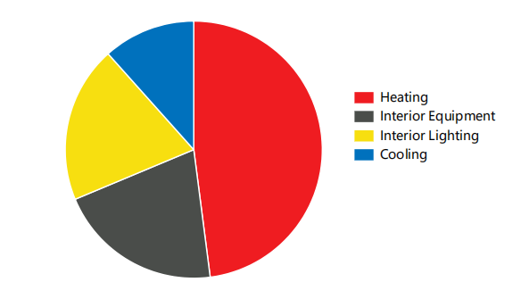
3. Exterior wall analysis
Energy Simulation
End Uses | Concrete | Metal | Wood
R-value(m²·℃/W) | 1.029 | 1.446 | 1.618
U-value(W/m²·℃) | 0.972 | 0.692 | 0.618
Heating(MBtu) | 1046 | 1035 | 1022
Cooling(MBtu) | 229 | 257 | 245
Conclusion
- The resistance of concrete is smallest,while that of wood is biggest
- When the resistance is bigger, the overall heat transfer coefficient is smaller,the heating and cooling load are smaller

Slide 9
Techinical Environment Systems
Openstudio Thermal Analysis
Thank you for watching
Prop.Behzad Najafi
Zhou,Yuhan | Zhang,Yawen | Ni,Jingjing | Kou,Yu

