Slide 1
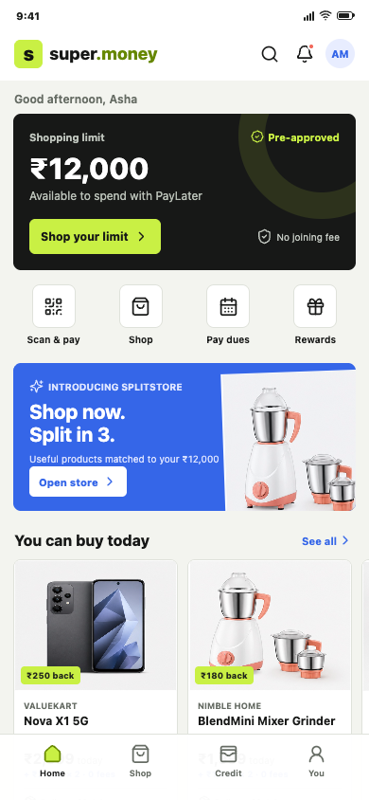
s
super.money
WHY NOW
Affordable Commerce after credit.
Start from the product super.money already has, then build the next high-value use case.
OBSERVED CURRENT RELATIONSHIP
Payments
Credit Health
Credit access
Affordable Commerce
Frequent UPI relationship
Score and education
Building and borrowing
Credit becomes useful at purchase intent
The strategic question
Can affordability become a repeat, contribution-positive commerce layer?
AFFORDABLE COMMERCE
01
Notes:
0:00-0:20 Hi, I am Naman Jain. I started with the current super.money product rather than a blank page. The app already connects payments with credit score, credit building, credit access, and a Splitstore commerce entry. My question was what comes next: how can that existing relationship become an affordability-first commerce business with repeat usage and positive contribution?

Slide 2
s
super.money
WHO + WHAT
One launch cohort. Three category groups.
A narrow wedge produces clearer product-market-fit and unit-economics evidence.
INITIAL CUSTOMER
01
Budget + refurbished phones
SELECTION RULE
LAUNCH
High-frequency
UPI users
High affordability need
Category
attractiveness
Existing user | Practical purchase: Rs. 5K-Rs. 30K
02
Small home appliances
Intent x affordability x AOV x supply
LAUNCH
Low return complexity
Credit underserved
Suitable short-tenor access
Returns + fraud + operational cost
Cash-flow constrained
Smaller amount due today
03
Work, study + accessories
LAUNCH
Deal seeker
Full UPI + funded offer
Bundle and repeat potential
100-300 SKUs
AFFORDABLE COMMERCE
02
Notes:
0:20-0:45 I would launch for existing high-frequency UPI users considering a practical five-to-thirty-thousand-rupee purchase. That includes credit-underserved users, cash-flow-constrained users, and full-UPI deal seekers. I would begin with budget phones, small appliances, and work or study devices. These categories combine real affordability need with manageable returns and available supply. The first release is one hundred to three hundred governed SKUs, so product-market-fit evidence is not hidden by marketplace breadth.

Slide 3
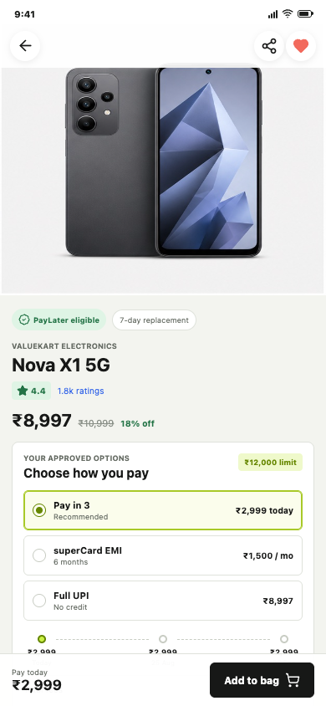
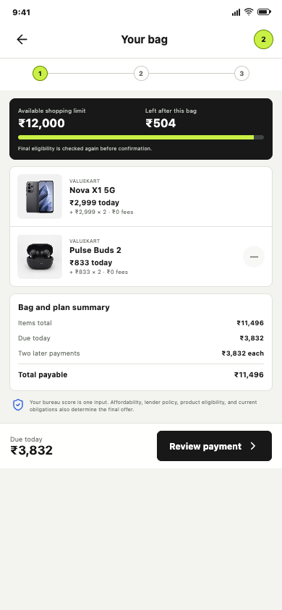
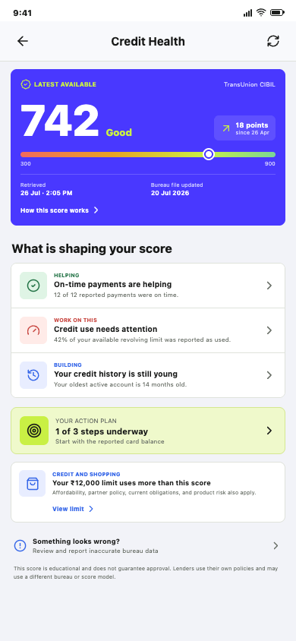
s
super.money
BORROWER PRODUCT
Affordability starts discovery and governs the bag.
Every growth mechanic exposes its cash-flow consequence before confirmation.
DECISIONS DEMONSTRATED
Rs. 12,000
Available limit visible
Rs. 3,832
Bundle payment today
Rs. 504
Limit remains after bag
Score != offer
Separate purpose and policy
1
Splitstore
2
PDP
3
Bag
4
Credit Health
Due-today discovery
Approved plans before cart
AOV within remaining limit
Trust, action, correction
AFFORDABLE COMMERCE
03
Notes:
0:45-1:15 The borrower experience begins with affordability, not a finance option discovered at the last step. Splitstore lets Asha browse by what is due today. The product page exposes price, plan, lender, fees, KFS, dates, and full-UPI fallback. The new bag is the AOV decision surface: it shows remaining limit and one relevant add-on with the exact repayment change. Credit Health remains under Profile and supports source, freshness, factors, actions, delay, and correction without promising approval.

Slide 4
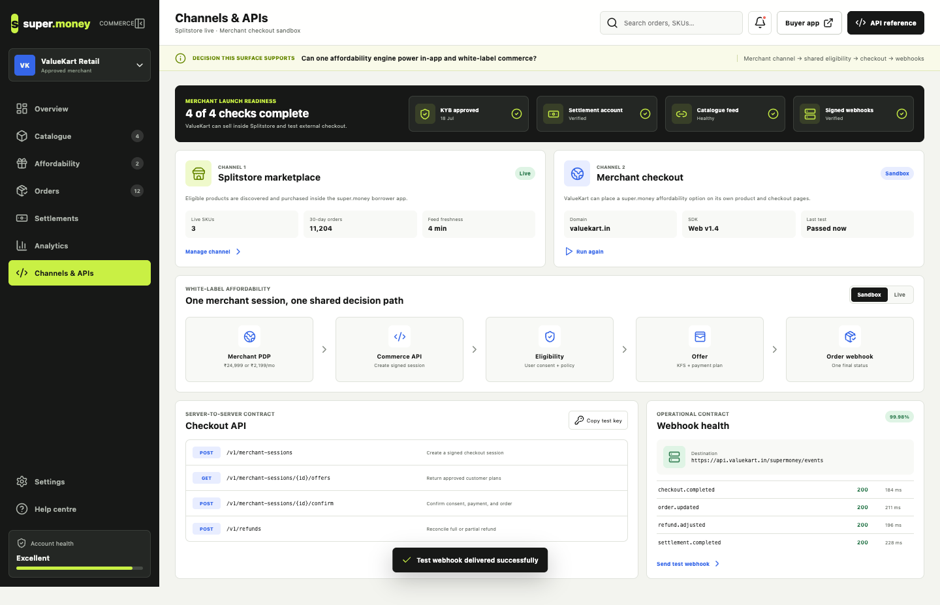
s
super.money
SUPPLY + DISTRIBUTION
One merchant OS. Two distribution channels.
Splitstore proves the marketplace; merchant APIs extend the affordability engine.
CHANNEL 1
Splitstore marketplace
super.money owns discovery through repayment.
CHANNEL 2
Merchant checkout
Signed session, shared eligibility, signed webhooks.
MERCHANT VALUE
Conversion + AOV uplift
Measured incrementality | Predictable settlement
One integration | No lender workflow
AFFORDABLE COMMERCE
04
Notes:
1:15-1:40 The supply side is an affordability operating system. Sellers complete KYB, settlement, catalogue, and webhook checks; manage SKU financeability; fund measured offers; fulfil one order state; and reconcile payout. The same platform supports two channels: Splitstore inside super.money and a white-label option on a merchant site. The merchant creates one signed session and receives approved offers, final order status, refunds, and settlement webhooks without integrating each lender.

Slide 5
s
super.money
BUSINESS + DATA
Repeat buyers lead. Contribution decides scale.
The metric tree joins product-market-fit, merchant value, and credit quality.
NORTH STAR
12-MONTH DIRECTION
AOV
SCALE GATE
Repeat buyers
Rs. 100 Cr
Rs. 7,700
Rs. 70
Monthly returning commerce purchasers
Annualised GMV scenario
10.8K monthly orders
Contribution/order before fixed cost
CANONICAL MONTHLY FUNNEL
ILLUSTRATIVE RS. 7,700 ORDER
Targeted
1.5M
Variable revenue
+ Rs. 246
Store
180K
Rewards + payment
- Rs. 65
PDP
54K
Bag
18.9K
Support + operations
- Rs. 46
Checkout
14.6K
Risk exposure
- Rs. 65
Orders
10.8K
Contribution
Rs. 70
Experiment: affordability on PDP
Primary: PDP -> bag | Guardrails: contribution, returns, 30+ DPD
AFFORDABLE COMMERCE
05
Notes:
1:40-2:10 I would use monthly repeat commerce buyers as the product North Star because one subsidised purchase does not prove a habit. Contribution is the scale gate. In the illustrative hundred-crore annualised case, one-point-five million targeted monthly exposures produce ten-thousand-eight-hundred orders at a seventy-seven-hundred-rupee AOV. The example order contributes about seventy rupees after rewards, payments, support, fraud, refunds, and platform risk exposure. The first experiment compares a price-first PDP with due-today affordability. The primary metric is PDP-to-bag, with contribution, returns, and thirty-plus DPD as guardrails.

Slide 6
s
super.money
SYSTEM DECISION
One checkout coordinates independent systems.
The technical depth is in state, compensation, and reconciliation.
Borrower app
Catalogue
Eligibility
Offer engine
Checkout
In-app journey
Valid supply
User + SKU policy
Frozen terms
Durable saga
Payment + mandate
Lender
Merchant order
FAILURE WORTH DESIGNING
Authorisation truth
Legal credit truth
Fulfilment truth
1
Loan booked
2
Order creation failed
3
Compensation requested
FOUR ENGINEERING CONTROLS
4
Reconciliation verifies outcome
Idempotency
State machine
Compensation
Reconciliation
No customer success until terminal state is valid
AFFORDABLE COMMERCE
06
Notes:
2:10-2:35 The simple experience depends on one difficult system decision. Catalogue and Credit Health feed separate eligibility and offer services. The checkout orchestrator then coordinates payment, mandate, lender, and order systems. For example, if the loan books and order creation fails, the session cannot show success. It enters a compensation state, requests loan cancellation or reversal, and reconciliation verifies both partners. Idempotency and explicit state are required because these systems cannot share one database transaction.

Slide 7
s
super.money
GTM + CLOSE
Six months to prove one closed loop.
Expansion follows repeat contribution, operational quality, and credit guardrails.
M1
M2
M3
M4
M5
M6
Define
Lock
Build
Operate
Alpha
Beta
30 buyers
15 merchants
Prototype
contracts
Catalogue
quotes
Checkout
refunds
1K users
3 sellers
50K users
holdouts
EXPANSION GATES
Repeat
Economics
Risk
Operations
Trust
30/60/90-day habit
Positive cohort contribution
DPD + fraud within threshold
Refund + settlement matched
Consent + complaints healthy
Marketplace -> prove the affordability engine -> extend it to merchant checkout
AFFORDABLE COMMERCE
07
Notes:
2:35-3:00 I would launch this over six months. Month one locks the user, merchant, category, P-and-L, and regulatory constraints. Month two locks prototypes and contracts. Months three and four build one reconciled commerce loop. Month five is a one-thousand-user alpha, and month six is a feature-flagged fifty-thousand-user beta with experiment holdouts. The result is an affordability layer built on something super.money already understands about the customer: their ability to pay. The marketplace proves the engine; white-label merchant checkout expands its distribution.

Slide 8
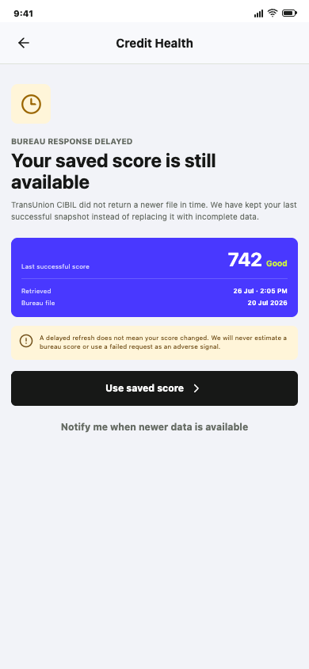
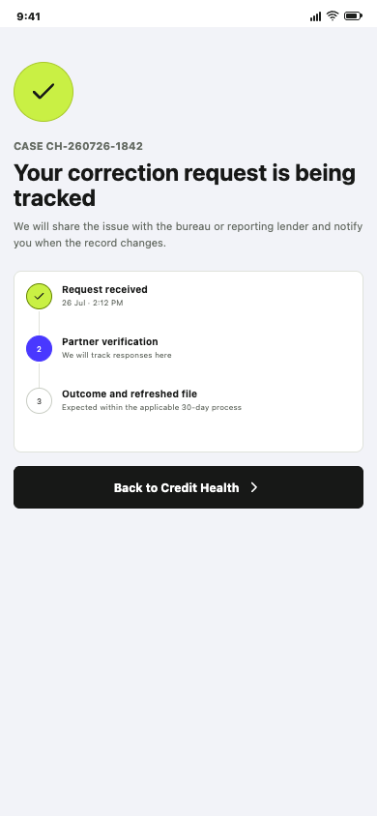
s
super.money
CREDIT HEALTH
Credit Health: explain, act, correct, and degrade honestly.
The score is a dated bureau fact; the action plan and correction case are separate product state.
Consent
Bureau adapter
Purpose evidence
Canonical pull
Snapshot
Explanation
Source + freshness
Governed factors
Action plan
Case service
Three safe steps
Tracked correction
Boundary: Credit Health consent cannot silently become lending consent.
TECHNICAL APPENDIX
08
Notes:
Appendix. Credit Health is a complete borrower module. Consent leads to a latest-available bureau pull, an immutable dated snapshot, governed factor explanations, three safe actions, and a tracked correction service. A partner timeout keeps the last valid snapshot and never invents a score. Eligibility uses a separate approved purpose.

Slide 9
s
super.money
EXPERIMENT APPENDIX
Category and experiment decisions are explicit.
Scope and growth both use measurable gates.
CATEGORY PRIORITISATION
FIRST CONTROLLED EXPERIMENTS
Category
Need
Complexity
Decision
01
Due-today discovery
Primary: PDP -> bag
Guard: Contribution + DPD
Budget phones
High
Medium
Launch
Small appliances
High
Low
Launch
02
Responsible bundle
Primary: AOV + attach
Guard: Checkout + returns
Work/study
Medium-high
Low
Launch
20 / 33 / 50% down
Primary: Positive orders
Guard: 30+ DPD
03
Fashion
Medium
High
Later
Travel
High
High
Later
04
Seller funding holdout
Primary: Incremental orders
Guard: Seller contribution
TECHNICAL APPENDIX
09
Notes:
Appendix. Category choice uses affordability need and supply readiness minus return, fraud, and operational complexity. The first experiments isolate discovery, bag AOV, down payment, and seller funding. Each treatment has contribution and credit-quality guardrails.

Slide 10
s
super.money
API + SCHEMA APPENDIX
Shared contracts connect in-app and merchant checkout.
One session links transparent terms to independent legal and operational records.
PUBLIC API
CHECKOUT SESSION IS THE JOIN POINT
POST
/v1/affordability/quotes
Freeze user-SKU plans
CHECKOUT_SESSION
quote + consent + state
POST
/v1/checkout-sessions
Create durable session
POST
/v1/checkout-sessions/{id}/confirm
Run saga
QUOTE
PAYMENT
LOAN
POST
/v1/merchant-sessions
External checkout
separate record
separate record
separate record
POST
/v1/refunds
Reconcile obligation
ORDER
REFUND
SETTLEMENT
separate record
separate record
separate record
Idempotency key
Expiring quote
Signed webhook
TECHNICAL APPENDIX
10
Notes:
Appendix. The central data-model decision is to use checkout session as the join point across quote, payment, loan, order, refund, and settlement. In-app and merchant checkout share canonical offer and orchestration contracts. Every write is idempotent; quotes expire; webhooks are signed and replay-safe.

Slide 11
s
super.money
RISK + COMPLIANCE APPENDIX
Trust controls are part of the product state.
A controlled launch needs transparent credit, correct money, and reversible partner operations.
Consent
Separate Credit Health, commerce, and lending purposes
LAUNCH RISK REGISTER
Credit loss
Small limits + down payment + DPD gate
Disclosure
Lender, APR, fees, dates, total repayment, KFS
Return abuse
User / seller / SKU policy
Seller quality
KYB + SLA + settlement controls
Correction
Bureau case and grievance tracked to outcome
Partner outage
Adapter + cache + retry + reconciliation
Misleading claims
Governed content + approval language
Refund
Outstanding obligation adjusts before excess cash refund
Feature flag
Circuit breaker
Audit trail
Named owner
Decision rule: expansion stops when contribution, repayment, refund, seller, consent, or complaint guardrails fail.
TECHNICAL APPENDIX
11
Notes:
Appendix. Compliance is represented as product and system state: purpose-bound consent, lender attribution, APR and total repayment, versioned KFS, auditable acceptance, grievance and correction, refund allocation, and data minimisation. The main launch risks are credit loss, returns, seller quality, partner outages, and misleading claims. Each has a product control and a kill switch or operating owner.

