Slide 1
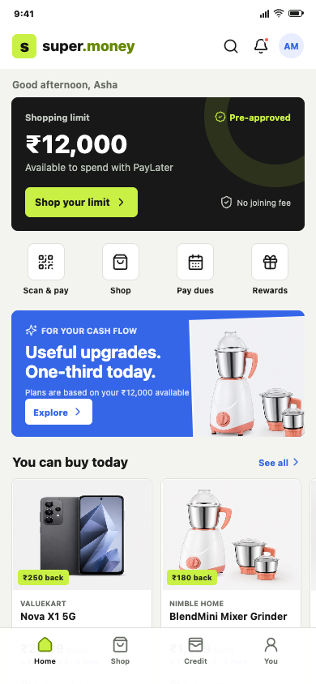
s
super.money
AFFORDABLE COMMERCE
Affordable Commerce
inside super.money
A credit-aware catalogue, native financed checkout, and merchant affordability OS.
UPI gives frequency.
Credit gives monetization.
Commerce gives intent.
Product concept + clickable prototype
Naman Jain | Product Manager - Commerce
AFFORDABLE COMMERCE CONCEPT
01
Notes:
0:00-0:20
Hi, I am Naman Jain. Instead of sending only a resume, I wanted to show how I would approach the Commerce PM mission at super.money.
This is a focused product concept for turning UPI frequency into responsible, contribution-positive financed commerce. I built the product thesis, buyer and seller prototype, economics, system design, schema, APIs, and launch plan.

Slide 2
s
super.money
THE OPPORTUNITY
Do not put a generic marketplace inside a UPI app.
Use payments frequency and financial signals to make discovery affordable, responsible, and commercially viable.
01
02
03
UPI frequency
Commerce intent
Responsible credit
Daily habit creates trusted entry points and live cash-flow signals.
Useful, narrow categories convert a payment relationship into demand.
Pre-qualified plans lower upfront cost without hiding the obligation.
NORTH STAR
Contribution-positive financed GMV from repeat users
Not raw GMV
AFFORDABLE COMMERCE CONCEPT
02
Notes:
0:20-0:55
My starting point is what not to build. A generic marketplace would compete on breadth, logistics, and discounting. That is not the differentiated advantage of a high-frequency payments app.
The stronger wedge is to use payment frequency and financial context to qualify demand. The user should see products that fit what they can responsibly pay today, while the platform also checks SKU risk, seller economics, and lender rules.
That creates a commerce experience whose ranking objective is not clicks or raw GMV. It is contribution-positive financed GMV from repeat users.

Slide 3
s
super.money
PERSONAS
Two users, one shared affordability problem.
The buyer needs certainty about cash flow. The seller needs measurable conversion without becoming a lender.
Asha, 26
Value merchant
AM
First-job salaried user | Bengaluru
VK
Mobile accessories / small appliances
JOBS TO BE DONE
JOBS TO BE DONE
Know the exact amount due today before browsing deeply
Compare transparent plans without credit-card anxiety
Track order, loan, refund, and repayment in one place
Make more SKUs financeable without integrating lenders
Fund only offers that create incremental conversion
Reconcile orders, refunds, fees, and settlement cleanly
Thin-file, not high-risk by default
Pays for measured outcomes
AFFORDABLE COMMERCE CONCEPT
03
Notes:
0:55-1:25
The first buyer persona is Asha, a 26-year-old salaried user in Bengaluru. She uses UPI daily, has a thin credit file, and avoids unclear fees. Her question is simple: what can I buy now, what is due today, and what happens after purchase?
The supply-side persona is a value merchant. The merchant wants higher conversion and AOV, but does not want to integrate multiple lenders, reconcile loan states, or spend on discounts that would have converted anyway.
The product must solve both jobs in the same transaction. Buyer transparency and seller incrementality cannot be designed separately.

Slide 4
s
super.money
NARROW SCOPE
Three connected functions, not marketplace breadth.
Each function closes a specific commerce-credit loop and has a measurable P&L consequence.
01
02
03
Credit-aware catalogue
Native financed checkout
Merchant affordability OS
Show only relevant, financeable choices with the upfront amount first.
Orchestrate payment, mandate, loan, and order behind one review.
Make SKU and offer economics visible before a seller spends.
PRIMARY METRIC
PRIMARY METRIC
PRIMARY METRIC
PDP open + quote view
Qualified demand
Cart-to-order success
Less abandonment
Incremental conversion
Profitable supply
OUT OF SCOPE
Broad marketplace | Inventory ownership | High-return categories | Long-tenor shopping loans | Full LMS / collections stack
AFFORDABLE COMMERCE CONCEPT
04
Notes:
1:25-1:55
I narrowed the initial scope to three connected functions.
First, a credit-aware affordable catalogue that ranks financeable SKUs by what the user can pay today.
Second, a native PayLater and EMI-on-UPI checkout that makes the lender, KFS, fees, mandate, and fallback explicit.
Third, a merchant affordability OS for catalogue onboarding, SKU eligibility, offer funding, orders, settlements, and analytics.
I would explicitly keep broad marketplace breadth, inventory ownership, high-risk categories, long-tenor lending, and a full underwriting or collections stack outside the first release.

Slide 5
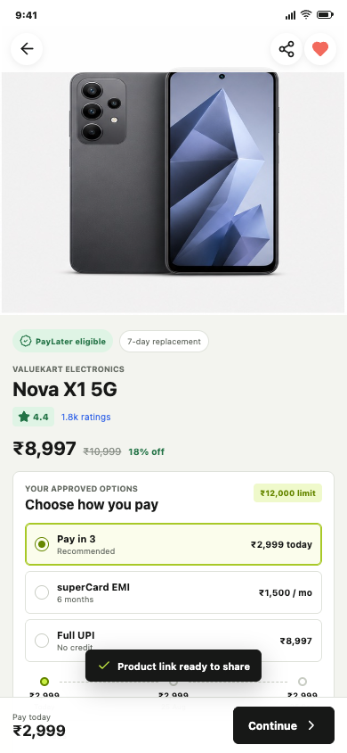
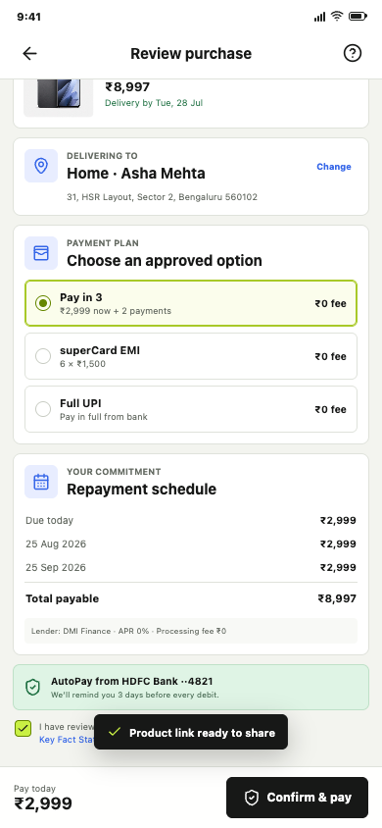
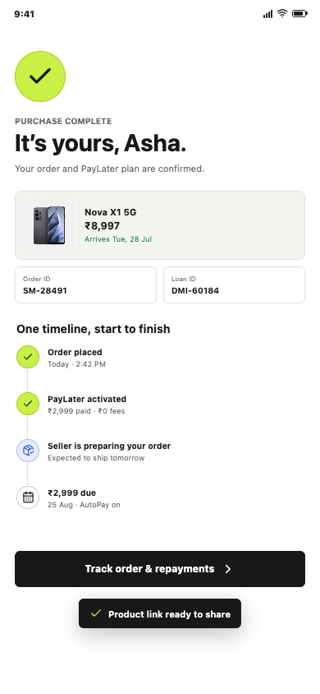
s
super.money
BUYER MOBILE
Affordability starts discovery - it does not interrupt checkout.
Every screen answers a credit question before the user is asked to commit.
1. ACTIVATE
2. EXPLAIN
3. CONSENT
4. UNIFY
THE PRODUCT DECISIONS
Activate with a responsible limit, not a sale banner
Rank by upfront affordability and approval fit
Show lender, fees, KFS, dates, and fallback early
Unify order and repayment after purchase
Buyer app = mobile
AFFORDABLE COMMERCE CONCEPT
05
Notes:
1:55-2:50
The buyer journey starts on the UPI home with a pre-qualified shopping limit. This converts a payment habit into qualified commerce intent without opening an endless marketplace.
In discovery and on the product page, the amount due today is more prominent than the total price. Asha sees the approved plan, dates, lender, zero fees, return policy, and full UPI fallback before checkout.
Checkout then asks for one informed confirmation. Behind that, the platform coordinates the down payment, AutoPay mandate, loan booking, and seller order.
The confirmation does not split the experience into a seller order and a lender account. It presents one timeline with order ID, loan ID, delivery, and next due date. That unified obligation is important for trust, support cost, and repayment quality.

Slide 6
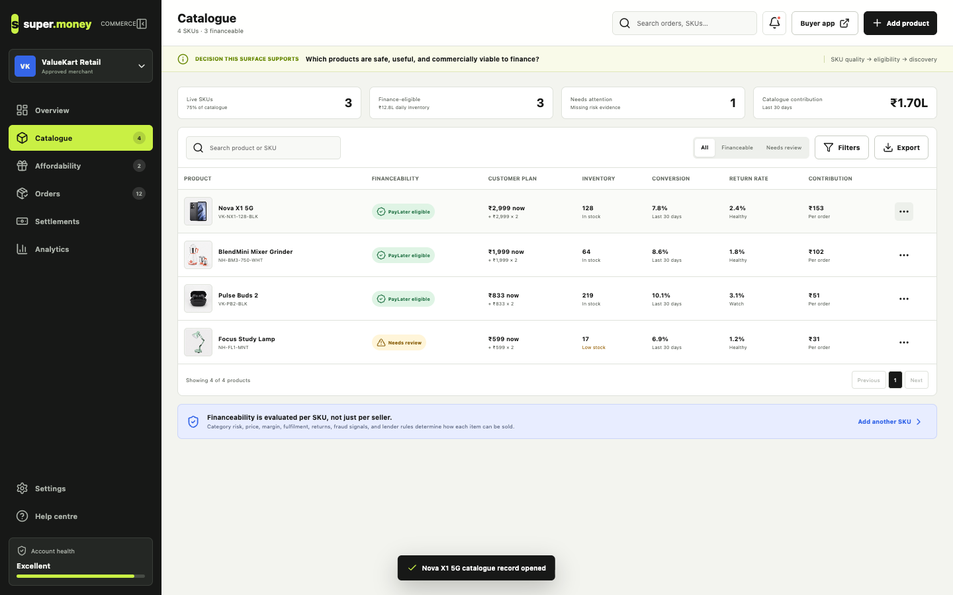
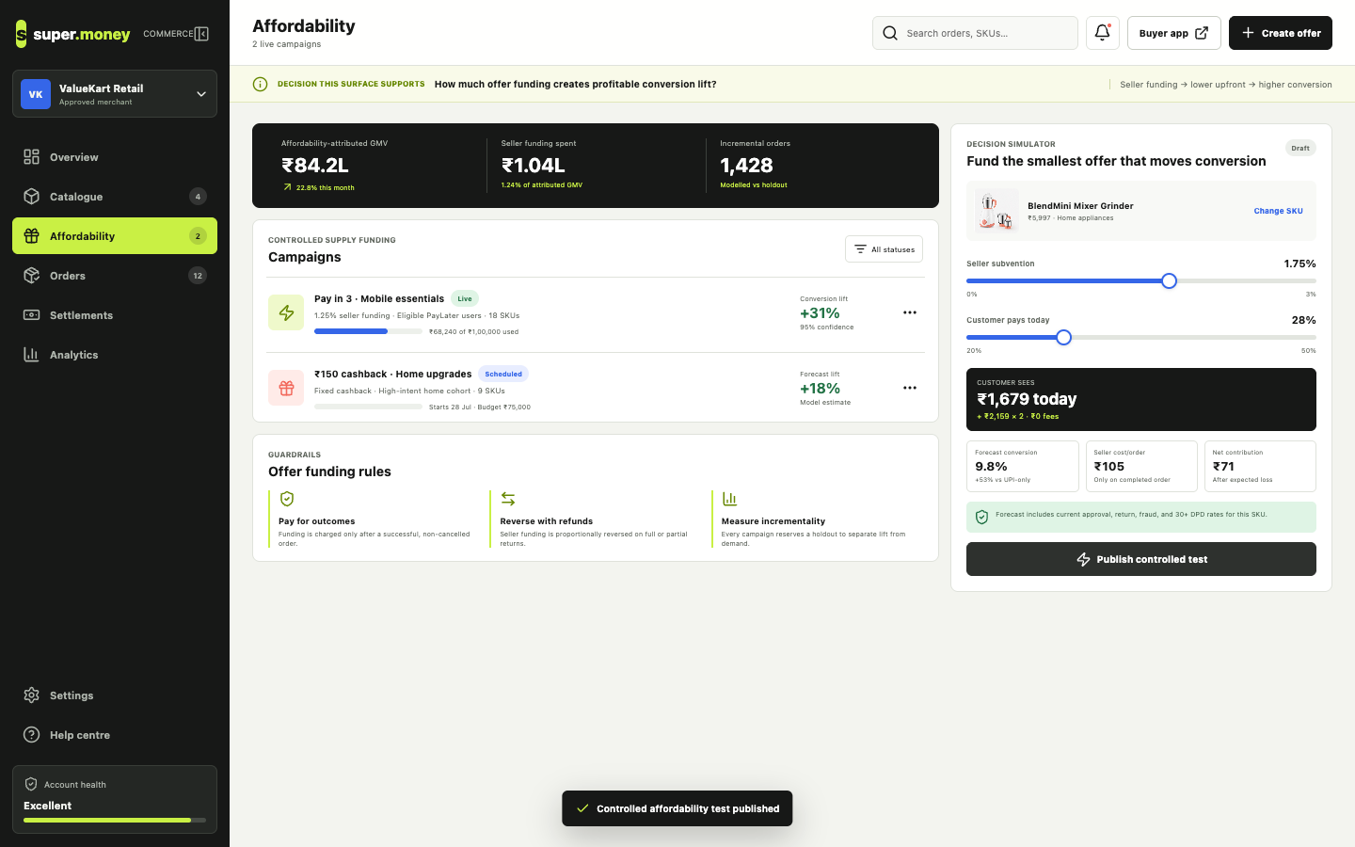
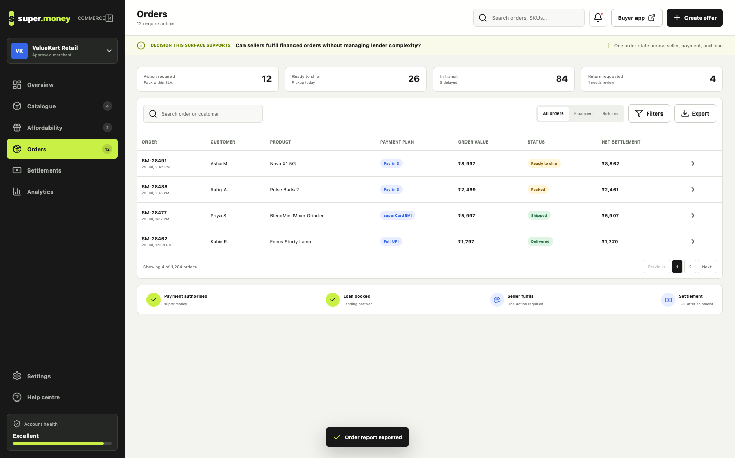
s
super.money
SELLER WEB PORTAL
The supply side is an affordability operating system.
Sellers should manage SKU quality, offer incrementality, fulfilment, and payout - not lender workflows.
SKU-LEVEL CATALOGUE
OFFER SIMULATOR
SHARED ORDER STATE
Financeability, inventory, returns, and contribution per SKU
Fund the smallest offer that creates measurable lift
One fulfilment workflow across payment, loan, and settlement
Merchant promise: higher conversion and AOV without building a lending stack.
AFFORDABLE COMMERCE CONCEPT
06
Notes:
2:50-3:40
The seller experience is a desktop operating portal.
Catalogue eligibility is evaluated per SKU, not just per merchant. Category risk, price, margin, stock, seller SLA, returns, and lender rules decide whether an item can carry a plan.
The affordability simulator makes seller funding an economic decision. A merchant can change subvention and the customer upfront amount, then see forecast conversion, cost per order, and net contribution before publishing a controlled test.
Once orders arrive, the merchant sees one commerce state. Payment authorization and loan booking are already coordinated; the seller only fulfils. Settlements then reconcile platform fees, offer funding, refund reversals, and net payout.
This is the path to a white-label affordability product through Breeze as well as in-app commerce.

Slide 7
s
super.money
FINTECH DEPTH
One customer action coordinates four independently failing systems.
The checkout orchestrator owns idempotency, state transitions, compensation, and one customer timeline.
01
02
03
04
05
Quote locked
Consent + KFS
Pay + mandate
Loan booked
Order placed
Payment succeeds, loan fails
Release / refund down payment
NON-NEGOTIABLE CONTROLS
Loan books, order fails
Cancel loan before success
Idempotency on every external action
Persisted consent and KFS version
Full-UPI fallback
Unified support timeline
Return after delivery
Adjust principal, then user refund
Central key: checkout_session_id links quote, payment, mandate, loan, order, refund, and support events.
AFFORDABLE COMMERCE CONCEPT
07
Notes:
3:40-4:25
This is where the problem becomes a fintech lending platform problem rather than a commerce UI problem.
A single purchase can fail at payment, mandate creation, lender booking, or seller order placement. The checkout orchestrator therefore needs an explicit state machine and idempotency key for every external action.
For example, if the down payment succeeds but the loan fails, release or refund the payment. If the loan books but the order fails, cancel or reverse the loan before presenting success. If an order is later returned, adjust outstanding principal first and only then calculate any user refund.
The customer should not see internal compensation mechanics, but support and operations need the complete joined event history. That is why checkout session is the central entity linking quote, payment, loan, order, mandate, and refund.

Slide 8
s
super.money
ILLUSTRATIVE P&L
Scale the cohorts that repay and repeat - not the GMV that looks large.
A simple funnel is useful only when revenue, incentives, returns, operations, and credit loss are joined.
MONTHLY FUNNEL
5.0M UPI users exposed
PER-MONTH OUTPUT
₹5.7 Cr
400K Commerce entries
financed GMV
₹7.4L
140K Product views
Net revenue
3.0%
contribution
42K Checkout starts
Variable cost
1.7%
Contribution
1.3%
18.9K Orders
Illustrative assumptions, not a forecast. Expansion gate = repeat contribution after refunds, incentives, fraud, and expected credit loss.
AFFORDABLE COMMERCE CONCEPT
08
Notes:
4:25-5:00
I would manage this as a business line, so the product model needs an explicit contribution equation.
This illustrative case starts with five million exposed active users. With an eight percent commerce entry rate, thirty-five percent PDP conversion, thirty percent checkout start, and forty-five percent financed completion, it produces about eighteen thousand nine hundred monthly orders.
At a three-thousand-rupee AOV, that is roughly five-point-seven crore of financed GMV. If net revenue is three percent and variable cost is one-point-seven percent, contribution is about one-point-three percent of GMV, or seven-point-four lakh per month before fixed cost.
The number is deliberately modest. The early objective is to identify which cohorts, SKUs, sellers, and offer constructs produce repeat contribution after returns and delinquency. Scale should follow repayment performance.

Slide 9
s
super.money
MEASUREMENT
A metric tree that protects growth from credit and incentive leakage.
The North Star only moves when conversion, repayment, and unit economics improve together.
NORTH STAR
Contribution-positive financed GMV from repeat users
GROWTH
CREDIT
ECONOMICS
Eligible-user activation
Checkout completion
AOV + 60-day repeat
Mandate success
7+ / 30+ DPD
Expected loss by cohort
Contribution / order
Refund-adjusted GMV
Offer + support cost
FIRST CONTROLLED EXPERIMENTS
1. Upfront label
2. Down payment
3. Seller subvention
4. Repayment reminder
AFFORDABLE COMMERCE CONCEPT
09
Notes:
5:00-5:25
The measurement model starts with one North Star and three guardrail families.
Growth covers qualified entry, checkout completion, AOV, and repeat. Credit covers mandate success, seven-plus and thirty-plus DPD, and expected loss. Economics covers net contribution per order, refund-adjusted GMV, offer cost, and support cost.
The first experiments should isolate the biggest product decisions: whether upfront affordability labels improve relevant discovery, what down payment balances approval and risk, whether seller subvention creates incremental conversion, and how repayment reminders affect AutoPay success.
Every offer test needs a holdout. Otherwise the merchant may subsidize orders that would have happened anyway.

Slide 10
s
super.money
90-DAY MVP
Build one closed loop before adding catalogue breadth.
Launch with three categories, eligible users, one core BNPL plan, and a full-UPI fallback.
DAYS 0-15
DAYS 16-30
DAYS 31-60
DAYS 61-90
Define constraints
Lock the contract
Build the loop
Controlled beta
User + seller research
Lender / compliance map
Category + risk rules
Clickable prototype
Schema + API contracts
Refund + experiment plan
Eligibility + quote
Checkout + lender + order
Ledger + support timeline
3 categories
20-50 sellers
Daily funnel + risk review
GO / NO-GO AT DAY 90
Checkout completion | 60-day repeat | DPD within threshold | Contribution improving week on week
AFFORDABLE COMMERCE CONCEPT
10
Notes:
5:25-5:50
The first ninety days are designed to answer one question: can credit-aware discovery and seller-funded affordability create repeat, contribution-positive commerce?
Days zero to fifteen define user, seller, category, lender, and compliance constraints using interviews and existing funnel data.
Days sixteen to thirty lock the buyer and seller prototype, API contracts, schema, refund design, and experiment plan.
Days thirty-one to sixty build the closed loop: catalogue ingestion, eligibility, quote, checkout orchestration, lender adapter, order bridge, repayment ledger, and support timeline.
Days sixty-one to ninety launch a controlled beta with three categories and twenty to fifty sellers or a controlled catalogue. Expansion is a go or no-go decision based on conversion, repeat, DPD, and contribution.

Slide 11
s
super.money
THE BET
Make affordability a system capability, not a checkout widget.
The focused wedge connects buyer trust, seller incrementality, and lending discipline.
Credit-aware discovery
+
Native financed checkout
+
Merchant affordability OS
WHAT I BUILT
Mobile buyer prototype
Seller operations portal
Product, P&L, and GTM blueprint
System, schema, and API design
90-day experiment-led launch plan
OPEN THE
PROTOTYPE
super-money-affordable-commerce.naman884186.chatgpt.site
Naman Jain
AFFORDABLE COMMERCE CONCEPT
11
Notes:
5:50-6:10
The core bet is that affordability should be a system capability, not a checkout widget.
Credit should shape which products are discovered. Checkout should coordinate the regulated obligation. The seller platform should prove incrementality and contribution before funding an offer.
The prototype and accompanying document make the assumptions explicit, including what I would not build first. I would value the opportunity to walk through the decisions, compare them with what the super.money team is learning, and then adjust the roadmap from real user, seller, risk, and P&L data.
Thank you for watching.

Slide 12
s
super.money
APPENDIX A
System architecture: personalized supply into one orchestrated obligation.
Separate decisioning, orchestration, and ledgers so each can scale and fail independently.
Payment
Mandate
Buyer mobile
Seller portal
Catalogue +
SKU risk
CHECKOUT
ORCHESTRATOR
Lender
Order
User signals
Catalogue feeds
Credit eligibility +
offer engine
EVENTS AND READ MODELS
Repayment ledger
Refund reconciliation
Unified timeline
Seller settlement
Risk + analytics
TECHNICAL APPENDIX
12
Notes:
Appendix.
Use this slide only if the audience asks how the product hangs together technically.
The left side ingests user financial signals and seller catalogue data. Eligibility and offer services combine those constraints into user-SKU quotes. The checkout orchestrator then coordinates payment, mandate, lender, and order adapters. Events populate the repayment ledger, refund reconciliation, unified timeline, seller settlement, and analytics.

Slide 13
s
super.money
APPENDIX B
Core schema: one checkout session joins commerce and credit.
The model keeps user eligibility, SKU rules, financial obligation, and fulfilment independently auditable.
IDENTITY + RISK
SUPPLY
DECISION + SESSION
OBLIGATION
COMMERCE
users
sellers
affordability_quotes
loans
orders
user_financial_signals
products
checkout_sessions
repayments
refunds
credit_profiles
product_finance_rules
mandates
seller_settlements
Key IDs: user_id → product_id → quote_id → checkout_session_id → loan_id + order_id → refund_id
TECHNICAL APPENDIX
13
Notes:
Appendix.
The core data-model decision is to make checkout_session the join point, not order or loan alone.
User financial signals and credit profiles determine affordability. Products and product finance rules determine SKU-level eligibility. A quote is frozen into checkout session. Loan, repayment, order, and refund records then remain separate regulated or operational ledgers linked by stable identifiers.

Slide 14
s
super.money
APPENDIX C
API surface: personalized commerce in, auditable events out.
Consumer and merchant contracts share quote, checkout, order, and refund semantics.
CONSUMER
MERCHANT
GET
/v1/commerce/home
Personalized rails
POST
/v1/merchants
Onboard seller
GET
/v1/products
Affordable catalogue
POST
/v1/catalogue/products:bulk_upsert
Sync supply
GET
/v1/products/{id}/affordability
Eligible plans
POST
/v1/affordability/quote
White-label quote
POST
/v1/checkout-sessions
Freeze quote
POST
/v1/checkout/merchant-session
Start Breeze flow
POST
/v1/checkout-sessions/{id}/confirm
Orchestrate purchase
POST
/v1/orders/{id}/refund
Reconcile return
GET
/v1/orders/{id}/timeline
Unified obligation
POST
/v1/webhooks/order-status
Sync fulfilment
Contract rules: idempotency keys | quote expiry + version | signed webhooks | replay protection | event audit trail
TECHNICAL APPENDIX
14
Notes:
Appendix.
The consumer APIs personalize home, product listing, affordability, checkout, and the unified timeline.
Merchant APIs support catalogue upsert, affordability quotes, merchant checkout sessions, refunds, and operational webhooks.
All create or confirm endpoints require an idempotency key. Quotes are versioned and expire. Webhooks are signed and replay-safe. The merchant sees super.money checkout semantics rather than lender-specific APIs.

Slide 15
s
super.money
APPENDIX D
Risk guardrails are product requirements, not post-launch controls.
Responsible limits, SKU restrictions, seller quality, disclosure, and refund design determine whether the flywheel works.
CREDIT LOSS
Small limits, down payment, short tenor, DPD cohort gates
RETURN ABUSE
Exclude high-return SKUs; hold limit until resolution
SELLER QUALITY
KYB, risk tiers, SLA monitoring, settlement holds
REGULATORY
Lender disclosure, KFS, stored consent, audit trail
USER CONFUSION
One timeline; plain refund and repayment language
Expansion follows repayment quality and contribution - never approval rate alone.
TECHNICAL APPENDIX
15
Notes:
Appendix.
The initial product should control credit loss through small limits, meaningful down payments, short tenors, category restrictions, and repayment-led limit growth.
Return abuse is managed at user, seller, and SKU level. Seller quality requires KYB, risk tiers, SLA monitoring, and settlement controls.
Regulatory trust requires lender disclosure, a versioned KFS, stored consent, clear separation of order and loan contracts, and transparent refund adjustment.
The user-facing mitigation for complexity is one plain-language timeline across purchase, fulfilment, refund, and repayment.

