Slide 1
Facebook Prototype Project
Bridget Mc-Addy
Prototype Presentation

Slide 2
Introduction
Prototype of Facebook
Focus on core features and database design
Using PostgreSQL

Slide 3
Purpose
Connect users
Share posts
Interact through likes, comments, and friendships

Slide 4
Core Features
User registration & login
Create posts
Like posts
Comment on posts
Friend system

Slide 5
Technology Stack
Backend: Django (Python)
Database: PostgreSQL
Frontend: HTML & CSS
Version Control: GitHub

Slide 6
Database Tables
Users
Posts
Likes
Comments
Friends

Slide 7
Relationships
One user → many posts
One post → many likes/comments
Users ↔ users (many-to-many)
Using foreign keys

Slide 8
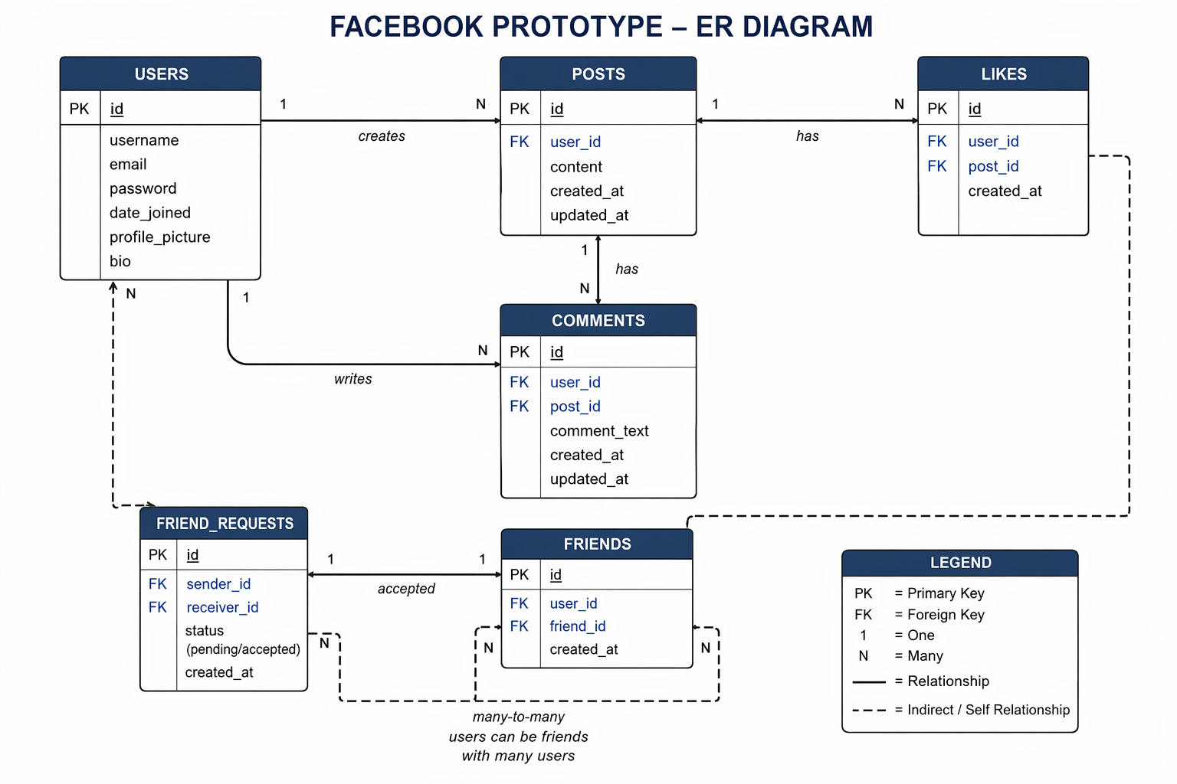
Use of AI
Used for guidance
All outputs reviewed and understood

Slide 9
System Flow
User logs in
Creates post
Others like/comment
Users become friends
Data stored in PostgreSQL

Slide 10
Key Concepts
Primary Key: Unique ID
Foreign Key: Connects tables
One-to-Many
Many-to-Many

Slide 11

Conclusion
Demonstrates social media system design
Focus on database and relationships

