Slide 1
SMART on FHIR

Slide 2
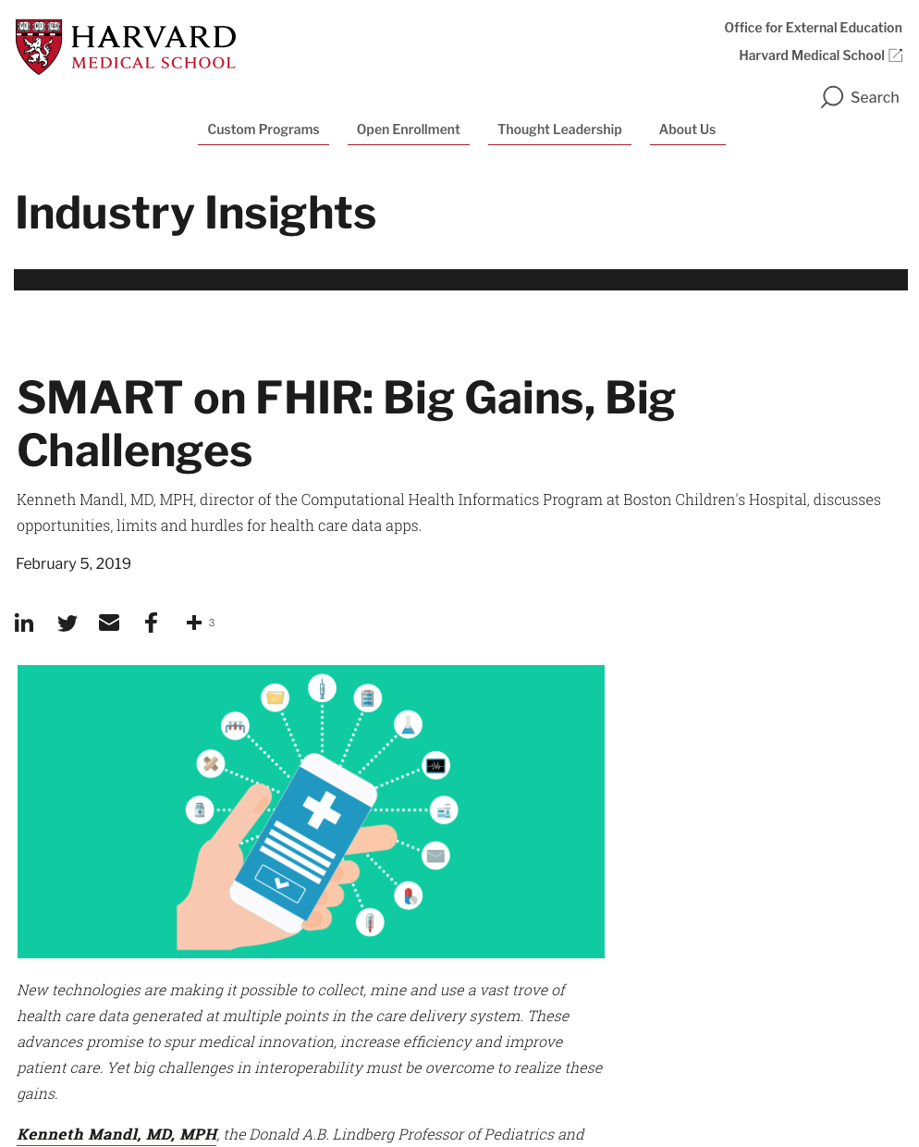
Industry adoption of SMART on FHIR
Standard implementation growing, enabled by extensions
EMR provides “federated” token to MUSE – secure method of cross referencing and authenticating users without User ID/Password
EMR and app must agree on standard to federate user identification - standard must account for role-based authorization
EMRs that federate using a proprietary ID lack ability to federate roles – even with synchronization of user ID to MUSE, requires admin work to map users into roles

Slide 3


MUSE NX & SMART on FHIR
MUSE NX leverages an HL7 Standard called SMART on FHIR that is based on state-of-the-art IT Cybersecurity Standards OAuth 2.0 & OpenId Connect - specifically supporting the Public App & EHR Launch profile. MUSE NX extends the standard slightly by federating the Active Directory (or LDAP) domain and username credentials in the token returned upon a successful launch for seamless Single Sign On integration with EHRs.

Slide 4


MUSE NX supports SMART on FHIR
Substitutable Medical Applications and Reusable Technologies
Fast Healthcare Interoperability Resource
Provides a standard for how EHR systems and their applications authenticate and integrate.
Provides an API and a set of data models for structuring and accessing medical data
https://hl7.org/fhir/smart-app-launch/#smart-authorization--fhir-access-overview

Slide 5
Prerequisites
Must use LDAP Authentication in MUSE to an Active Directory Server
Must map at least one Active Directory Group to a MUSE role
Must enable SMART on FHIR

Slide 6
