Slide 1
Using R to Automate the Investigation of POTENTIAL Pediatric Health Disparities
Nonye Madu, MPH
Paul Wildenhain, BA
R/Medicine
September 8, 2018

Slide 2
CHOP is using R to jumpstart the investigation of potential pediatric health disparities
An assessment of previous project work revealed a dearth of initiatives directly relating to the investigation of potential health disparities
A strong desire to address this gap was not enough to overcome the challenges of performing manual data analysis
We leveraged existing data infrastructure to create an internal R package that automatically generates stratified data sets and graphs
Notes:
Nonye

Slide 3


Who we are and who we serve
CHOP Facts
The nation’s first pediatric hospital
546 beds, >1 million inpatient and outpatient visits per year
250 active international patients per month
Robust quality improvement program
2017 Philadelphia Population Estimates
1,580,863 people White: 44.8% Black: 43.9% Hispanic or Latino: 14.8% Asian: 7.7%
Notes:
Nonye
- It is the oldest pediatric hospital in the nation, founded, in 1855.
- Large facility, with the main hospital housing over 500 beds and seeing more than a million visitors per year. Many of those visitors are international patients, primarily from the Middle East.
People from all over the country and the world come to CHOP, but the typical patient is from the Philadelphia metropolitan region. CHOP serves Philadelphia’s large, and as you can see, diverse patient population.
It is very highly regarded, always ranking within the top 3 in the U.S. News and World Report rankings over the last decade. CHOP’s commitment to quality is demonstrated by the hospital’s extensive quality improvement program.

Slide 4
What is the purpose of quality improvement?
Incorporating evidence-based care into practice with the goal of…
Standardizing/reducing variation
Increasing efficiency/reducing waste
Improving outcomes/minimizing harm
CHOP’s Office of Clinical Quality Improvement (OCQI) partners with clinical teams to help pinpoint issues, identify driving factors, test changes, and sustain progress
Notes:
Nonye
- Research is about creating new knowledge, whereas QI takes evidence based care and implements it into daily practice. Research proves the drug works, quality improvement incorporates it into the workflow.
QI is all about standardization. Doing things the same is more important than doing things right because if everyone is doing the same thing, any process change can be universally implemented. If ten different people are doing ten different things, even if one of those 10 people is right,
- We help teams define problems, diagnose driving factors, test and implement changes with data feedback, and sustain any progress made.
Improvement about iterative, rapid improvement! If the first test doesn’t work, step back and try again.

Slide 5
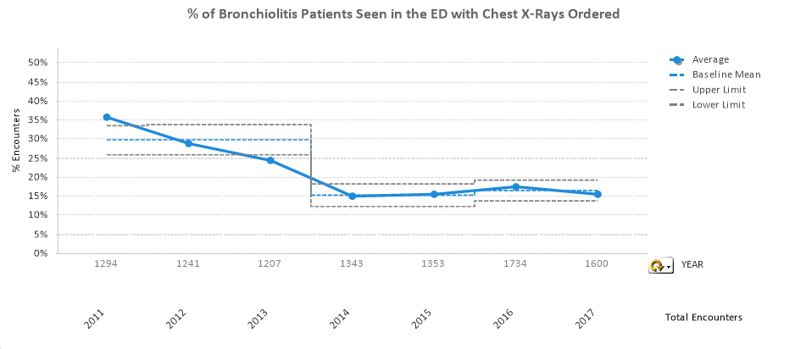
Reducing X-Ray Use: A successful QI initiative
AAP Pathway Revision
Desired Metric Direction
Notes:
Nonye
In 2014, American Academy of Pediatrics published new recommendations for care of patients presenting to the ED with bronchiolitis. Among the recommendations: no chest x-rays—considered extraneous care.
CHOP incorporated these recommendations into their clinical pathway (standard of care document) and began a QI project to make sure the recommendations were followed and care was standardized— and the project was a big success, since 2011 x-ray utilization has gone down from 35% to 15%.
Improvement is hard, so for a project to be this successful is no small feat. The team deserves to uncork a bottle and have a toast. A happy QI ending!

Slide 6
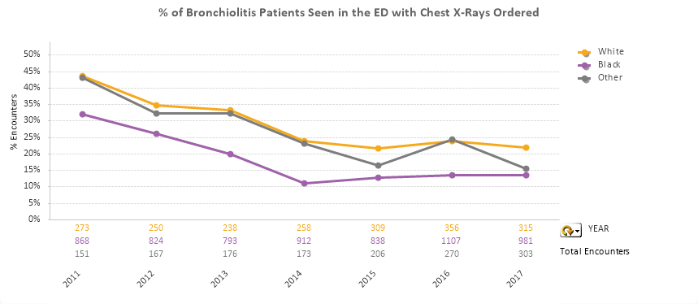
But what if we examine the data differently?
AAP Pathway Revision
Desired Metric Direction
Notes:
Nonye
You can see that the x-ray use for all three groups has decreased, which is great. But the story here is a little different. There is a marked difference in the x-ray utilization for white patients vs. black patients, and over hundreds of patients per year, over the course of several years, the difference has remained remarkably stable.
What’s going on? Isn’t quality improvement supposed to standardize treatment?
Maybe the white parents are more demanding in wanting the x-ray that isn’t recommended while black parents are more likely to go with the flow.
Maybe both sets of parents are equally demanding, but there’s unconscious bias on the part of the providers where they’re more likely to acquiesce to the requests of white parents.
We don’t know exactly why this difference is occurring, and the main factor driving the difference might not be race, but the fundamental point is that something appears to be happening.

Slide 7
You won’t know if something might be happening unless you look.
Notes:
Nonye
And you’ll never know if there’s a potential disparity in action unless you actively look for it.

Slide 8
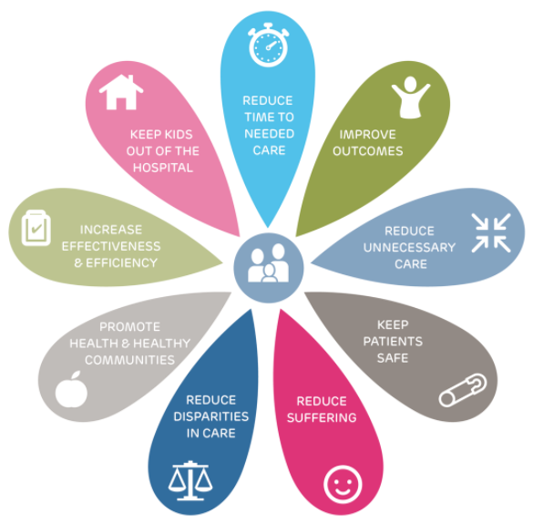
We have not been looking and need to start
10
Total QI initiatives worked on by OCQI (completed or in progress) since July 2013: 159
Barriers to implementing a blanket disparities screen:
Manual work to add in demographic data fields and generate stratified visualizations is time consuming
Manual analysis = tougher implementation of a standardized screening protocol
20
24
35
16
6
14
1
7
Notes:
These are the quality themes we generally try to address with all of our projects. We recently conducted an assessment to see how many of these themes were represented in our work.
All themes have been represented multiple times…except for disparities. Despite working with a population predominately from diverse Philadelphia, segregated Philadelphia, poorest major city in the country Philadelphia, we have only had one project address this theme in our 5 years of existence.
So we decided, we need to start, but there were two major issues we needed to contend with:
The manual workload of adding all the demographic data and generating separated stratified visuals would be too much for an analyst. I did the bronchiolitis analysis, and it took me 2 hours to edits, validate, and visualize. Multiply that by 159 projects, and you have a lot of hours than can be spent doing something else.
QI is about standardization, and there would be no way to protocolize a screen if everyone is stratifying data in a different way

Slide 9
The need for simple, systematic approach to screening for potential disparities led to the creation of the internal demographics package.
Notes:
Nonye
Paul will expand on this more.

Slide 10




The internal demographics package was the right solution
Resources at our disposal:
Enterprise data warehouse containing data from our EMR
Data mart structure where project cohorts and metrics were packaged into predefined tables
Ongoing team initiative to increase R utilization
Experience creating an internal R package to automatically generate statistical process control charts
Notes:
Paul
Lessons learned from making a previous package:
Managing the project in GitHub
Incorporating tests and continuous integration
Taking advantage of helper functions

Slide 11
The demographics package automatically generates stratified charts
Outputs three charts, stratifying the given metric by three different demographic categories:
Race/Ethnicity, Insurance Payer Type, Primary Language
Demographic information added automatically to cohort based on patient medical record number and visit account number
Charts can be either bar or run charts
Bar charts useful for an overall summary—default argument
Run charts useful to establish if differences changed over time
Notes:
Paul
Demographics for stratification were chosen based on recommendations from literature and consultation with a disparities group at Seattle Children’s.

Slide 12








The demographics package automatically generates stratified charts
Back-End Process:
GATHER
MANIPULATE
VISUALIZE
Retrieve demographic data and add to cohort
Prepare data for plotting
Iteratively generate plots
Notes:
Paul
*Data sets must contain PAT_KEY and VISIT_KEY, but it would be rare to encounter a patient-based cohort that does not have either of these components.

Slide 13
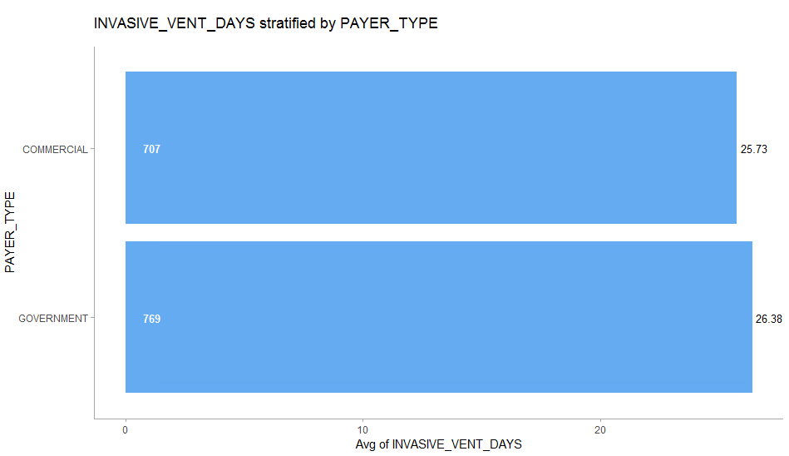
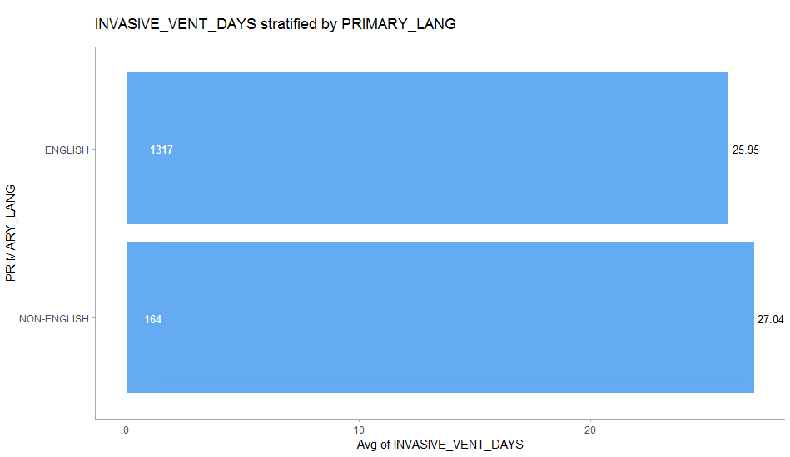
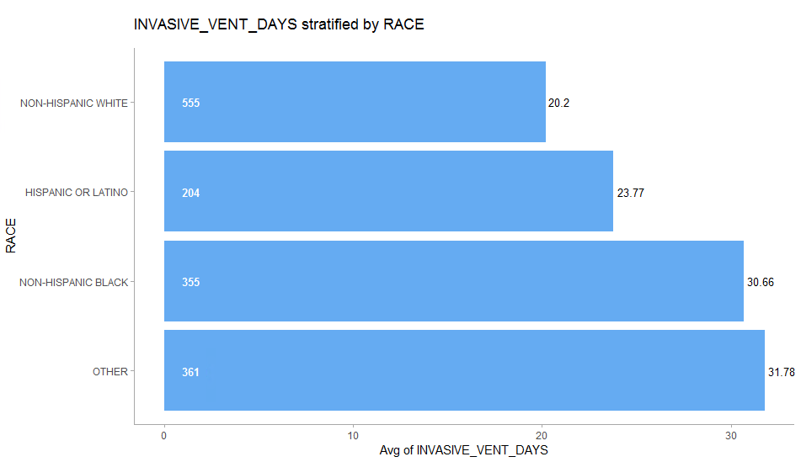
The demographics package automatically generates stratified charts
Notes:
Paul

Slide 14
How has the demographics package been used to identify potential disparities?
Notes:
Paul

Slide 15
Case study #1: AKI in the ICU
Project Overview
Cohort: Patients with acute kidney injury (AKI) in an intensive care unit (ICU) on invasive ventilation
Goal: Reduce the total days spent on invasive ventilation
Bar charts were generated because: there is limited historical data available for this cohort
Notes:
Paul

Slide 16
Case study #1: AKI in the ICU
Notes:
Paul

Slide 17
Case study #2: NPO Clear Fluid Fasting Time
Project Overview
Cohort: Patients coming from home for an anesthetic procedure who were discharged on the same day
Goal: Reduce the NPO clear fluid fasting time to 4 hours or less for 60% of cases
Run charts were generated because: there is ample historical data from the point of the first intervention
Notes:
Nonye

Slide 18
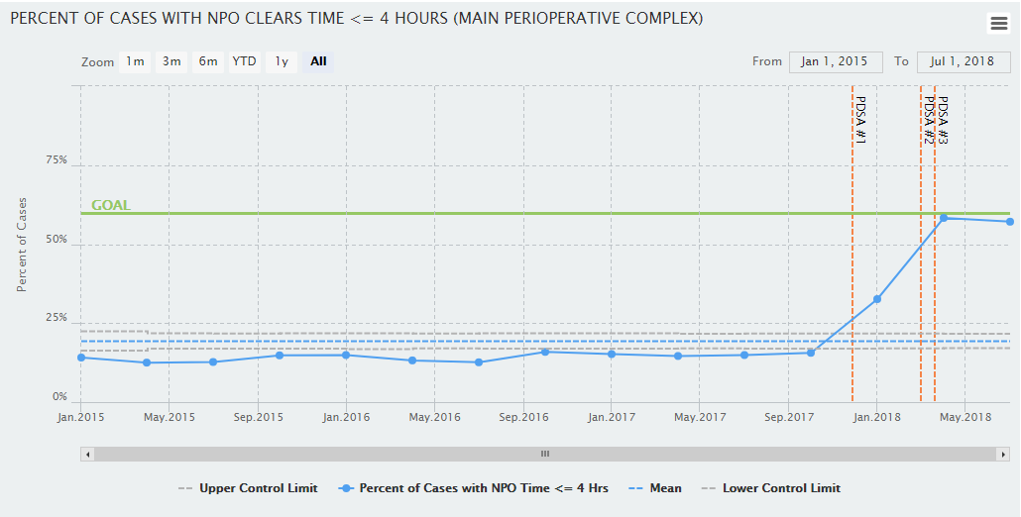
Case study #2: NPO Clear Fluid Fasting Time
Notes:
Nonye

Slide 19
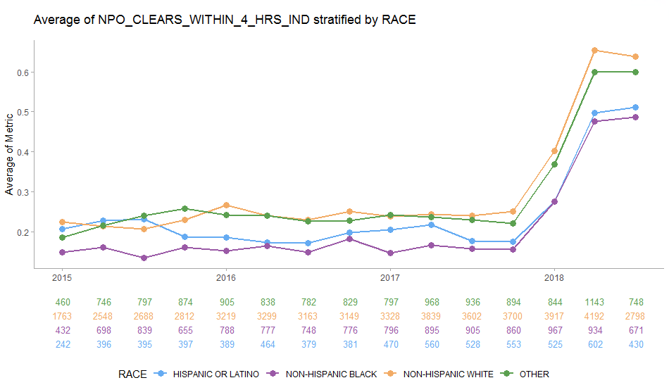
Case study #2: NPO Clear Fluid Fasting Time
Intervention
Pre-Intervention #1
(Dec 2017) Average:
Non-Hispanic White: 24%
Non-Hispanic Black: 16%
Difference: 8%
Post-Intervention #1 Average:
Non-Hispanic White: 53%
Non-Hispanic Black: 37%
Difference: 16%
Notes:
Nonye
Showed the team the data, they are discussing potentially interviewing families to try to figure out why there is a difference. They don’t know what’s driving the difference, and that’s fine. The key is that they know there’s a difference, and can incorporate this data into their continued improvement efforts.

Slide 20


Moving Forward
Technical Enhancements
Leverage data marts and project metadata repository to automatically run function
Create dashboard for easy exploration
Add more stratification variables
Infrastructure Building
Establish a workgroup dedicated to disparities investigation
Use data to generate stories and create guidance
The package is not for drawing conclusions, but for having data to serve as a starting point.
Notes:
Paul
Nonye
It will take some work to reframe the way QI work is approached from an organizational standpoint, as this is not an angle that we have generally pursued in the past. Not only is this a necessary way to approach our work from a moral standpoint, but any outcome measure will only improve as much as the group with the worst outcomes, so it’s something we have to do to maximize the impact of our quality improvement efforts.

Slide 21
Summary Disparities potentially exist, but investigation must precede action. R is a great tool for automating analyses addressing organizational gaps.
Presenter Contact Information:
Nonye Madu, Senior Clinical Data Analyst – maduc@email.chop.edu
Paul Wildenhain, Clinical Data Analyst II – wildenhaip@email.chop.edu
GitHub mirror: https://github.com/chop-analytics/demographics
CHOP’s QI Program: https://www.chop.edu/centers-programs/quality-and-patient-safety
Also, we’re hiring! Contact us for more information if interested!

