Slide 1
Reproducible Clinical Trial Design for Patient Centered Outcomes Research (PCORI)
Denise Esserman, PhD
Department of Biostatistics, Yale University
In collaboration with Michael Kane, PhD,
Briana Cameron, PhD, Peter Peduzzi, PhD

Slide 2
Introduction
Reproducibility is essential in clinical research.
It puts the field on sound scientific footing, it allows other members of the community to interrogate current results, and it facilitates discovery.
For example, it is not generally distinguished from replicability (in lay terms).
However, there currently isn’t consensus on the definition and implementation of reproducibility.
Furthermore, we as a community, have not clearly defined reproducibility in the context of clinical trials.

Slide 3
Replicability versus Reproducibility
Replicability. “Scientific studies ought to be replicable, meaning that a study should produce the same results if repeated exactly. Replicability can be increased by doing in-depth research on other similar experiments and ruling out variables you may not have thought of originally.”¹
Reproducibility. ”The closeness of the agreement between the results of measurements of the same measurand carried out with same methodology described in the corresponding scientific evidence (e.g. a publication in a peer-reviewed journal).”²
¹https://psychcentral.com/encyclopedia/replicability/; ²https://en.wikipedia.org/wiki/Reproducibility

Slide 4
What the NIH says…
“Two of the cornerstones of science advancement are rigor in designing and performing scientific research and the ability to reproduce biomedical research findings. The application of rigor ensures robust and unbiased experimental design, methodology, analysis, interpretation, and reporting of results. When a result can be reproduced by multiple scientists, it validates the original results and readiness to progress to the next phase of research. This is especially important for clinical trials in humans, which are built on studies that have demonstrated a particular effect or outcome.”
https://www.nih.gov/research-training/rigor-reproducibility

Slide 5
What the FDA says…
“Making research findings and the digital data supporting those findings accessible and analyzable promotes robust and open communication with the scientific community thereby bolstering the credibility of scientific findings and the regulatory decision-making based upon those findings. ”¹
“The usual requirement for more than one adequate and well-controlled investigation reflects the need for independent substantiation of experimental results. A single clinical experimental finding of efficacy, unsupported by other independent evidence, has not usually been considered adequate scientific support for a conclusion of effectiveness.”²
¹https://www.fda.gov/scienceresearch/aboutscienceresearchatfda/ucm433459.htm; ²https://www.fda.gov/downloads/Drugs/GuidanceComplianceRegulatoryInformation/Guidances/ucm072008.pdf

Slide 6
How can we replicate results if we can’t even reproduce them?
Lack of reproducibility is currently a big problem in clinical trials
E. Shanil et al. (2014) put an upper bound on the final analysis published from a set of 37 publications at 35%.
Need to also be concerned about the study design.
Ebrahim S, Sohani ZN, Montoya L, et al. Reanalyses of randomized clinical trial data. JAMA. 2014;312(10):1024-1032.

Slide 7
Why is reproducibility difficult in clinical medicine?
Clinicians often not aware of what we mean by reproducible.
Large number of clinicians do not have a solid understanding of what the statistician is doing – or even their role in the study.
A fully reproducible analysis may increase liability¹
¹Baggerly KA, Coombes KR. Deriving chemosensitivity from cell lines: forensic bioinformatios and reproducible research in high-throughput biology. The Annals of Applied Statistics. 2009.3(4): 1309-1334.

Slide 8
Motivating Example: Two-stage clinical trial design
Need to understand how a patient’s preference for a certain treatment over others affects his/her outcome response
May be influenced through improved adherence or an additional psychological response
Especially important in unblinded studies and/or behavioral interventions

Slide 9
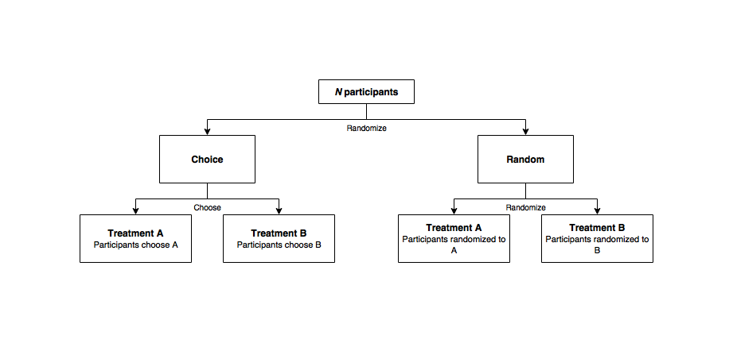
Two-stage design

Slide 10
Definition of effects
Treatment Effect: The average effect a particular treatment will have in a specified population
Selection Effect: The difference in treatment effect influenced by self-selection of a given treatment by patients
Preference Effect: The change in outcome resulting from the interaction between a patient's preferred treatment and the treatment actually received

Slide 11
Methods Development
Expansion to allow for stratification
Binomial/Count outcomes
Estimation of optimal allocation
Undecideds

Slide 12
Shiny app: design
http://18.217.10.93/pcori-page/

Slide 13
R package: preference
Design (more in depth options)
Analysis
Extra functions

Slide 14
Future directions
Expansion – other trial designs
Curtailed samples (e.g. Simon two-stage, stopped negative binomial)
Getting R package completed
Incorporate into web application
Expansion beyond design so that we don’t just have reproducible components, but that we can have a reproducible trial – start to finish.

Slide 15
Reproducible code
To make all of this work, we have to make sure that we do our part.
How do we ensure that the code is reproducible as versions of R change and packages are altered?
packrat
switchR
Major changes – could allow downloading of packages used to generate (large files to download)

Slide 16
Acknowledgements
Michael Kane
Peter Peduzzi
Briana Cameron
Yu Shi,
Xian Gu
Funding: This work was partially supported through a Patient-Centered Outcomes Research Institute (PCORI) Award and Yale's CTSA Award.
Disclaimer: All statements in this report, including its findings and conclusions, are solely those of the author and do not necessarily represent the views of the Patient-Centered Outcomes Research Institute (PCORI),its Board of Governors of Methodology Committee

