Slide 1

Designing an Organizational Network System Applying Advanced Security Features with EtherChannel and Load-balancing

Slide 2
Presented By
Green University of Bangladesh
Md Badrul nasim
Id:201002189

Slide 3
Content Outline
Introduction
Proposed Method
Motivation
Implementation Tools
Objectives
Evaluation
Related Work
Conclusion
Requirements
References

Slide 4
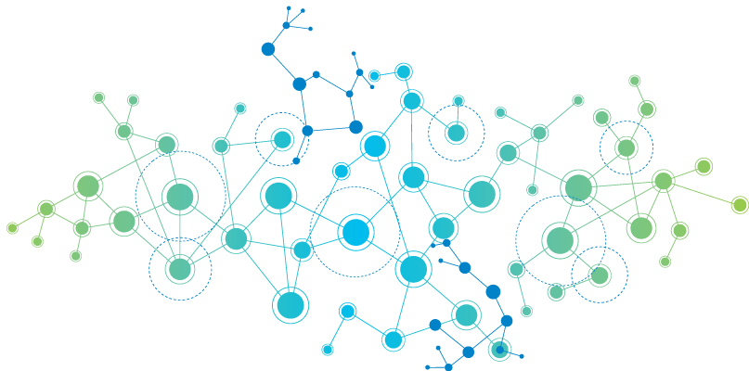
Introduction

Slide 5

Introduction
Security and performance are very critical concern
Implementation of EtherChannel and Load-Balancing
Distribute network traffic efficiently across multiple resources
Designing a state-of-the-art organizational network system

Slide 6
Motivation
Secure and reliable network
Coupled with seamless customer experiences
Optimizing the network design for cost efficiency
Improving overall resource utilization
Fast and reliable access to organization platforms
Provides low latency.
Safeguard sensitive information from unauthorized access
Implementing robust security measures

Slide 7
Objectives

Slide 8
Objectives
Deploy EtherChannel for High Availability
Setup Load-Balancing for Optimal Resource Utilization
Set up Redundancy and Failover Mechanisms
Ensuring Network device Monitoring and Logging
Implement Advanced Security Measures

Slide 9
Problem statement
Inadequate Security
Lacks robust security and risks unauthorized access
Reliability and Downtime
Suffers frequent disruptions, failover mechanisms and backup systems
Cost Inefficiency
Unnecessary hardware, maintenance and operational expenses
Limited Scalability
Unable to Accommodate future growth and technological advancements

Slide 10
Applications
Network Recovery and Data-flow Continuity
Secure Remote Access
Secure and reliable network connectivity for Large Organization
/38

Slide 11
Related work
No | Paper | Description | Limitation
1 | Design and simulation of a banking network system[1] | includes an online banking system, ATM network, mobile banking system, and point-of-sale system | Security system not upgraded not user friendly time based transmission
2 | Cyber security threats, vulnerabilities, and security solutions models in banking[2] | network infrastructure, including potential threats and solutions to improve network security | management of big data becomes more critical Risks and threats should be contextualized.
3 | Security problems and countermeasures with commercial banking computer networks[3] | Security problems and challenges that commercial banks face | should have awareness of security major issue of commercial banks

Slide 12
Existing work [1/2]
Information Security in an Organization[8]
Categorized Security Measures
Describes various attacks and their nature of breaking network system
Lacks the core design of an improved network system
Bank System Network Design[9]
Build a network system which is useful for data redundancy
Lacks to cover the firewall security measures
Effective in small organizations
/38

Slide 13
Existing work [2/2]
An Internet of Things Model for Process Management[10]
Highlights the use of IoT devices in layer based approach
System does not applicable due organizations centralized data infrastructure
Lack of consideration of the method of data redundancy and seamless data flow.
/38

Slide 14
EXISTING PROTOCOL & SERVICES
01
Virtual Router Redundancy Protocol (VRRP)
02
Port-Channel load-Balance Src-Dst-Mac
03
Internet Protocol Service Level Agreement (IP SLA)
04
Routing Protocol OSPF
05
Rapid Per VLAN Spanning Tree (RPVST)
06
Authentication, Authorization and Accounting(AAA)
07
Static and Dynamic PAT

Slide 15
Requirement TOOLs
01
Emulated Virtual Environment Next. Generation (EVE-NG)
02
VMware Workstation
03
Wireshark
Cisco Adaptive Security Device Manager (ASDM)
04
05
Router, Switch and FireWall IOS Images
06
Windows Secure Copy (WinSCP)
07
Cisco Packet Tracer

Slide 16
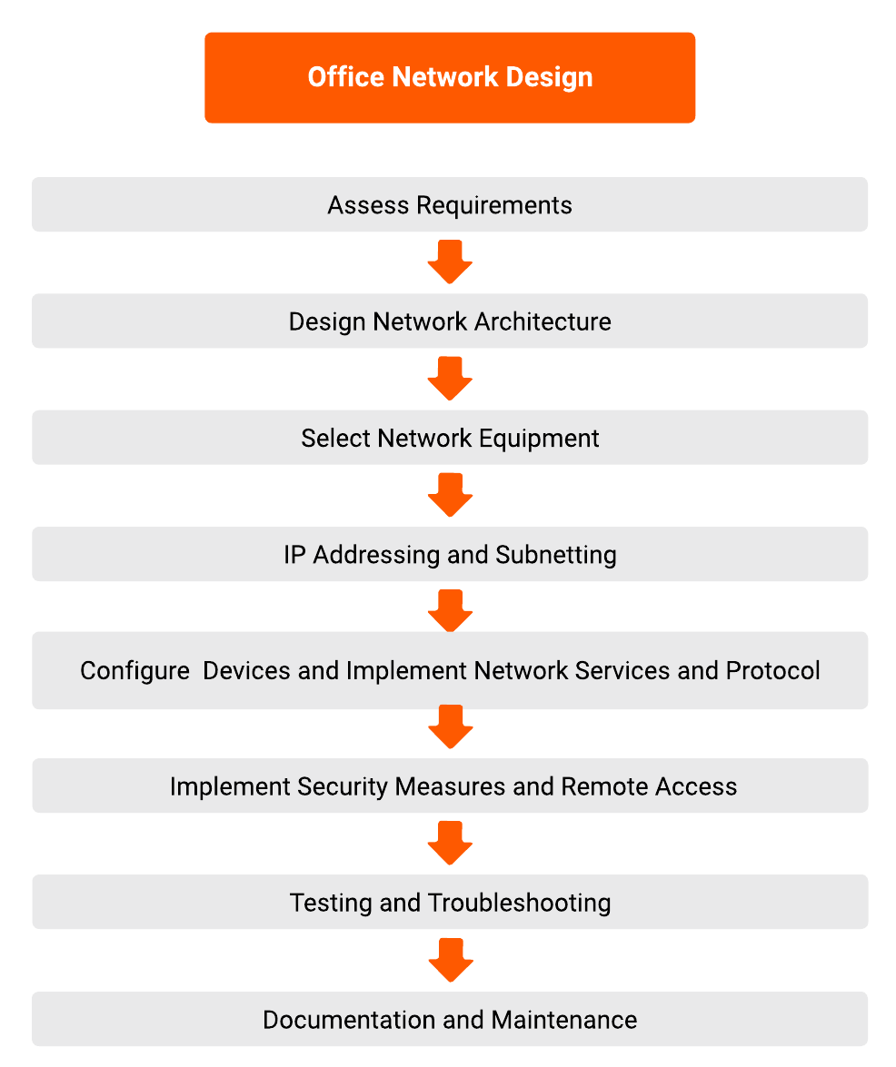
workflow Diagram
Figure 1: Workflow Diagram

Slide 17
Proposed method

Slide 18
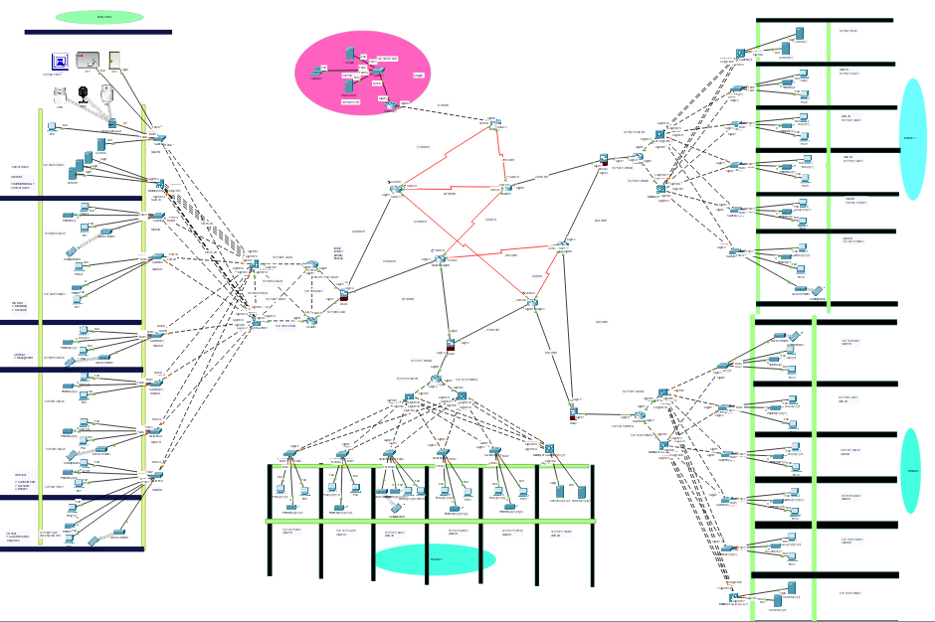
Proposed method
3
Figure 2: Network
Tropology
1
2

Slide 19
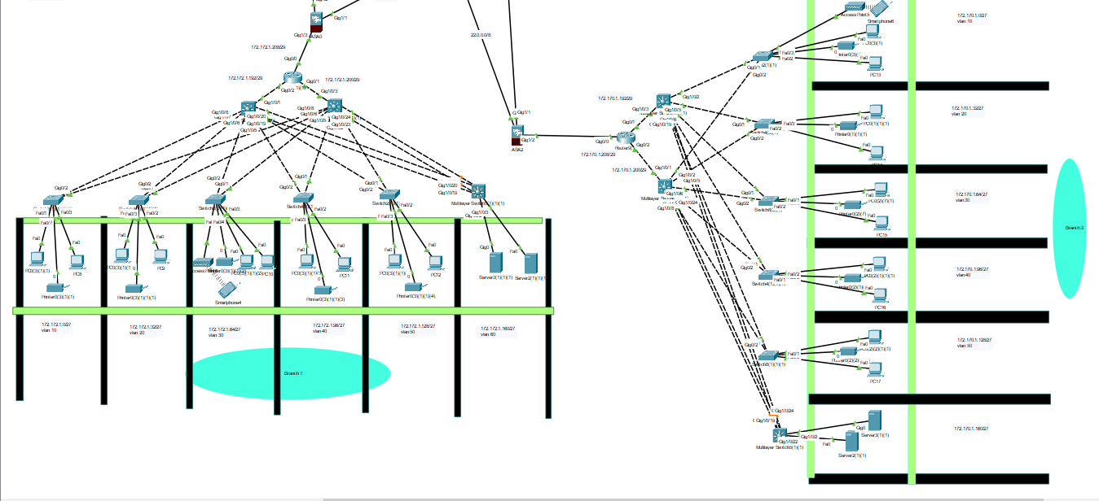
Proposed method (cont.)
Figure 3 : Sub-Branches Network

Slide 20
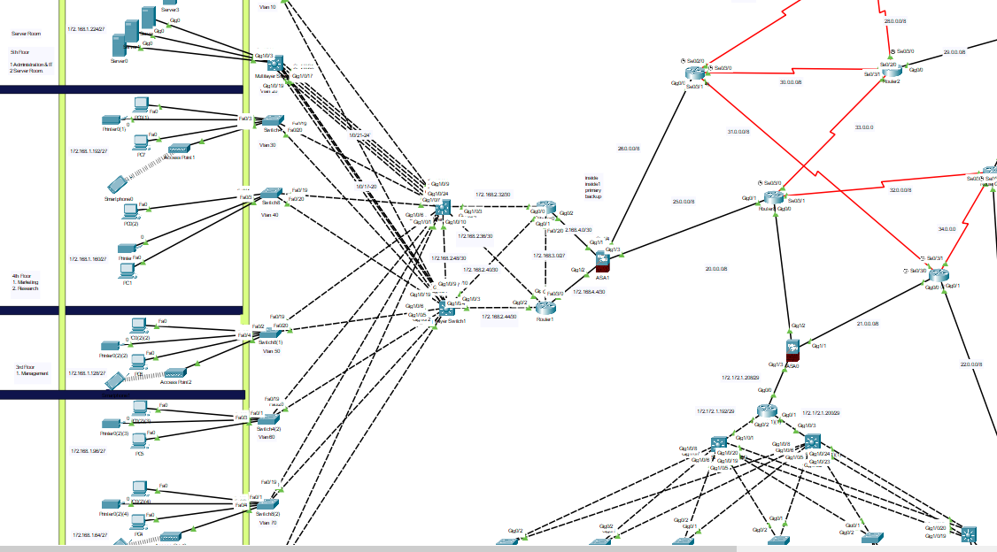
Proposed method (cont.)
Figure 4 : Head office Tropology

Slide 21
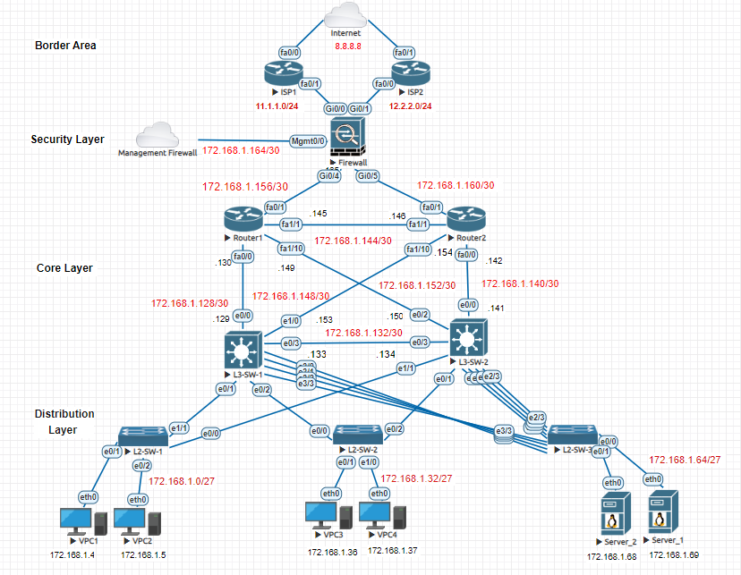
Implementation
Core network
EVENG
Figure 5 : Network Tropology Head-Office

Slide 22
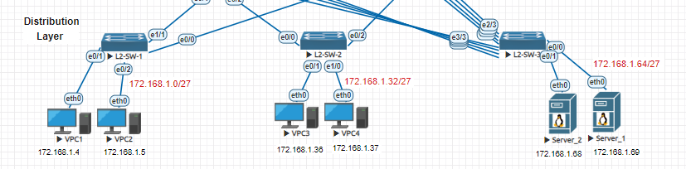
Implementation (cont.)
Dividing IPs for each department
Figure 6 : Network of Distribution Layer

Slide 23
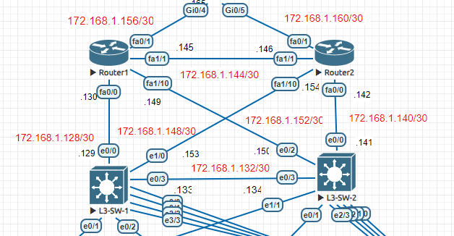
implementation (cont.)
Traffic controlling
Dynamic routing
Spanning tree
Figure 7 : Network of Core Layer

Slide 24
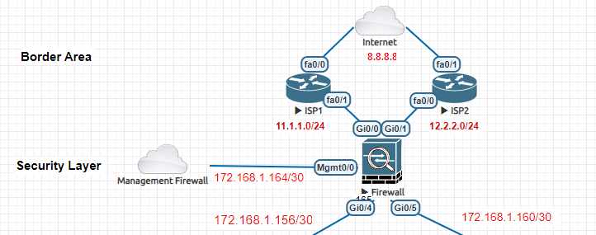
implementation (cont.)
Traffic filtering
ISP failure control
Figure 8 : Network of Security Layer and Border Area

Slide 25
Evaluation

Slide 26
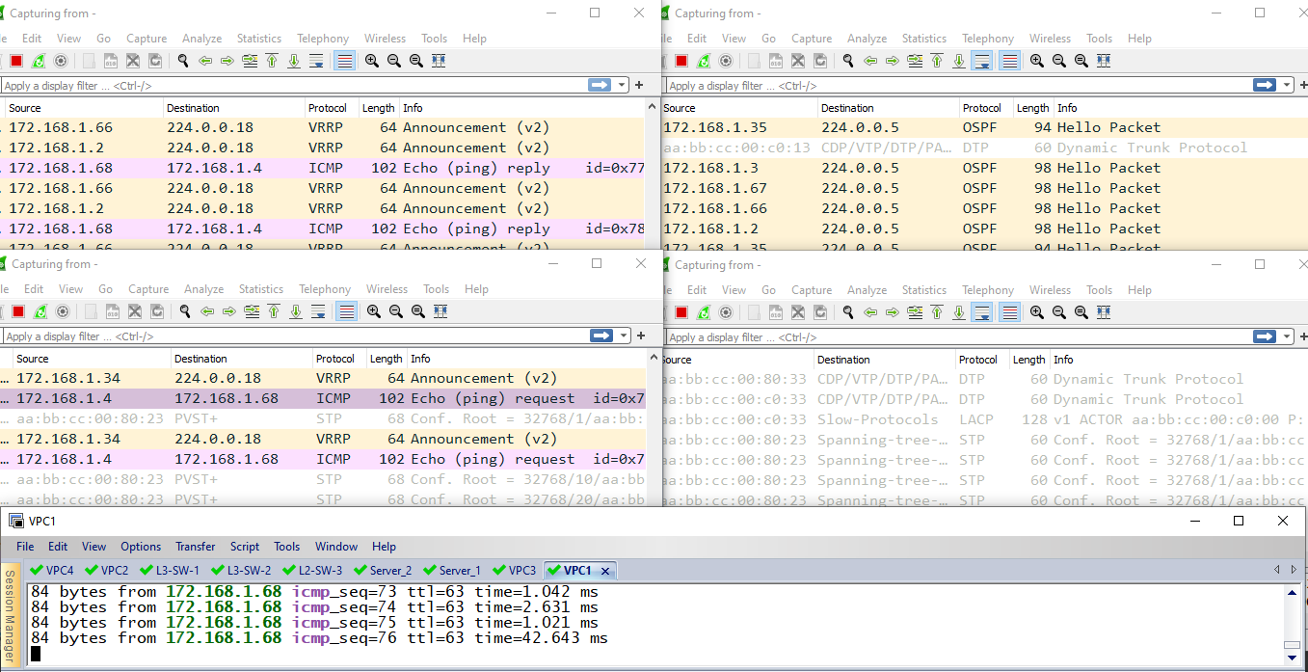
Evaluation
L3-SW-1
Port e3/0
L3-SW-1
Port e3/1
Ether-Channel
Load balancing
Scenario 1 :
L3-SW-1
Port e3/2
L3-SW-1
Port e3/3
VPC1
Figure 9 : Checking Ether-Channel load balancing

Slide 27
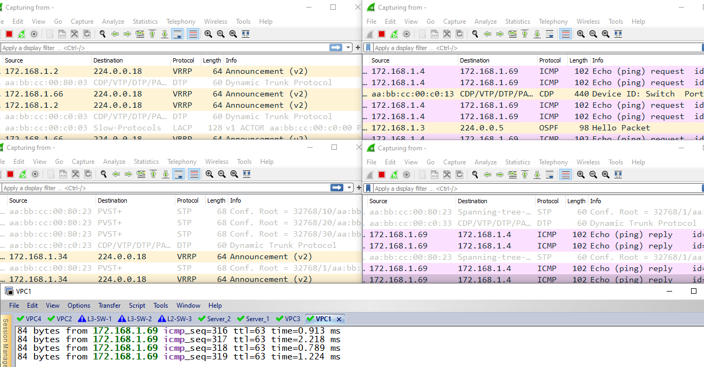
Evaluation (cont.)
L3-SW-1
Port e3/0
L3-SW-1
Port e3/1
Ether-Channel
Load balancing
Scenario 2 :
L3-SW-1
Port e3/3
L3-SW-1
Port e3/2
VPC1
Figure 10 : Checking Ether-Channel load balancing

Slide 28
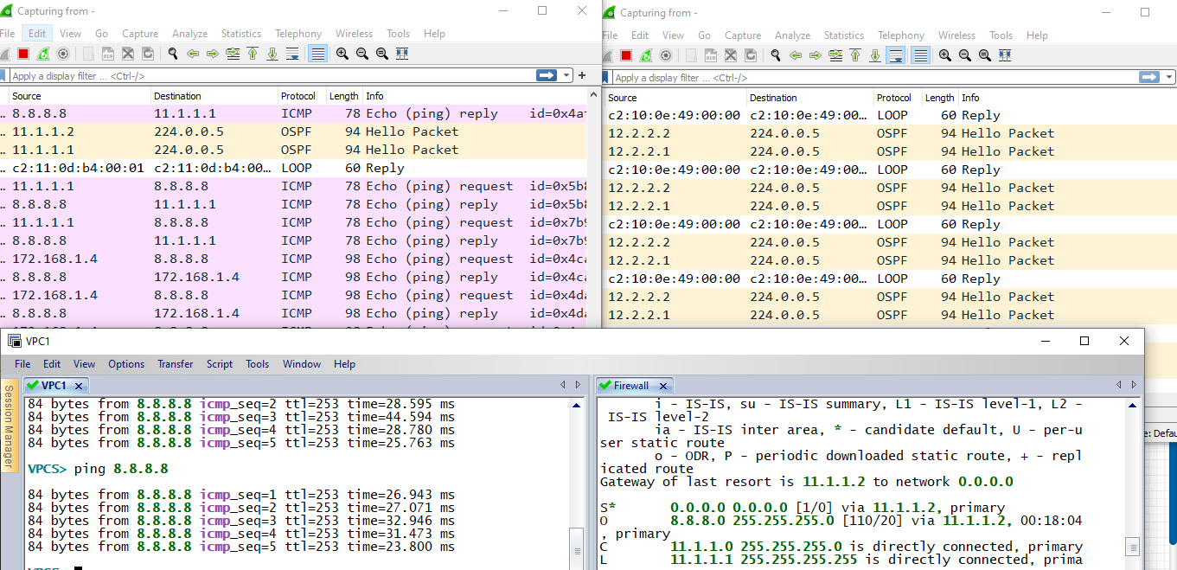
Evaluation (cont.)
Firewall
Port gi0/0 Connected to ISP1
Firewall
Port gi0/1 Connected to ISP2
ISPs Failover
Scenario 1 :
VPC1
Firewall
CLI Interface
Figure 11 : ISPs Failover Testing

Slide 29
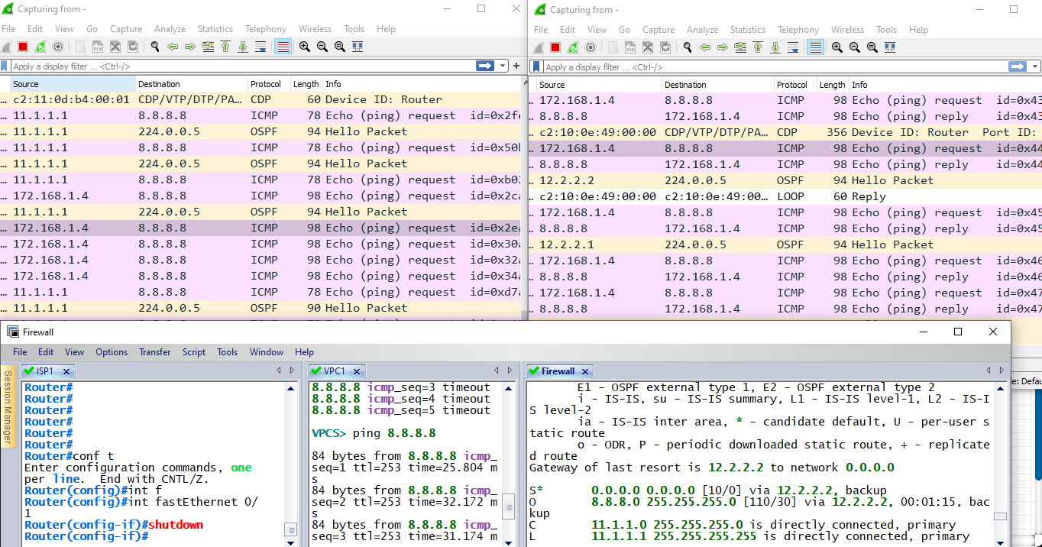
Evaluation (cont.)
Firewall
Port gi0/0 Connected to ISP1
Firewall
Port gi0/1 Connected to ISP2
ISPs Failover
Scenario 2 :
ISP1
CLI Interface
VPC1
Firewall
CLI Interface
Figure 12 : ISPs Failover Testing

Slide 30
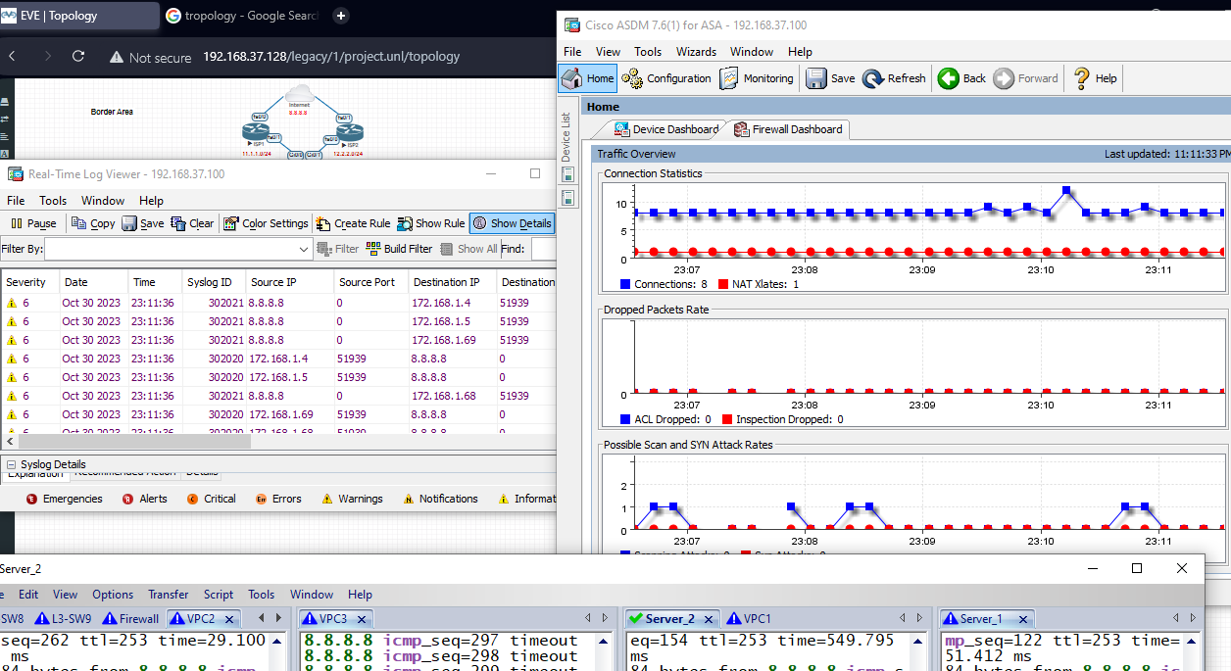
Evaluation (cont.)
Monitoring
Firewall:
Figure 13 : ASDM Firewall Managemet Tool

Slide 31
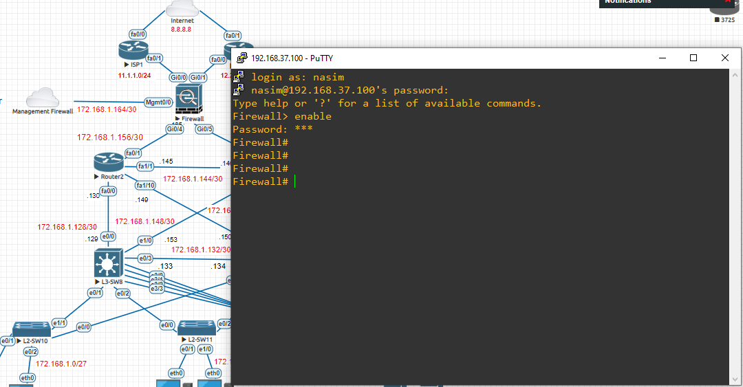
Evaluation (cont.)
Devices Security:
Figure 14 : Remote Access on Firewall

Slide 32
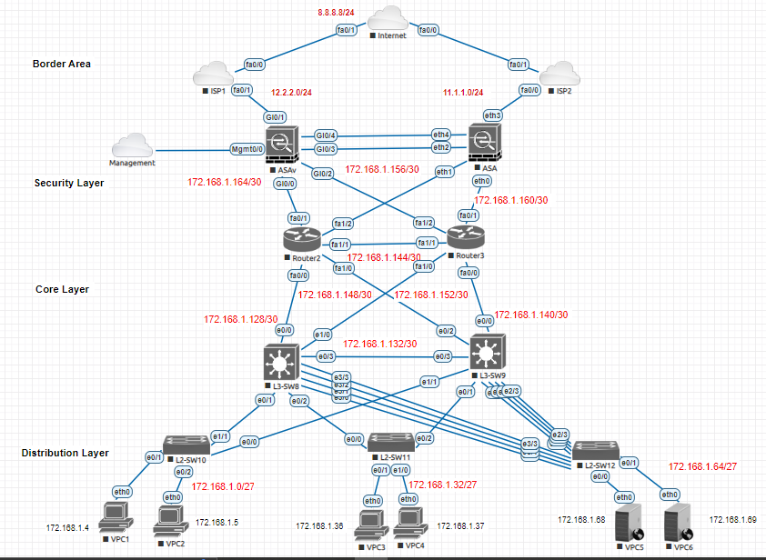
Future work
Figure 16 : Firewall Failover

Slide 33
Gantt Chart
Figure 15 : Gantt Chart of office Network

Slide 34
conclusion
To implement the network system in real organization
To overcome the lack of the manual organization network systems
Security is a major issue regarding organization issues

Slide 35
reference
[1] Hannan, Abdul & Bin Bakkre, M. A. Jobayer & Ray, Rajib & Selim, Md. (2015). Design and Simulation of a Banking Network System. American Journal of Engineering Research (AJER). 4. 79-91.
[2] Diptiben Ghelani, Tan Kian Hua, Surendra Kumar Reddy Koduru. ”Cyber Security Threats, Vulnerabilities, and Security Solutions Models in Banking”. Authorea. September 22, 2022.
[3] Y. Liu, X. Sun and X. Mao,"Security Problems and Countermeasures with Commercial Banking Computer Networks," 2011 Seventh International Conference on Computational Intelligence and Security, Sanya, China, 2011, pp. 821-825, doi: 10.1109/CIS.2011.186.
[4] Tood Lammle. Cisco Certified Network Associated study Guide 640-802 (7th edition).
[5] Configure the ASA for Redundant or Backup ISP Links --- cisco.com.

Slide 36
Reference (cont.)
[6] Understand EtherChannel Load Balance and Redundancy on Catalyst Switches --- cisco.com.
[7] Secure Shell Configuration Guide. cisco.com.
[8] Mohammed Alhassan and Alexander Adjei-Quaye. Information security in anorganization. International Journal of Computer (IJC):pp 100–116, 01 2017.
[9] Bank System Network Design — dribbble.com. https://dribbble.com/
shots/21391333-Bank-System-Network-Design.
[10] William Villegas, Xavier Palacios, and Milton Roman Ca ̃nizares. An internet of things model for improving process management on university campus. Future Internet, 12:162, 09 2020.

Slide 37
Any Questions!!

Slide 38
Thank you!!!

