Slide 1
De Java 11 à Java 17
Quoi de neuf entre ces deux LTS?
Bertrand NAU
Lead Developper @ Talan Labs

Slide 2
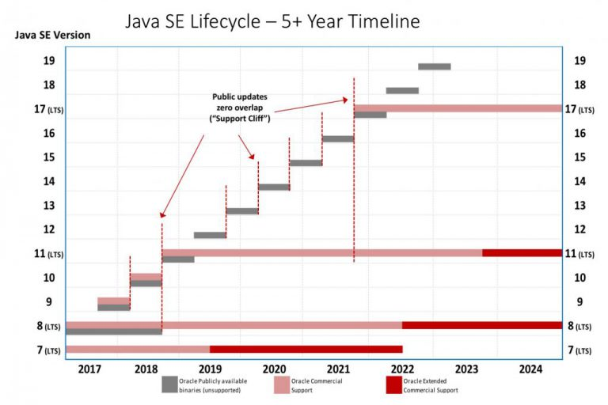
Lifecycle

Slide 3
Covered JEPs
Transversal
12: Preview Features
Language
378: Text Blocks
395: Records
409: Sealed Classes
361: Switch Expressions
406: Pattern Matching for switch (Preview)
394: Pattern Matching for instanceof
API Evolutions
Hotspot
358: Helpful NullPointerExceptions
377: ZGC: A Scalable Low-Latency Garbage Collector
379: Shenandoah: A Low-Pause-Time Garbage Collector
341: Default CDS Archives
350: Dynamic CDS Archives
Tools
392: Packaging Tool
Core libs
389: Foreign Linker API (Incubator)
412: Foreign Function & Memory API (Incubator)
Infrastructure
369: Migrate to GitHub

Slide 4
Preview Features
JEP 12

Slide 5
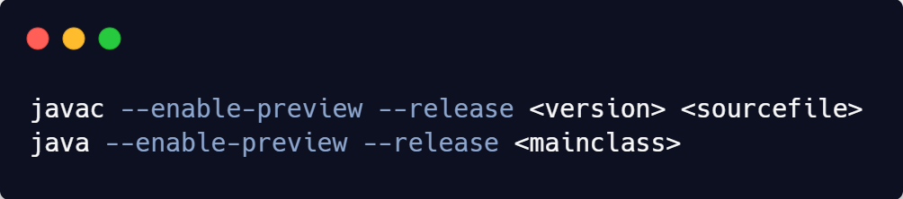
Preview Features
Feature that may evolve or be disabled in the future
Aimed to collect feedback from the community

Slide 6
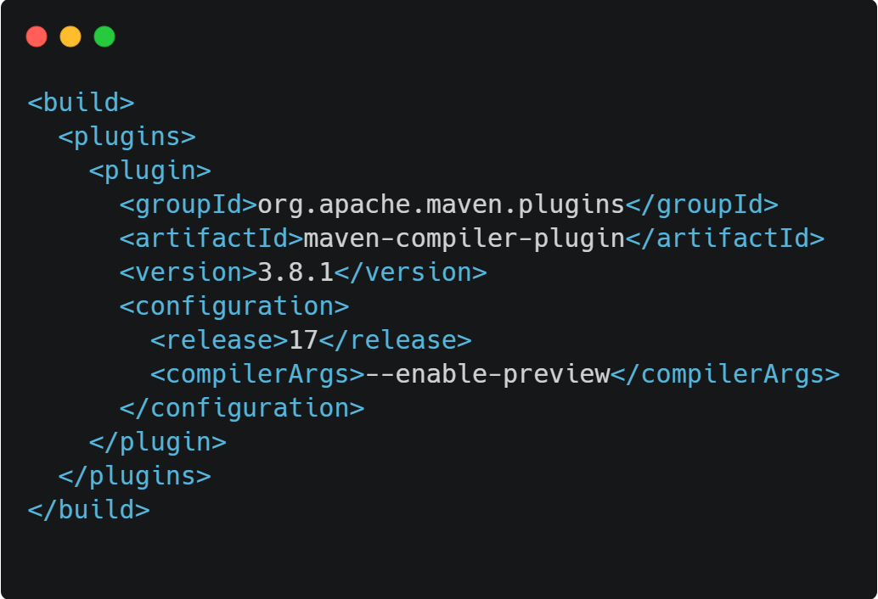
Preview Features: Maven

Slide 7
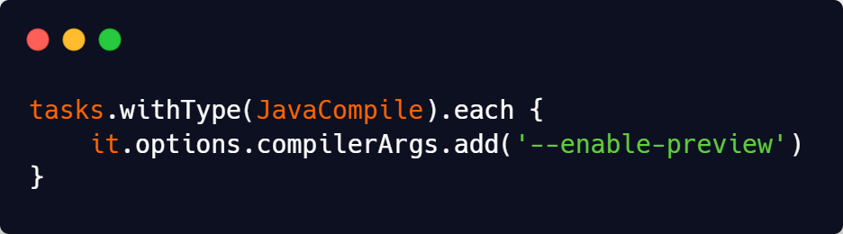
Preview Features: Gradle

Slide 8
Text Blocks
JEP 378

Slide 9
Text Blocks
Multi-line String Literal
Enclosed by three double quotes
Has the String type

Slide 10
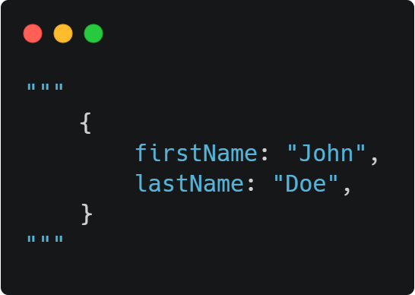
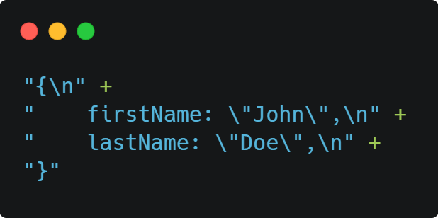
Text Blocks
Java 17
Java 11

Slide 11
Text Blocks
First line should contain white characters only
Trailing white characters are removed and should be escaped
A line can be separated by an antislash
Notes:
Démo!!!!!!!!

Slide 12
Text Blocks
The rules for indentation are:
White lines are ignored
We delete the starting character of all lines until we reach a visible one
All whitespaces count the same
Notes:
Démo!!!!!!!!

Slide 13
Text Blocks
No interpolation
Hard to use concatenation because of indentation rules
Privilege formatting
Notes:
Démo!!!!!!!!

Slide 14
Records
JEP 395

Slide 15
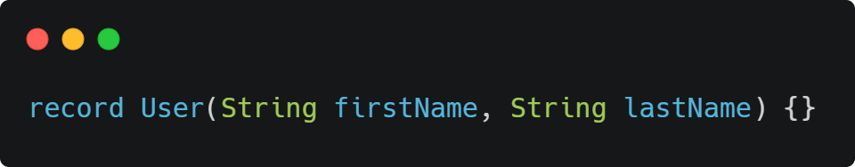
Records
New kind of class
Wraps immutable data

Slide 16
Records
Constructor, accessors, equals, hashcode, toString auto-generated
Accessors are not getters
They all extend java.lang.Record
Notes:
Démo!!!!!!!!!!!!!!!!!!

Slide 17
Records
They can implement interfaces
They can have nested records
They can have methods
They can have static fields
Notes:
Démo!!!!!!!!!!!!!!!!!!

Slide 18
Records
They are not java beans
They are named tuple
They cannot be used with JPA
They are good candidates for DTOs
They can be used with Lombok

Slide 19
Sealed classes
JEP 409

Slide 20
Sealed classes
Sealed classes have a limited number of children
Allowed children are listed with the new permits keyword
Children are final, sealed, or non-sealed
Notes:
Demo!!!!!!!!!!!!!!!!!!!!!!!!!!!!!!!!!!!!!!!!!!!

Slide 21
Switch
JEP 361

Slide 22
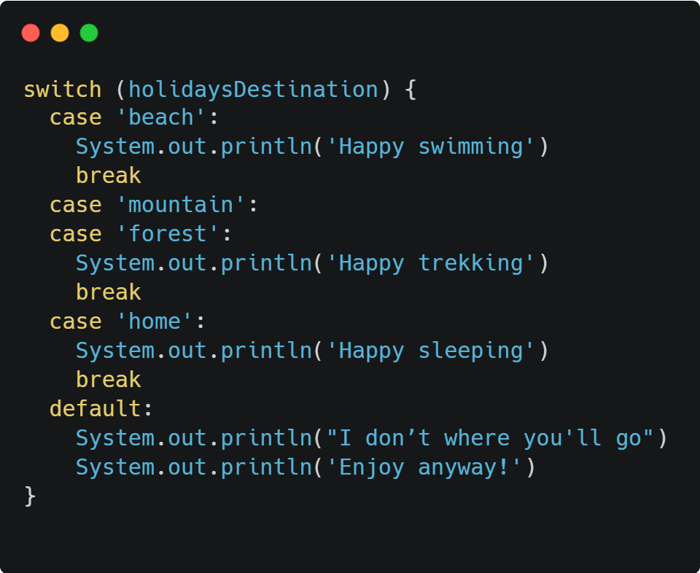
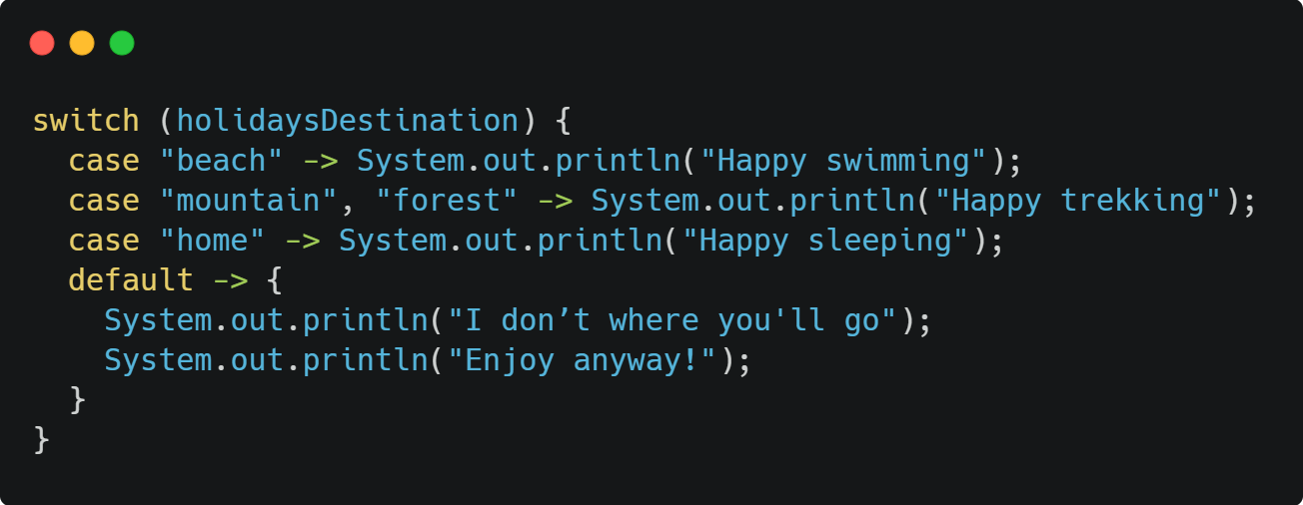
Switch
Java 11
Java 17

Slide 23
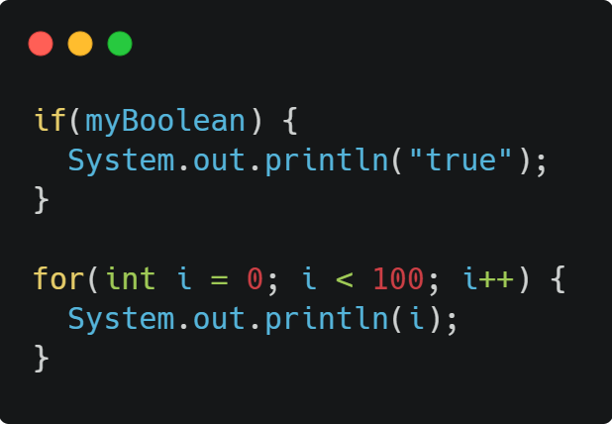
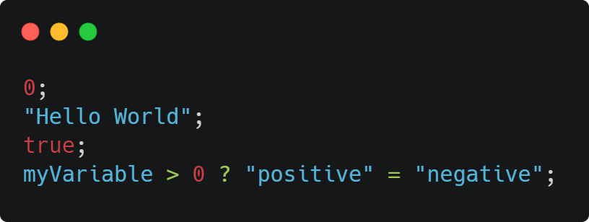
Switch Expressions
Statements
Expressions

Slide 24
Switch Expressions
Switch clause becomes an expression if it’s affected to a variable
All cases must be covered
If using an enum or a sealed class, no need for default case
When in a block, you can’t use return. Use yield instead
Notes:
Demo!!!!!!!!!!!!!!!!!!!!!!!!!!!!!!!!!!!!!!!!!!!

Slide 25
Pattern matching for switch (preview)
JEP 406

Slide 26
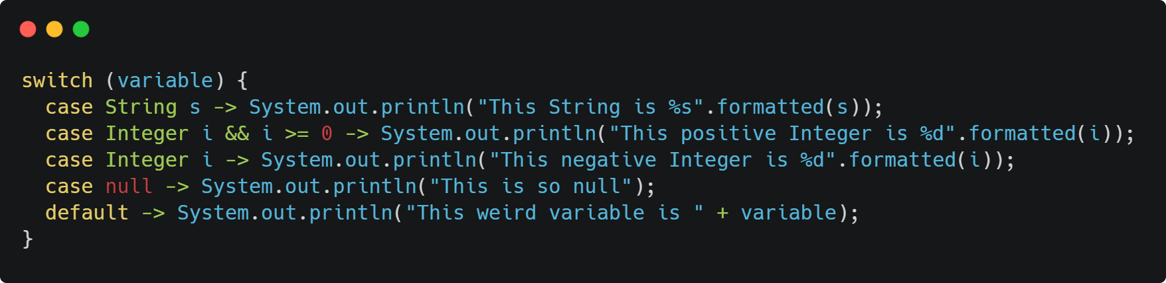
Pattern Matching for switch

Slide 27
Pattern Matching for switch
Elegant way to handle null case
If a branch is unreachable, compiler error
No primitive types

Slide 28
Pattern matching for instanceof
JEP 394

Slide 29
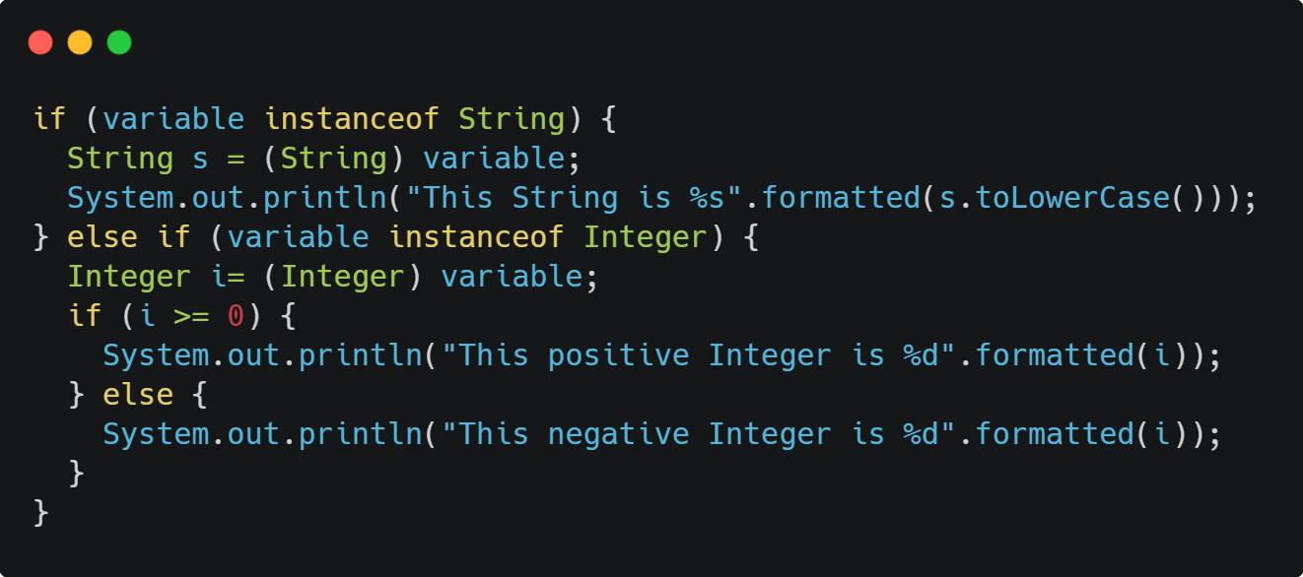
Pattern Matching for instanceof
Java 11

Slide 30
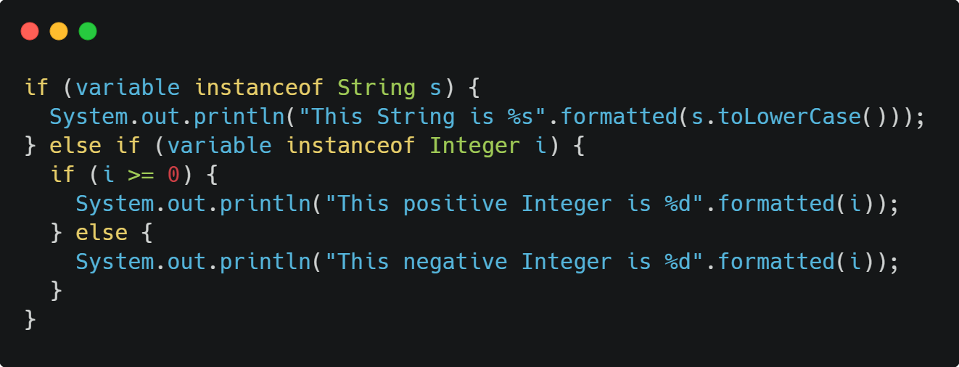
Pattern Matching for instanceof
Java 17

Slide 31
Pattern Matching for instanceof
No need to explicitly cast the variable
Visit Amber project for future proposals

Slide 32
API Evolution
Notes:
Demo d’entrée de jeu!!!!!!!!!!!!!!!!!!!!

Slide 33
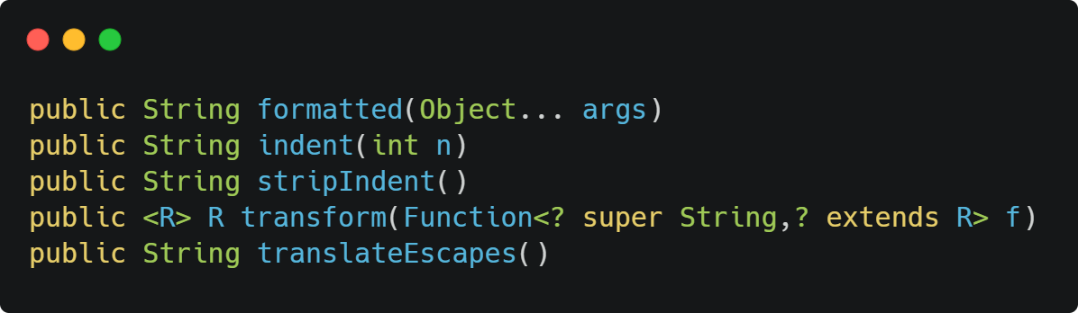
String

Slide 34
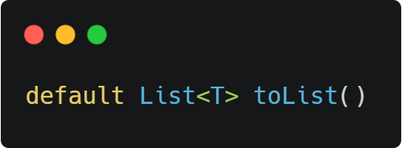
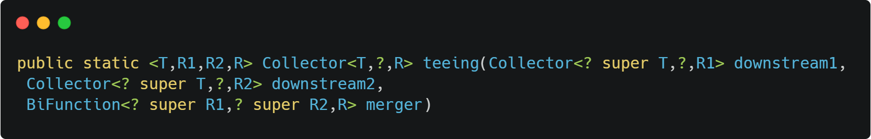
Stream API
Stream
Collectors
Notes:
Demo!!!!!!!!!!!!!!!!!

Slide 35
API Evolution
To go further: https://javaalmanac.io/jdk/17/apidiff/11/

Slide 36
Helpful NPE
JEP 358
Notes:
Démo!!!!!!!!!!!!!!!!!!!!

Slide 37
Garbage Collectors
JEP 377 JEP 379

Slide 38
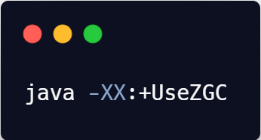

Garbage Collectors
2 new low latency GCs
ZGC: Developped by Oracle
Up to 16 TB of heap
Shenandoah: Developped by Red Hat
Not supported by the Oracle JDK

Slide 39
CDS Archives
JEP 341 JEP 350

Slide 40
CDS Archives
Exports classes and metadata into an archive
The archive is imported at the next run
It reduces the startup time and the memory consumption

Slide 41
Packaging Tool
JEP 392

Slide 42
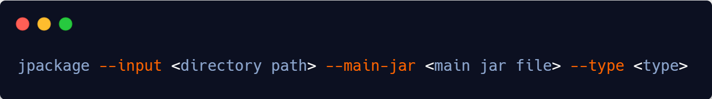
Packaging Tool
Tool that generates an installer from a java application
Multiple output types (.deb, .pkg, .msi…)

Slide 43
Natives API (incubator)
JEP 389 JEP 412

Slide 44
Natives APIs (Incubator)
Helps calling native third party librairies
Alternative to JNI - no need to write glue code
Currently, Foreign Functions and Foreign Memory access
Part of the Panama project

Slide 45
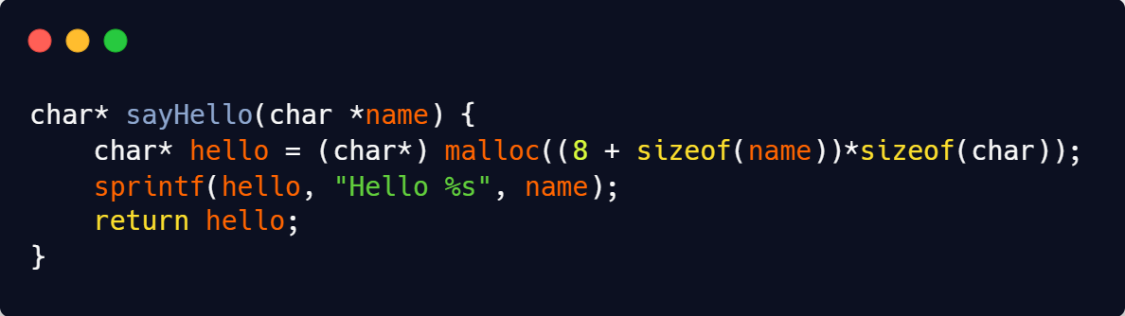
Natives APIs (Incubator)

Slide 46
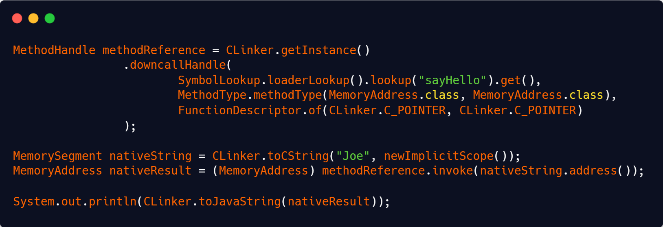
Natives APIs (Incubator)

Slide 47
Migration to Github
JEP 369
https://github.com/openjdk/

Slide 48


Thank you
https://github.com/bnau/java-11-17

