Slide 1
De Java 11 à Java 17
Quoi de neuf entre ces deux LTS?

Slide 2
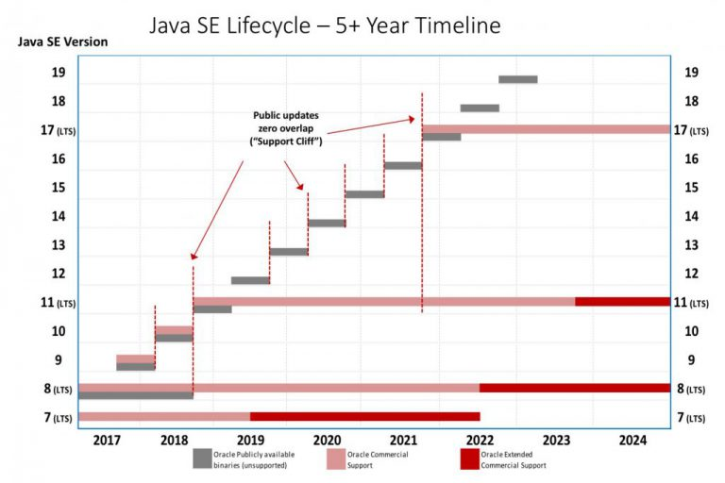
Lifecycle

Slide 3
Preview Features
JEP 12

Slide 4
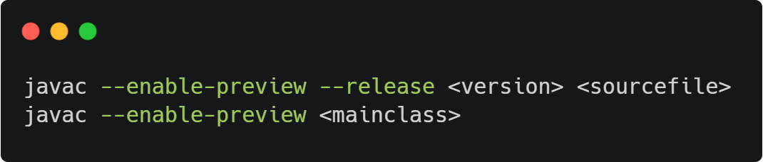
Preview Features
Feature that may evolve or disabled in the future
Aimed to collect feedback from the community

Slide 5
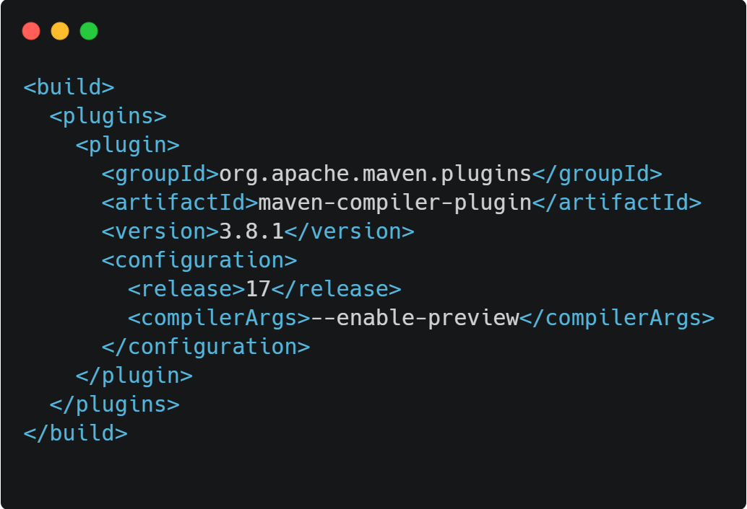
Preview Features: Maven

Slide 6
Preview Features: Gradle

Slide 7
Text Blocks
JEP 378

Slide 8
Text Blocks
Multi-line String Literal
Enclosed by three double quotes
Has the String type

Slide 9
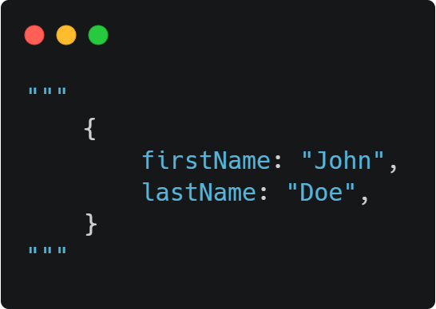
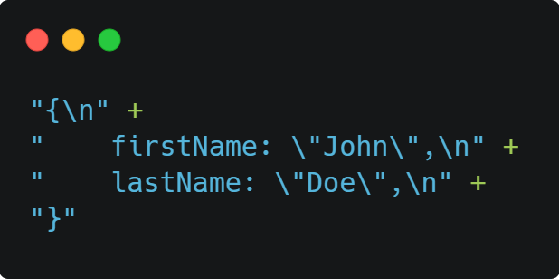
Text Blocks
Java 17
Java 11

Slide 10
Text Blocks
First line should contain white characters only
Trailing white characters are removed and should be escaped
A line can be separated by an antislash
Notes:
Démo!!!!!!!!

Slide 11
Text Blocks
The rules for indentation are:
White lines are ignored
We delete the starting character of all lines until we reach a visible one
All whitespaces count the same
Notes:
Démo!!!!!!!!

Slide 12
Text Blocks
No interpolation
Hard to use concatenation because of indentation rules
Privilege formatting
Notes:
Démo!!!!!!!!

Slide 13
Records
JEP 395

Slide 14
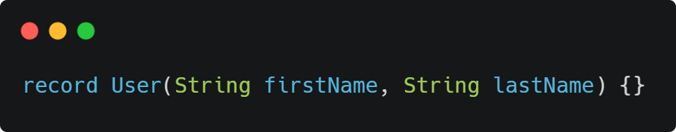
Records
New kind of class
Wraps immutable data

Slide 15
Records
Constructor, accessors, equals, hashcode, toString auto-generated
Accessors are not getters
They all extend java.lang.Record
Notes:
Démo!!!!!!!!!!!!!!!!!!

Slide 16
Records
They can implement interfaces
They can have nested records
They can have methods
They can have static fields
Notes:
Démo!!!!!!!!!!!!!!!!!!

Slide 17
Records
They are not java beans
They are named tuple
They cannot be used with JPA
They are good candidates for DTOs
They can be used with Lombok

Slide 18
Sealed classes
JEP 409

Slide 19
Sealed classes
Sealed classes have a limited number of children
Allowed children are listed with the new permits keyword
Children are final, sealed, or non-sealed
Notes:
Demo!!!!!!!!!!!!!!!!!!!!!!!!!!!!!!!!!!!!!!!!!!!

Slide 20
Switch
JEP 361

Slide 21
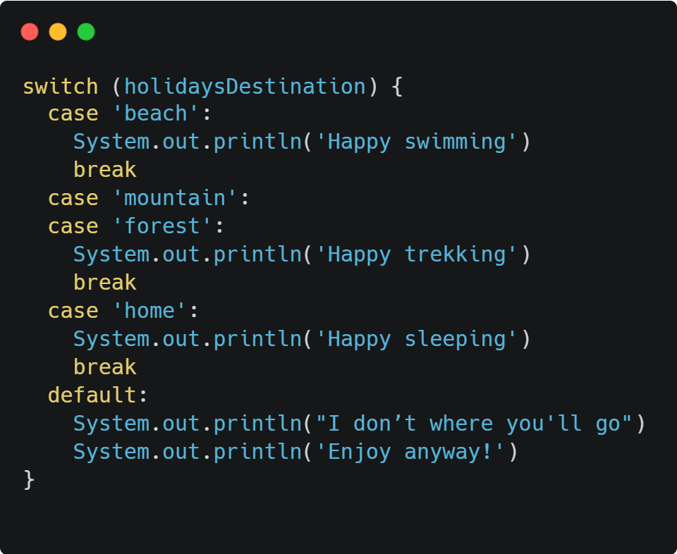
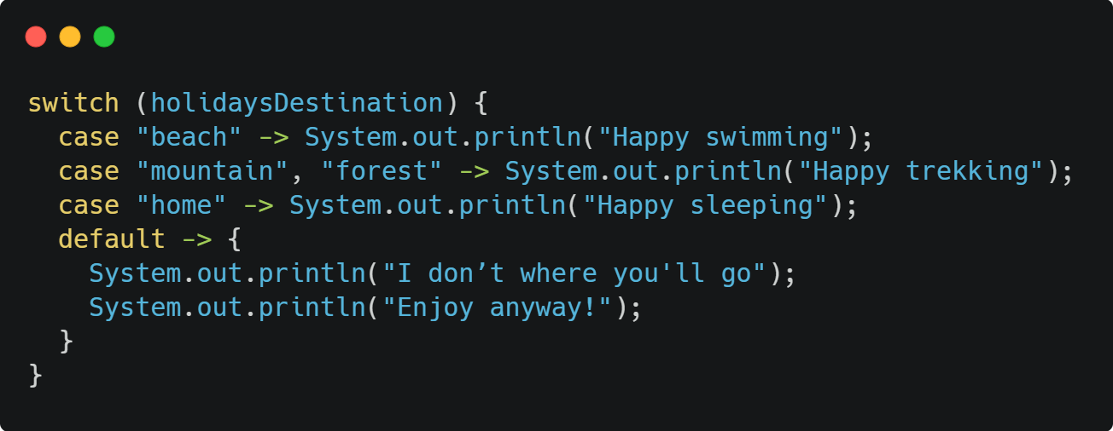
Switch
Java 11
Java 17

Slide 22
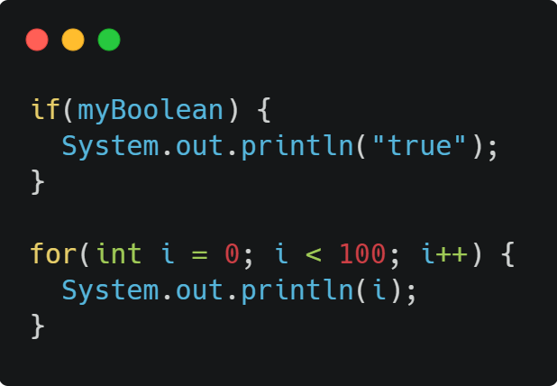
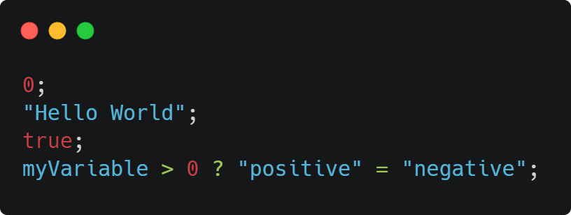
Switch Expressions
Statements
Expressions

Slide 23
Switch Expressions
Switch clause becomes an expression if it’s affected to a variable
All cases must be covered
If using an enum or a sealed class, no need for default case
When in a block, you can’t use return. Use yield instead
Notes:
Demo!!!!!!!!!!!!!!!!!!!!!!!!!!!!!!!!!!!!!!!!!!!

Slide 24
Pattern matching for switch (preview)
JEP 406

Slide 25
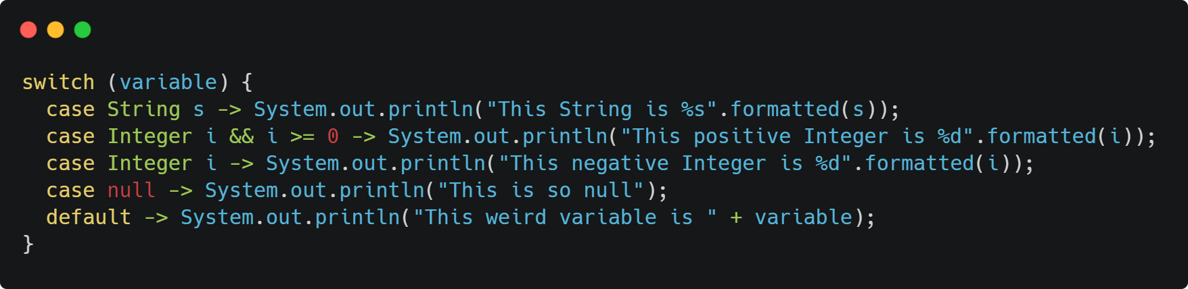
Pattern Matching for switch

Slide 26
Pattern Matching for switch
Elegant way to handle null case
If a branch is unreachable, compiler error
No primitive types

Slide 27
Pattern matching for instanceof
JEP 394

Slide 28
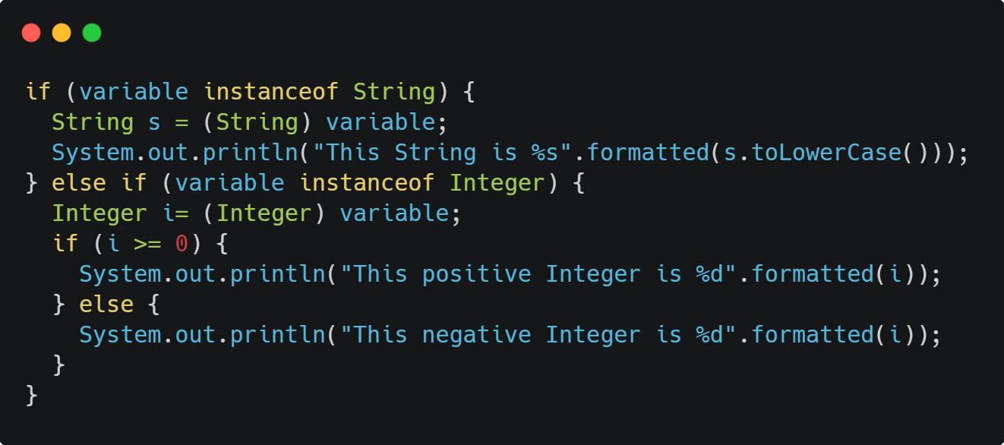
Pattern Matching for instanceof
Java 11

Slide 29
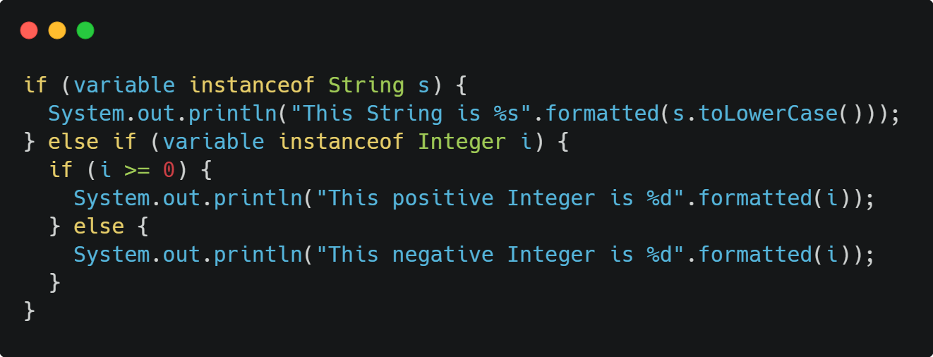
Pattern Matching for instanceof
Java 17

Slide 30
Pattern Matching for switch
No need to explicitly cast the variable
Visit Amber project for future proposals

Slide 31
API Evolution
Notes:
Demo d’entrée de jeu!!!!!!!!!!!!!!!!!!!!

Slide 32
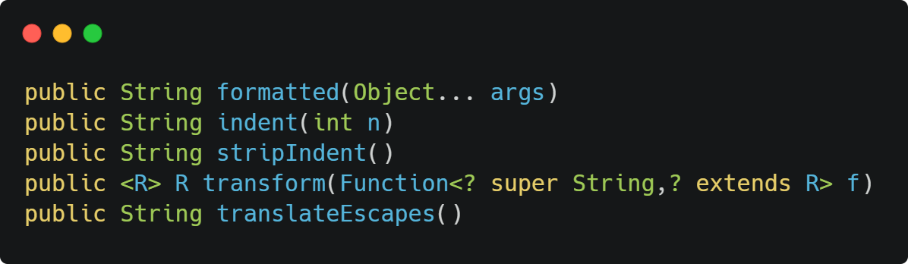
String

Slide 33
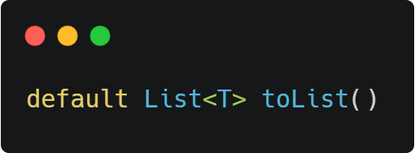
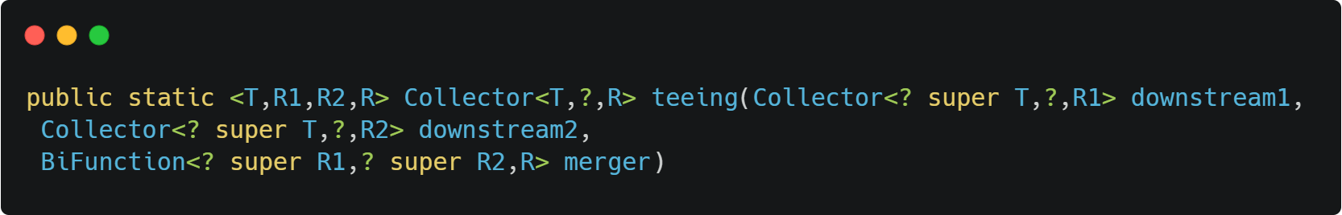
Stream API
Stream
Collectors
Notes:
Demo!!!!!!!!!!!!!!!!!

Slide 34
API Evolution
To go further: https://javaalmanac.io/jdk/17/apidiff/11/
Notes:
Demo!!!!!!!!!!!!!!!!!

