Slide 1
Enterprise Architecture Strategies
Narasimha Baliga

Slide 2
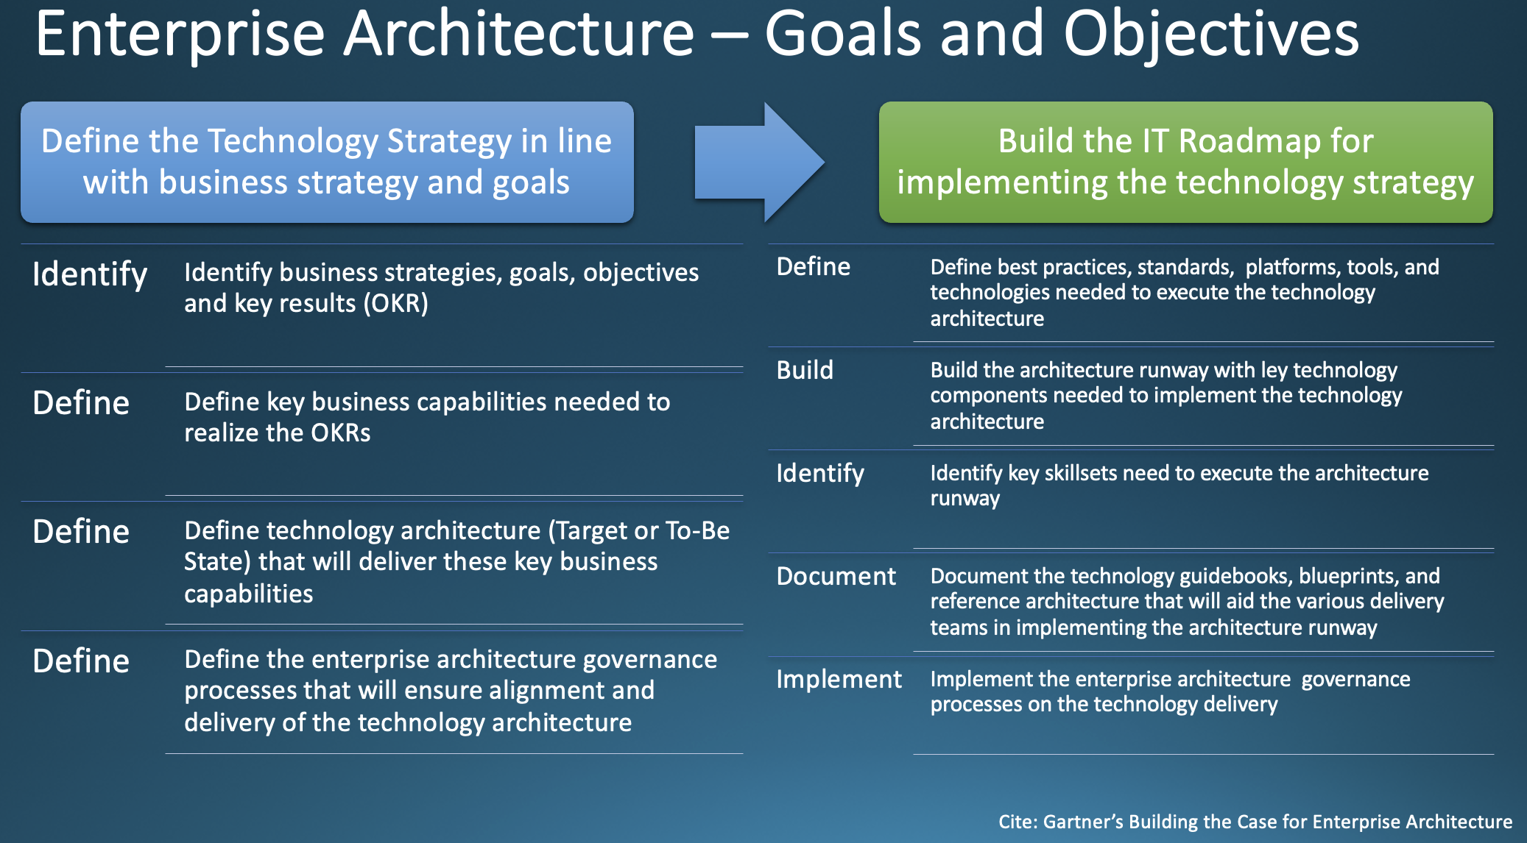

Slide 3
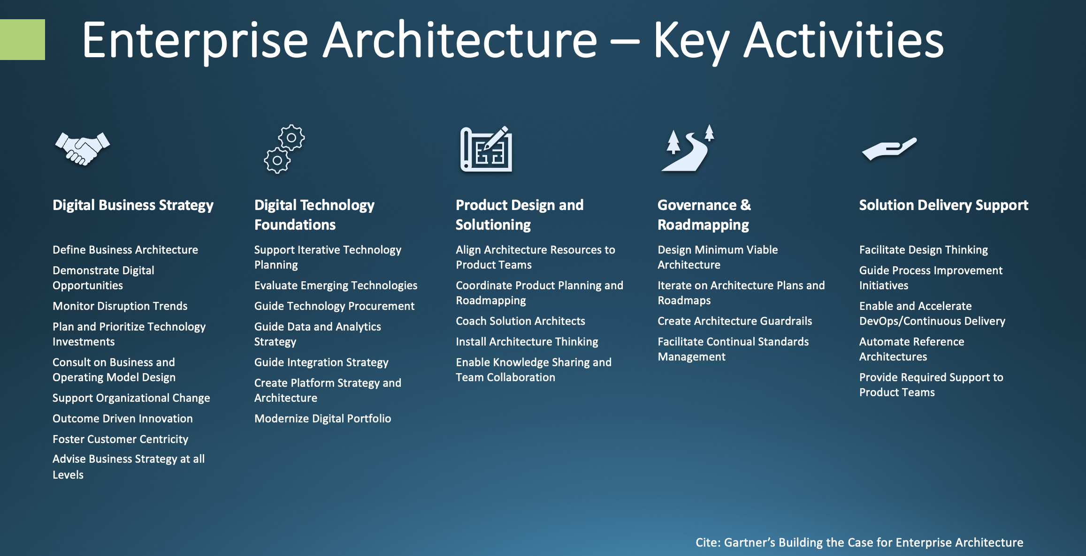

Slide 4
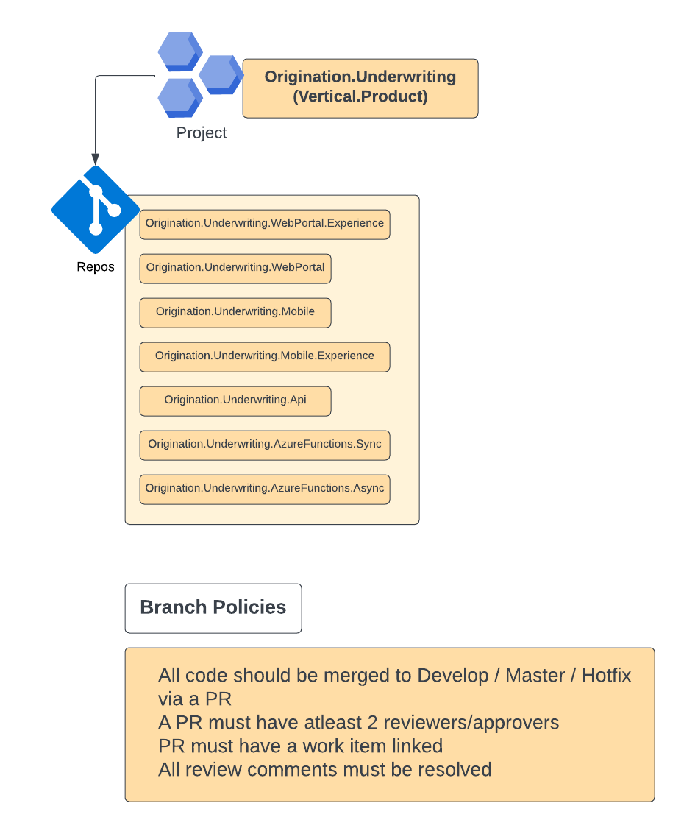
Azure DevOps – Code Repos, policies

Slide 5

Azure DevOps (cont.) code scanning, unit tests run, code coverage etc.
Sonar Cloud/Vera Code
Vulnerabilities, maintainability, Coverage, Duplication etc.

Slide 6
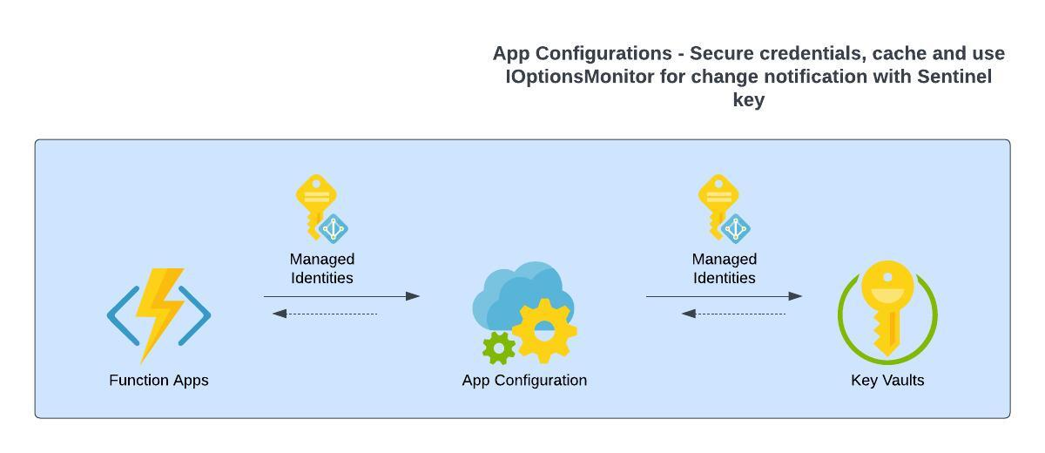
Securing App Configurations

Slide 7
Build cross cutting features for applications using Template projects and Nugets
Caching
Authentication
Sturctured Logging
SQL - Database Repository patterns using EF
NoSQL – Cosmos SDK wrapper
Messaging – Event Grid, Service Bus, Event Hub

Slide 8
SQL
DACPAC for SQL
SQL cost for past 12 months – 183KUS$
Use Serverless – Currently 40 SQL Server DB instances on Dev subscription – single, elastic and serverless, hardly any load seen
Exception - nwl-dev-enterpriseanalytics
VM – vdi

Slide 9
IAC
ARM
Terraform

Slide 10
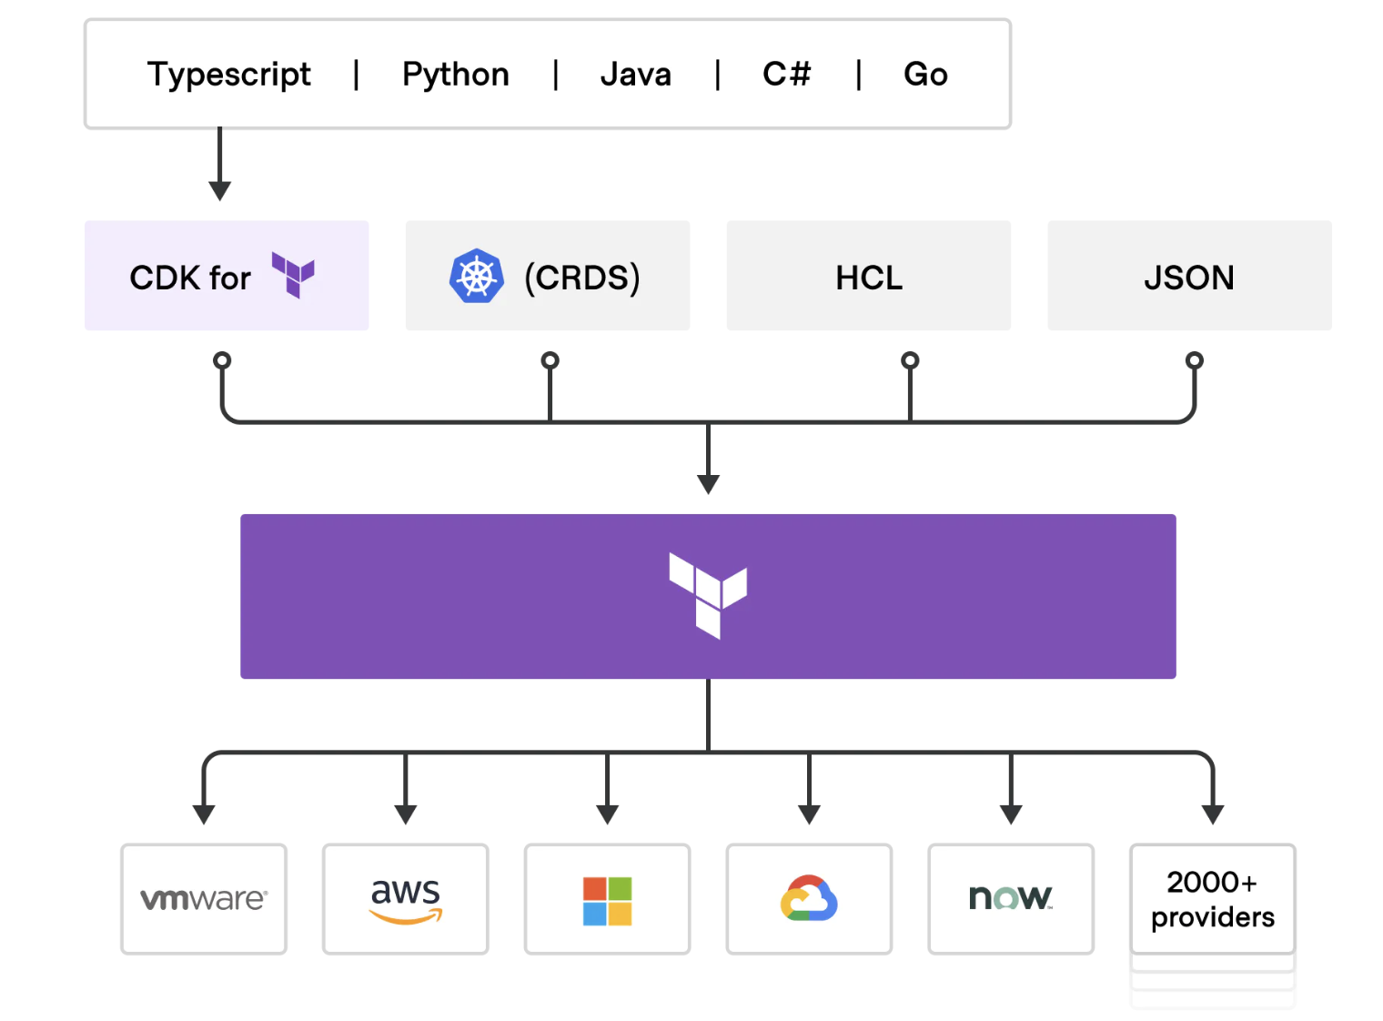
CDK for Terraform

