Slide 1
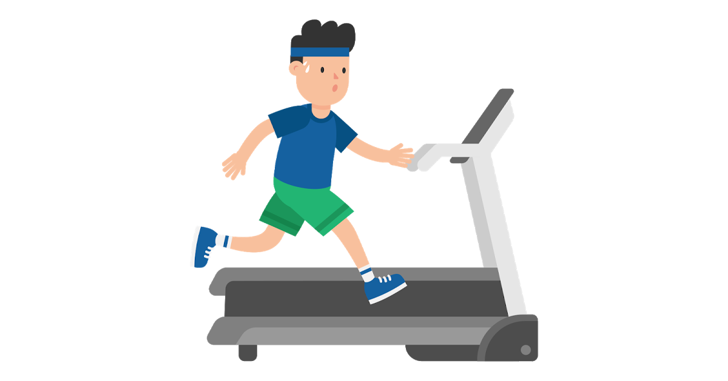
Cardiofitness Treadmill Purchases
Comparison of our company treadmill purchases

Slide 2
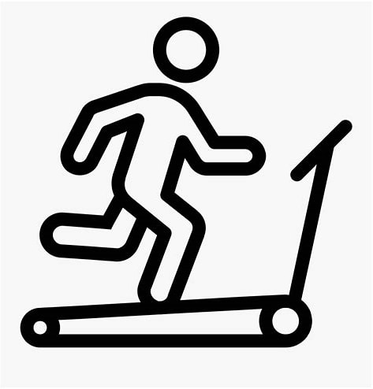
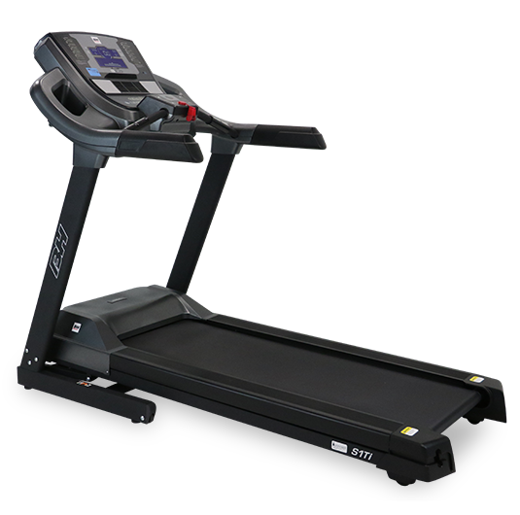
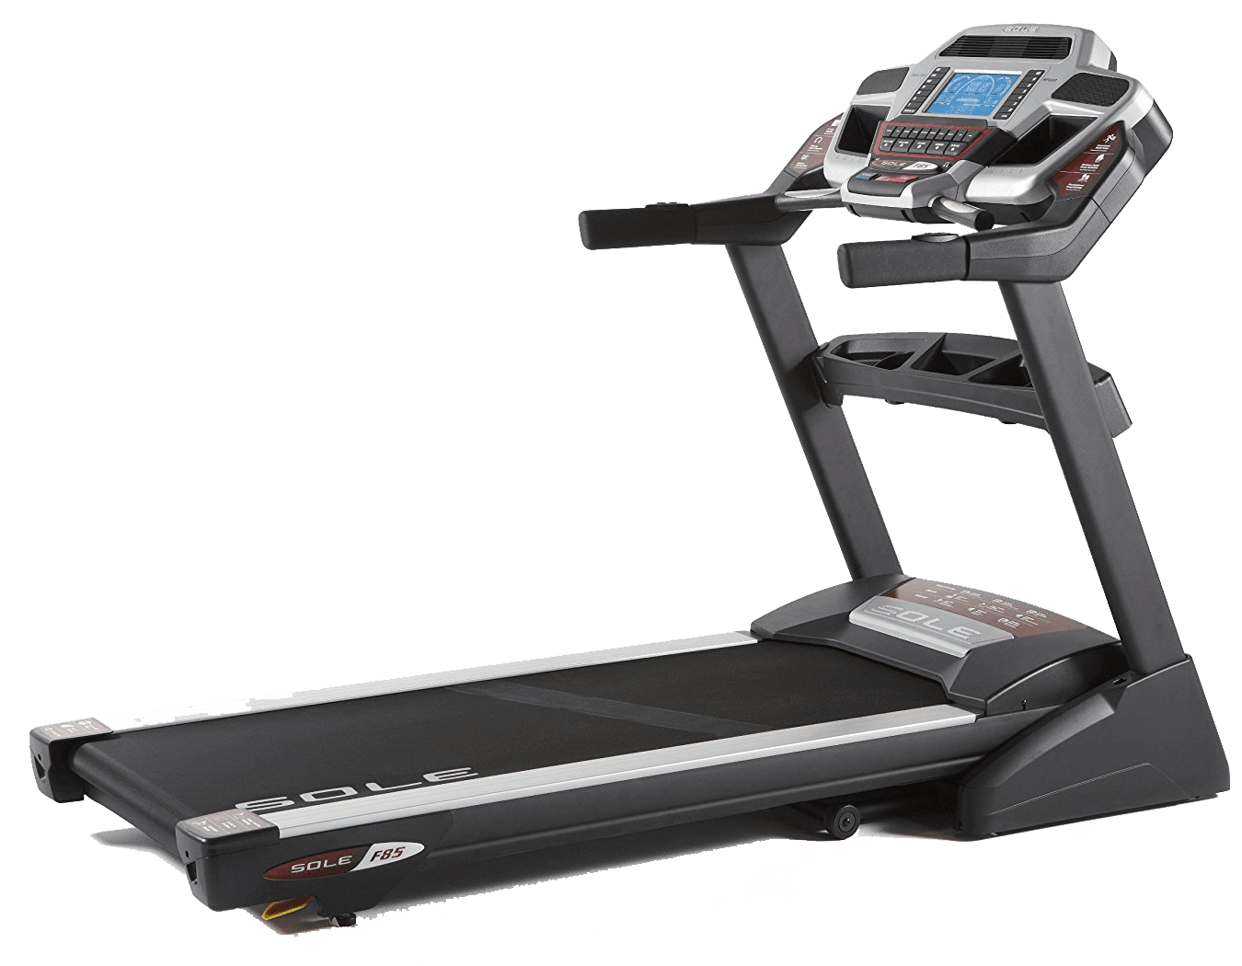
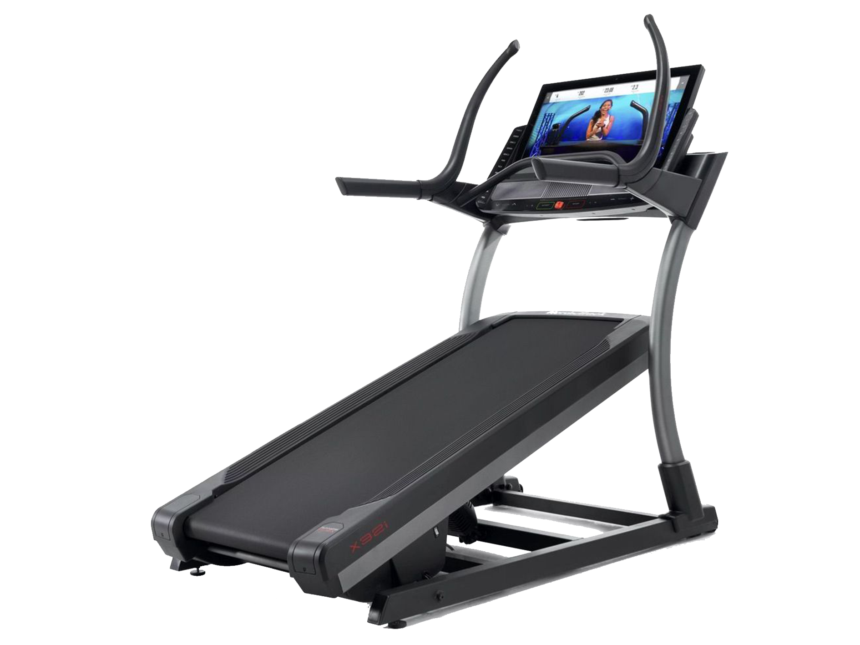
CardioGood Fitness
A leading treadmill provider
Maximise the sale opportunities of the three products
TM195
TM498
TM798

Slide 3


Executive summary
Grasping new opportunities
CardioGood Fitness can increase profits by:
Phasing out TM195
Tailor T798 to women

Slide 4

Introduction
Support CardioGood Fitness growth
£
We were approached by CardioGoodFitness to identify new opportunities to increase the proft based on their existing product protfolio
Increasing profits is important for the future development of the company
Hypothesis: we believe that customers could be shifted towards more profitable products

Slide 5
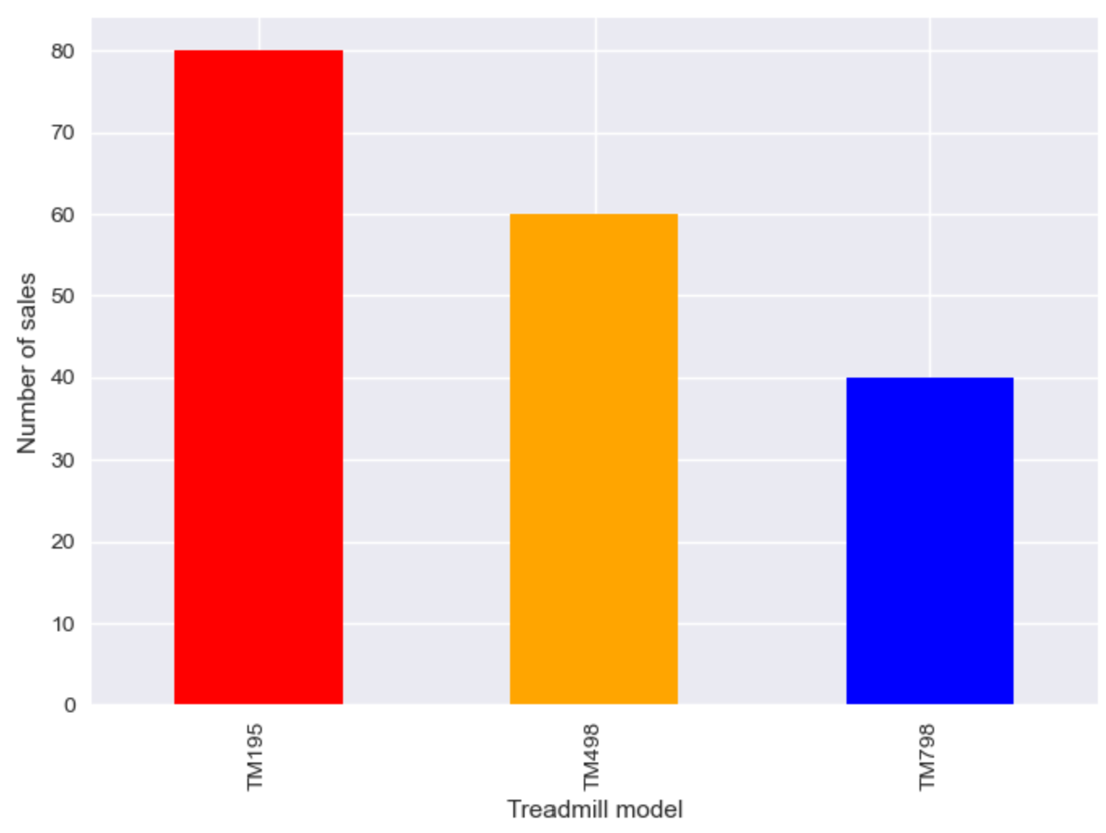
Distribution of treadmill sales
TM195 sold for twice the number of TM798 and TM498 was in-between

Slide 6
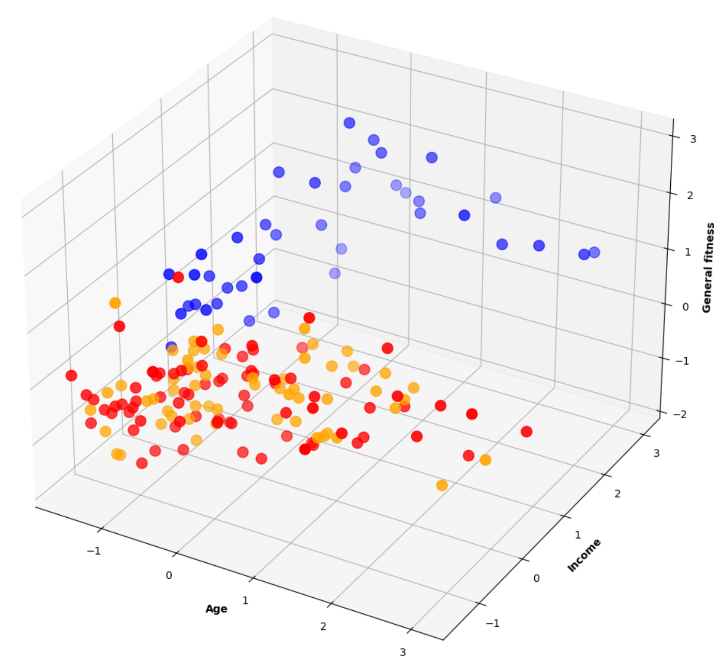



Standard customer profiles
There are two customer profiles for three treadmill models
Three main features dictated profiles:
• Age
• Income
• General fitness (including self-assessed fitness level, usage, miles run per week)
• TM195 and TM498 have the same targets
TM798
TM195
TM498
Recommendation:
• Phasing out TM498 should lead to more sales in TM498, which is more profitable, and save cost on production lines

Slide 7
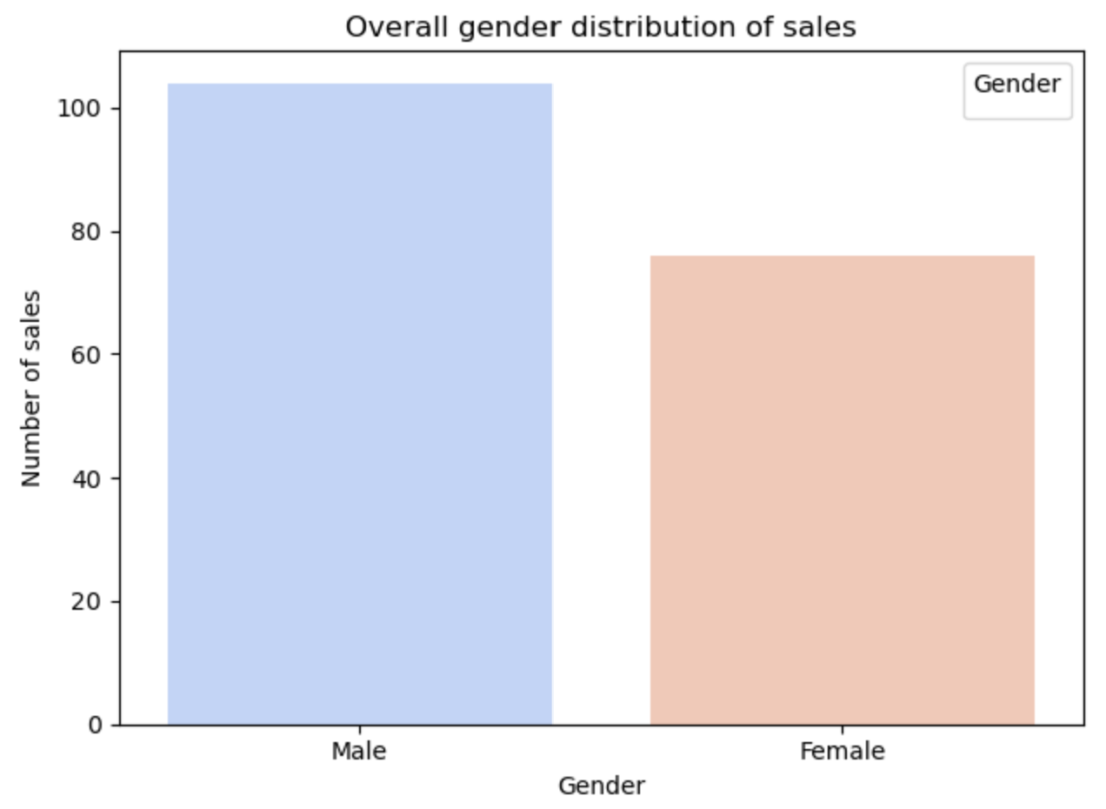
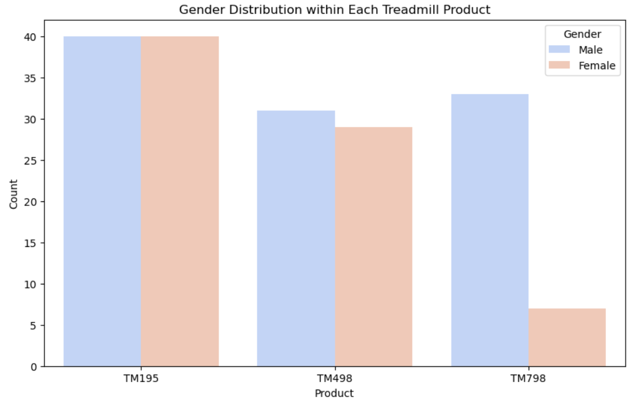
Gender distribution of sales
The gender distribution is not uniformally across

Slide 8
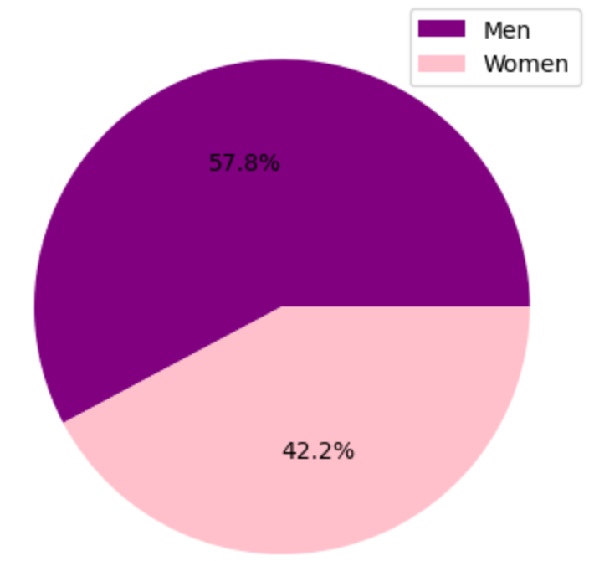
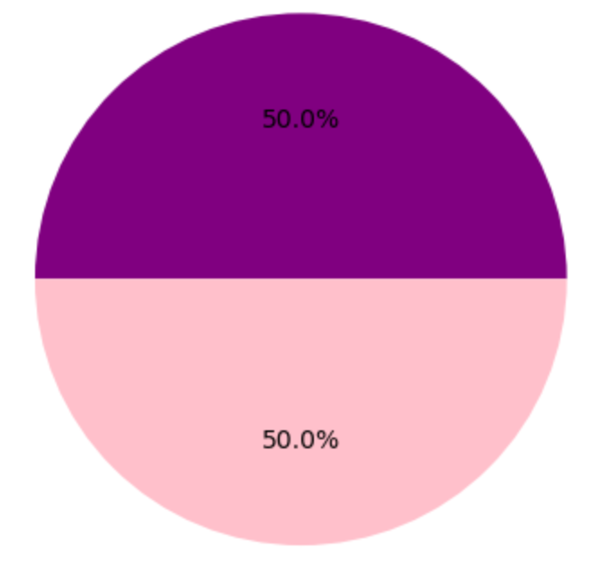
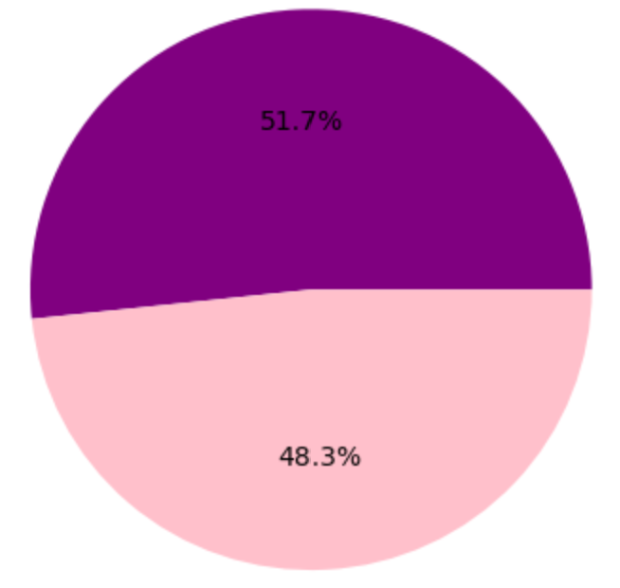
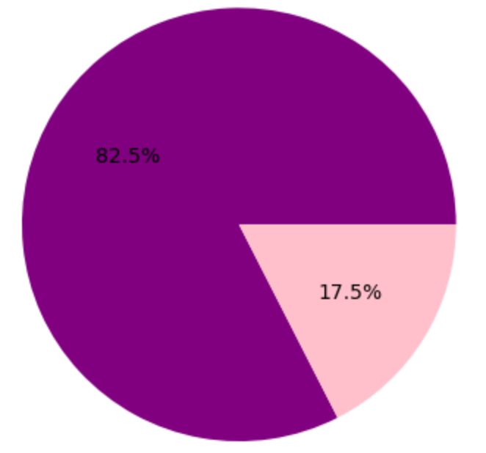
Gender distribution of sales
The gender distribution is not uniformally across
Overall ratio of men vs women
TM498
TM195
TM798
• More women than expected buy TM498 and TM195
• A lot less women than expected buy TM798
Recommendation:
• CardioGood Fitness should explores how increasing the sales of TM798 among women

Slide 9
Conclusion
Support CardioGood Fitness growth
CardioGood Fitness can increase profits buy phasing out TM195, and improve the appeal of TM798 among women
TM798 is not popular among women and might need to be rebranded

