Slide 1
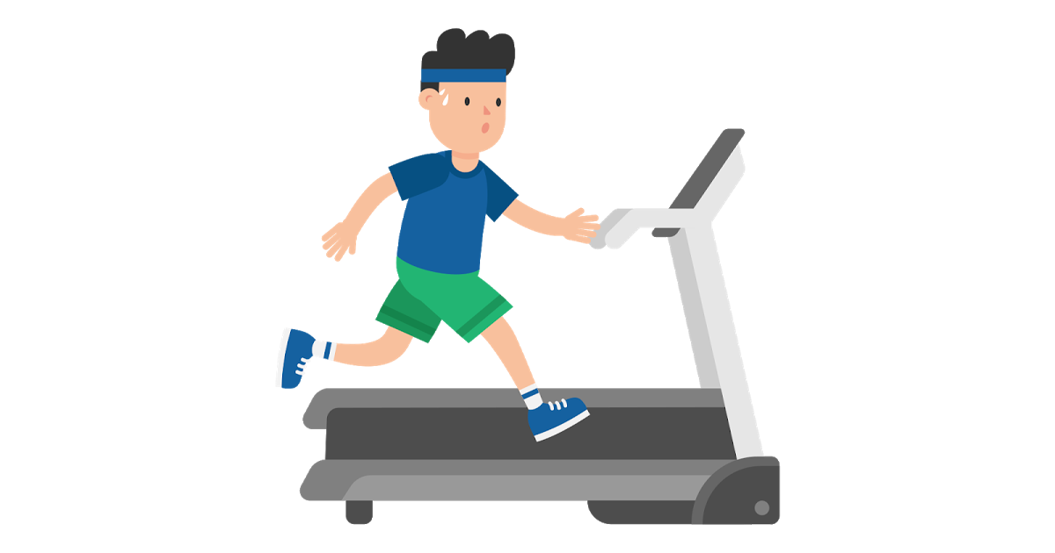
Cardiofitness Treadmill Purchases
Comparison of our company treadmill purchases

Slide 2
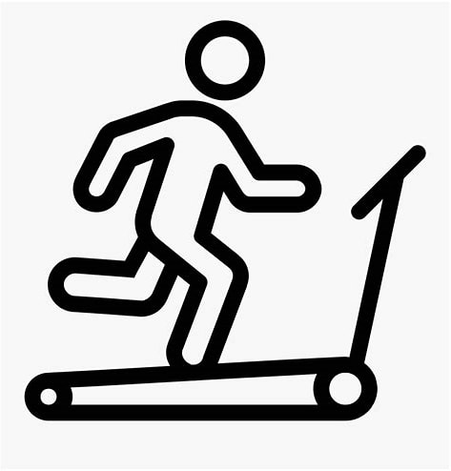
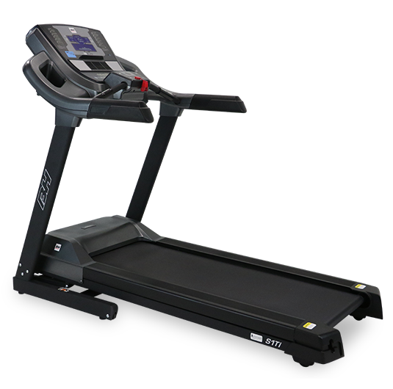
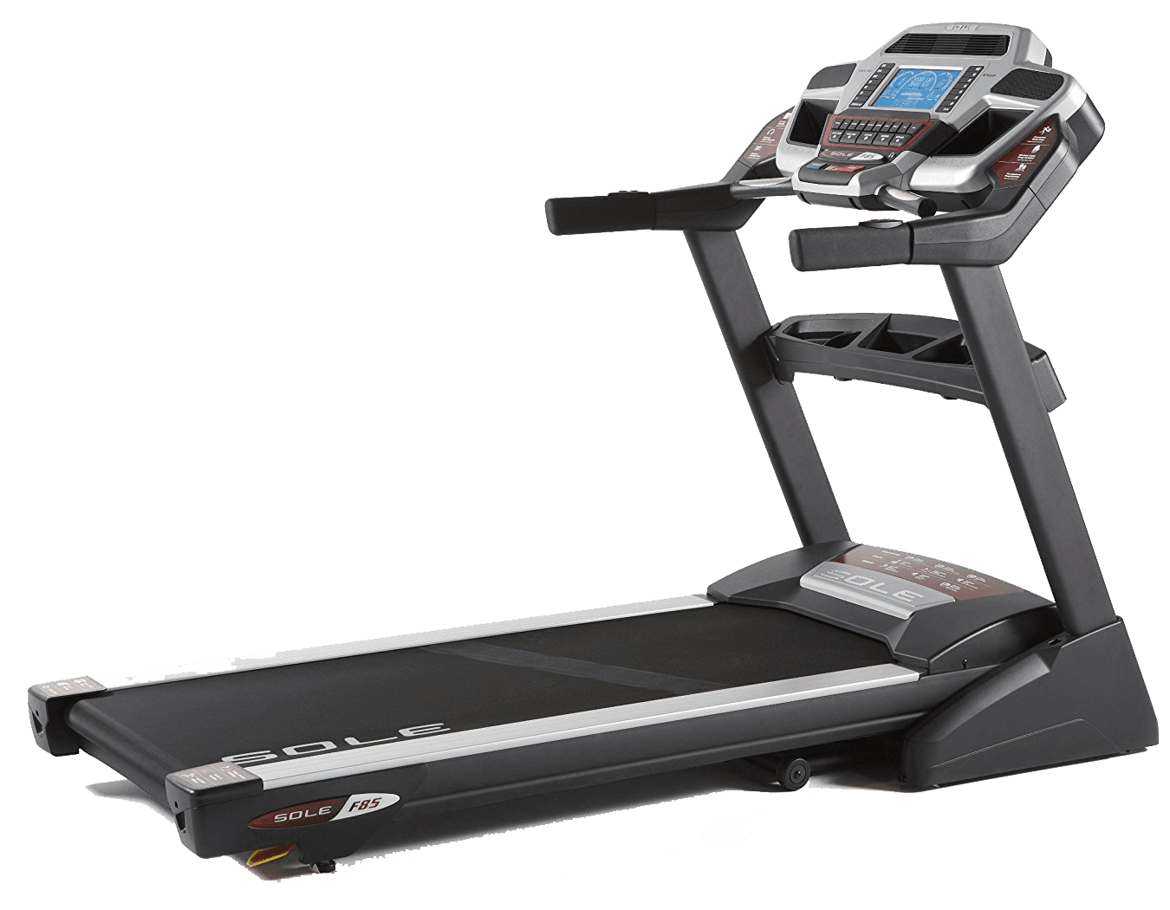
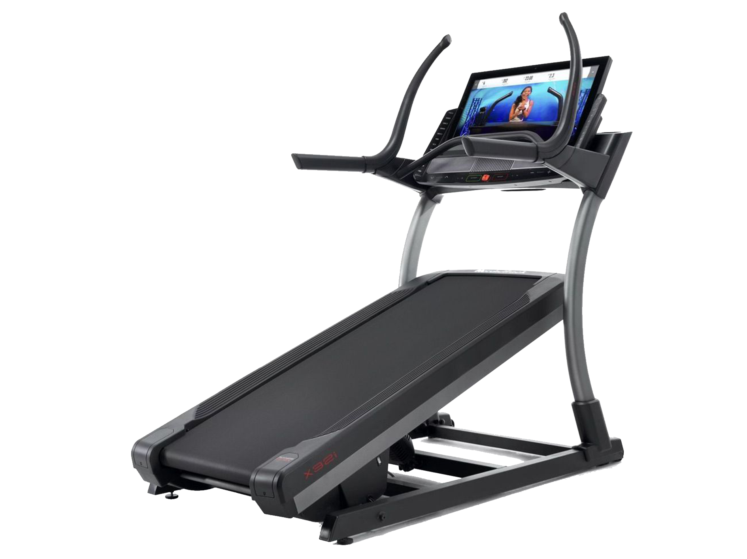
CardioGood Fitness
A leading treadmill provider
Maximise the sale opportunities of the three products
TM195
TM498
TM798

Slide 3


Executive summary
Grasping new opportunities
CardioGood Fitness can increase profits by:
Phasing out TM195
Tailor T798 to women

Slide 4

Introduction
Support CardioGood Fitness growth
£
We were approached by CardioGoodFitness to identify new opportunities to increase the profit based on their existing product portfolio
Increasing profits is important for the future development of the company
Hypothesis: we believe that customers could be shifted towards more profitable products

Slide 5
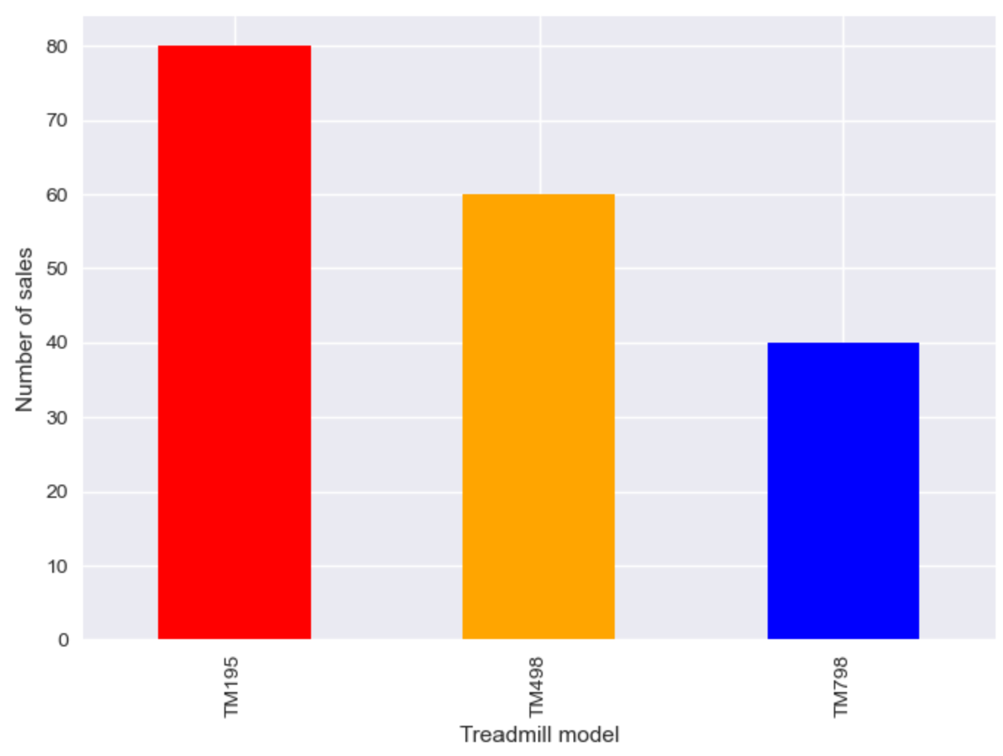
Distribution of treadmill sales
TM195 sold for twice the number of TM798 and TM498 was in-between

Slide 6
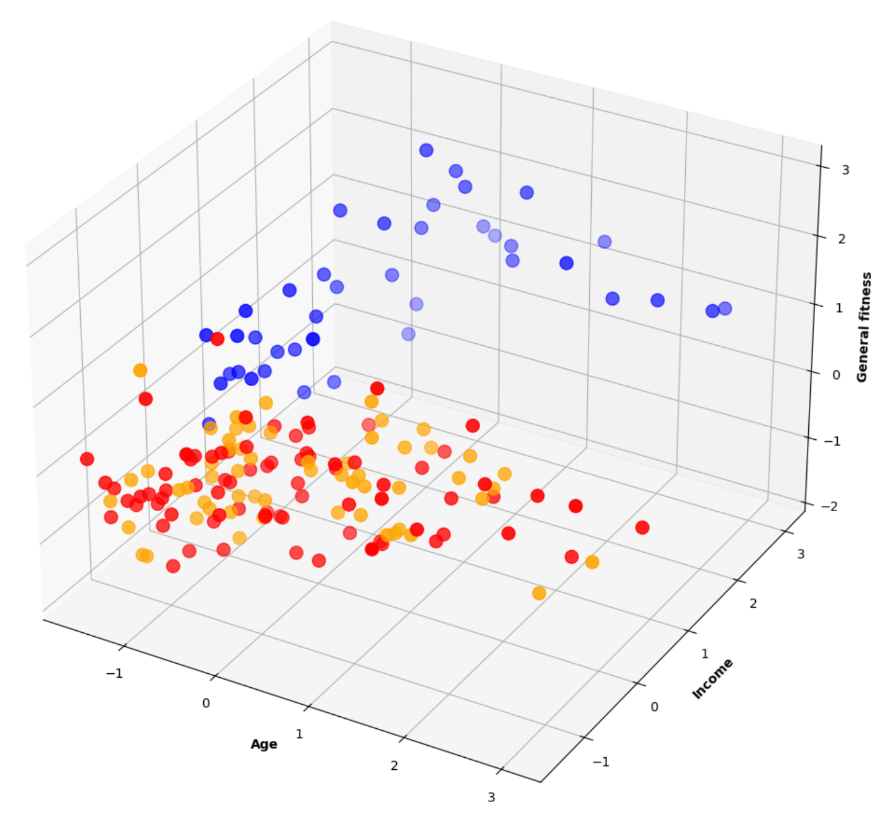



Standard customer profiles
There are two customer profiles for three treadmill models
Three main features dictated profiles:
• Age
• Income
• General fitness (including self-assessed fitness level, usage, miles run per week)
• TM195 and TM498 have the same targets
TM798
TM195
TM498
Recommendation:
• Phasing out TM498 should lead to more sales in TM498, which is more profitable, and save cost on production lines

Slide 7
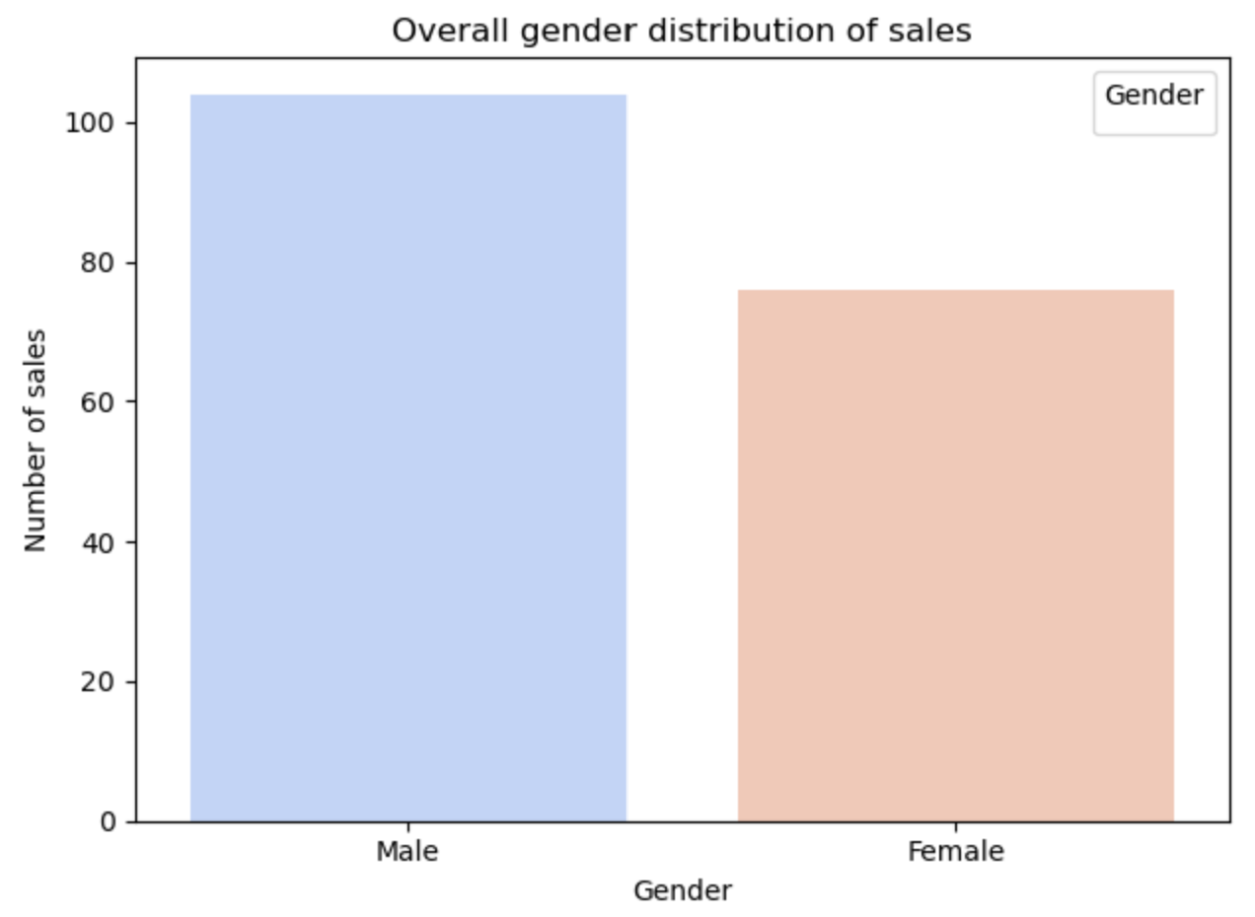
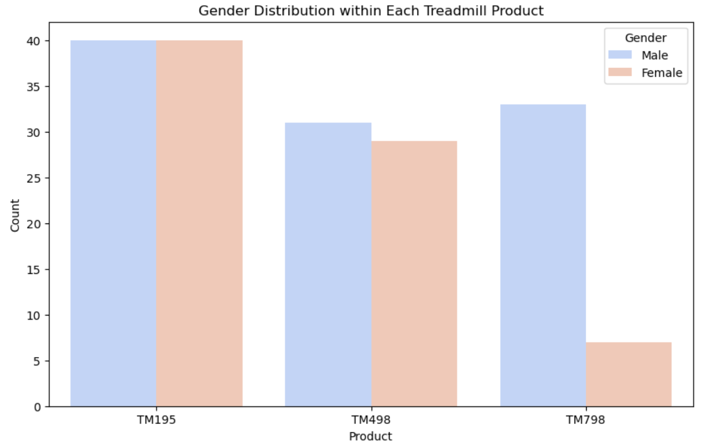
Gender distribution of sales
The gender distribution is not uniformally across

Slide 8
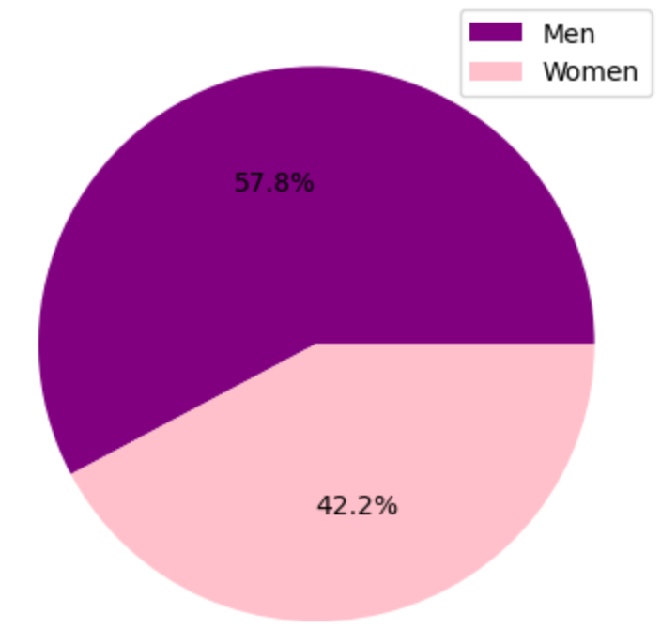
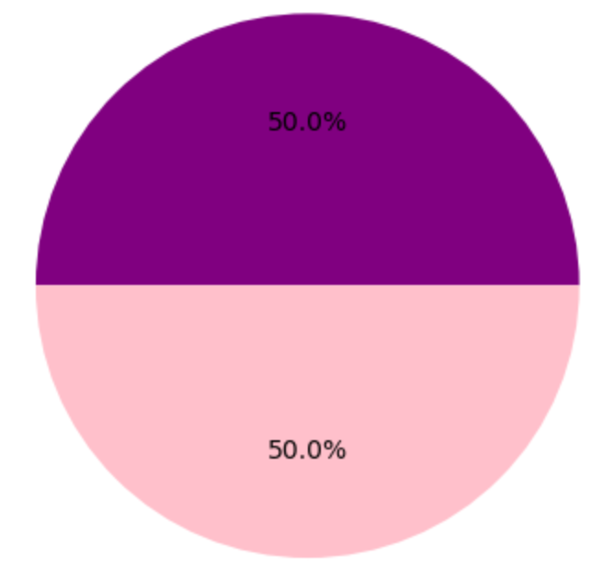
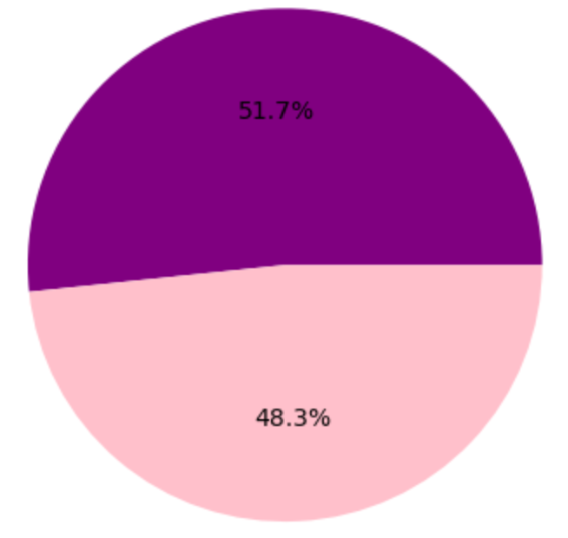
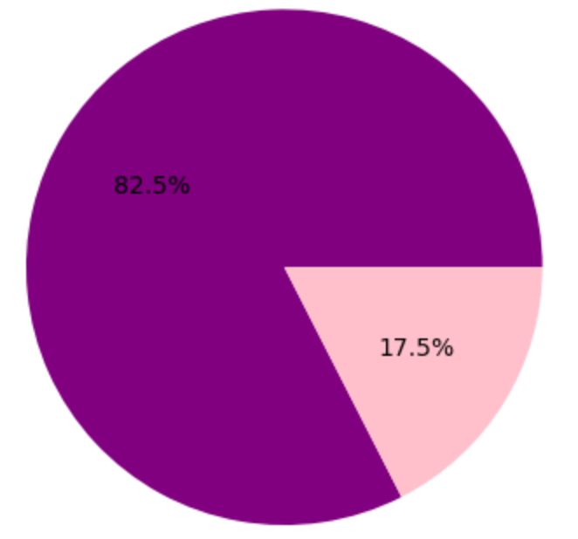
Gender distribution of sales
The gender distribution is not uniform across all products
Overall ratio of men vs women
TM195
TM498
TM798
• More women than expected buy TM498 and TM195
• Fewer women than expected buy TM798
Recommendation:
• CardioGoodFitness should explore how to increase the sales of TM798 among women e.g. rebranding or targeted marketing
Notes:
So, into the Gender Dist of Sales…
Overall, the ratio across all 3 products leans in favour of men with 57.8% of men making purchases versus 42.2% of buyers being women.
We can see that there is an even split in the base-model TM195 and a fairly even split in the mid-range 498 product.
Where we see a significant difference is in the high end TM798 product where men make up the majority of purchases and only 17.5% of purchases were made by women. Clearly there is an opportunity here to increase the sales to women.
We would recommend to CGF that they should explore ways to increase the sales of TM798 to women to level out the ratio here in line with their other products, perhaps through rebranding or a targeted marketing campaign

Slide 9
Conclusion
Support CardioGoodFitness growth
The Current Situation…
TM195 and TM498 customers are similar
TM798 is not popular amongst women
CardioGoodFitness can increase profits:
→ Phasing out TM195
→ Improving the appeal of TM798 among women by rebranding or targeted marketing
Notes:
To conclude, we can see that, currently, TM195 shares the same customer profile as TM498 and that TM798 is not as popular amongst women.
We believe that there is scope to increase profits. The strategies of which are twofold.
One – they can phase out the baseline 195 model - as the customer profile is similar to the 498 model, there is a loss of revenue as currently customers are buying the cheaper option. By removing this option, the 498 will become the new baseline that future customers will buy, and this will result in higher profits.
Secondly – if CGF improve the appeal of model 798 amongst women, by rebranding or more targeted marketing towards women, this will lead to more women purchasing the high-end product and will drive up profits.
This concludes our presentation, thank you for listening and we would like to open the floor for any questions. ☺

