Slide 1
AGAPAI · THESIS PRESENTATION
Spatiotemporal Pipeline
Location retrieval • Date/time retrieval • Event clustering
Current pipeline: extraction, validation, metadata fallback, and event grouping
Presenter: [Your name] | [Course / panel / date]
POSTS → LOCATION + TIME → EVENT GROUPS
AgapAI · Spatiotemporal Pipeline
01 / 14

Slide 2
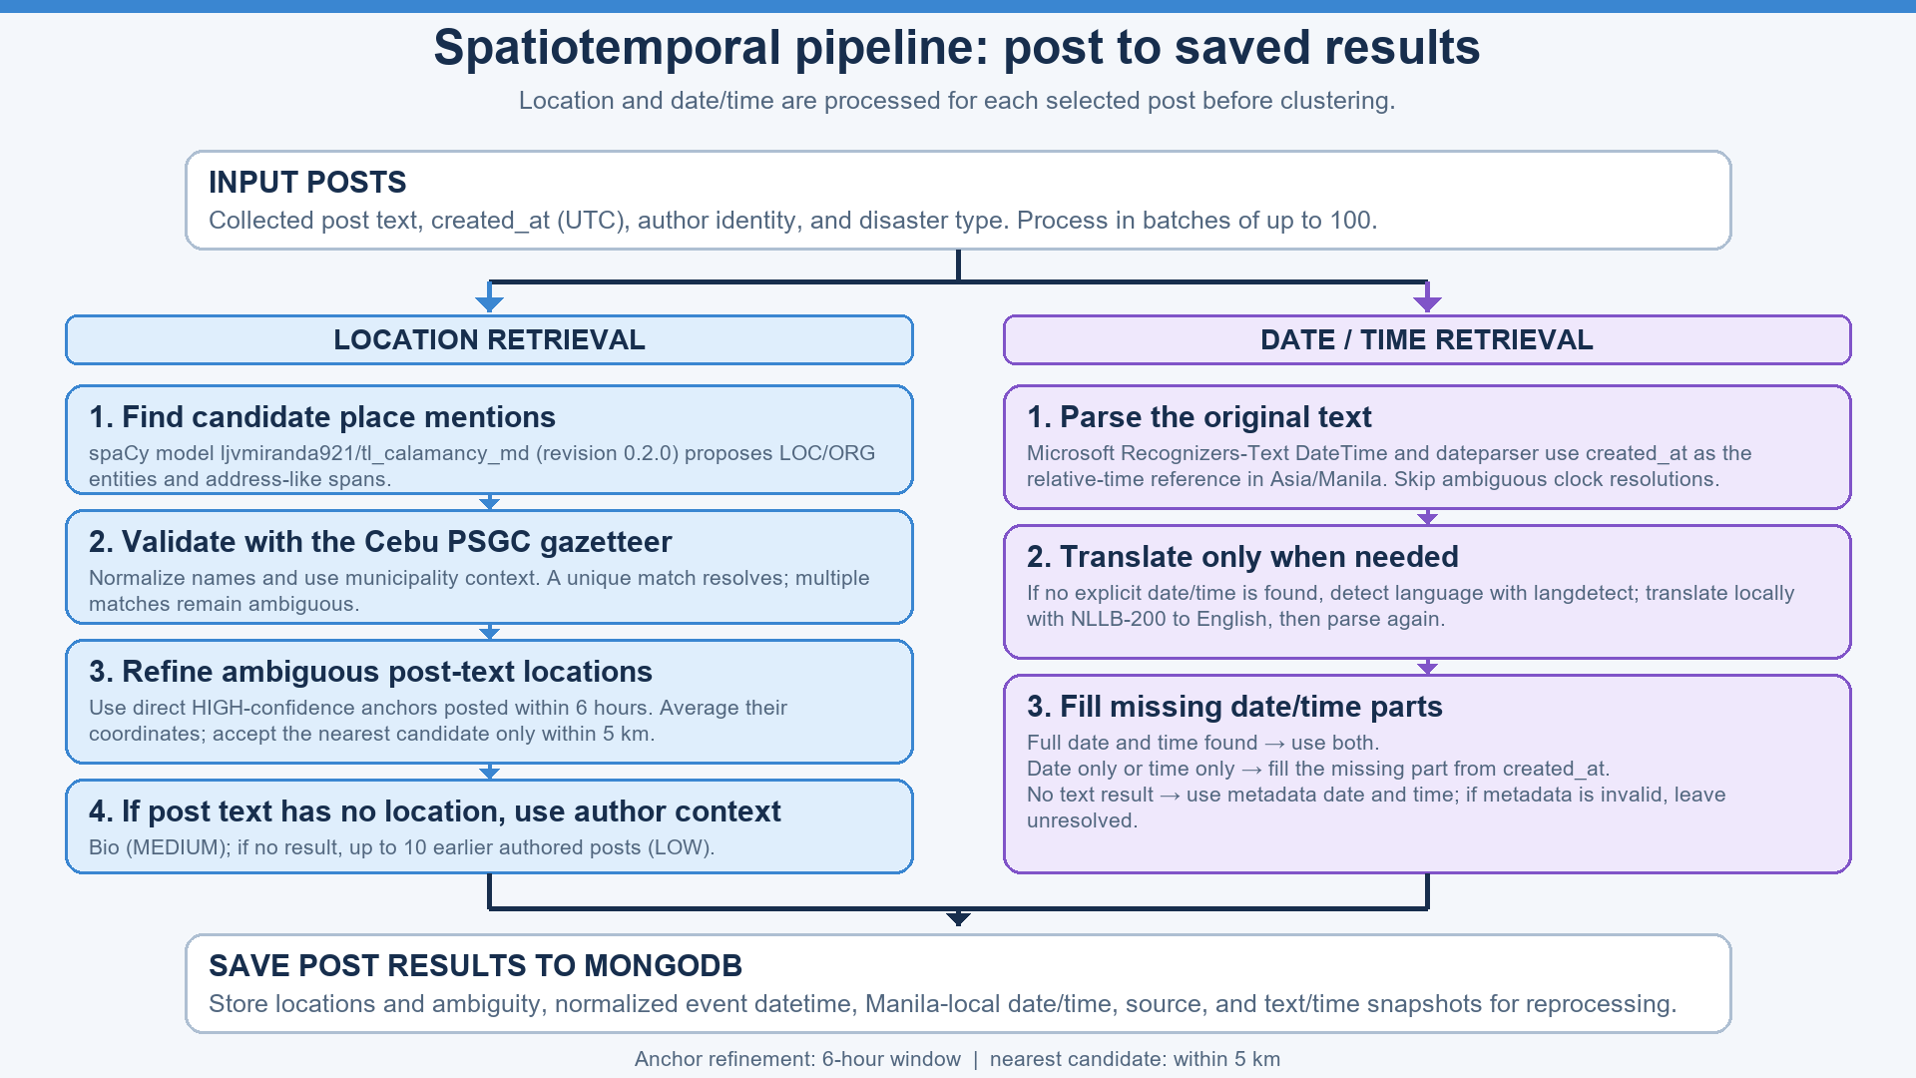
PIPELINE FLOW
From posts to event summaries
• Select posts already collected in MongoDB.
• Process up to 100 posts per batch.
• Extract and save validated locations and event date/time.
• Cluster eligible located posts and return rows and events to the dashboard.
KEY POINT
Location and date/time are processed for each post before event grouping.
PROCESS ORDER
Select → extract → validate → save → cluster → display.
AgapAI · Spatiotemporal Pipeline
02 / 14

Slide 3
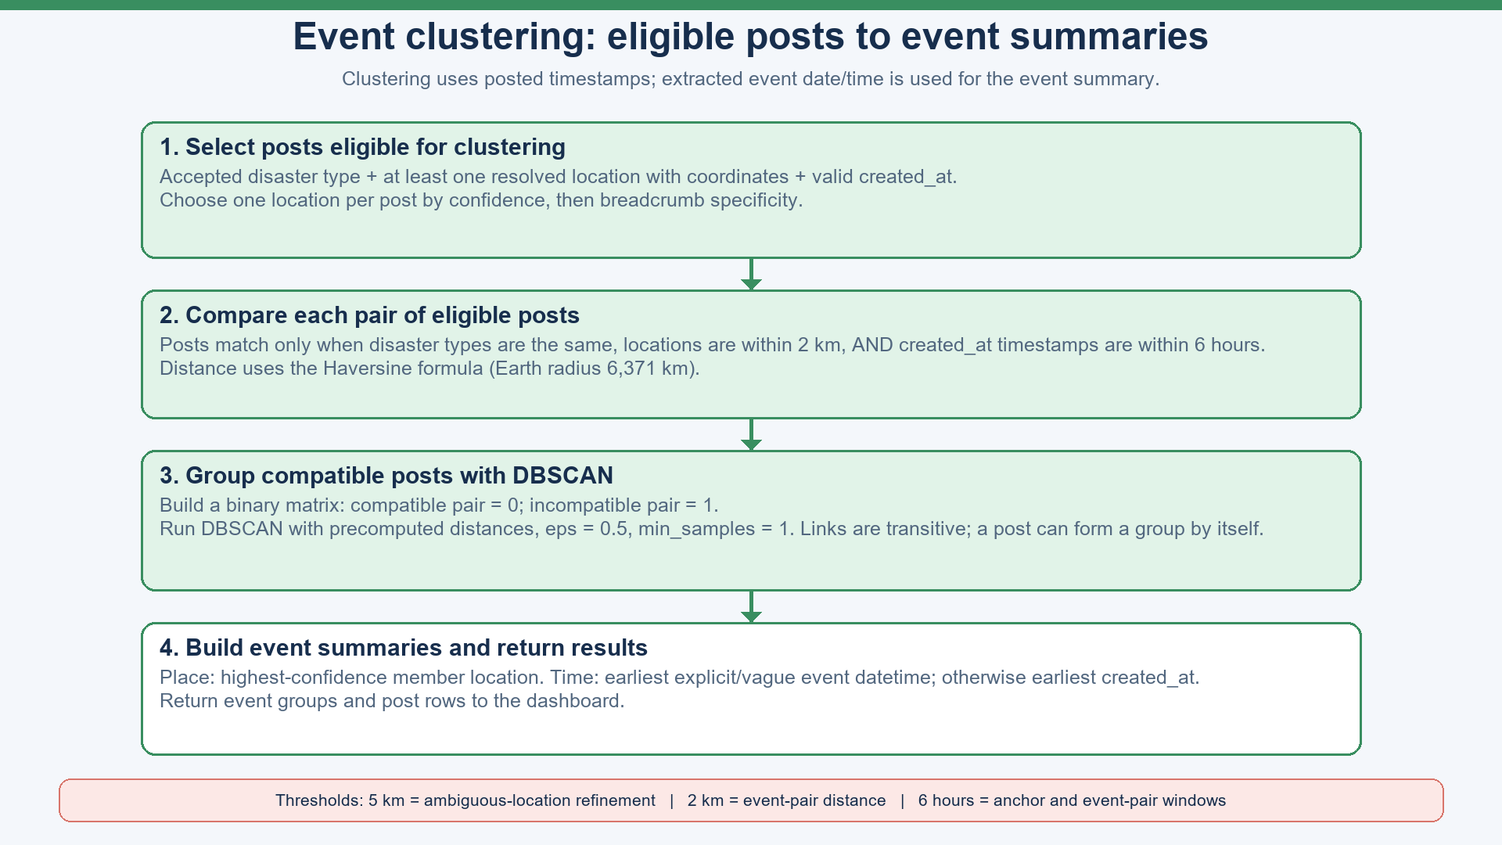
INPUT → PROCESS → OUTPUT
How each post is processed
• Input: post text, created_at, author identity, and upstream disaster type.
• Process: extract location candidates, validate them, and parse event date/time from text.
• Fallbacks: use bio/history only when post text has no location; use created_at for missing or unparsed time.
• Output: save location/time results and provenance; snapshots detect changed posts for reprocessing.
LOCATION FLOW
Post text → gazetteer → optional bio/history or nearby-anchor check.
DATE/TIME FLOW
Original text → Recognizers-Text/dateparser → translation if needed → metadata fallback.
AgapAI · Spatiotemporal Pipeline
03 / 14

Slide 4
LOCATION 1 · CANDIDATES
Find possible place mentions
• spaCy model: ljvmiranda921/tl_calamancy_md, revision 0.2.0.
• Collect model entities labelled LOC or ORG.
• Also build spans from proper nouns and address-like grammatical relations.
• Candidate spans still require gazetteer validation before becoming locations.
GRAMMAR CUES
Relations include oblique, noun modifier, compound, apposition, coordination, and list.
IMPORTANT
The model proposes text spans. It does not provide final PSGC identity or coordinates.
AgapAI · Spatiotemporal Pipeline
04 / 14

Slide 5
LOCATION 2 · GAZETTEER
Match candidates to Cebu place records
• Cebu PSGC gazetteer provides official names, types, parents, coordinates, and codes.
• Normalize case, hyphens, and whitespace before lookup.
• Check the full candidate; otherwise use the longest known place phrase inside it.
• Use municipality context to narrow matches; retain unresolved candidates as ambiguous.
ALIASES
Municipality aliases are derived from official names and administrative metadata.
RESULT
One match resolves. Multiple matches remain visible for review.
AgapAI · Spatiotemporal Pipeline
05 / 14

Slide 6
LOCATION 3 · AUTHOR CONTEXT
Use location sources in order
• Post text first: HIGH confidence.
• If the post has no resolved or ambiguous place, check the author bio: MEDIUM.
• If the bio has no result, check up to 10 earlier authored posts: LOW.
• Earlier posts must be by the same author and strictly before the target post.
STOP RULE
A resolved or ambiguous post-text result stops the bio/history fallback.
HISTORY
The target and duplicates are excluded; empty posts still count toward the limit of 10.
AgapAI · Spatiotemporal Pipeline
06 / 14

Slide 7
LOCATION 4 · SPATIAL REFINEMENT
Resolve an ambiguous place using nearby anchors
• First pass collects direct HIGH-confidence gazetteer locations.
• Second pass checks ambiguous posts against anchors within 6 hours.
• Average anchor coordinates; select the nearest candidate only if it is within 5 km.
• If no candidate qualifies, keep the location ambiguous.
5 KM RULE
This resolves one place candidate. It is separate from the 2 km event-pair rule.
CONFIDENCE NOTE
Centroid method is recorded; current code leaves confidence/source defaults unchanged.
AgapAI · Spatiotemporal Pipeline
07 / 14

Slide 8
DATE/TIME 1 · ORIGINAL TEXT
Name the date and time parsers
• Microsoft Recognizers-Text DateTime: recognizers-text-date-time 1.0.2a2.
• Recognizers-Text runs with Culture.English and a post-time reference.
• dateparser 1.4.3+: search_dates and DateDataParser parse matched expressions.
• Ambiguous clock resolutions are skipped rather than guessed.
DATEPARSER SETTINGS
Asia/Manila timezone, timezone-aware results, past-date preference, and relative base.
RANGE RULE
Cross-calendar-day ranges are rejected; accepted same-day ranges use that date.
AgapAI · Spatiotemporal Pipeline
08 / 14

Slide 9
DATE/TIME 2 · LANGUAGE FALLBACK
Detect language and translate locally
• Language detector: langdetect.
• Translation model: NLLB-200, facebook/nllb-200-distilled-600M.
• Translate to English locally, then run the same date/time parsers again.
• Translation runs when original text has no explicit time or datetime result.
LANGUAGE CODES
English → eng_Latn; Tagalog → tgl_Latn; other detections default to Cebuano.
LIMIT
langdetect has no distinct Cebuano class; short or mixed-language text can be misdetected.
AgapAI · Spatiotemporal Pipeline
09 / 14

Slide 10
DATE/TIME 3 · COMPLETE THE RESULT
Use metadata for missing components
• Full date and time recognized → use both extracted components.
• Date only → fill time from created_at; time only → fill date from created_at.
• No parseable expression → use metadata date/time; no valid metadata → unresolved.
• Relative phrases use the post timestamp in Asia/Manila as their reference.
EXAMPLE
If “yesterday” is recognized for a June 26 PHT post, the event date is June 25.
NO PHRASE LIST
There is no hand-written temporal vocabulary; libraries parse the original or translated text.
AgapAI · Spatiotemporal Pipeline
10 / 14

Slide 11
SAVED POST RESULTS
Store values and their sources
• ner_datetime stores provenance and phrase/resolution details or fallback information.
• ner_datetime_source: explicit, vague_date, fallback, or unresolved.
• ner_event_datetime stores the normalized instant; event_date/time are Manila-local strings.
• The table uses saved date/time first, then event datetime, then posted metadata.
WHY STORE SOURCES
It shows whether a result came from text, translation, or metadata fallback.
TIMEZONE
created_at is normalized to Asia/Manila for local interpretation and display.
AgapAI · Spatiotemporal Pipeline
11 / 14

Slide 12
CLUSTERING 1 · ELIGIBLE POSTS
Select posts with enough information to compare
• Disaster type must be flood, earthquake, typhoon, fire, or landslide.
• At least one location must be resolved to coordinates.
• A valid created_at timestamp is required.
• Choose one location per post by confidence, then breadcrumb specificity.
EXCLUDED
Posts with ambiguous-only locations or invalid posting times do not enter clustering.
DATE/TIME ROLE
Text-extracted event time helps the summary; created_at controls pair matching.
AgapAI · Spatiotemporal Pipeline
12 / 14

Slide 13
CLUSTERING 2 · MATCH AND GROUP
Apply pair rules, then run DBSCAN
• Pair match requires the same disaster type, distance ≤ 2 km, and posted-time difference ≤ 6 h.
• Haversine distance uses Earth radius 6,371 km.
• Binary matrix: compatible pair = 0; incompatible pair = 1.
• DBSCAN: precomputed distances, eps 0.5, min_samples 1.
GROUP BEHAVIOR
Links are transitive: A–B and B–C can join even if A–C does not match.
SINGLE POSTS
min_samples=1 allows an eligible post to form a cluster by itself.
AgapAI · Spatiotemporal Pipeline
13 / 14

Slide 14
EVENT SUMMARY AND DISPLAY
Choose a representative place and time
• Event location comes from the member with the highest location confidence; coordinates are not averaged.
• Event time uses the earliest explicit/vague event datetime when available.
• If none exists, use the earliest posted created_at timestamp.
• Return event summaries and post rows for the table, event list, and map.
MEMBERSHIP VS SUMMARY
Extracted dates do not change group membership; type, distance, and posted time do.
EVENT IDS
IDs such as event-0 are generated for the response, not saved as permanent event records.
AgapAI · Spatiotemporal Pipeline
14 / 14

