Slide 1

Benchmarking Message Brokers for IoT-Edge
Computing: A Comprehensive Performance Study
(Journal Extension Plan)
Tapajit Chandra Paul¹, Pawissanutt Lertpongrujikorn¹, Hai Duc Nguyen², and Mohsen Amini Salehi¹
¹High Performance Cloud Computing (HPCC) Lab, University of North Texas, USA
²Argonne National Laboratory and University of Chicago, USA
Notes:
-

Slide 2
Proposed Extension: Beyond 1-to-1 Steady Load
Goal
  Extend the benchmark from isolated pairwise communication to shared-topic, various topology and dynamic workloads
Why this matters
  Real IoT systems are rarely pure 1-to-1
  Many applications use aggregation or broadcast
  Steady-rate benchmarks miss behavior under traffic spikes
  We want to study both topology effect and traffic dynamics
Four new experiments
  Exp 1: Fan-out under steady load → replication efficiency
  Exp 2: Fan-in under steady load → aggregation efficiency
  Exp 3: Bursty fan-out (under dynamic traffic) → overload and recovery behavior
  Exp 4: Bursty fan-in (under dynamic traffic)

Slide 3
Why extension? (hidden)
Why?
  Current paper studies isolated 1-to-1 steady load
  Extension studies shared-topic workloads
  Extension also studies dynamic traffic

Slide 4
Experiment 1: Fan-Out Under Steady Load
Research question
  How efficiently can each broker replicate shared-topic messages to many subscribers?
Topology
  P publishers → broker → S subscribers
  All publishers publish to the same topic
  All subscribers subscribe to the same topic
Publisher scaling rule
  P = max(1, ceil(S / 100))
  use 1 publisher per 100 subscribers
Suggested subscriber scales
  S = 500, 1000, … , 5000
  then publishers become: 5, 10, 20, … , 50
Notes:
Feedback needed: Is 1:100 the right primary ratio, or should we also test 1:10 and 1:20?

Slide 5
Use cases of Fan-Out Topology
Industrial control-state dissemination
  one supervisory controller distributes setpoints, schedules, or control parameters to many machines on the shop floor
Plant-wide configuration updates
  one management service pushes configuration or policy changes to many gateways and devices
Operational dashboard distribution
  one analytics service publishes processed plant status to many operator consoles and local applications

Slide 6
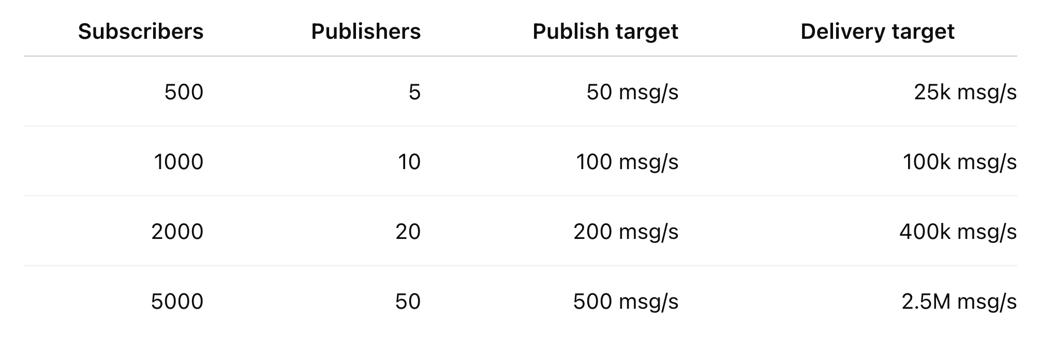
Experiment 1: Fan-Out Under Steady Load
Offered load
  Publish throughput target = P × 10
  Delivery throughput target = P × 10 × S
Metrics
  Delivery Throughput
  Latency
  CPU Utilization
  Memory footprint
  Network overhead / bandwidth usage
Use Cases
  Industrial controller sends setpoints to many machines
  Management service pushes configuration to many gateways
  Analytics service distributes plant status to dashboards

Slide 7
Fan-Out: What We Expect
Expect to see
  Delivery overhead rises with subscriber count
  CPU rises quickly
  Latency rises at high fan-out
  Multi-threaded brokers scale better
  Single-threaded brokers saturate earlier
We learn
  Which brokers are best for broadcast
  Cost of message replication
  Whether 1-to-1 strength also helps in fan-out

Slide 8
Results (Throughput)
(4 vCPU, 8 GB RAM)

Slide 9
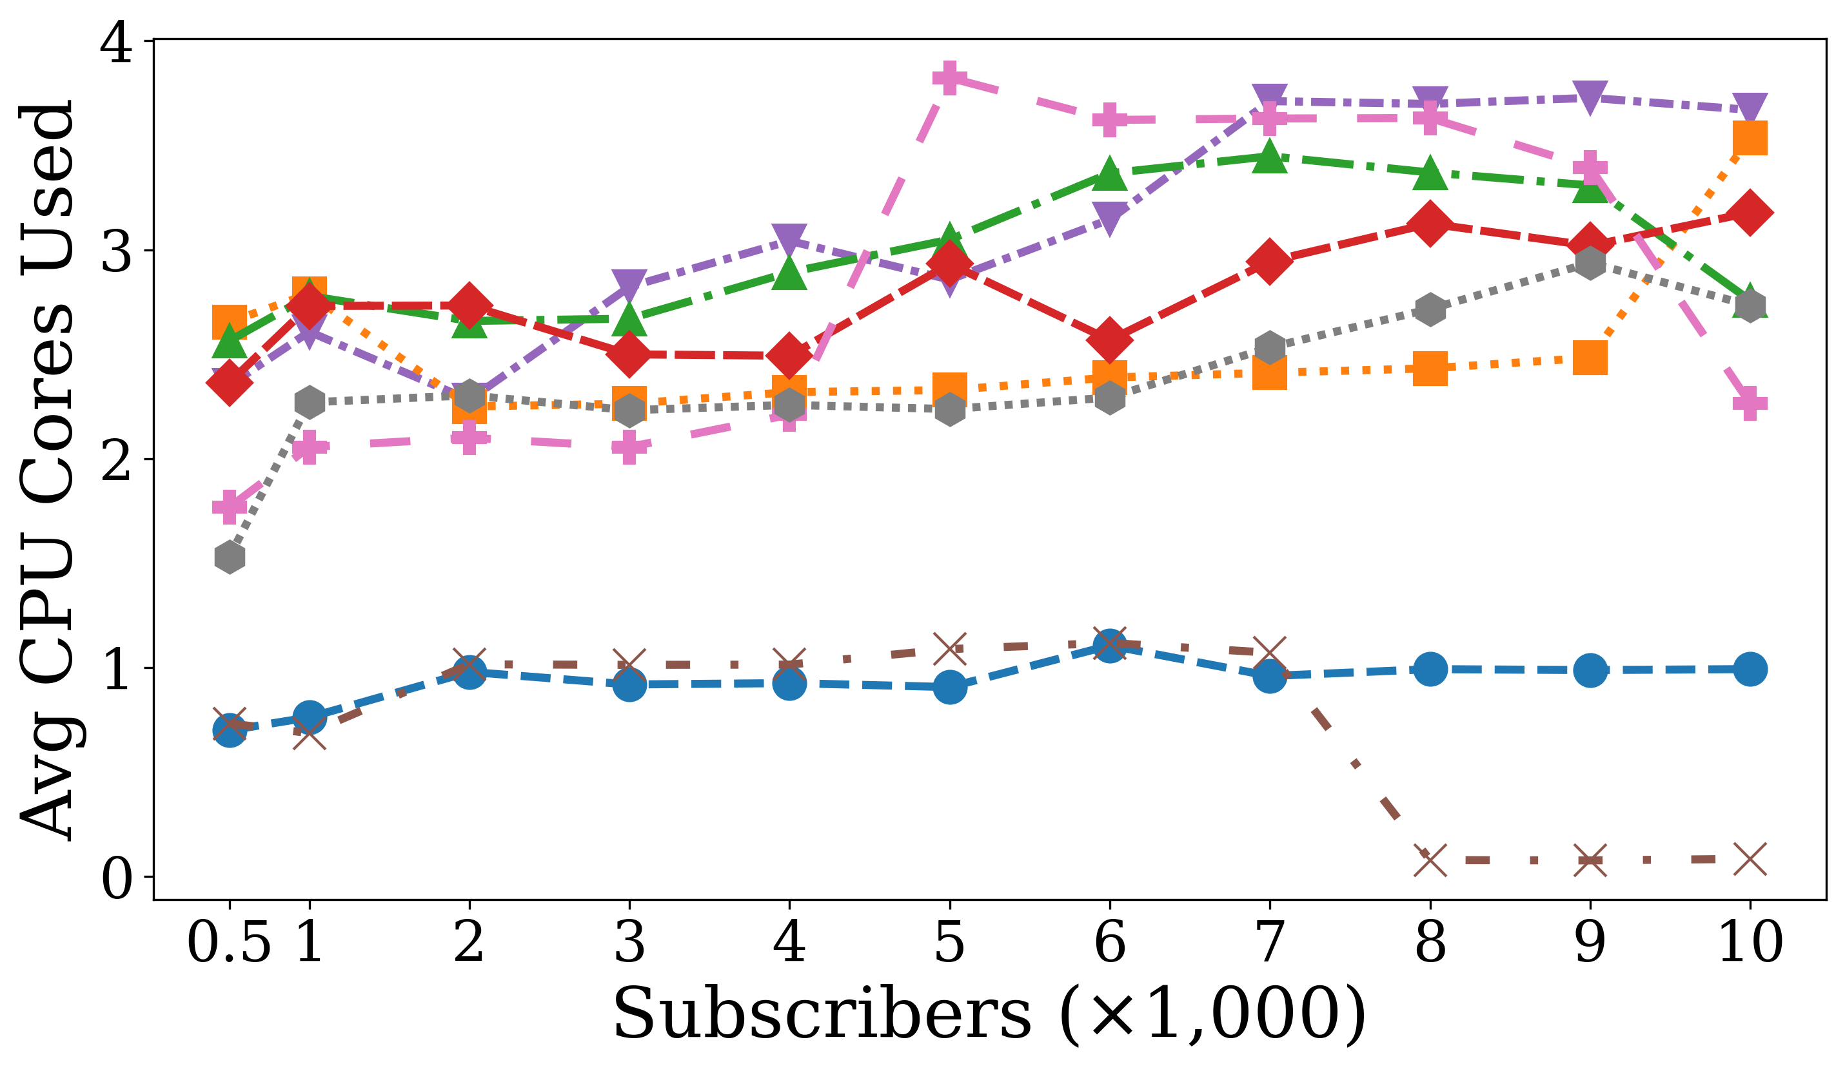
Results (CPU)
(4 vCPU, 8 GB RAM)

Slide 10
Results (Memory)
(4 vCPU, 8 GB RAM) (hidden)

Slide 11
Why Network Bandwidth for fan-out (hidden)
Fan-out replicates messages to many subscribers
Network cost naturally grows in Fan-out
This is where “bytes on wire” is most meaningful

Slide 12
Why 1 Publisher per 100 Subscribers? (hidden)
Why not only 1 publisher?
  less realistic for practical deployments
  may under-stress ingress
  may overemphasize one client’s limits
Why 1:100 makes sense, because:
  keeps the experiment primarily fan-out
  introduces just enough ingress diversity
  aligns nicely with the original study’s scale
  easy to explain and reproduce

Slide 13
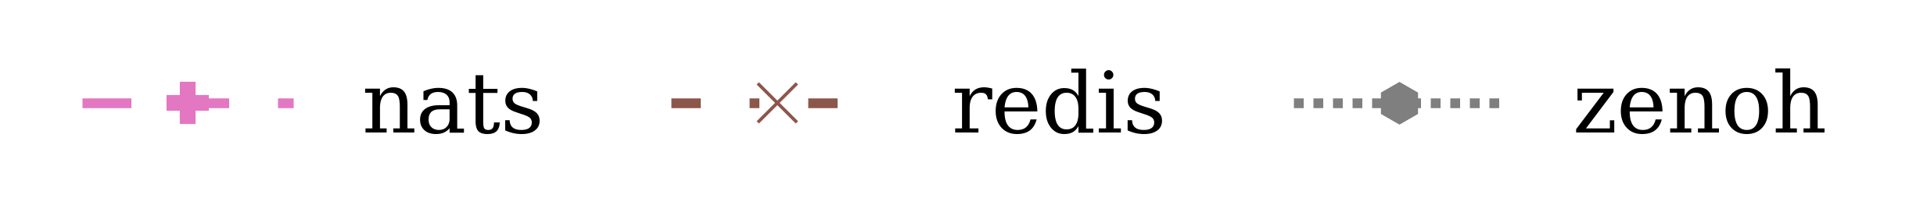
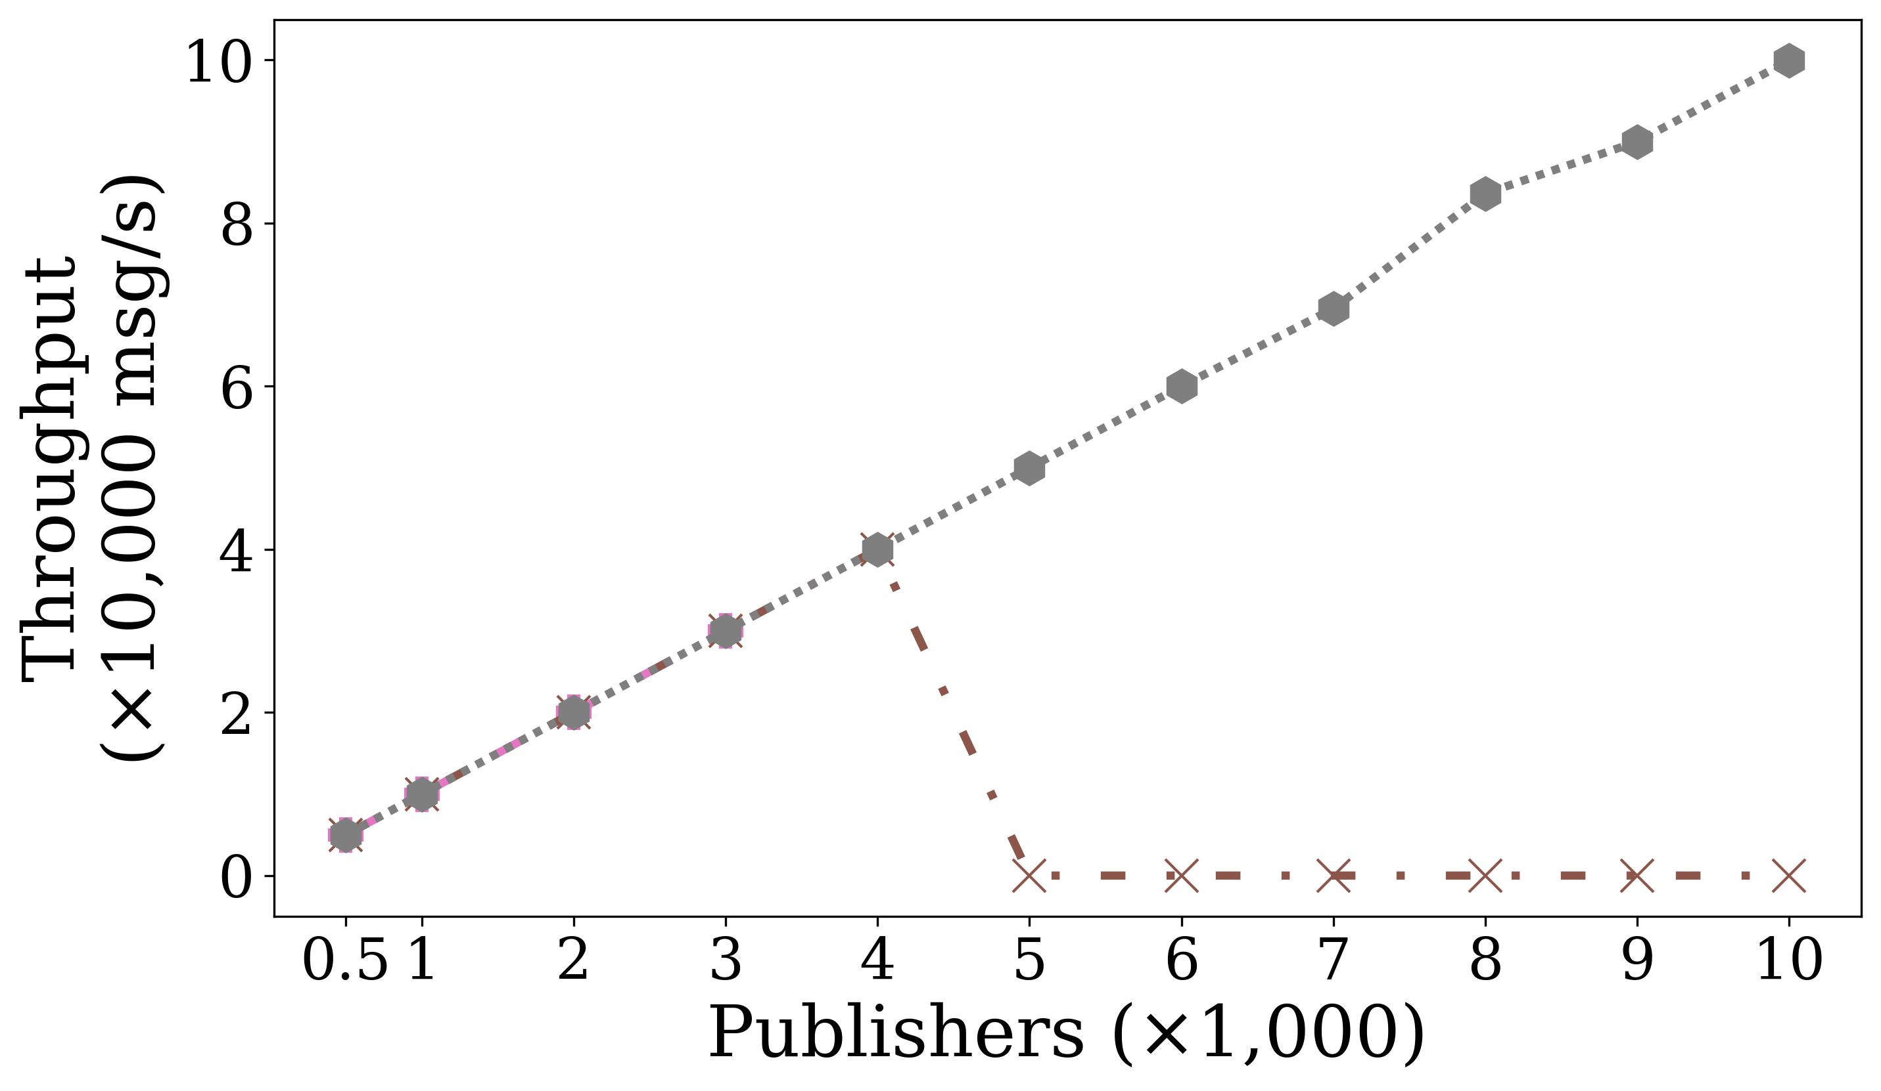
Fan-In Initial Results (hidden)

Slide 14
Experiment 2: Fan-In Under Steady Load
Research question
  How does performance change when many publishers send to one shared topic instead of isolated 1-to-1 pairs?
Topology
  N publishers → broker → 1 subscriber
  All publishers publish to the same topic
Why this experiment
  isolates the effect of shared-topic aggregation
  keeps traffic steady
  directly comparable to the current throughput experiment
Notes:
The problem is not correctness; the problem is that it mixes aggregation with replication, so the results become harder to explain. For the main paper, 1 subscriber gives the cleanest fan-in result. A few subscribers are better as a secondary sensitivity study.
Topology
N publishers → 1 subscriber
All publishers publish to the same topic

Slide 15
Use cases of Fan-In Topology
Sensor aggregation at an edge gateway
  many IoT devices continuously send telemetry to one collector for monitoring and analytics
Fleet or robot status collection
  many distributed agents report health, position, or state updates to a central controller
Industrial data ingest
  multiple machines publish measurements to a shared stream for local processing

Slide 16
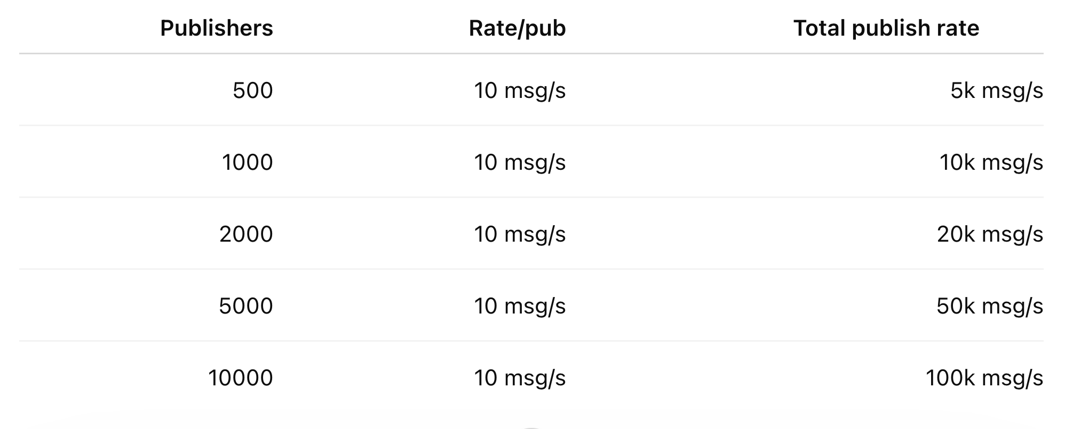
Experiment 2: Fan-In Under Steady Load
Parameters
  Publishers: 500, 1000, 2000, 5000, 10000
  Subscriber: 1
  Rate per publisher: 10 msg/s
  Payload: 1 KB
  Duration: 120 s
  Warmup: 60 s
  QoS: 0
Metrics
  Delivery Throughput
  CPU Utilization
  Memory footprint
  Latency
  Network Bandwidth
Use Cases
  Sensor aggregation: Many devices send telemetry to one edge gateway.
  Fleet status collection: Robots or distributed agents report state to one controller.
  Industrial data ingest: Machines publish measurements to one local processing stream.

Slide 17
Fan-In: What We Expect
Expect to see
  Fan-in is cheaper than fan-out
  Throughput still drops vs 1-to-1
  Shared-topic contention increases
  CPU rises with publisher count
  Latency rises gradually
We learn
  Which brokers are best for aggregation
  Cost of hot shared-topic ingest
  Whether ingress or topic handling is the bottleneck

Slide 18
Experiment 3: Bursty Controlled Fan-Out
Research question
  How do brokers behave when one-to-many dissemination is combined with bursty traffic and recovery periods?
Topology
  20 publishers → broker → 2000 subscribers
Why this experiment
  Exp 1 shows steady-state fan-out behavior
  Exp 3 adds transient overload
  this is closer to alarms, event bursts, and sudden telemetry spikes

Slide 19
Experiment 3: Bursty Controlled Fan-Out
Research question
  How do brokers behave when one-to-many dissemination is combined with bursty traffic and recovery periods?
Topology
  Same as Exp 1
  P publishers → S subscribers
  shared topic
  P = max(1, ceil(S / 100))
  S = 1000
Why this experiment
  Exp 1 shows steady-state fan-out behavior
  Exp 3 adds transient overload
  this is closer to alarms, event bursts, and sudden telemetry spikes

Slide 20
Use cases of Bursty Fan-Out Topology
Emergency alert dissemination
  one event suddenly triggers notifications to many receivers at once
Intrusion or alarm broadcast
  a monitoring system pushes urgent alerts to multiple downstream systems simultaneously
Traffic / airspace advisory push
  a sudden event causes one publisher to send time-sensitive updates to many consumers

Slide 21
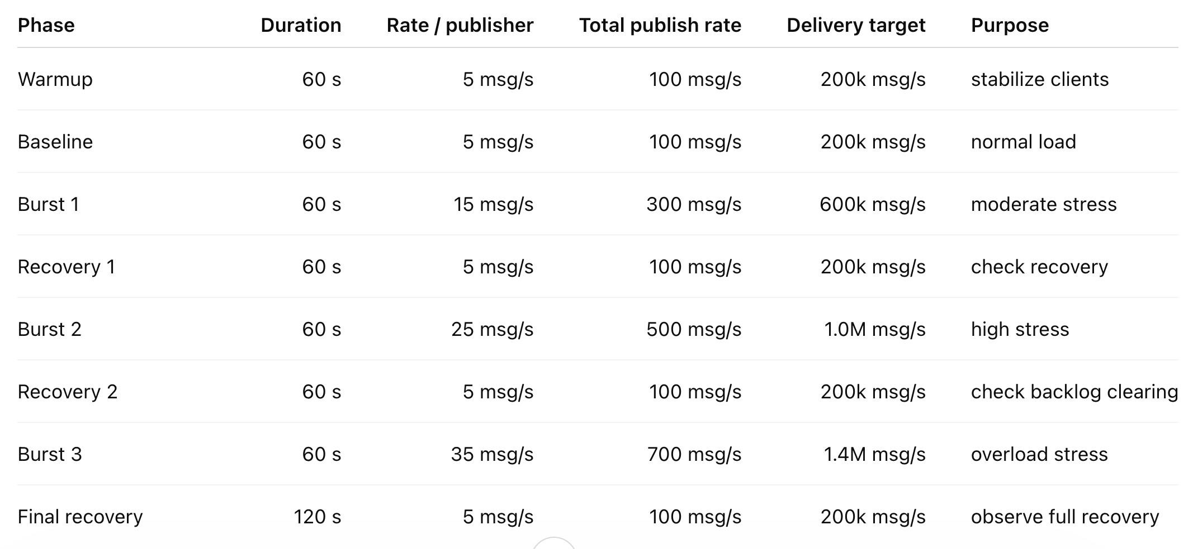
Experiment 3: Bursty Traffic Profile
Traffic phases
  Warmup: 60 s @ 10 msg/s per publisher
  Loll: 60 s @ 10 msg/s per publisher
  Burst: 120 s @ 30 msg/s per publisher
  Recovery: 60 s @ 10 msg/s per publisher
Metrices:
  Delivery Throughput
  CPU Utilization
  Memory Usage
  Latency
  Network Bandwidth
Notes:
For experiment 3: Bursty Traffic Profile, we want to have multiple burst or multiple of each phases,
warmpu-> Loll -> Burst -> Recovery -> Burst -> Recovery -> Burst

Slide 22
Exp 4: Payload Sensitivity in Shared-Topic Workloads
Research question
  How does message payload size affect broker performance in shared-topic communication patterns such as fan-in and fan-out?
Why this experiment?
  Previous paper studied payload size only in small-scale latency tests
  This experiment checks whether broker rankings change when payload size and shared-topic topology interact
Topologies
  Fan-Out: 10 publishers → 1000 subscribers, shared topic
  Fan-In: 1000 publishers → 1 subscriber, shared topic

Slide 23
Payload Sensitivity in Shared-Topic Workloads
Common parameters
  Rate per publisher: 10 msg/s
  Duration: 120 s
  Warmup: 60 s
  QoS: 0
  Metrics: p95 Latency
Example Use Cases
  Small telemetry
  Temperature, humidity, status flags.
  Rich industrial messages
  Diagnostics, metadata, alarms, state snapshots.

Slide 24
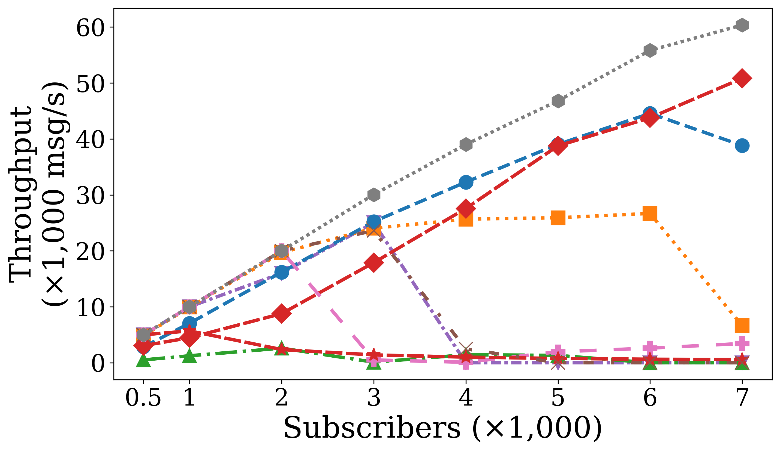
Fan Out Results (Throughput)
(4 vCPU, 8 GB RAM)
Notes:
Make length a little bigger
Instead of time, ignore messages (first 100)
Make Message based
First 10 message for every pub
Don’t stop the subscribers -> to make stop the message loss
Try various/different ratio: 1:10, 1:20
Why RabbitMQ is consuming
Connect the hypothesis to number/evidence

Slide 25
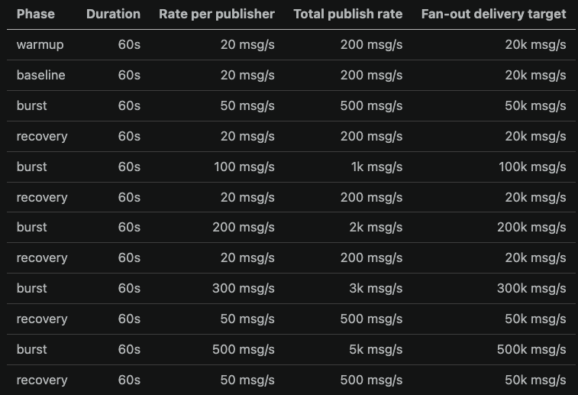
Bursty Fan Out
Experimental Setup
4 vCPU, 8 GB RAM
Subscriber: 1000, Publisher: 10

Slide 26
Use cases of Bursty Fan-Out Topology
Mobile IoT devices with unstable wireless links
Edge gateways temporarily losing connectivity
Disaster-response sensors moving in and out of coverage
Industrial devices that sleep, reconnect, and resume receiving data

Slide 27
Delivery Throughput (MQTT Brokers)
Notes:
If we plot all the brokers in the same graph, is it going to be convulated?
--rate-profile "warmup:60:5,baseline:60:5,burst:120:25,recovery:60:5, ,burst:60:25"

Slide 28
CPU Usage (MQTT Brokers)

Slide 29
Memory Usage (MQTT Brokers)

Slide 30
Delivery Throughput
Non-MQTT Brokers
MQTT Brokers
Notes:
If we plot all the brokers in the same graph, is it going to be convulated?
--rate-profile "warmup:60:5,baseline:60:5,burst:120:25,recovery:60:5, ,burst:60:25"

Slide 31
CPU Usage (non-MQTT Brokers)

Slide 32
Memory Usage (non-MQTT Brokers)

Slide 33
Analysis
NATS performed best overall, sustaining ~10M fan-out msg/s with <1% loss, ~3.3 cores CPU, and only ~123 MiB average memory.
Zenoh scaled cleanly to ~2M msg/s, then throughput plateaued around ~3.4M msg/s while loss and latency increased sharply.
Redis was stable up to ~1M msg/s, but CPU saturated near 4 cpu cores that and throughput stayed around ~2.0M msg/s.
Across all three, CPU rises with throughput until saturation; after that, extra load mainly becomes latency and loss.
Memory stayed relatively low overall, with increases mainly during overload/backlog phases rather than normal scaling.

Slide 34
Experiment 4: MQTT Message Recovery under Intermittent Connectivity
Research question
  When subscribers disconnect temporarily, how much data can MQTT persistent sessions recover after reconnect?
Topology
  20 publishers → broker → 2000 subscribers
Why this experiment
  Real IoT devices often disconnect briefly
  MQTT has built-in session persistence

Slide 35
MQTT Message Recovery for Intermittently Powered Batteryless IoT
Core idea:
Batteryless IoT devices are not always online or offline. Their real availability is usually somewhere between 0 and 1 because they repeatedly power on, lose energy, recharge, and reconnect.

Slide 36
Why this experiment?
Batteryless node life cycle
Harvest
energy
Power ON
+ connect
Receive
messages
Power OFF
+ unavailable
Energy
depleted
Research gap
Previous experiments mostly answer:
This experiment tries to answer:
“How fast can the broker deliver messages when clients remain connected?”
“Can the communication semantics maintain continuity when the device repeatedly disappears?”

Slide 37
Why availability matters
Batteryless devices depend on harvested energy.
Small energy buffers cause frequent power loss.
Devices may miss messages while powered off.
MQTT persistent sessions may help recover those missed messages.

Slide 38

Key Concepts
Device Availability Ratio (DAR) represents the fraction of an operating cycle during which the intermittently powered IoT device is active and capable of communication.
Examples:
  1.0 = always powered
  0.75 = mostly available
  0.50 = intermittently available
  0.25 = mostly unavailable
  Real batteryless IoT is mainly in the middle region, not only 0 or 1.

Slide 39
Experiment Design
Each level repeats the same ON/OFF rhythm several times during a run. (Cycle Length: 100s)
80s -> ON
20s -> OFF
Pick a time randomly when to turn the device OFF
Availability | ON window | OFF window
100% | Always ON | 0s OFF
80% | 80s ON | 20s OFF
60% | 60s ON | 40s OFF
40% | 40s ON | 60s OFF
20% | 20s ON | 80s OFF
ON
OFF
Notes:
Fix ON and OFF duration
Start with the uniform one

Slide 40
Topology
Publisher 1
100 topics
Subscriber 1
topic/device/0001
MQTT
Broker
Publisher …
Subscriber … • unique topic
Publisher 10
100 topics
Subscriber 1000 topic/device/1000
10 stable publishers
1000 intermittently powered subscribers
1000 unique topics
Each subscriber subscribes to 1 topic
Each publisher owns 100 topics

Slide 41
Message Generation Configuration
Parameter | Primary value
Subscribers / topics | 1000 / 1000
Publishers | 10
Payload | 128 B
Rate per topic | 2 msg/s
Aggregate publish rate | 2,000 msg/s
Traffic pattern | Constant-rate
Retained flag | False
Publisher availability | Always online

Slide 42
Modes
Mode | Publish QoS | Subscribe QoS | Clean Session | Purpose / expected behavior
Control A | 0 | 0 | True | Best-effort baseline; messages during outage are lost
Control B | 1 | 1 | True | Reliable while connected; no offline-session recovery
Target | 1 | 1 | False | Persistent session; eligible offline messages should be queued
CONTROL A
CONTROL B
TARGET
QoS 0 + Clean
QoS 1 + Clean
QoS 1 + Persistent
Separates best-effort loss from persistence behavior.
Shows that QoS alone does not preserve offline messages.
Same Client ID after restart; broker maintains session state.

Slide 43
Outage Design
OFF duration = 100 × (1 − DAR)
ON duration = 100 × DAR
DAR | OFF / cycle | ON / cycle | Random OFF start
100% | 0 s | 100 s | No outage
80% | 20 s | 80 s | U(5, 75) s
60% | 40 s | 60 s | U(5, 55) s
40% | 60 s | 40 s | U(5, 35) s
20% | 80 s | 20 s | U(5, 15) s
U(a, b) s: Randomly select the outage start time between a s and b s within each 100 s cycle.
Example — 60% DAR, one subscriber
ONLINE
OFFLINE (40s(
ONLINE
WARM-UP
CYCLE 1
CYCLE 2
CYCLE 3
FINAL DRAIN
60 s
0–100 s
100–200 s
200–300 s
120 s
All online
Random outage/client
Random outage/client
Random outage/client
All online • publishing stopped

Slide 44
Three independent runs
Use three fixed random seeds. A seed generates the complete 1000-subscriber × 3-cycle outage schedule.
Seed 1
Run 1
Seed 2
Run 2
Seed 3
Run 3
Schedule matrix A
Schedule matrix B
Schedule matrix C
1000 clients × 3 outages/client
1000 clients × 3 outages/client
1000 clients × 3 outages/client

Slide 45
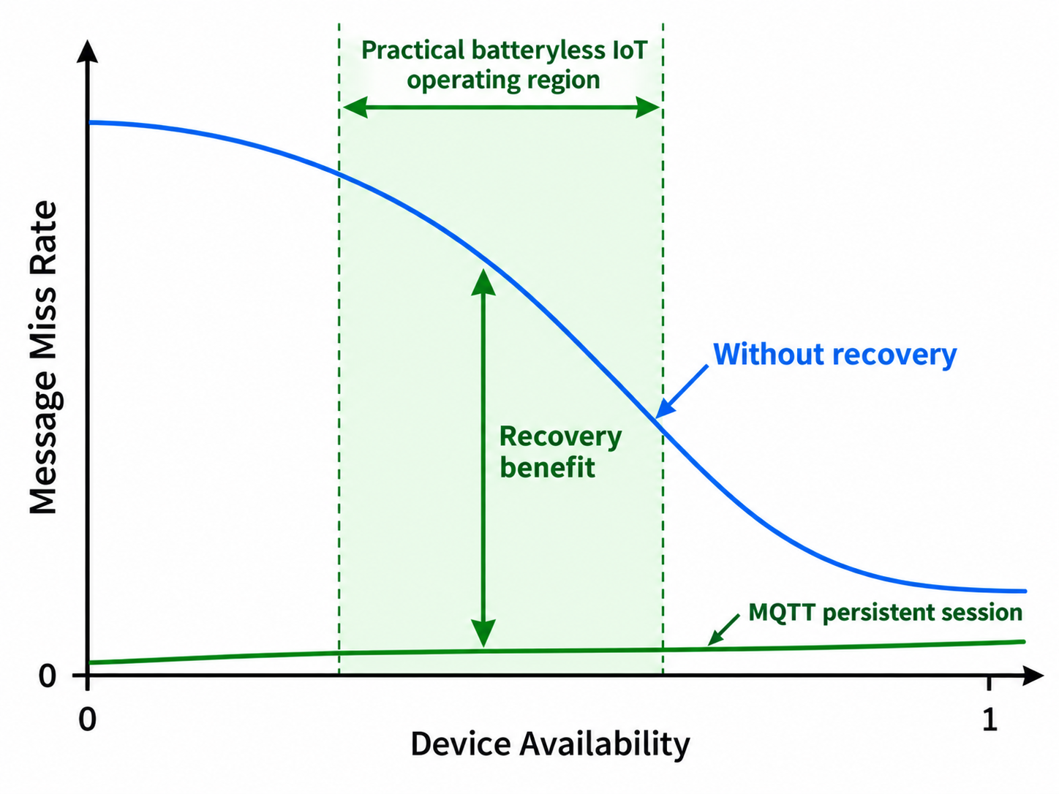

Expected Result
Persistence Recovery Gain:
(PRG)
Device Availability Ratio (DAR)

Slide 46
Clean Session
Clean session = true
  Client connects to the broker.
  When it disconnects, the broker removes its stored session state.
  If messages are published while that subscriber is offline, they are generally not saved for later delivery to that client.
  When the client reconnects, it starts a new session.
Clean session = false
  The broker keeps the client's session after disconnection.
  The client reconnects using the same Client ID.
  With appropriate QoS and subscriptions, the broker can retain messages while the client is offline and deliver them after reconnection.

Slide 47
Experiment 5: Experimental Design
Factor | Levels
MQTT session mode | QoS 0 clean, QoS 1 clean, QoS 1 persistent
Workload level | Moderate, Stress
Session Modes:
Mode | QoS | Clean session | Expected behavior
Control A | 0, 1, 2 | true | Offline messages lost
Control B | 1 | true | QoS helps only while connected
Target | 0, 1, 2 | false | Broker queues and redelivers missed messages
Key idea:
Only the persistent-session mode should recover messages sent while subscribers are offline.
QoS is for normal situation – Mention that
Notes:
For experiment 3: Bursty Traffic Profile, we want to have multiple burst or multiple of each phases,
warmpu-> Loll -> Burst -> Recovery -> Burst -> Recovery -> Burst

Slide 48
Workload Setup
Load | Topics | Payload | Rate/topic | Total rate
Moderate | 200 | 128 B | 2 msg/s | 400 msg/s
Stress | 500 | 128 B | 5 msg/s | 2500 msg/s
Topology
One publisher and one subscriber per topic using multi-dimensional topic mapping.
Notes:
For experiment 3: Bursty Traffic Profile, we want to have multiple burst or multiple of each phases,
warmpu-> Loll -> Burst -> Recovery -> Burst -> Recovery -> Burst

Slide 49
Run Timeline
Phase | Time | Subscriber | Purpose
Baseline | 0–60s | Online | Normal delivery
Offline 1 | 60–90s | Offline | Create backlog
Recovery 1 | 90–150s | Online | Measure catch-up
Offline 2 | 150–180s | Offline | Create second backlog
Recovery 2 | 180–240s | Online | Measure second catch-up
Final drain | 240–300s | Online | Drain queued messages
Notes:
For experiment 3: Bursty Traffic Profile, we want to have multiple burst or multiple of each phases,
warmpu-> Loll -> Burst -> Recovery -> Burst -> Recovery -> Burst

Slide 50
Metrics
Primary metric
  Final delivery ratio
Recovery metrics
  Backlog drain time
  Recovery throughput
  Latency after reconnect
Resource metrics
  Broker memory during offline windows
  Broker CPU during recovery windows
Instead of asking only:
  How fast is the broker?
We are asking:
  What happens/How does the broker performs when IoT connectivity is unreliable?
Notes:
MQTT's value appears in intermittent-connectivity scenarios, where persistent sessions allow disconnected clients to recover missed messages, although that reliability comes with recovery-time, CPU, and memory costs.

Slide 51
Expected Result
Because subscribers are offline for 60s out of 240s publishing time:
  Control A should deliver around 75%
  Control B should deliver around 75%
  Persistent-session MQTT should deliver close to 100%
What We Learn:
  Whether MQTT persistent sessions provide real recovery benefit
  In cs=f, which one gives better throughput
  How much recovery costs in latency, CPU, and memory
  Whether MQTT has an advantage in intermittent-connectivity scenarios

Slide 52
Experiment 4: MQTT Message Recovery for Intermittently Powered Batteryless IoT
Motivation
  Batteryless IoT devices operate using harvested environmental energy.
  Small energy buffers and unpredictable harvesting cause frequent power interruptions.
  Devices therefore alternate between:
  Active → Power Loss → Recharge → Active
  Communication must tolerate repeated device unavailability and reconnection.
  Question: Can MQTT persistent sessions provide message continuity across these intermittent power periods?

Slide 53
Batteryless IoT challenge
Energy available
↓
Device powers ON
↓
MQTT connected
↓
Energy depleted
↓
Device powers OFF
↓
Harvest / recharge
↓
Device powers ON + reconnects

Slide 54
Batteryless IoT Scenario
Edge Application → MQTT Broker → Batteryless IoT Nodes
The batteryless node acts as an intermittently available subscriber.
While powered:
  receives configuration updates
  receives commands/control information
  receives alerts or application state
During energy shortage:
  device loses power
  publisher continues generating messages
  broker may retain messages for the unavailable device
After harvesting sufficient energy:
  device restarts
  reconnects with the same MQTT client identity
  queued messages may be recovered
Research Question: How effectively can MQTT persistent sessions recover messages for intermittently powered batteryless IoT devices after energy-induced outages?
Notes:
An intermittently powered batteryless IoT actuator/sensing node receives configuration updates, commands, application state, or control information from an edge application. While the node is powered off, the broker continues receiving messages destined for it. When harvested energy becomes available and the device reconnects, MQTT persistent sessions may allow those messages to be recovered.

Slide 55
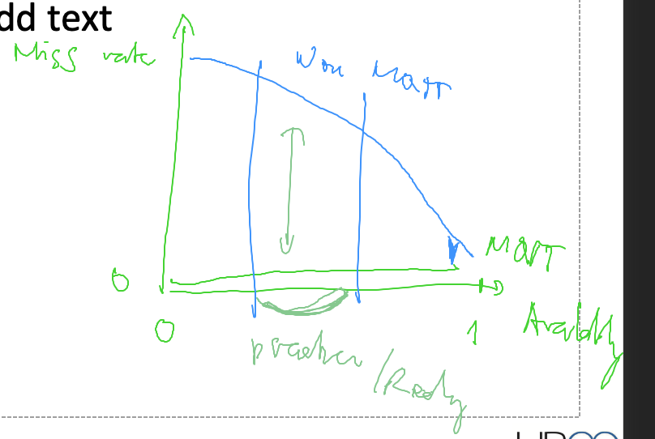

Slide 56
Session Modes
Mode | QoS | Clean session | Expected behavior
Control A | 0 | true | Messages during outage are lost
Control B | 1 | true | Reliable while connected, but no offline recovery
Target | 1 | false | Broker queues eligible messages and delivers after reconnection
Instead of a graceful MQTT disconnect:
Abruptly terminate/power-off the subscriber → restart → reconnect

Slide 57
Intermittent-Power Timeline
Phase | Time | Subscriber | Purpose
Baseline | 0–60s | Online | Sufficient harvested energy
Offline 1 | 60–90s | Power Off | Energy depleted
Recovery 1 | 90–150s | Online | Recharge + reconnect + recovery
Offline 2 | 150–180s | Power Off | Second energy failure
Recovery 2 | 180–240s | Online | Reconnect + second recovery
Final drain | 240–300s | Online | Final backlog drain

Slide 58
What Does This Experiment Tell Us?
Existing MQ-Bench experiments ask:
  How fast and efficiently do message brokers perform?
Experiment 5 asks something different:
  Can message-broker semantics maintain communication continuity when IoT devices cannot remain continuously powered?

Slide 59
Metrices
Reliability
  Final delivery ratio
  Number/fraction of messages recovered after reconnect
Recovery behavior
  Backlog drain time
  Recovery throughput
  Post-reconnection latency
Broker cost
  CPU utilization during recovery
  Memory growth while devices are unavailable
  Cost of maintaining persistent session

Slide 60
Expected Results / Hypothesis
QoS 0 + Clean
  Power loss → missed messages → LOST
QoS 1 + Clean
  Power loss → missed messages → LOST
QoS 1 + Persistent
  Power loss
  ↓
  Broker queues messages
  ↓
  Device harvests energy
  ↓
  Reconnect
  ↓
  Recover queued messages

Slide 61
Contribution
Places MQ-Bench in an emerging batteryless / intermittently powered IoT landscape.
Quantifies the benefit of MQTT persistent sessions.
Quantifies the cost of reliability in CPU, memory, latency, and recovery time.
Evaluates whether an existing widely used IoT messaging protocol can help support intermittent devices without proposing a new networking protocol.

