Slide 1
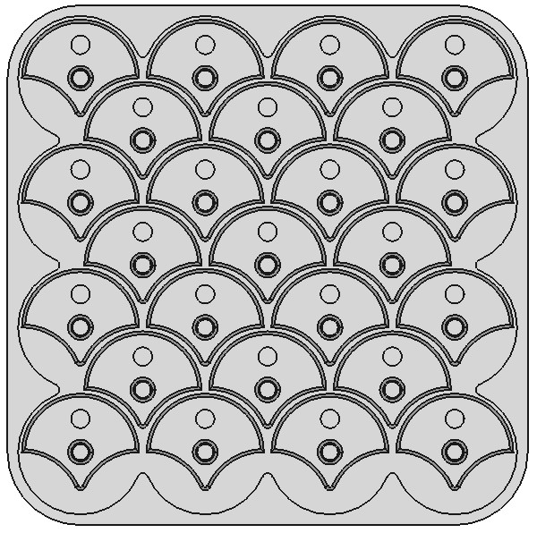
In this layout all pieces point South
+Y
-3 -2 -1 0 1 2 3
+X
-3 -2 -1 0 1 2 3
North
+Y
West
East
+X
South

