Slide 1
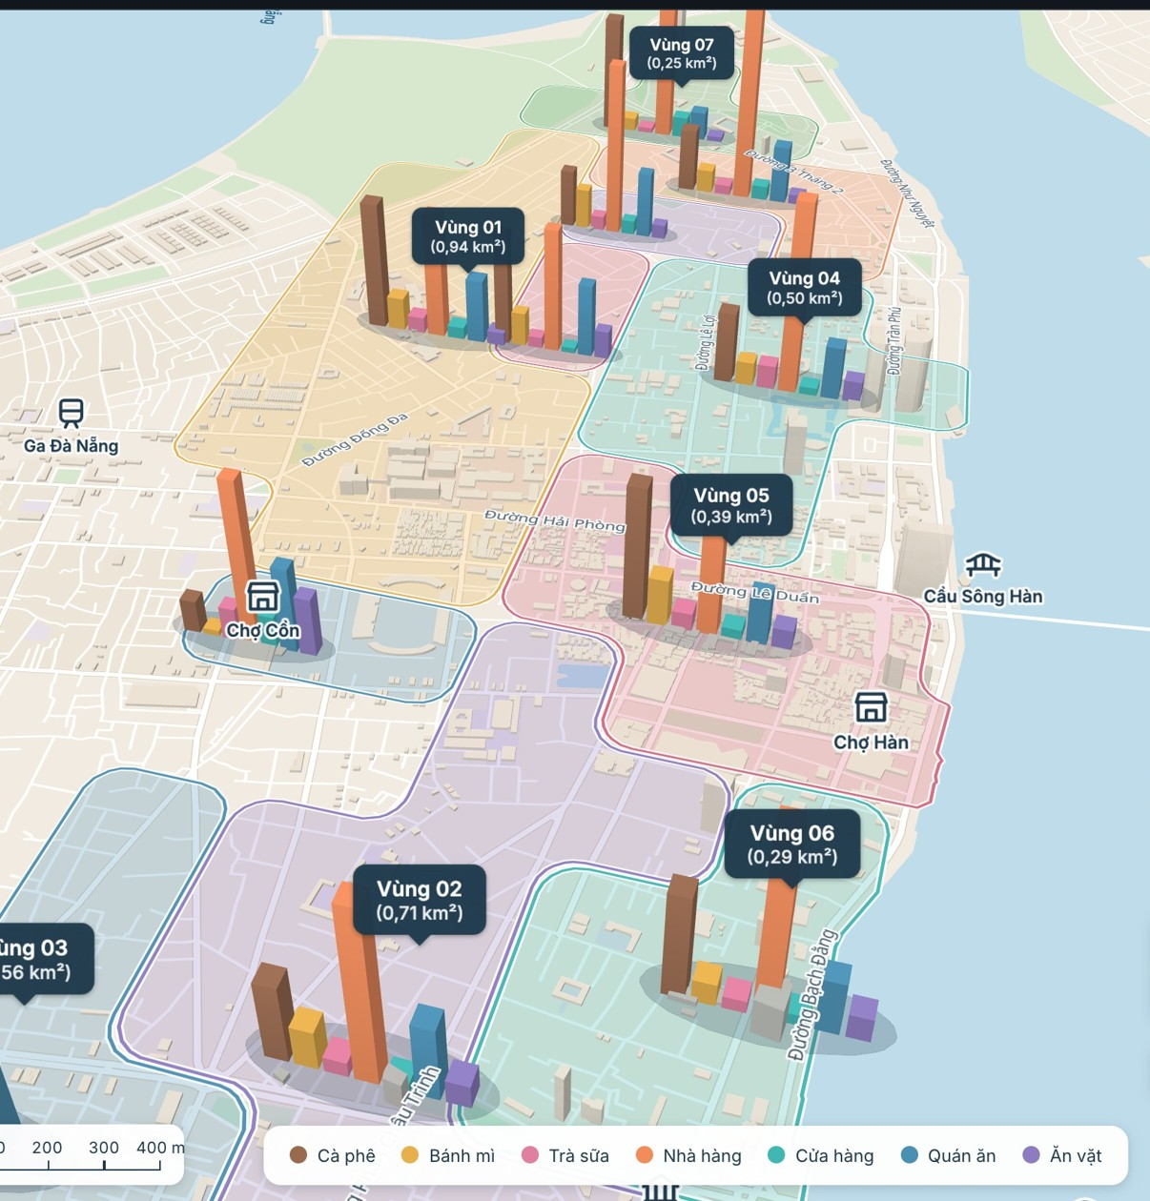
HaiChau Hotspots
Mining food and drink area types in central Da Nang from Google Maps reviews
Final project · Data Mining (DAM501)
Nguyễn Văn Tú · Bùi Ngọc Bảo Trân
Lê Ngọc Hiếu · Lê Bảo Nguyên
Notes:
Good morning, everyone. We are presenting HaiChau Hotspots, our final project for Data Mining, DAM501. Our team is Nguyễn Văn Tú, Bùi Ngọc Bảo Trân, Lê Ngọc Hiếu and Lê Bảo Nguyên. The project uses Google Maps reviews to answer one question: what kind of food and drink area is each part of central Da Nang?

Slide 2
The project in one slide
1
Question
2
Method
3
Result
What kind of food and drink area is each part of central Da Nang?
Unsupervised clustering of the business mix in 250 m grid cells
Seven area types, delivered in an interactive 3D web map
301,566
1,581
70
7
11
reviews collected
venues analysed
grid cells of 250 m
area types
connected zones
Notes:
Here is the whole project in one slide. We collected 301,566 reviews, then analysed 1,581 venues on a 250-metre grid of 70 cells. Because no labels exist, we used unsupervised clustering. K-Means with k equal to 7 gives seven area types, which form 11 connected zones on the map. The result is delivered as an interactive web map. The rest of this talk explains how we got there and how far the results can be trusted.

Slide 3
The question: what kind of food area is each neighbourhood?
Who it helps
Pins show where venues are.
Business mix shows what an area is like.
1
Venue owners
Find areas that suit a business concept
2
Diners
See what each area is strong at
3
Urban researchers
We describe every area by its share of coffee, rice, noodles, hotpot and other businesses.
Get a structured view of the city centre
What we deliver
Named area types
A data profile for each type
A web map to explore the results
Notes:
A map full of pins tells you where venues are, but not what an area is like. We describe an area by its business mix: the share of coffee, rice, noodles, hotpot and so on. This helps three groups. People opening a venue can find areas that suit their concept. Diners can see what an area is strong at. Urban researchers get a structured view of the city centre. Our deliverables are area types with understandable names, a profile for each type, and a web map to explore them.

Slide 4
A 10-step process from problem to feedback
1
2
3
4
5
Problem definition
Analytic approach
Data requirements
Data collection
Data understanding
Area types by business mix
Unsupervised clustering
Location, category, price, reviews
Google Maps through Apify
Quality and distributions
6
7
8
9
10
Data preparation
Model
Evaluation
Deployment
Feedback
Categories, grid and features
K-Means, Hierarchical, GMM
Metrics, agreement, meaning
Interactive web map
Limits and next steps
Notes:
We followed the ten-step process of the course, and the notebook is organised in the same order. Steps one to three frame the problem. Steps four to six collect, understand and prepare the data. Steps seven and eight build and evaluate the models. Steps nine and ten deploy the result and collect feedback. The next slides follow this order.

Slide 5
Data: real reviews crawled from Google Maps with Apify
Google Maps
Apify
Team crawl files
One workbook
Public place pages and reviews
→
Google Maps Reviews Scraper actor
→
Merged across the team
→
Single source for the analysis
301,566
1,602
Jul 2012 – Oct 2026
27 – 29 Oct 2026
reviews, one per row
places
range of review dates
crawl period
Each row holds the star rating, text, date, reviewer-reported price band and the details of the place.
Notes:
All of our data comes from Google Maps. We crawled it with Apify, using the Google Maps Reviews Scraper actor, between the 27th and 29th of October 2026. The team's crawl files were merged into one workbook containing 301,566 reviews of 1,602 places, dated from July 2012 to October 2026. Each row is one review, with the star rating, text, date and the details of the place. This single file is the source for the whole analysis.

Slide 6
Data understanding: ratings skew positive, coverage is uneven
78%
of reviews have five stars
74%
of reviews have written text
1,266
places have price information
119
places have under half of their Google reviews crawled
Notes:
Two things stand out when we explore the data. First, ratings are very positive: 78 percent of all reviews are five stars. That limits how well stars alone can separate areas. Second, coverage is uneven. 74 percent of reviews have text, 1,266 places have price information, and 119 places have less than half of their Google reviews in our crawl. So we use Google's overall score for ratings, and we use the crawled reviews mainly for keywords and trends.

Slide 7
Cleaning: no review removed, structure made usable
13,357 | Wrongly parsed neighbourhoods rebuilt
2,473 | English-run rows aligned with Vietnamese place details
12,318 | Comment cells with HTML line breaks fixed
80,199 | Missing crawl group values filled from file names
50 → 1 | Image columns merged, with no data lost
15 | Columns under 1% filled removed
Columns
161 → 62
Reviews
301,566
All kept: every review ID is unique
Every rule and row count is logged in the workbook's notes sheet.
Notes:
Cleaning kept all 301,566 reviews, because every review ID is unique. The work was on the structure, which went from 161 columns to 62. We merged long lists such as the 50 image columns, and removed 15 columns that were less than one percent filled. We fixed real errors too. For example, 13,357 neighbourhood values were wrongly parsed, and Vietnamese and English crawl runs used different labels. Every rule is logged in a notes sheet inside the workbook, so the cleaning can be audited.

Slide 8
Preparation: 150 Google categories become 7 business groups
1,602
places in the data
1,600
after 2 permanently closed
1,581
after 19 non-food places
1,537
in cells with 5+ venues
Notes:
Next, we prepared the venues. Starting from 1,602 places, we removed 2 permanently closed places and 19 places that are not food or drink, leaving 1,581. Google uses about 150 category labels, which is too sparse for clustering. We mapped them with rules to 11 food groups, then 7 business groups. The chart shows the overall mix. Rice and Vietnamese food, and drinks, make up about 60 percent. This overall share is the baseline that we compare each area against.

Slide 9
Features: each 250 m cell is described by its business mix
1
250 m grid
2
Business mix
3
Hellinger
4
PCA
Equal-sized units, independent of wards
Seven shares per cell, smoothed with a 250 m Gaussian radius
Square root of shares, suited to proportions
Keeps the main variation and reduces noise
70 cells
7
√p
87.4%
kept from 90, with 5+ venues
features per cell
transform
variance in 3 components
Prices, ratings and comments are excluded from clustering. They only describe the clusters afterwards.
Notes:
Our unit of analysis is a 250-metre grid cell rather than a ward, so every unit has the same size. Keeping cells with at least five venues gives 70 cells containing 1,537 venues. Each cell becomes a vector of seven shares. Because a cell may have only a few venues, we apply spatial smoothing with a 250-metre radius. We then apply the Hellinger transform, which suits proportions, and reduce to three principal components that keep 87 percent of the variance. Prices, ratings and comments are deliberately excluded here. They only describe the clusters afterwards.

Slide 10
Modelling: three algorithms compared across k = 3 to 7
K-Means
Centroid-based, fast and easy to explain. Selected.
Hierarchical (Ward)
Merges similar cells step by step; scores close to K-Means.
GMM
Probabilistic, but less stable: falls sharply after k = 4.
Notes:
We compared three clustering approaches: K-Means, which is centroid-based; Ward hierarchical clustering; and Gaussian Mixture Models, which are probabilistic. The chart shows silhouette scores. K-Means and Hierarchical stay close together between about 0.33 and 0.38, while GMM drops sharply after k equal to 4. We kept K-Means because it is stable, performs well and is easy to explain.

Slide 11
Why k = 7: more map detail, at a measured cost
k | Silhouette | Davies–Bouldin | Calinski–Harabasz | Stability
3 | 0.332 | 1.027 | 36.5 | 0.532
4 | 0.384 | 0.942 | 43.6 | 0.732
5 | 0.357 | 0.948 | 43.0 | 0.678
6 | 0.362 | 0.893 | 42.8 | 0.602
7 | 0.361 | 0.827 | 44.6 | 0.630
k = 4 scores best on
Silhouette and stability, but leaves one large mixed area
k = 7 scores best on
Davies–Bouldin and Calinski–Harabasz, and gives more useful detail
Our decision
K-Means. Best value per metric in orange. Lower is better for Davies–Bouldin; higher for the others.
k = 7 for interpretability. Stability of 0.63 stays above our 0.5 floor
Notes:
Choosing k was a deliberate trade-off, and we want to be open about it. k equal to 4 has the best silhouette, 0.384, and the best stability, 0.732. But it leaves one very large mixed area, which is not very useful on a map. k equal to 7 has the best Davies-Bouldin and Calinski-Harabasz scores. Its silhouette is only slightly lower at 0.361, and stability is 0.63, above our minimum of 0.5. So we chose 7 for interpretability and map detail, not because every metric favours it.

Slide 12
Evaluation: moderate structure, moderate agreement
0.36
0.83
0.63
How we read this
Silhouette
Davies–Bouldin
Bootstrap stability
The main structure holds across algorithms
Exact boundaries depend partly on the algorithm
Moderate silhouette fits a city, where areas change gradually
Types are tendencies, not strict categories
Agreement between models at k = 7 (ARI)
 | K-Means | Hierarchical | GMM
K-Means | 1.00 | 0.58 | 0.57
Hierarchical | 0.58 | 1.00 | 0.61
GMM | 0.57 | 0.61 | 1.00
Notes:
At k equal to 7, the three models agree moderately, with adjusted Rand index values between 0.57 and 0.61. The main structure holds, but exact boundaries depend partly on the algorithm. The silhouette of 0.36 is moderate too. This is reasonable for a city, where areas change gradually rather than having sharp edges. So we read the types as tendencies, not as strict categories.

Slide 13
Result: seven area types
Area type | Cells | Venues | Avg rating | Above overall share
Hotpot, BBQ & bars + International Khu lẩu nướng · nhậu – món quốc tế | 13 | 383 | 4.54 | Hotpot, BBQ & bars ×1.6, International & healthy ×1.3
Noodles & bread + International Khu bún phở · bánh mì – món quốc tế | 14 | 363 | 4.38 | Noodles & bread ×1.3, International & healthy ×1.2
Coffee Khu cà phê | 15 | 269 | 4.33 | Drinks ×1.4
Coffee + Noodles & bread Khu cà phê – bún phở · bánh mì | 9 | 222 | 4.52 | Drinks ×1.3, Noodles & bread ×1.2
Snacks + Rice & Vietnamese Khu ăn vặt – cơm · món Việt | 11 | 182 | 4.41 | Snacks & desserts ×1.5, Rice & Vietnamese ×1.4
Rice & Vietnamese + Hotpot, BBQ & bars Khu cơm · món Việt – lẩu nướng · nhậu | 4 | 76 | 4.46 | Rice & Vietnamese ×1.5, Hotpot, BBQ & bars ×1.4
Hotpot, BBQ & bars + Coffee Khu lẩu nướng · nhậu – cà phê | 4 | 42 | 4.35 | Hotpot, BBQ & bars ×2.5, Drinks ×1.2
Notes:
Here are the seven types. Each name comes directly from the one or two business groups that exceed the overall share the most. The largest is Hotpot, BBQ and bars plus International, with 383 venues and the highest average rating, 4.54. Next come Noodles and bread plus International with 363 venues, and Coffee with 269. Two types have only four cells each, so we treat those more cautiously.

Slide 14
Each type is defined by what it over-indexes on
Lift by area type | Drinks | Noodles & bread | Rice & Vietnamese | Snacks | Hotpot, BBQ & bars | International | Shops & markets
Hotpot, BBQ & bars + International | 0.9 | 0.9 | 0.8 | 1.2 | 1.6 | 1.3 | 0.7
Noodles & bread + International | 0.8 | 1.3 | 1.1 | 1.1 | 0.9 | 1.2 | 0.7
Coffee | 1.4 | 0.9 | 1.1 | 0.6 | 0.3 | 0.7 | 1.2
Coffee + Noodles & bread | 1.3 | 1.2 | 0.8 | 1.1 | 0.8 | 0.7 | 0.6
Snacks + Rice & Vietnamese | 0.8 | 0.8 | 1.4 | 1.5 | 0.6 | 0.9 | 1.5
Rice & Vietnamese + Hotpot, BBQ & bars | 0.7 | 0.7 | 1.5 | 0.3 | 1.4 | 0.6 | 1.8
Hotpot, BBQ & bars + Coffee | 1.2 | 0.4 | 0.7 | 0.0 | 2.5 | 0.8 | 3.2
Lift = share of a group in the type ÷ its overall share. Orange is above the overall share, teal is below. Italic values on white are groups under 5% of the type; they are not used for naming.
Notes:
This table shows lift: a group's share in a type divided by its overall share. A lift above 1 means more than average. For example, the Hotpot and Coffee type has 2.5 times the usual share of hotpot and bars. The Coffee type has 1.4 times the usual share of drinks and only about a third of the usual hotpot share. Names ignore groups below five percent of a type, because a high lift on a very small group is mostly noise. That is why the shops and markets column does not appear in any name.

Slide 15
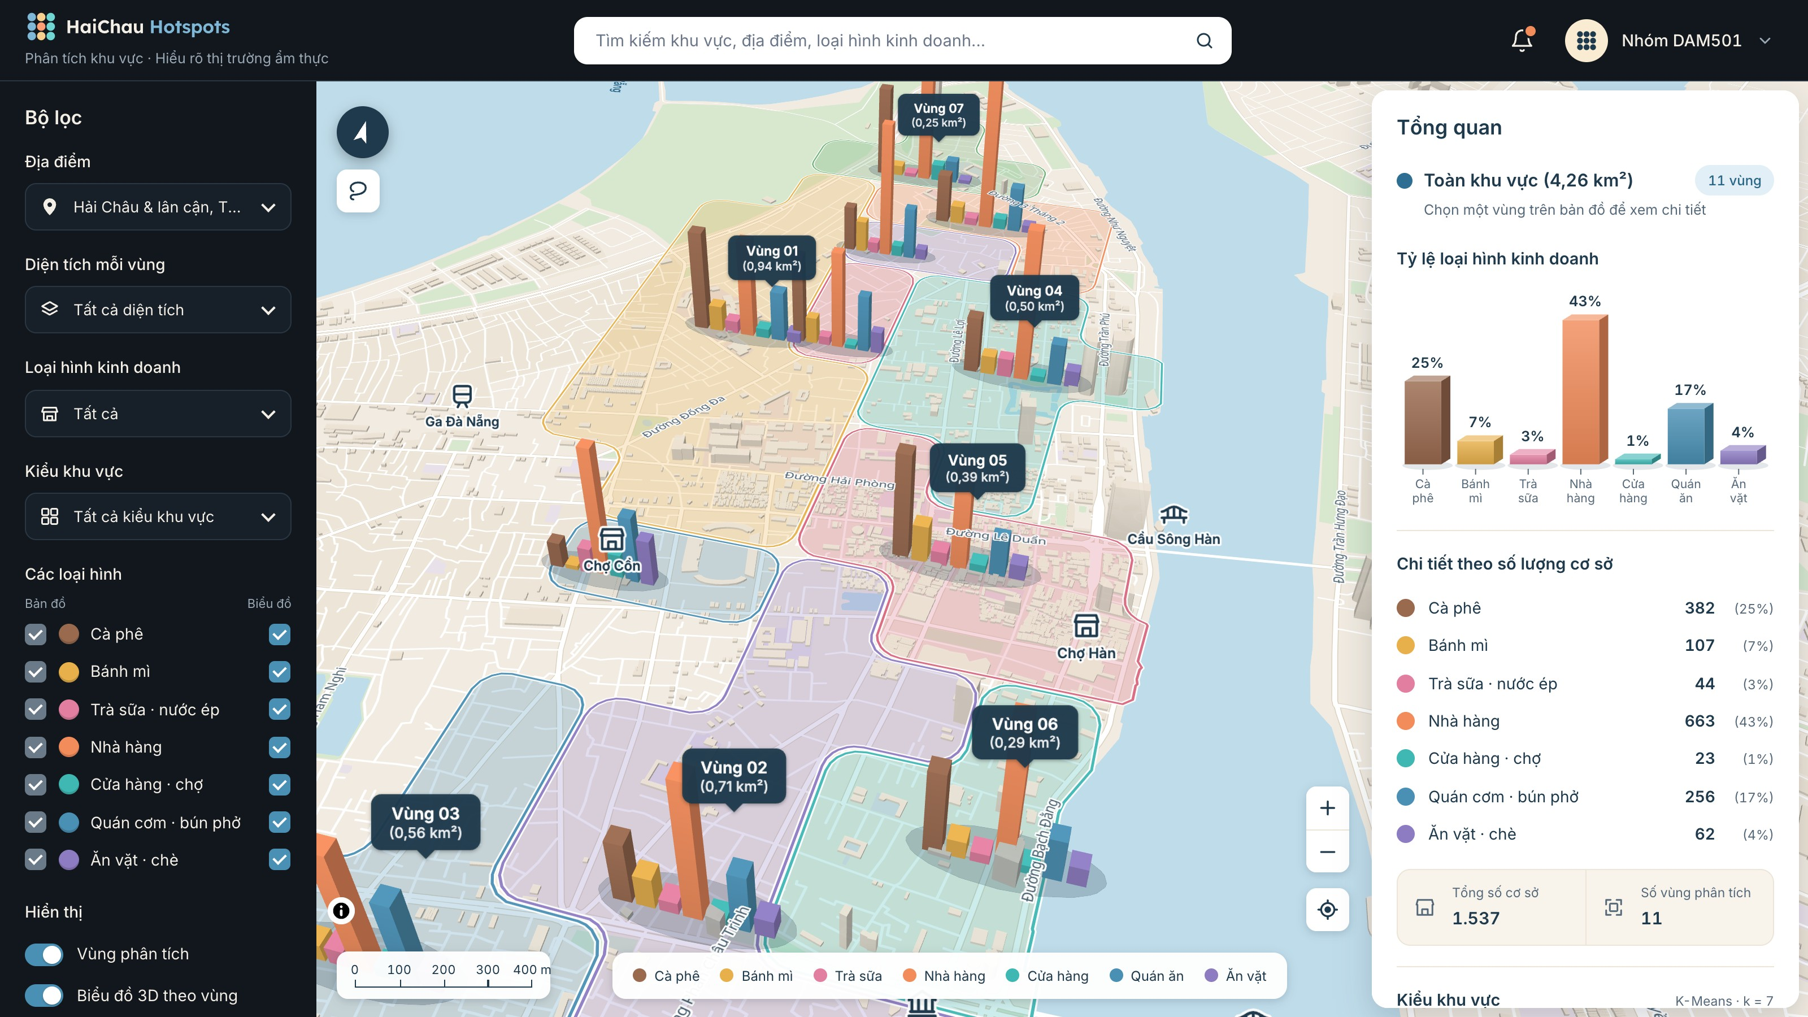
On the map, the types form 11 connected zones
11
connected zones
4.26
km² of land covered
Colour shows the area type
3D bars show the business mix
Outlines follow the Han River
Notes:
Adjacent cells of the same type are merged into connected zones, which gives 11 zones covering about 4.26 square kilometres of land. Zone colour shows the type, and the 3D bars show the business mix inside each zone. Zone outlines are clipped along the Han River, so areas count only land.

Slide 16
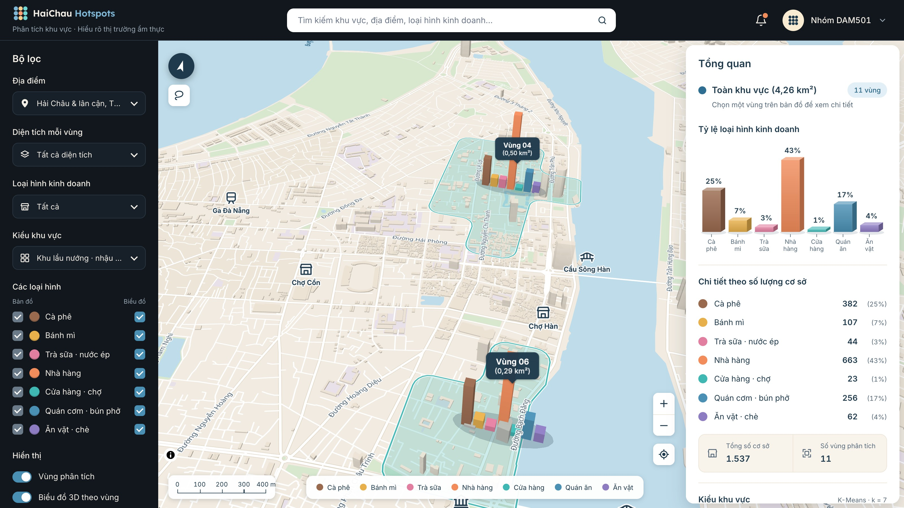
The web turns the results into an explorable map
1
Filter
By place, area size, business type and area type
2
Search
Find any zone or venue
3
Draw
Circle any region for instant statistics
4
Switch
Map or satellite, light or dark
Filtered to one area type. The interface is in Vietnamese for local users.
Notes:
Deployment is a static web page, built with MapLibre, that needs only one JSON file produced by the notebook. Users can filter by place, area size, business type and area type; search for a zone or venue; and draw a free-form region to get instant statistics. It also has map and satellite views, and light and dark themes. The interface is in Vietnamese, because the main audience is local. Our demo video walks through all of these features.

Slide 17
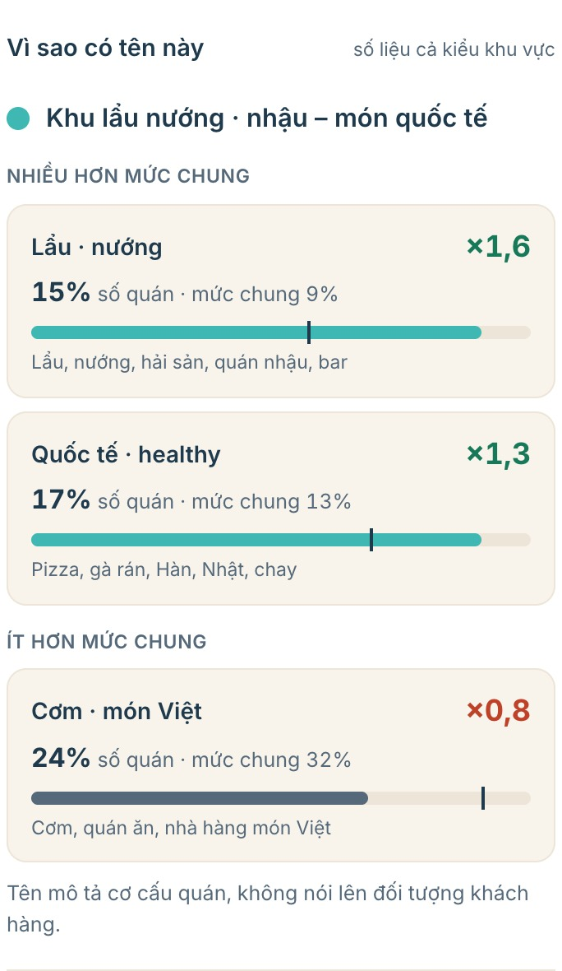
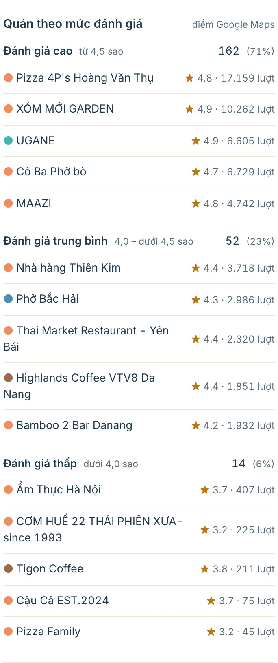

Inside a zone: Zone 06 explains itself with numbers
228
Why this name
Venues by rating
Positive comments
venues
786
venues per km², the densest zone
4.56
average Google rating
151,786
Google ratings in total
Notes:
Let us open Zone 06. It has 228 venues and is the densest zone, at 786 venues per square kilometre, with an average rating of 4.56. The panel explains the name with numbers: hotpot and bars are 1.6 times the overall share at type level, and international food is 1.3 times. It also lists venues by high, medium and low rating. 162 venues, or 71 percent of the rated venues, score 4.5 or above. Below that, it shows positive comments from the reviews.

Slide 18
Composition separates areas; price and ratings barely do
Business mix
Price
Star ratings
Works
Barely separates
Barely separates
×2.5
10 / 11
80–91%
highest lift used in a name
zones at up to 100,000₫
of reviews at 4+ stars per zone
Group shares differ from the overall mix by up to ×2.5, giving seven readable types.
10 of 11 zones share the same most common band. The bands are wide.
Reviews are positive everywhere, so high ratings alone say little.
Notes:
Here are our main findings. First, business mix does reveal distinct area types, as we have just seen. Second, price barely separates areas. In 10 of the 11 zones, the most common price band is up to 100,000 dong, partly because the bands are wide. Third, reviews are positive everywhere. The share of reviews with at least four stars is between 80 and 91 percent in every zone. So composition is the most informative signal in this dataset.

Slide 19
Limitations we report openly
1
Small sample
2
Untested settings
3
Uneven coverage
70 cells in the model; two types have only 4 cells
Other cell sizes and smoothing radii not yet tested
Favours venues on Google Maps; crawl depth varies
4
Names
5
Positive comments
6
Trends
Describe the business mix, not customers
Stars and keyword filters, not a sentiment model
Some crawl runs favoured the newest reviews
Notes:
We want to be clear about the limits. The model has only 70 cells, and two types have just four cells. We have not yet tested other cell sizes or smoothing radii. The data favours venues visible on Google Maps, and our crawl coverage differs between venues. Names describe the business mix, not who the customers are. The positive comment section uses star ratings and keyword filters, not a sentiment model. Trends may also be affected by crawl runs that favoured the newest reviews.

Slide 20
Conclusion and next steps
What we achieved
What comes next
About 300,000 raw reviews became 7 readable area types
Results are explorable in an interactive web map
Trade-offs and limits are reported openly
Test sensitivity to cell size and smoothing
Add a real sentiment model
Add opening hours to separate day and night areas
Gather feedback from local users
Thank you. We welcome your questions.
Nguyễn Văn Tú · Bùi Ngọc Bảo Trân · Lê Ngọc Hiếu · Lê Bảo Nguyên
Notes:
To conclude: we turned about 300,000 raw reviews into seven understandable area types, and delivered them in an interactive map, while staying open about the model's trade-offs. Next, we would test sensitivity to cell size, add a real sentiment model, include opening hours to separate daytime and night-time areas, and gather feedback from local users. Thank you for listening. We welcome your questions.

