Slide 1
ECONOMIC INNOVATION GROUP
The 80-80 Rule
What a wage subsidy would cost — and how many Americans it would put back to work
Benjamin Glasner and Adam Ozimek
Companion deck to the combined policy brief and technical appendix · July 2026
Agglomerations, installment three
Notes:
Companion deck to the 2026-07-09 combined brief and appendix. All figures and numbers are from the EIG 80-80 wage subsidy simulation, 2026 (CPS ORG May 2025–May 2026; PolicyEngine-US 2026).

Slide 2
WHY IT MATTERS
One policy, three results: a raise, a modest bill, and more work.
15.9M
$45–48B
1.49M
workers get a per-paycheck raise — about one in ten American workers
net federal cost per year, stable across every modeling approach
non-workers drawn into jobs (floor ~1.0M), plus ~200K FTE of added hours
Source: Economic Innovation Group 80-80 wage subsidy simulation, 2026.
Notes:
Headline. 15.9M reached; $45–48B net; 1.49M new entrants (conservative floor ~1.0M, joint upper corner 3.81M) plus ~0.19–0.28M FTE from part-timers extending hours. Cost is the firm result; entry is the wider band.

Slide 3
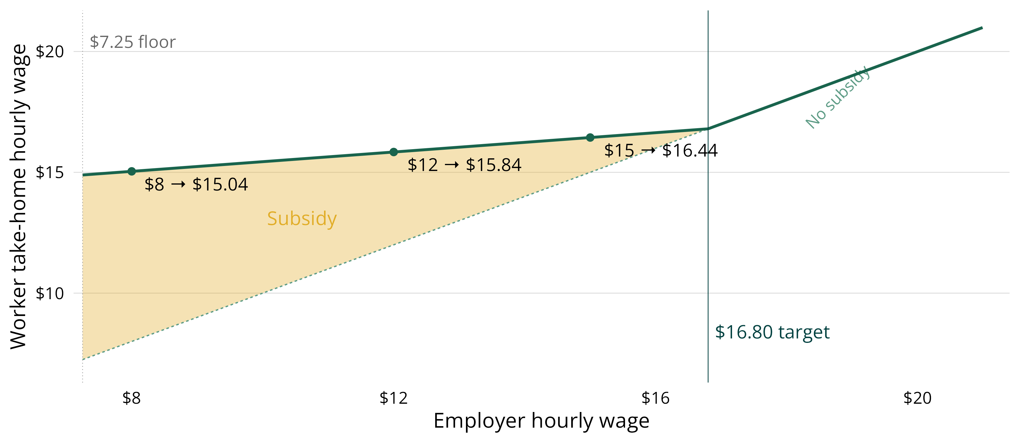
A QUICK REFRESHER
The subsidy fills 80% of the gap to a $16.80 target — in every paycheck.
Target = 80% of the $21.00 paid-hourly median; $7.25 is the lowest creditable base wage.
Source: Economic Innovation Group 80-80 wage subsidy simulation, 2026.
Notes:
Target = 80% of the $21.00 paid-hourly median = $16.80. $7.25 is the lowest creditable base wage (anti-fraud). Every dollar of employer raise still lifts take-home pay. Updated data: CPS May 2025–May 2026 ($21.00 median vs. the posts' $20).

Slide 4
01
What does it cost?
Start static, then let people respond. Reduced-form and structural models land in nearly the same place.

Slide 5
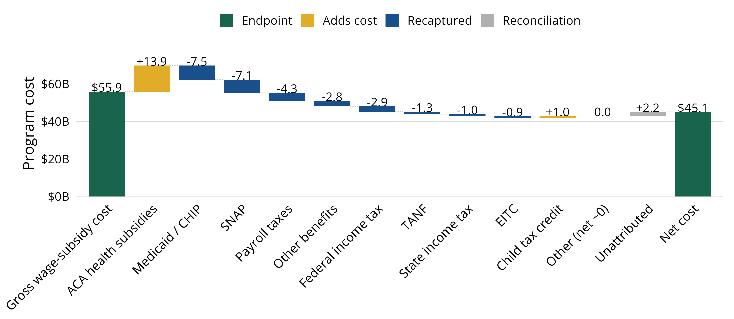
WHAT DOES IT COST?
Taxes and safety-net savings cut the cost from $56B gross to $45B net.
Recaptured taxes and SNAP/Medicaid savings, partly offset by higher ACA premium credits.
Source: Economic Innovation Group 80-80 wage subsidy simulation, 2026.
Notes:
Gross $55.9B → net $45.1B (static). Government recaptures payroll and income taxes and banks SNAP/Medicaid/TANF savings; partly offset by higher ACA premium tax credits (+24.9% of gross). The ACA interaction is real and any serious estimate must carry it.

Slide 6
WHAT DOES IT COST?
Net cost lands at $45–48B across every modeling approach.
Scenario | Gross ($B/yr) | Net ($B/yr)
Static (no behavioral response) | 55.9 | 45.1
Reduced-form, lower | 57.3 | 45.9
Reduced-form, central | 59.8 | 46.7
Reduced-form, upper | 63.6 | 47.6
Structural, sticky incumbent wages | 59.6–60.7 | 47.4–48.4
Incumbent hours response (adds to any row) | +0.5 to +2.4 | +0.2 to +1.3
Incidence upper bound (all wages renegotiate) | up to 109.1 | —
Net = gross minus federal tax recapture and safety-net offsets. Final row is a disclosed bound, not a forecast. Source: EIG 80-80 wage subsidy simulation, 2026.
Notes:
Central estimate: ~$57–$64B gross, $45–$48B net, plus up to ~$2B if part-timers extend hours. Getting outside that range requires the implausible all-wages-renegotiate scenario.

Slide 7
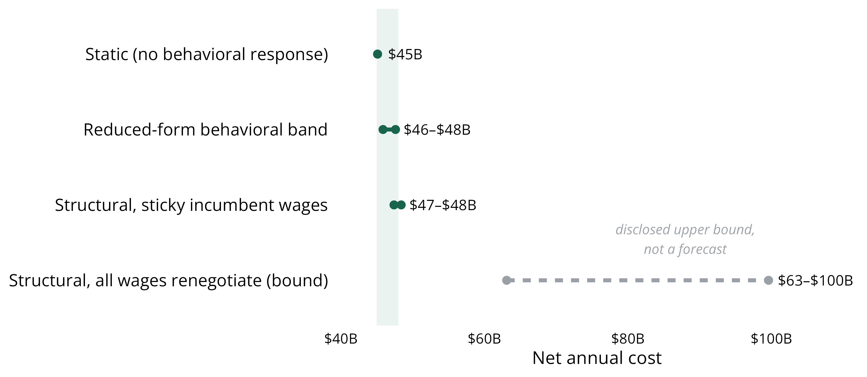
WHAT DOES IT COST?
Only wholesale wage renegotiation escapes the $45–48B net range.
Static, reduced-form, and structural models all cluster in the $45–48B net range.
Source: Economic Innovation Group 80-80 wage subsidy simulation, 2026.
Notes:
Static, reduced-form, and structural models all cluster in $45–48B net. Only the all-wages-renegotiate bound escapes it — and that contradicts the wage-rigidity evidence.

Slide 8
02
Who gets the money?
The eligible population looks like the low-wage workforce, because it is the low-wage workforce.

Slide 9
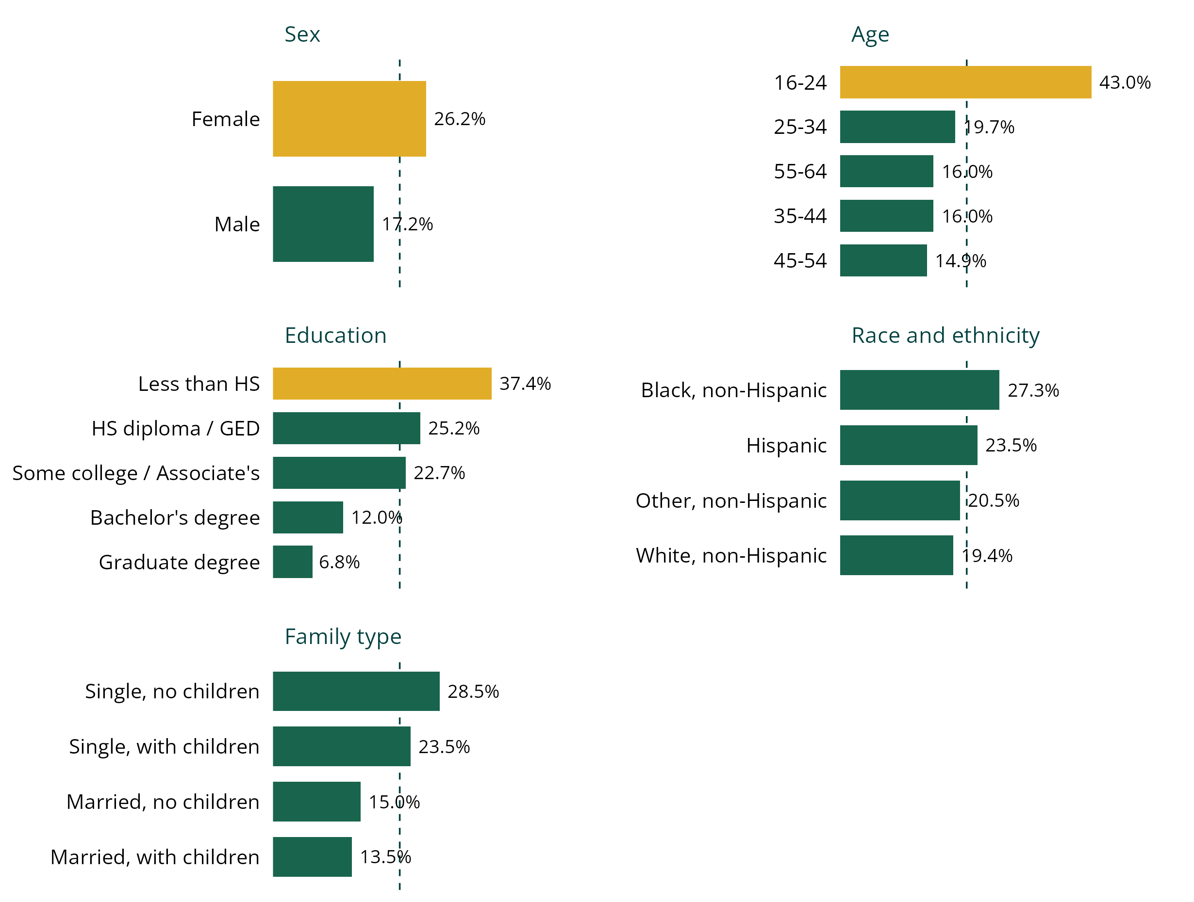
WHO GETS THE MONEY?
It reaches deepest among women, the young, and the least credentialed.
Dashed line: overall take-up, 21.7% of the paid-hourly workforce.
Women: 26.2% take-up vs. 17.2% for men; women are 60.5% of recipients.
Ages 16–24: 43.0% qualify — the highest take-up of any group.
Less than high school: 37.4% qualify, vs. 6.8% with a graduate degree.
Single parents: 23.5% qualify, well above married parents (13.5%).
Source: Economic Innovation Group 80-80 wage subsidy simulation, 2026.
Notes:
Third column of Table 2 (share of each group's paid-hourly workers) reframes the story: where the money pools vs. how deeply it reaches. Overall take-up is 21.7% of the paid-hourly workforce.

Slide 10
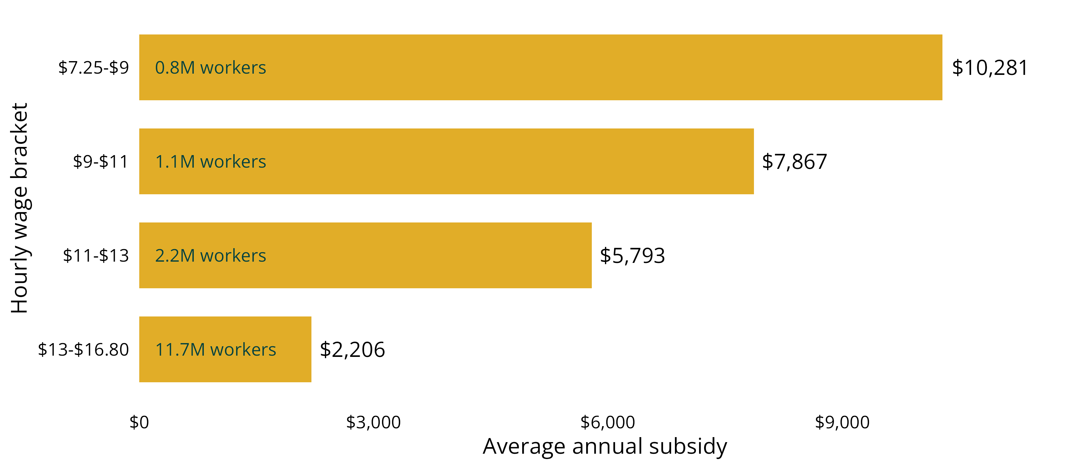
WHO GETS THE MONEY?
The lowest-wage workers receive the largest checks — by construction.
Average annual subsidy runs from $10,281 at $7.25–9 down to $2,206 at $13–16.80.
Source: Economic Innovation Group 80-80 wage subsidy simulation, 2026.
Notes:
Average annual subsidy by wage band: $7.25–9 → $10,281; $9–11 → $7,867; $11–13 → $5,793; $13–16.80 → $2,206. Steeply progressive within the eligible range.

Slide 11
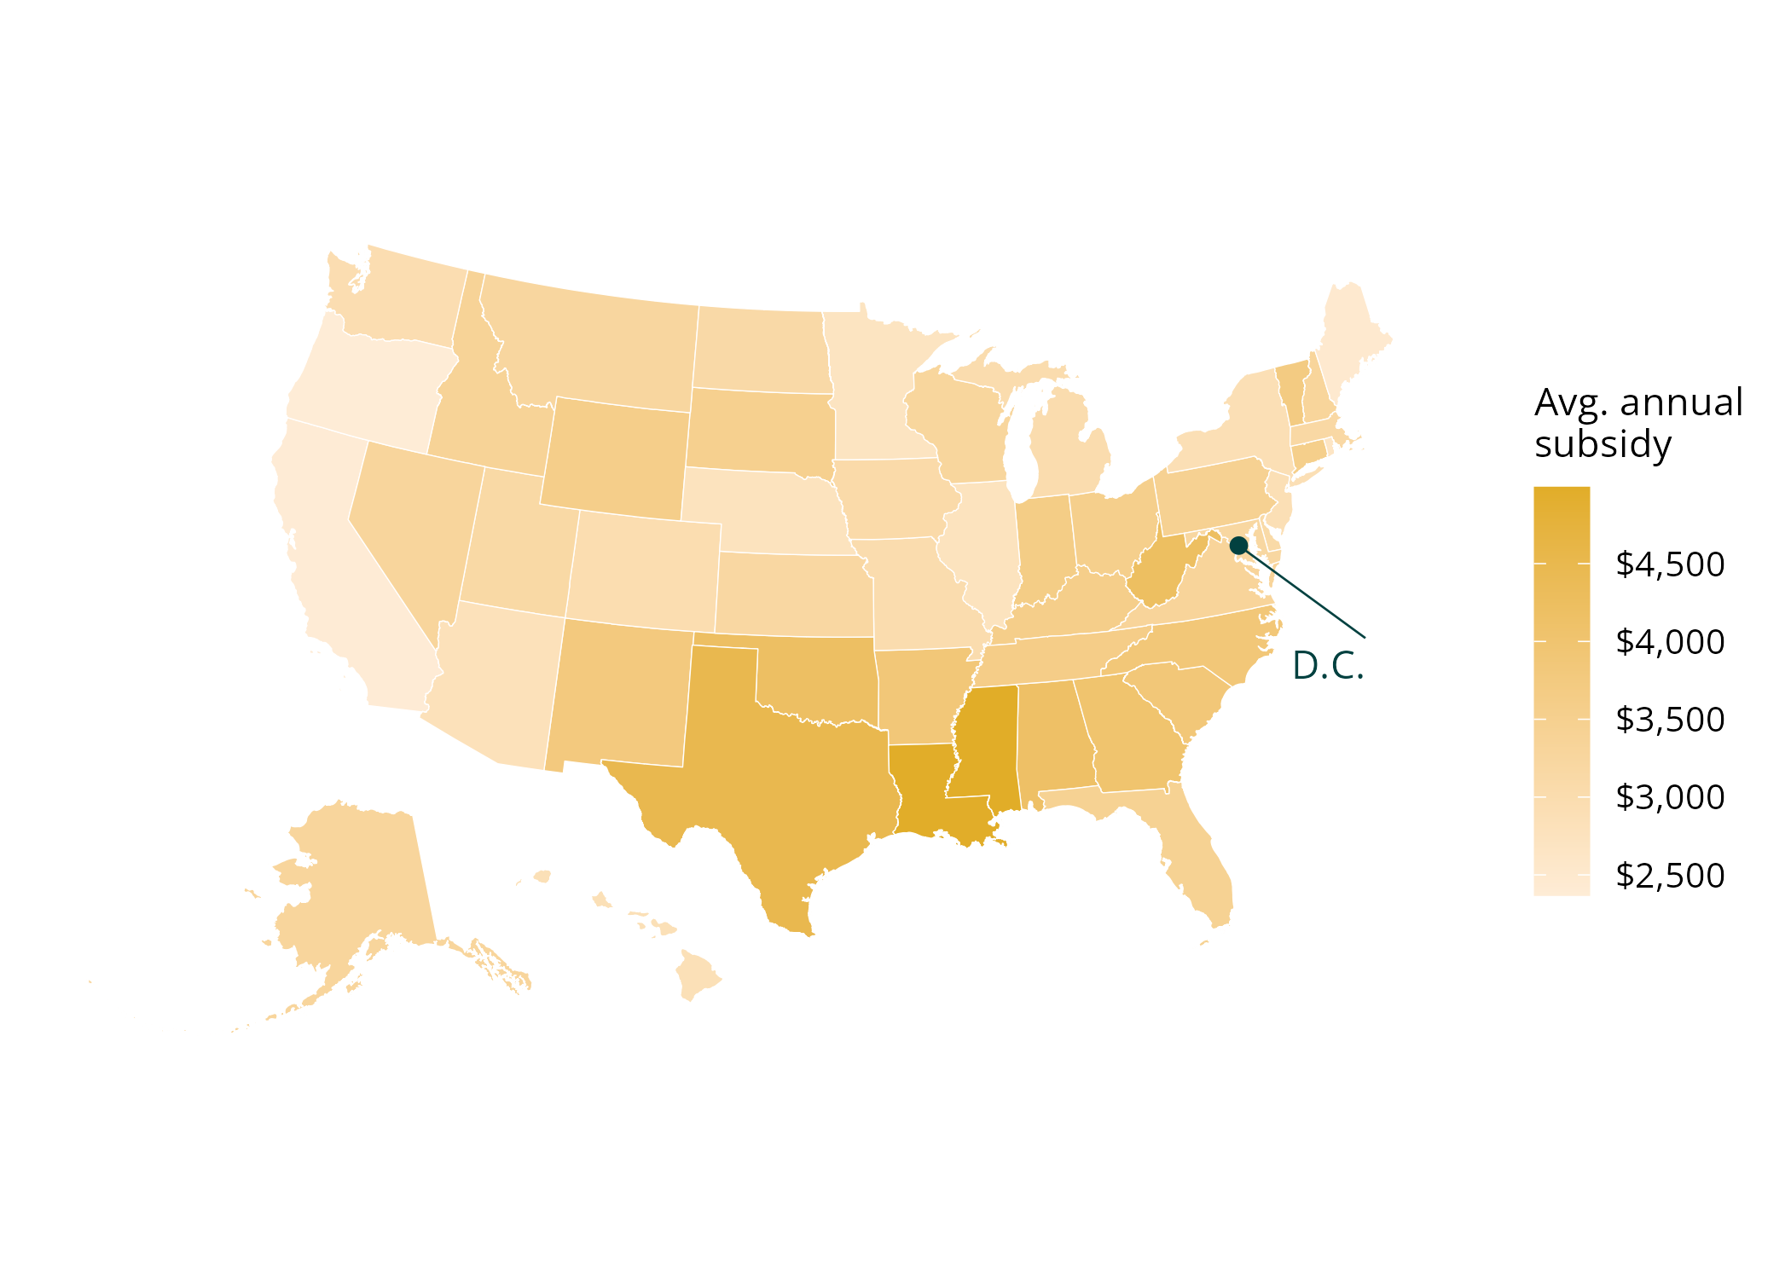
WHO GETS THE MONEY?
Because the target is national, money flows to lagging labor markets.
Average annual subsidy per eligible worker, by state.
Louisiana $4,981 and Mississippi $4,990 per eligible worker.
California $2,392 — less than half.
Louisiana: 317K eligible; West Virginia 105K averaging $4,229.
No commission picks winners — the formula finds distressed places.
Source: Economic Innovation Group 80-80 wage subsidy simulation, 2026.
Notes:
Average subsidy: Louisiana $4,981, Mississippi $4,990, vs. California $2,392. No commission picks winners — the formula finds distressed places on its own.

Slide 12
03
Does it pull people into work — and how many?
The simulation's genuinely new contribution: the first structural estimates of labor-force entry.

Slide 13
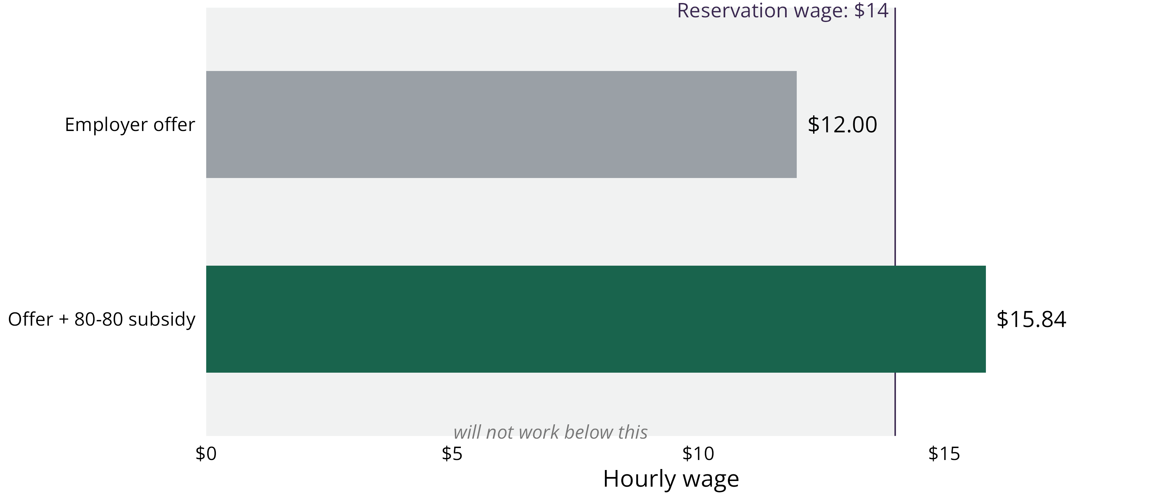
DOES IT PULL PEOPLE INTO WORK?
The subsidy exists to clear a worker's entry threshold.
The employer's offer alone falls short; the subsidy lifts total pay over the worker's reservation wage.
Source: Economic Innovation Group 80-80 wage subsidy simulation, 2026.
Notes:
Reframe the denominator: 59M non-employed adults overstates who a wage can reach — ~7M unemployed searching, ~34M out for other reasons (half ages 16–24, in school), ~10M unable to work, ~9M retired. A realistic wage-responsive pool is closer to 10–15M.

Slide 14
DOES IT PULL PEOPLE INTO WORK?
1.49 million enter work at the evidence-central estimate.
Scenario | New entrants (millions)
Conservative floor (no wage penalty) | 1.02
Evidence-central | 1.49
High (joint upper corner) | 3.81
Full range across the parameter grid | 0.23–3.81
Evidence-central, by group — single mothers | 0.24
Evidence-central, by group — other women | 1.07
Evidence-central, by group — men | 0.18
Headline scenarios are internally-consistent parameter bundles, not single-lever excursions. Source: EIG 80-80 wage subsidy simulation, 2026.
Notes:
Floor applies NO wage penalty (a conservative choice, not neutral — offer-decay evidence rules out zero). Evidence-central adds a modest ~10% status-differentiated penalty. High corner stacks all three uncertain axes upward.

Slide 15
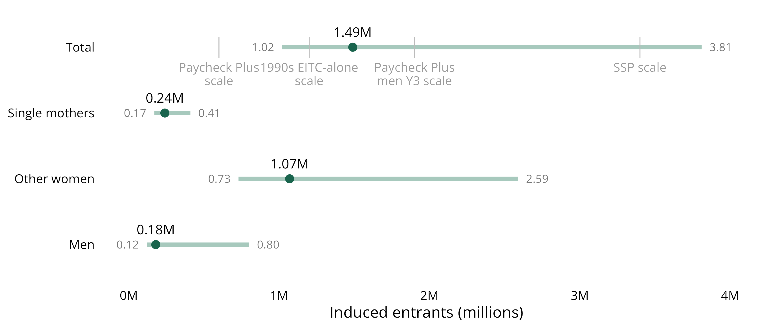
DOES IT PULL PEOPLE INTO WORK?
Entry by group, benchmarked against the closest real-world precedents.
1.49M central (floor 1.02M, high 3.81M) — between Paycheck Plus and the Self-Sufficiency Project.
Source: Economic Innovation Group 80-80 wage subsidy simulation, 2026.
Notes:
Reference marks scale the nearest precedents to our pool: 1990s EITC (~0.9M scaled, below our floor), Paycheck Plus NYC/Atlanta, the Canadian Self-Sufficiency Project. Our 1.49M sits between the Paycheck Plus demonstrations and SSP's exceptional response.

Slide 16
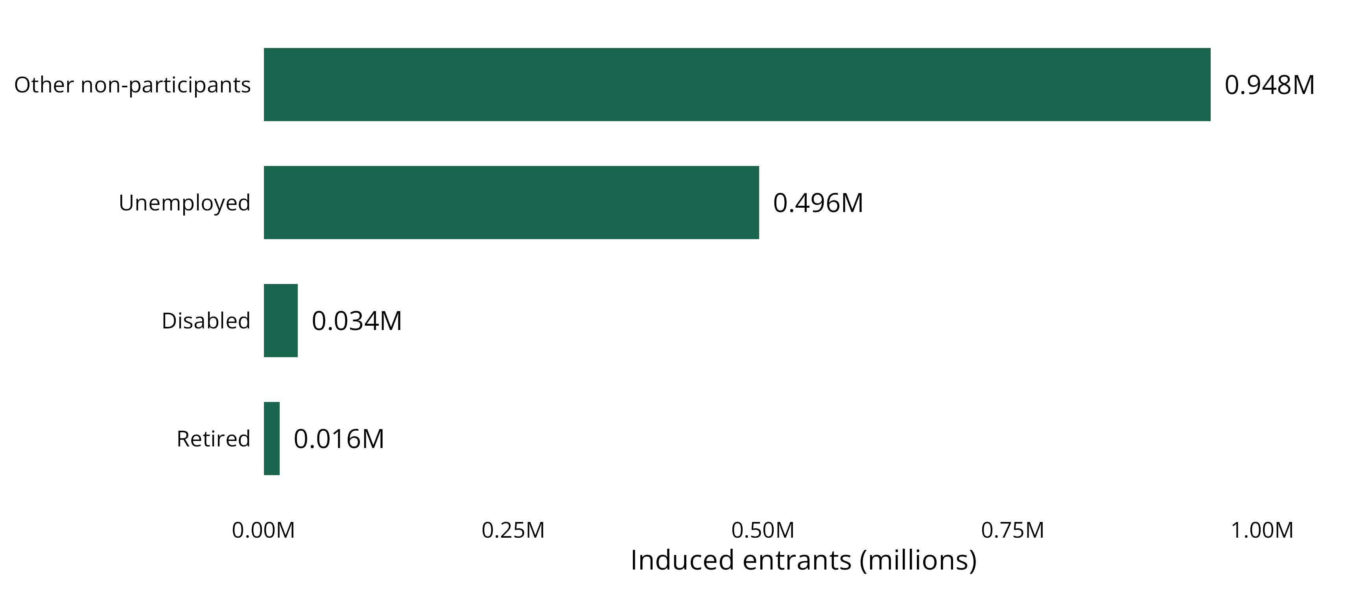
DOES IT PULL PEOPLE INTO WORK?
Barely any entrants are disabled or retired — they are job-seekers and other non-participants.
About a third are unemployed searchers; the disabled and retired are ~3% of entrants.
Source: Economic Innovation Group 80-80 wage subsidy simulation, 2026.
Notes:
About a third of entrants are unemployed job-seekers (monthly job-finding rates 5–6x other non-participants). The disabled and retired — a third of the non-employed — are ~3% of entrants. Male entry is real but modest: ~180K central (~120K floor), up to ~800K high; the broader prime-age male non-employment crisis is rooted in health and disability a wage cannot fix.

Slide 17
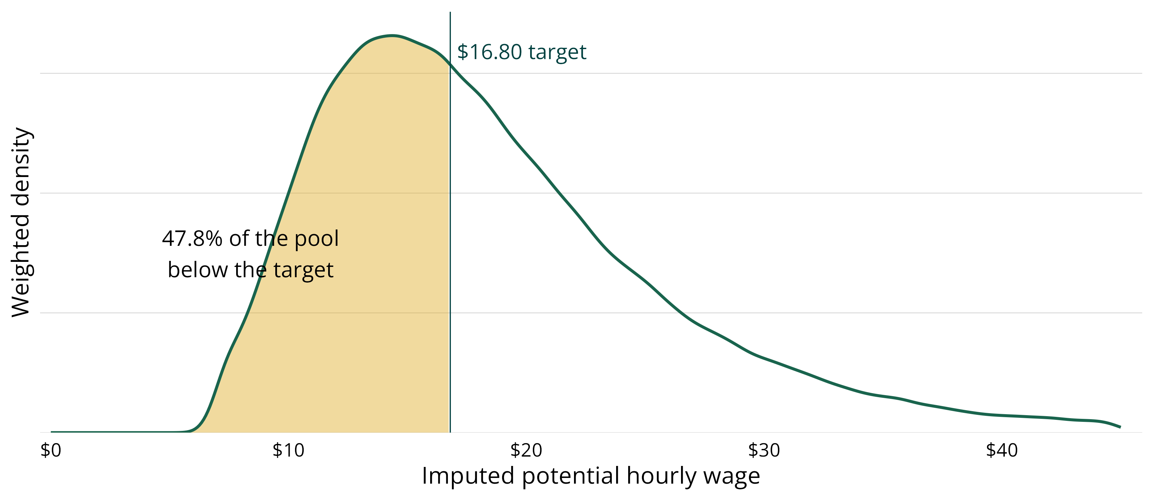
DOES IT PULL PEOPLE INTO WORK?
Nearly half the non-employed would earn below the target — more than double the rate among workers.
47.8% of the pool draws offers below $16.80, vs. 21.7% of paid-hourly workers.
Source: Economic Innovation Group 80-80 wage subsidy simulation, 2026.
Notes:
47.8% of the non-employed pool draws imputed offers below $16.80, vs. 21.7% of paid-hourly workers. Negative selection, as expected — but most of the pool is beyond the subsidy's reach. Offers are modeled as distributions, not points.

Slide 18
DOES IT PULL PEOPLE INTO WORK?
What about men? A wage subsidy reaches the men a wage can reach.
~180K
Roughly half of prime-age men out of the labor force report a serious health condition, and a quarter to a third receive disability benefits — barriers a higher wage does not remove.
The subsidy reaches the men a wage can move — disproportionately unemployed job-seekers and the most disadvantaged. The broader prime-age male non-employment crisis, much of it rooted in health and demand-side exclusion, needs complementary tools. We would rather report that straight than oversell the policy.
male entrants at the evidence-central estimate — about 120K at the conservative floor, up to ~800K in the high scenario
Source: Economic Innovation Group 80-80 wage subsidy simulation, 2026.
Notes:
Male non-employment motivated the first post. Male entry is real but modest — ~180K central, ~120K floor, up to ~800K high. Reach the men a wage can reach; the broader crisis needs complementary tools. Report it straight.

Slide 19
04
Is it worth it?
Employers keep almost none of it — and each new job costs a fraction of the alternatives we already fund.

Slide 20
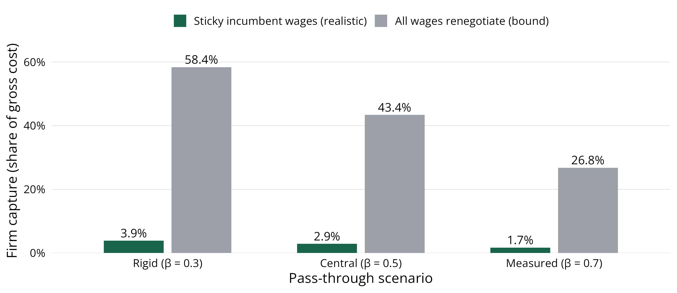
IS IT WORTH IT?
No — firms keep about 3% of the subsidy under realistic wage stickiness.
No more than ~4% across bargaining assumptions; the $7.25 floor caps how far wages can fall.
Source: Economic Innovation Group 80-80 wage subsidy simulation, 2026.
Notes:
With sticky incumbent wages, firms capture ~3% at the central bargaining split, ≤4% across the range. The $7.25 floor caps how far firms can push cash wages down. Disclosed worst case (all wages renegotiate): gross up to $109B, firm capture ~58% — a bound, not a forecast.

Slide 21
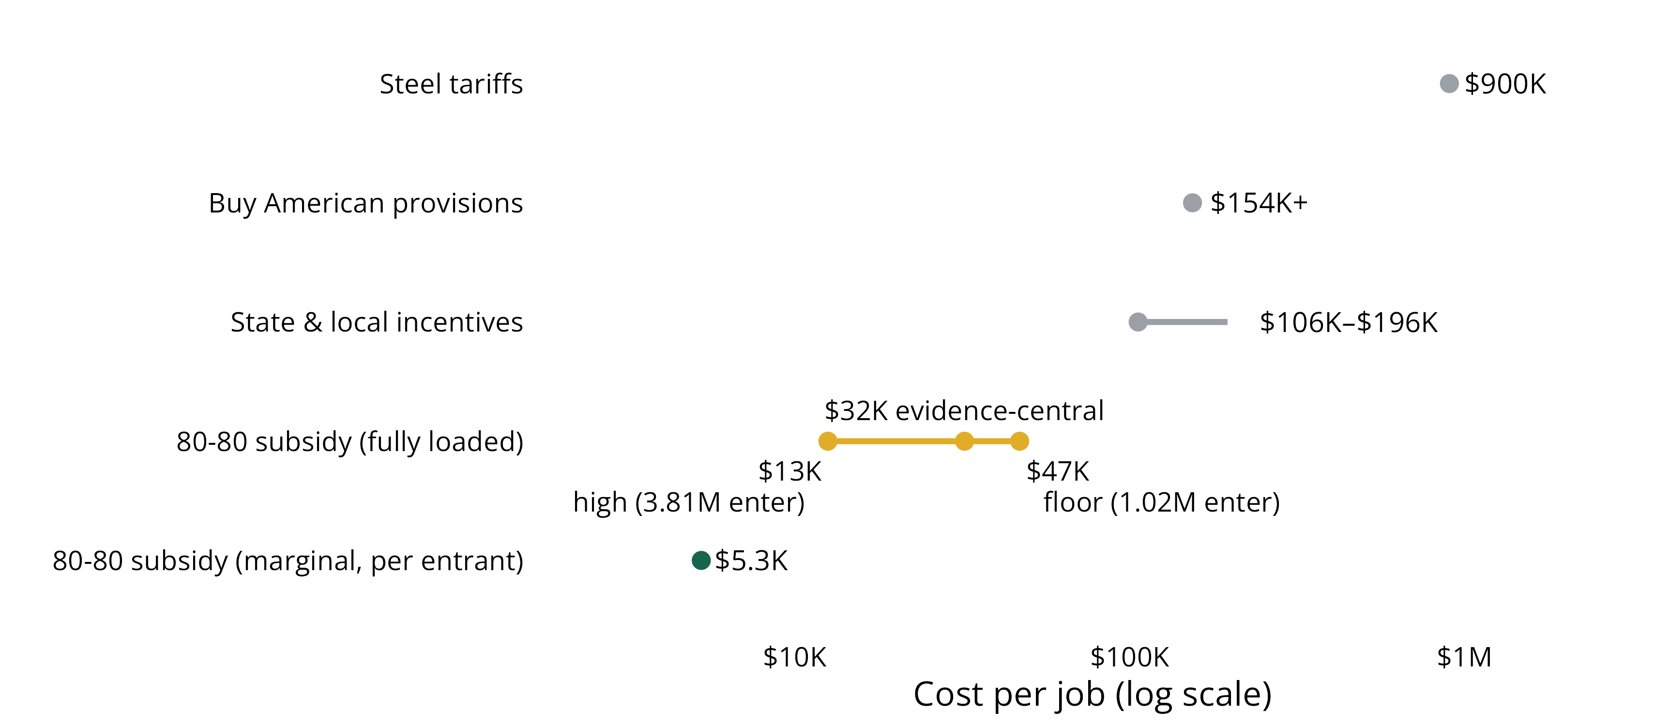
IS IT WORTH IT?
Cost per new job undercuts the job-creation policies we already run.
~$5,300 marginal; ~$32K fully loaded vs. $154K+ Buy American and ~$900K steel tariffs.
Source: Economic Innovation Group 80-80 wage subsidy simulation, 2026.
Notes:
Marginal cost per entrant: ~$5,300 gross / ~$3,900 net (entrants work part-time/part-year). Even charging the entire net cost to entrants yields ~$32,000 per job — below state/local incentives ($106K–$196K), far below Buy American ($154K+) and steel tariffs (~$900K). And the 'overhead' here is a raise for a fifth of hourly workers, not deadweight.

Slide 22
05
Does it play badly with the safety net?
The subsidy has no cliff of its own — but it inherits everyone else's.

Slide 23
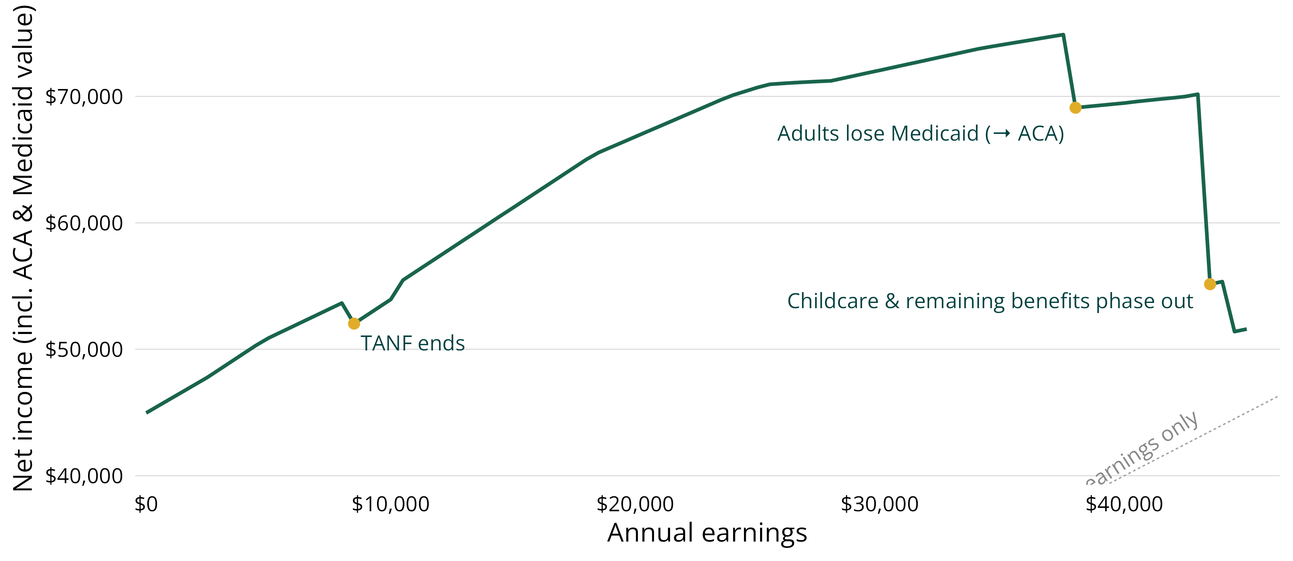
THE SAFETY-NET CLAWBACK
The subsidy has no cliff of its own — but it inherits everyone else's.
Net income climbs with earnings, then drops where Medicaid and other benefits phase out.
Source: Economic Innovation Group 80-80 wage subsidy simulation, 2026.
Notes:
For a representative single-parent household, net income climbs with earnings then drops where Medicaid and other benefits phase out. Roughly one in eight modeled entrants clear their threshold only across a benefit cliff.

Slide 24
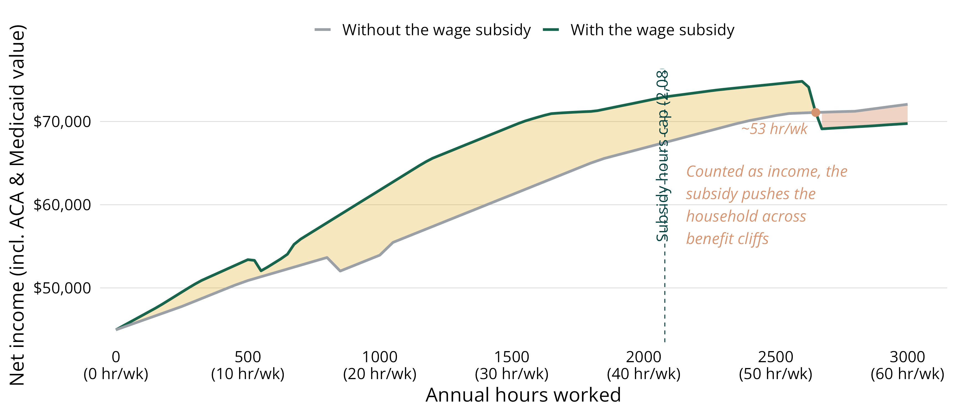
THE SAFETY-NET CLAWBACK
Past ~53 hours a week, the clawback can swallow the subsidy.
The subsidy adds ~$7,800 net at 20 hrs/wk and ~$5,600 at 40; it caps at 2,080 hours a year.
Source: Economic Innovation Group 80-80 wage subsidy simulation, 2026.
Notes:
Same Pennsylvania single parent, wage fixed at $10/hr, hours 0–3,000. Subsidy adds ~$7,800 net at 20 hrs/wk and ~$5,600 at 40. But it stops growing past its 2,080-hour cap, and added earnings eventually cross the Medicaid and childcare cliffs — beyond ~53 hrs/wk the subsidized household is worse off on net.

Slide 25
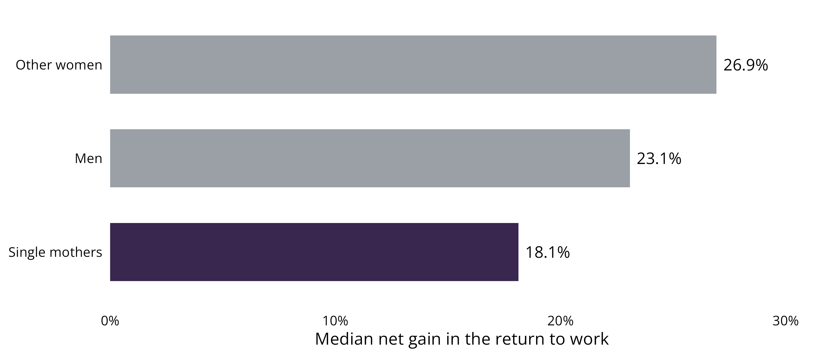
THE SAFETY-NET CLAWBACK
Single mothers gain the least net value from working — half is clawed back.
Median net return to working rises ~18% for single mothers vs. ~27% and ~23% for others.
Source: Economic Innovation Group 80-80 wage subsidy simulation, 2026.
Notes:
Median net return to working rises ~18% for single mothers vs. ~27% for other women and ~23% for men. Whether the subsidy counts against SNAP/Medicaid/TANF eligibility is a first-order design choice for Congress — not a detail to delegate.

Slide 26
06
How sure are you?
Cost is the firm result. Entry is the wider band — and we vary its drivers jointly, not one at a time.

Slide 27
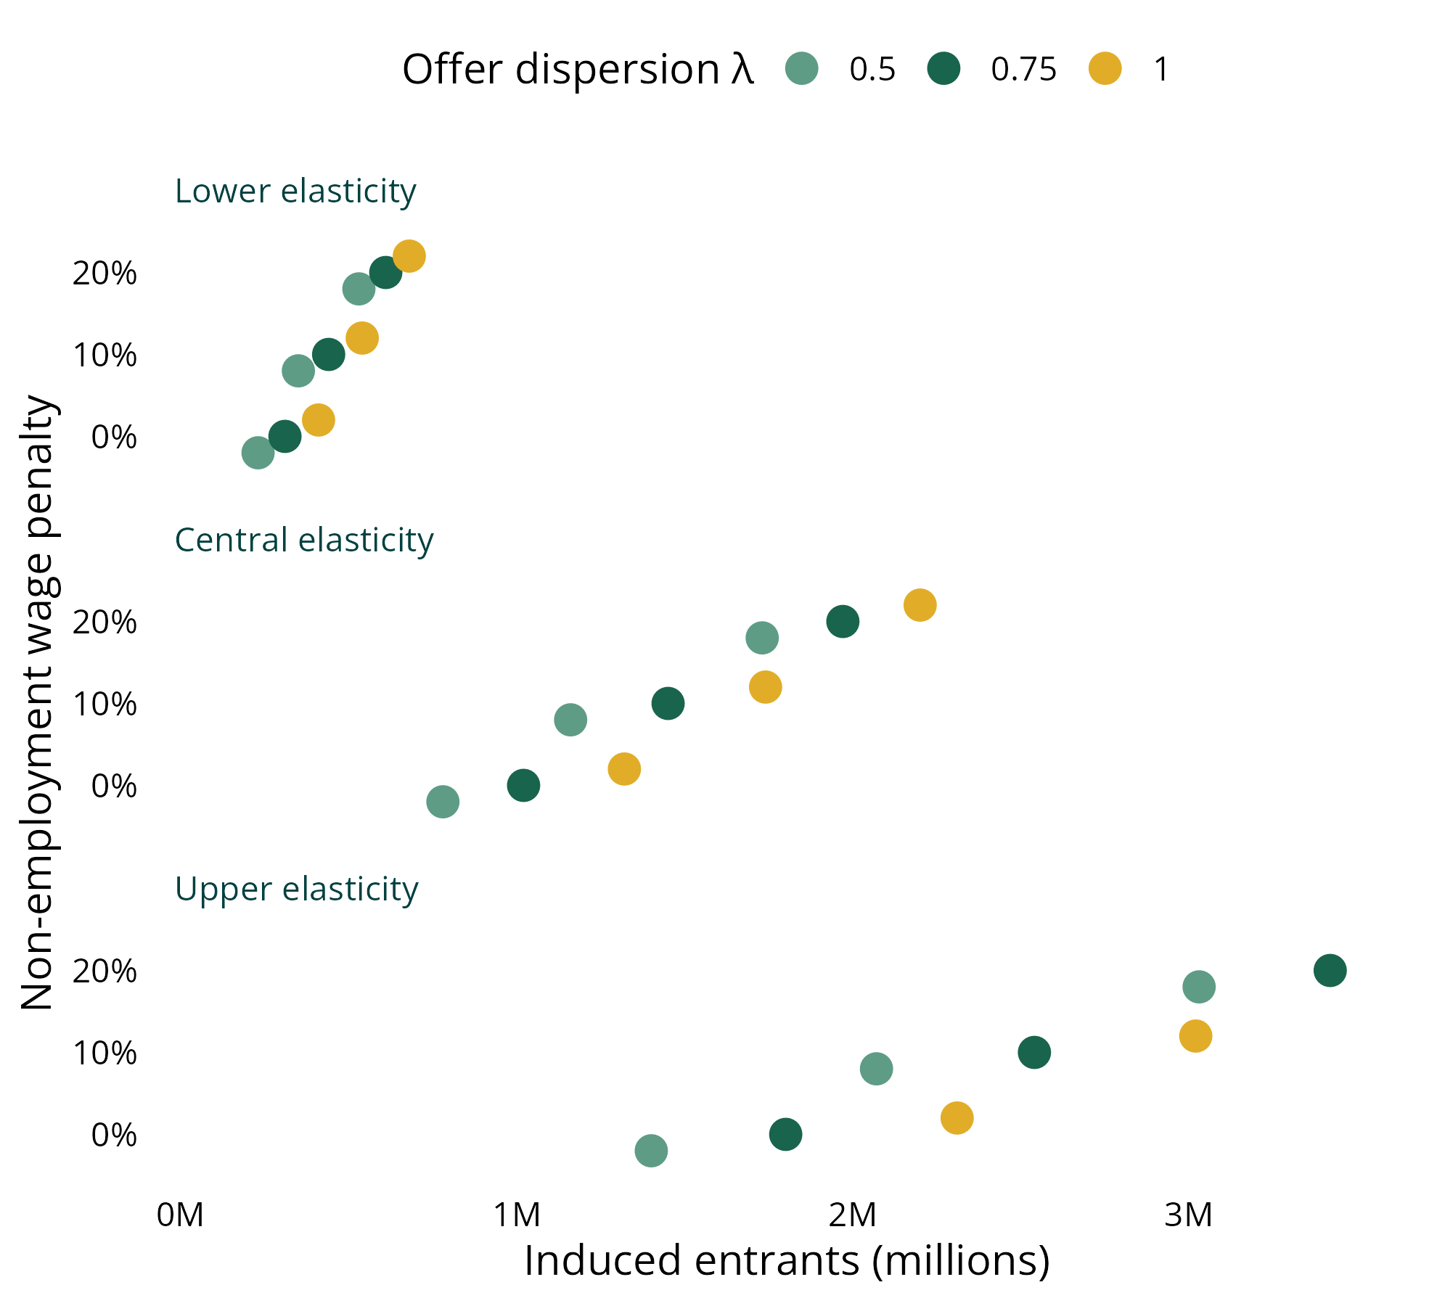
HOW SURE ARE YOU?
Entry spans 0.23–3.81M; the wage penalty is the single largest lever.
27-cell grid: penalty × dispersion × elasticity.
Cost is the firm result: $45–48B net across all three models.
Entry is the wider band — we vary its three drivers jointly, not one at a time.
Drivers: participation elasticity, offer dispersion, and the non-employment wage penalty.
We headline the evidence-central because a zero wage penalty is the one setting the evidence rules out.
Source: Economic Innovation Group 80-80 wage subsidy simulation, 2026.
Notes:
The full 27-cell grid (penalty × dispersion × elasticity) spans 0.23–3.81M. Effects build over years — these are steady-state levels, not first-year effects.

Slide 28
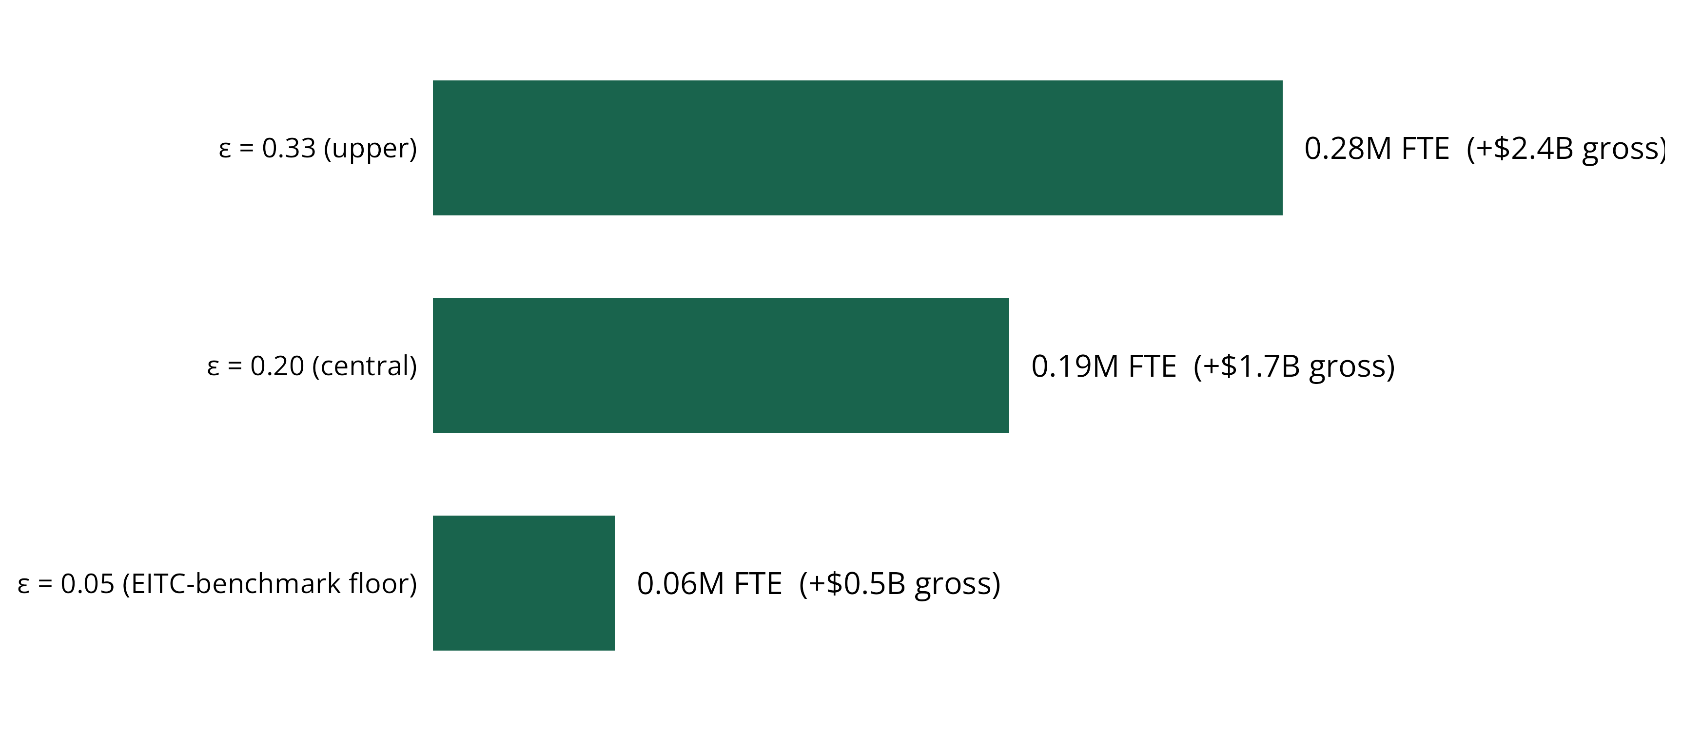
HOW SURE ARE YOU?
A second margin: part-timers add up to ~280K full-time-equivalents.
Consensus elasticities (0.2–0.33) give 0.19–0.28M FTE, alongside ~0.7M FTE from entry.
Source: Economic Innovation Group 80-80 wage subsidy simulation, 2026.
Notes:
The 80-80 pays in full on every added hour up to 40/wk — no phase-out, unlike the EITC. Under consensus elasticities (0.2–0.33), part-time incumbents add 0.19–0.28M FTE, alongside ~0.7M FTE from the entry margin. The hours margin matters nearly as much as entry.

Slide 29
THE BOTTOM LINE
For $45–48B net a year, the 80-80 rule raises pay for 15.9M workers and expands work on two margins.
Largest checks go to the poorest workers and the most distressed states.
~1.49M new entrants (floor ~1.0M; up to 3.81M) plus ~200K FTE of added part-time hours.
Marginal cost per new job is a few thousand dollars; fully-loaded ~$32K still beats the incentives we already run.
The open question is deliberate: whether the subsidy counts against means-tested benefits — a choice for statute.
Explore the interactive model: eig-wage-subsidy.streamlit.app
Notes:
We just answered the expensive questions. Cost is firm; entry is a disciplined band; the safety-net treatment is the first-order remaining design choice.

Slide 30
A
Technical appendix
The machinery behind every number: accounting, transported evidence, and disclosed judgment.

Slide 31
TECHNICAL APPENDIX · THE DATA FOUNDATION
CPS ORG, May 2025–May 2026: $21.00 median, $16.80 target.
From the hourly workforce to the eligible population | Workers (M)
Employed with an observed hourly wage, ages 16–64 | 137.2
Paid by the hour (excludes salaried workers) | 76.0
Less dependent children under 19 | 73.3
Earning below the $16.80 target — eligible | 15.9
Two behavioral models, on purpose
Reduced-form benchmark (EITC/CBO elasticities) and a structural search-and-matching model land within a few $B on net cost — the strongest robustness fact in the project.
One design assumption runs through everything
The subsidy is modeled as taxable income that counts against means-tested eligibility — the conservative reading. We report its consequences rather than assume them away.
Each row is a period-average weighted headcount (EARNWT). Source: EIG simulation, 2026; CPS ORG via IPUMS-CPS.
Notes:
Reading note: every result is accounting, transported evidence, or disclosed judgment. No program with the 80-80's exact design has been evaluated, so behavioral parameters are imported from similar programs.

Slide 32
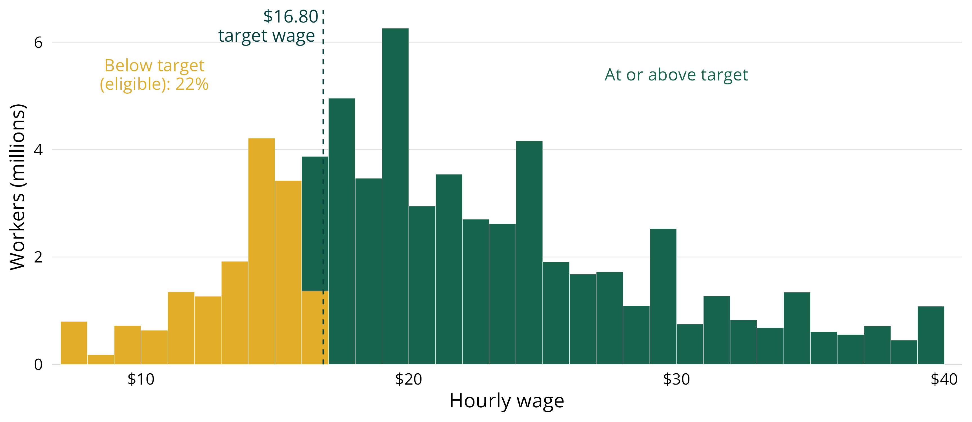
TECHNICAL APPENDIX · THE ELIGIBLE BASE
About one in five paid-hourly workers earn below the target.
Reported wages heap on round-dollar values; the $16.80 target sits on a dense stretch.
Source: Economic Innovation Group 80-80 wage subsidy simulation, 2026.
Notes:
Reported hourly wages heap on round-dollar values, and the $16.80 target sits on a dense stretch — so the eligible count is sensitive to exactly where the target lands.

