Slide 1
Team 6
Notes:
Start here

Slide 2
Members of Team 6
Developers:
Subash Dantuluri (UI, Coder)
Duy Ho (Database, SRS)
Chuong Le (Database)
Brian Nguyen (Coder, UI)
Lance Truong (QR Code Scan, UI, Coder, Logistics)
Designers:
Amanda Bell
John Reamer
Notes:
Introduce team member.
Mention Instructor wanted us to use a logo for our team.

Slide 3
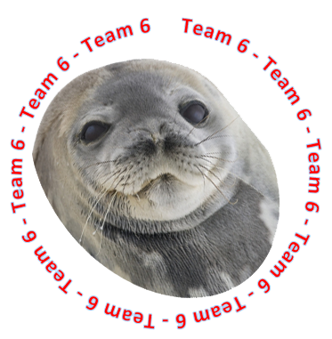
a.k.a “Seal Team Six”

Slide 4
Milestones
UI design (23 Oct 2013)
QR code scan (16 Oct 2013)
Database design (12 Oct 2013)
Database implementation (19 Oct 2013)
Database connectivity (19 Oct 2013)
Database Query, insert, modify (23 Oct 2013)

Slide 5
App Goals
Only authorized personnel gains access
Simplicity and quick access to data sets
Multiple ways to retrieval of record
Record entry
Modify/Add records
Alert notice
Database management system for records

Slide 6
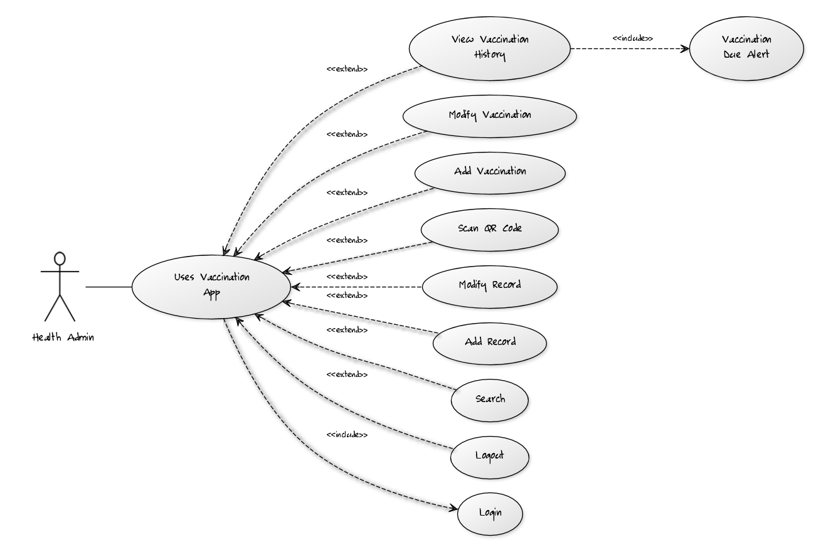

Slide 7
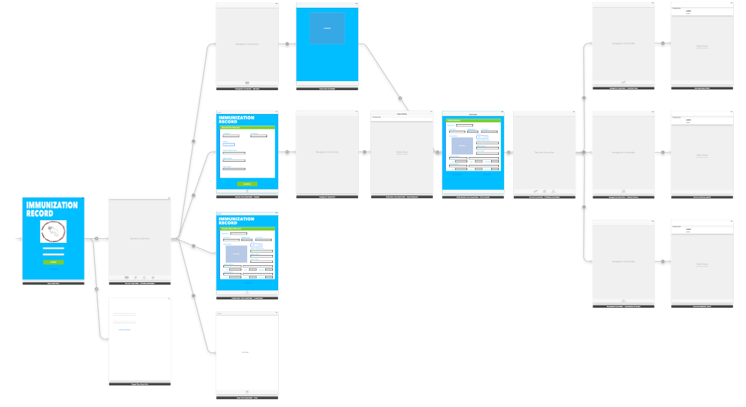
Storyboard

Slide 8
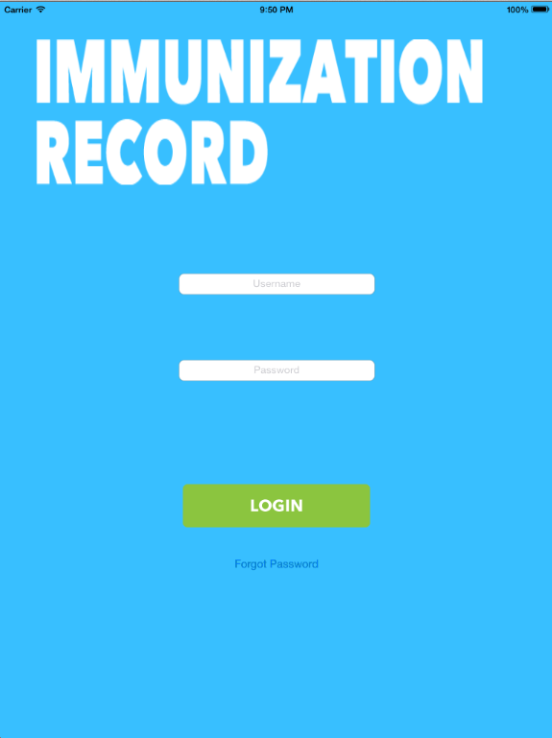
Login Interface

Slide 9
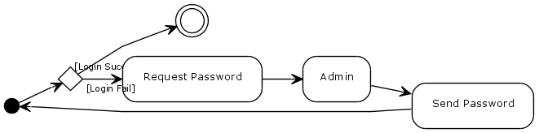
Login Activity Diagram

Slide 10
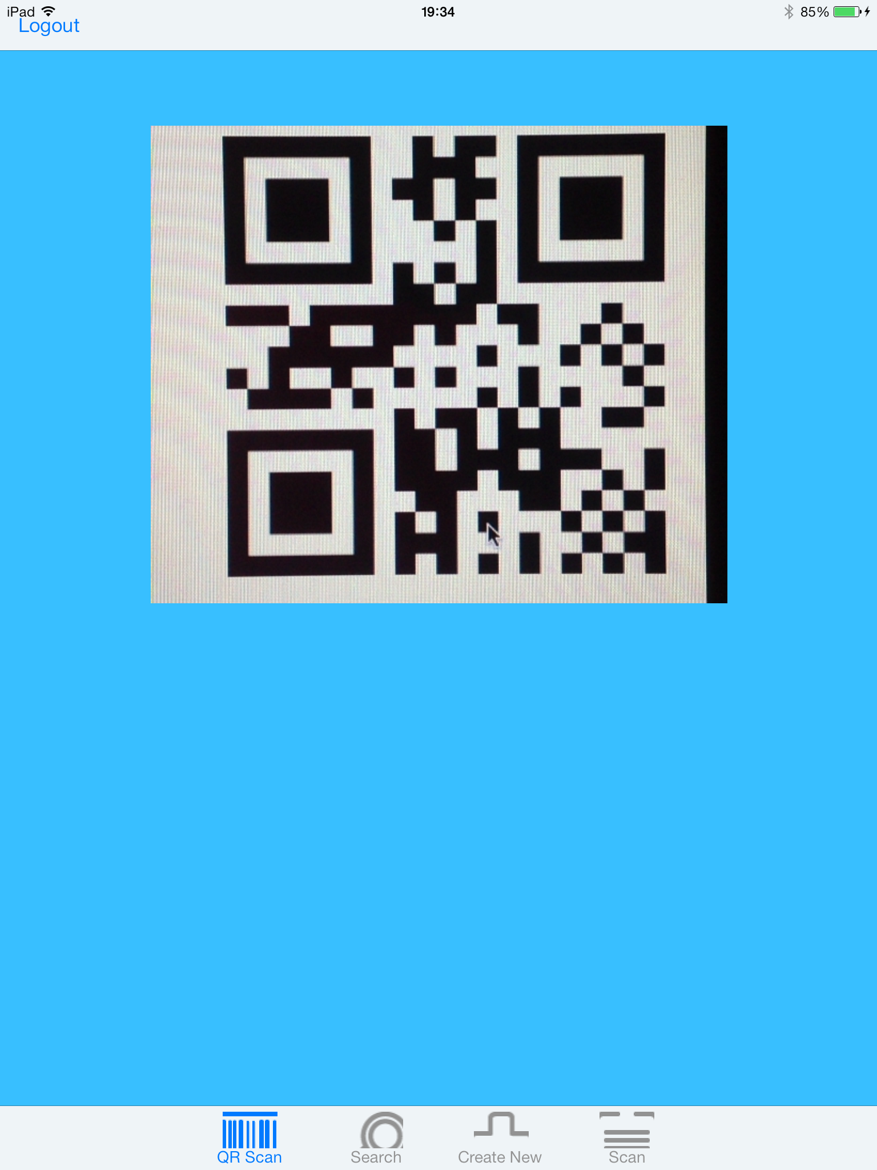
QR Scan View
Zxing Library

Slide 11
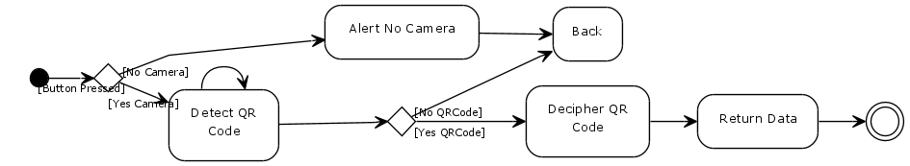
QR Code Scan Activity Diagram

Slide 12
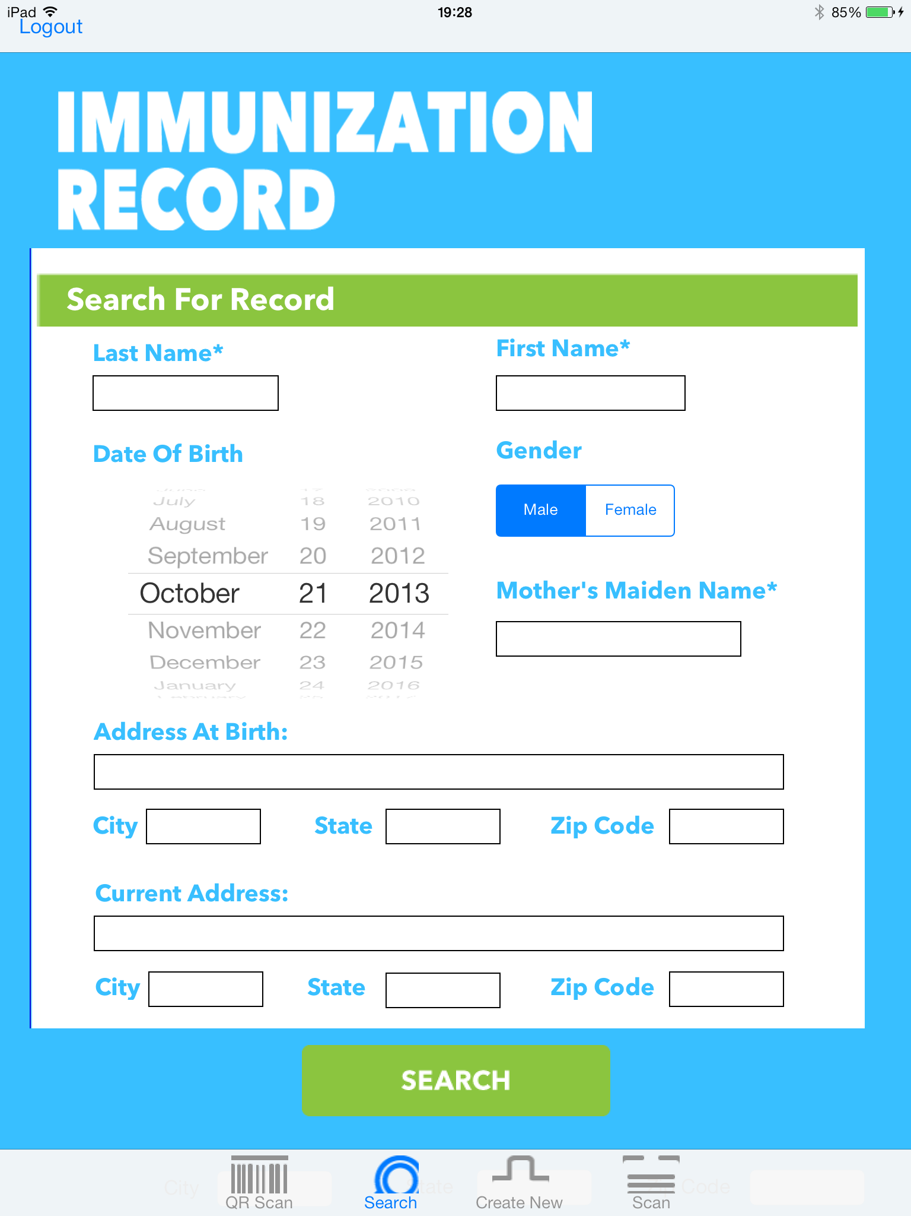
Search View

Slide 13
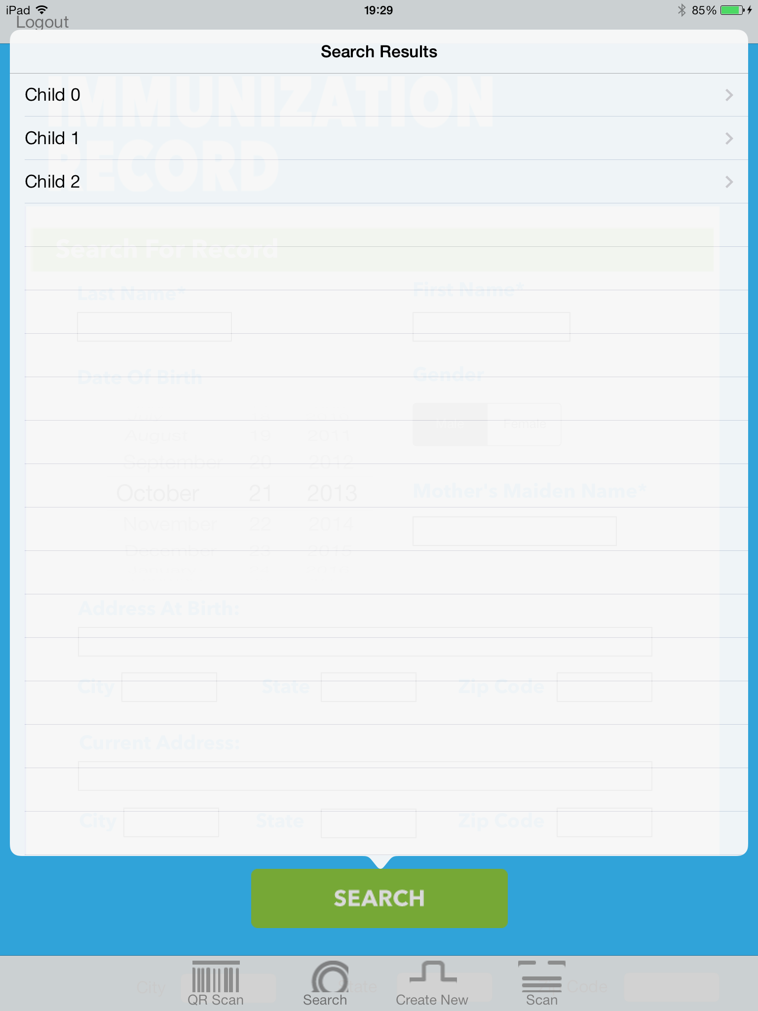
Search Results

Slide 14
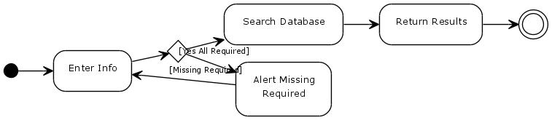
Record Search Activity Diagram

Slide 15
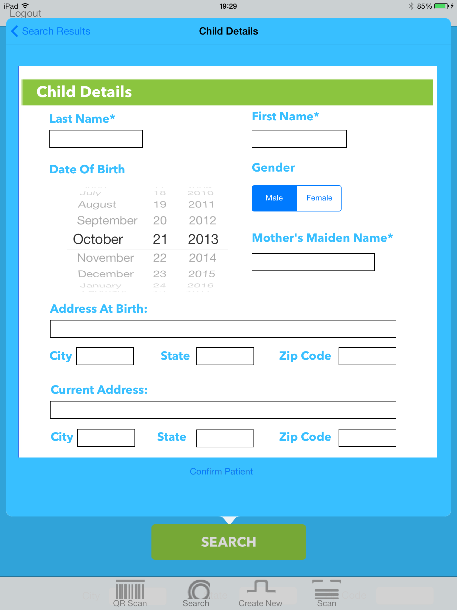
Child Information

Slide 16
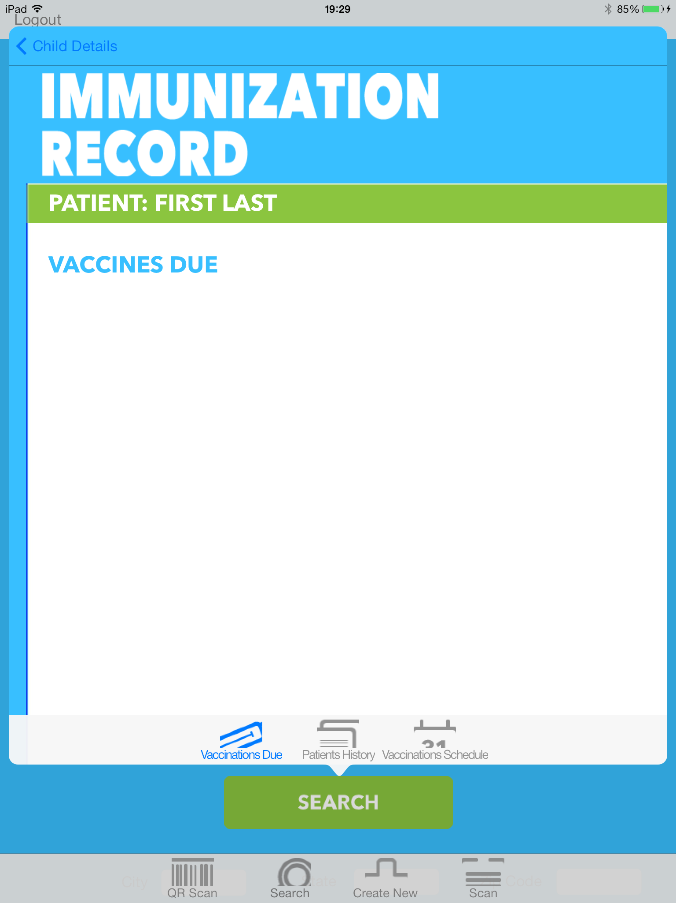
Vaccination Due

Slide 17
PATIENT
PHYSICIAN
has
VACCINATION
create/modify
has
VACCINE

Slide 18
first_name
middle_name
father_name
patient_id
mother_maiden_name
last_name
PATIENT
mother_name
gender
current_address(6)
birthdate
POB_address(6)
Street number
Street name
Zip code
City
State
Country
username
password

Slide 19
first_name
physician_id
middle_name
username
last_name
PHYSICIAN
password
department
email

Slide 20
date_taken
vaccine_id
return_date
VACCINATION
vaccination_id
patient_id
physician_id

Slide 21
vaccine_name
VACCINE
vaccine_id

