Slide 1


2020 IRM VIRTUAL WORLDWIDE WORKSHOP
Branding Guide
Draft 4.0 - August 2020

Slide 2
2020 IRM VIRTUAL WORLDWIDE WORKSHOP
Can We Trust the Numbers?
A guide to COVID Statistical Analysis in Kosovo
Branding Guide
Draft 4.0 - August 2020

Slide 3
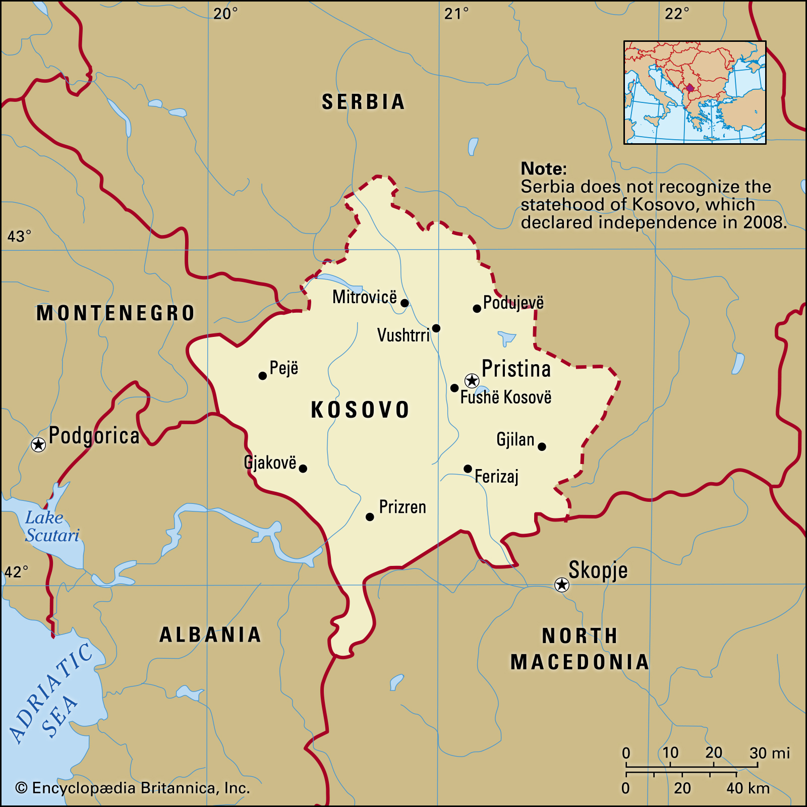
Kosovo? Is that a place?
Notes:
Kosovo is is partially recognized state and disputed territory in Southeastern Europe. On 17 February 2008, Kosovo unilaterally declared its independence from Serbia. It has since gained diplomatic recognition as a sovereign state by 98 UN member states. All its borders apart from the Serbian border are recognized. Kosovo has a population of roughly 1.8 million people.

Slide 4
Timeline of Events
Notes:
12/8/19 First Case of COVID in Wuhan
1/3/20 China Notifies WHO of Outbreak
1/21/20 First Case of COVID in the US
1/24/20 First Case of COVID in Europe
3/11/20 Kosovo Closes Schools
3/13/20 Kosovo Reports First Cases
3/15/20 Kosovo Institutes Restrictive Measures
3/16/20 Major European Countries Close Borders
3/17/20 Kosovo Closes Borders
6/3/20 Government of Kosovo Collapses
6/8/20 New Kosovo Government lifts Restrictions

Slide 5
Area at Issue

Slide 6

Can we trust the data?
Notes:
The new GoK is less cooperative with our efforts to monitor the situation on the ground. We get a lot of push back when we ask questions about strategy and validity of the data. They are even less precise about collection methodology. The FO asks IRM, is there any way to know if the numbers are truthful and valuable. This sets off a long discussion that can be broken down into two parts. Viability and Reliability.
The questions that start to arise come into forms, active manipulation and limiting unfavorable results. There are other questions about confidence interval and biased sample issues. However, the FO asks us to look specifically at the two most concerning issues. Active manipulation and limiting unfavorable results. We must use two very different tool set to get at the answer to these questions.

Slide 7
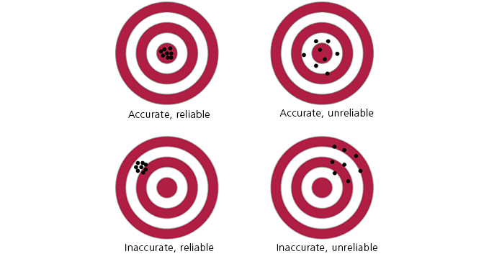
Viability vs Reliability vs Value
Notes:
Reliability and validity are concepts used to evaluate the quality of research. They indicate how well a method, technique or test measures something. Reliability is about the consistency of a measure, and validity is about the accuracy of a measure.

Slide 8
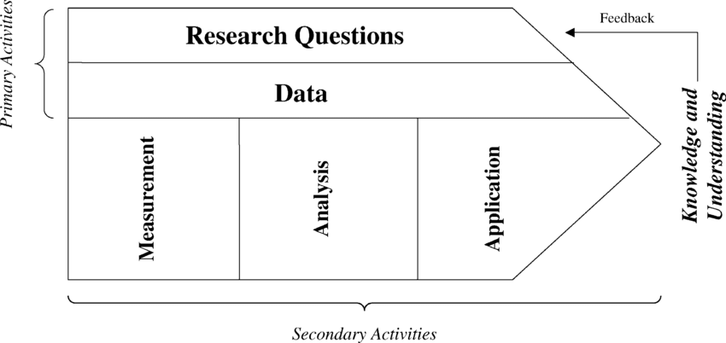
Methodology

Slide 9


Slide 10
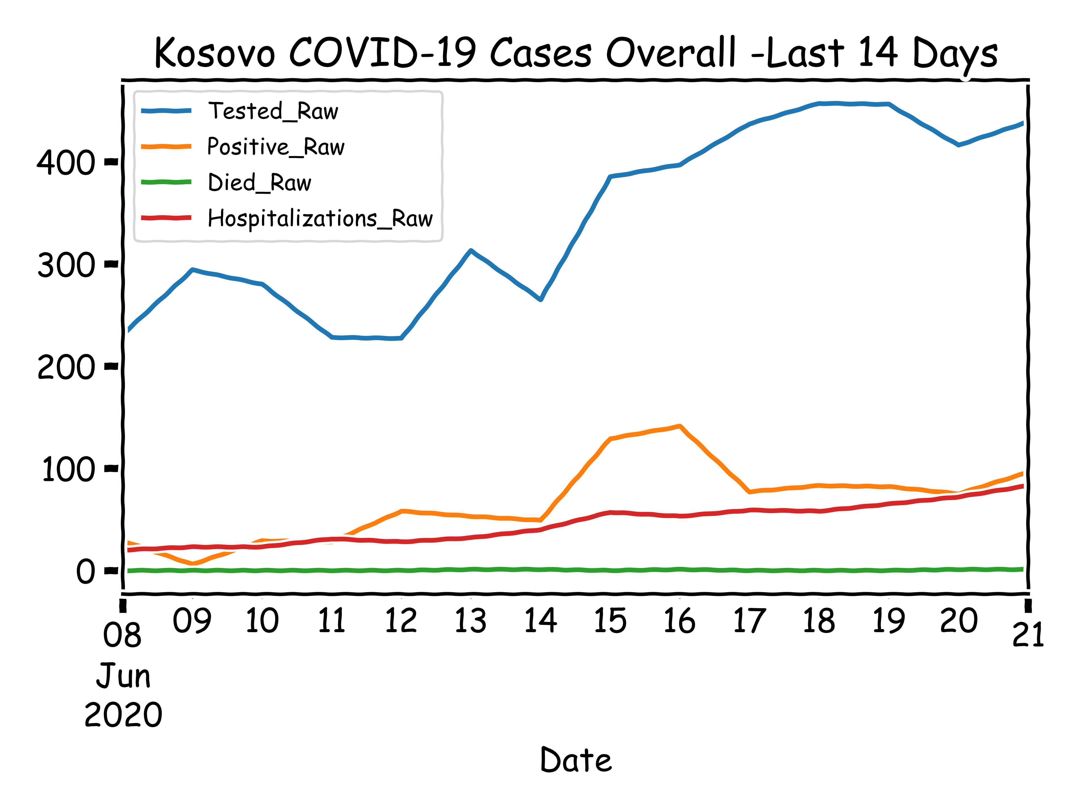
14 Day Picture in Kosovo, Ending June 21
Notes:
14 days after the government eased restrictions, all indicators were headed in the wrong direction except deaths. Death are a lagging indicator, we would expect to see them pick up at some point in the future.

Slide 11
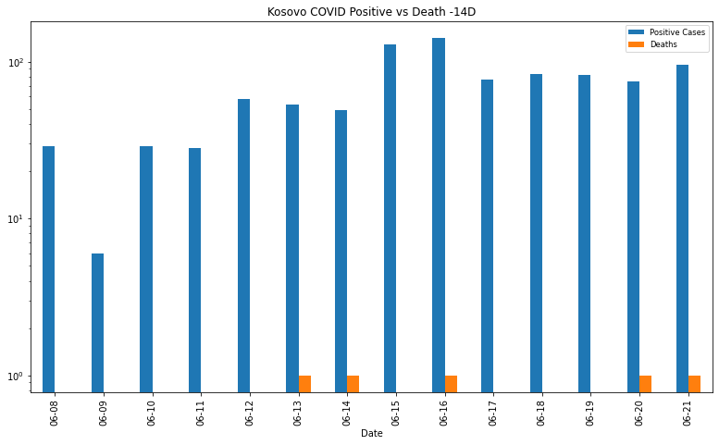

Slide 12
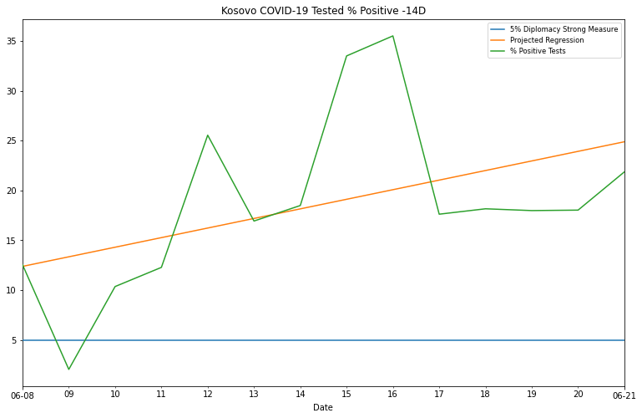
Kosovo 14 Day Percent Positive

Slide 13
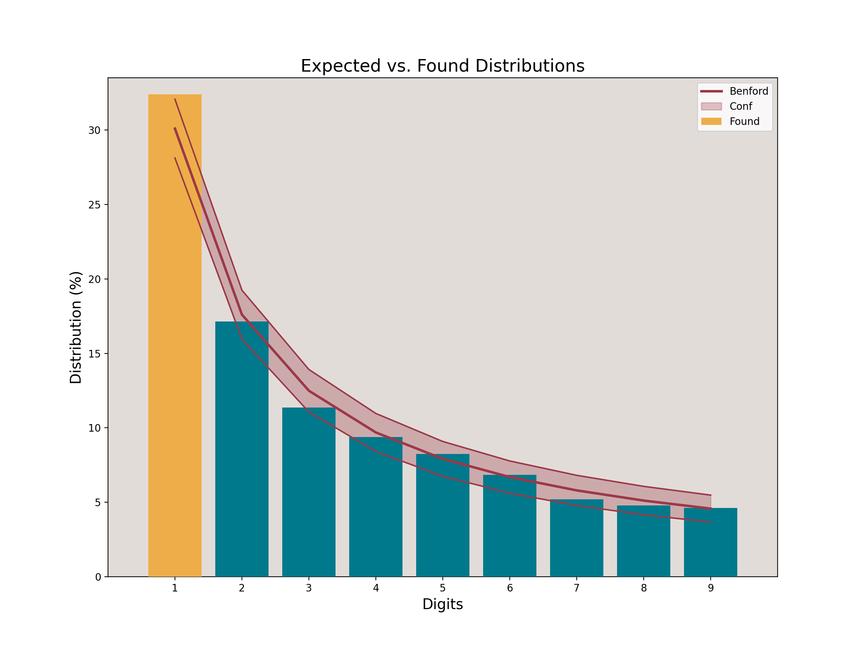
Benford Analysis
Notes:
This graphic was run using the python Benford analysis tool set with a 99% confidence interval.
############### First Digit Test ###############
Mean Absolute Deviation: 0.006312
0.006000 < MAD <= 0.012000: Acceptable conformity.
For confidence level 90%:
Kolmogorov-Smirnov: 0.023042
Critical value: 0.018660 -- FAIL
Chi square: 14.640889
Critical value: 13.362000 -- FAIL
Critical Z-score:1.645.
The entries with the significant positive deviations are:
Expected Found Z_score
First_1_Dig
1 0.30103 0.324072 3.010433

Slide 14
Active Cases Daily Swing

Slide 15

Working with a limited data set

Slide 16
Number of Deaths

