Slide 1


2020 IRM VIRTUAL WORLDWIDE WORKSHOP
Branding Guide
Draft 4.0 - August 2020

Slide 2



Who is Brian Levin?
Notes:
Brian Levin has worked in every field in informatics. He started with SUNY working with researchers and then moved to a senior role at Dartmouth School of Data Science. After 3 years as the Senior Medical Informaticist, he was promoted to Research Privacy and Security Officer. He currently works for the State Department as an Information Management Specialist stationed in Pristina Kosovo.

Slide 3
The Team
Courtney Strand, Medical Provider
Andreas Welch, IMO
Christopher Dittmeier, Ph.D, Political Officer

Slide 4
2020 IRM VIRTUAL WORLDWIDE WORKSHOP
Can We Trust the Numbers?
A guide to COVID Statistical Analysis in Kosovo
Branding Guide
Draft 4.0 - August 2020

Slide 5
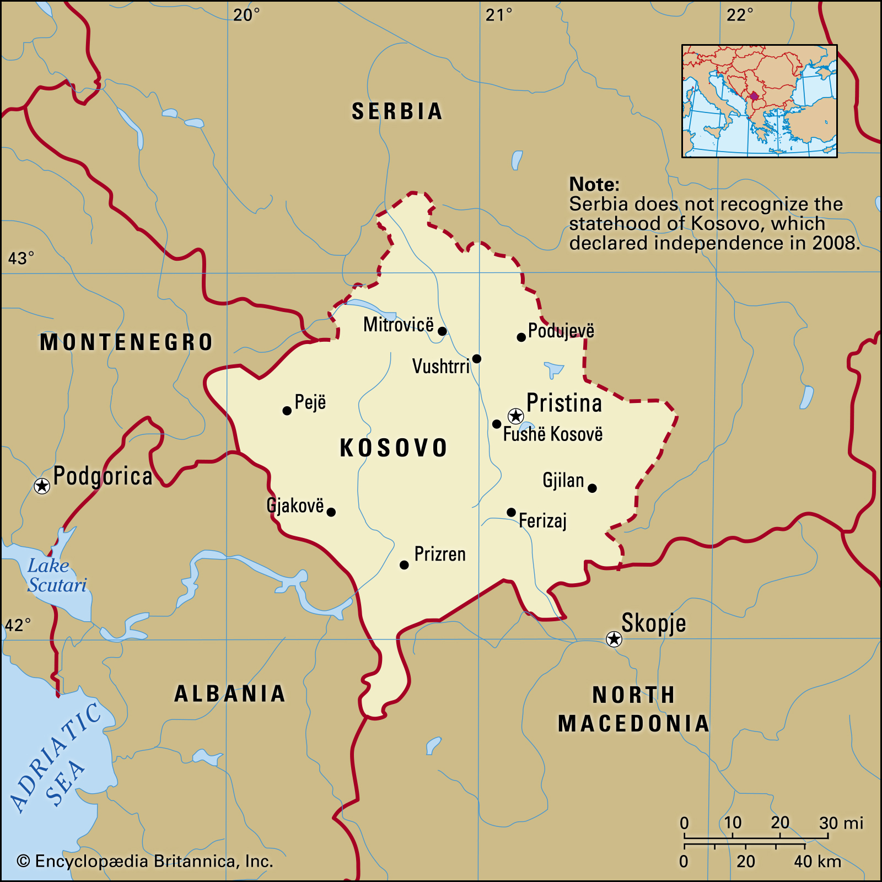
Kosovo? Is that a place?
Notes:
Kosovo is is partially recognized state and disputed territory in Southeastern Europe. On 17 February 2008, Kosovo unilaterally declared its independence from Serbia. It has since gained diplomatic recognition as a sovereign state by 98 UN member states. All its borders apart from the Serbian border are recognized. Kosovo has a population of roughly 1.8 million people.

Slide 6
Timeline of Events
Notes:
12/8/19 First Case of COVID in Wuhan
1/3/20 China Notifies WHO of Outbreak
1/21/20 First Case of COVID in the US
1/24/20 First Case of COVID in Europe
3/11/20 Kosovo Closes Schools
3/13/20 Kosovo Reports First Cases
3/15/20 Kosovo Institutes Restrictive Measures
3/16/20 Major European Countries Close Borders
3/17/20 Kosovo Closes Borders
6/3/20 Government of Kosovo Collapses
6/8/20 New Kosovo Government lifts Restrictions

Slide 7

Kosovo’s Swing
Notes:
As the new government came to power, it eased restrictions very quickly.

Slide 8
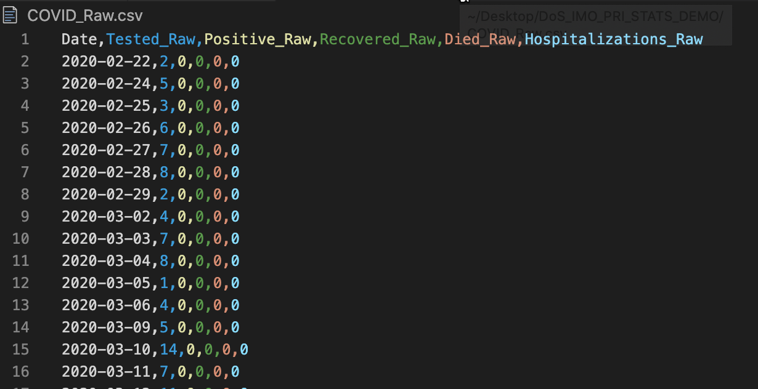
What does our data set look like?

Slide 9
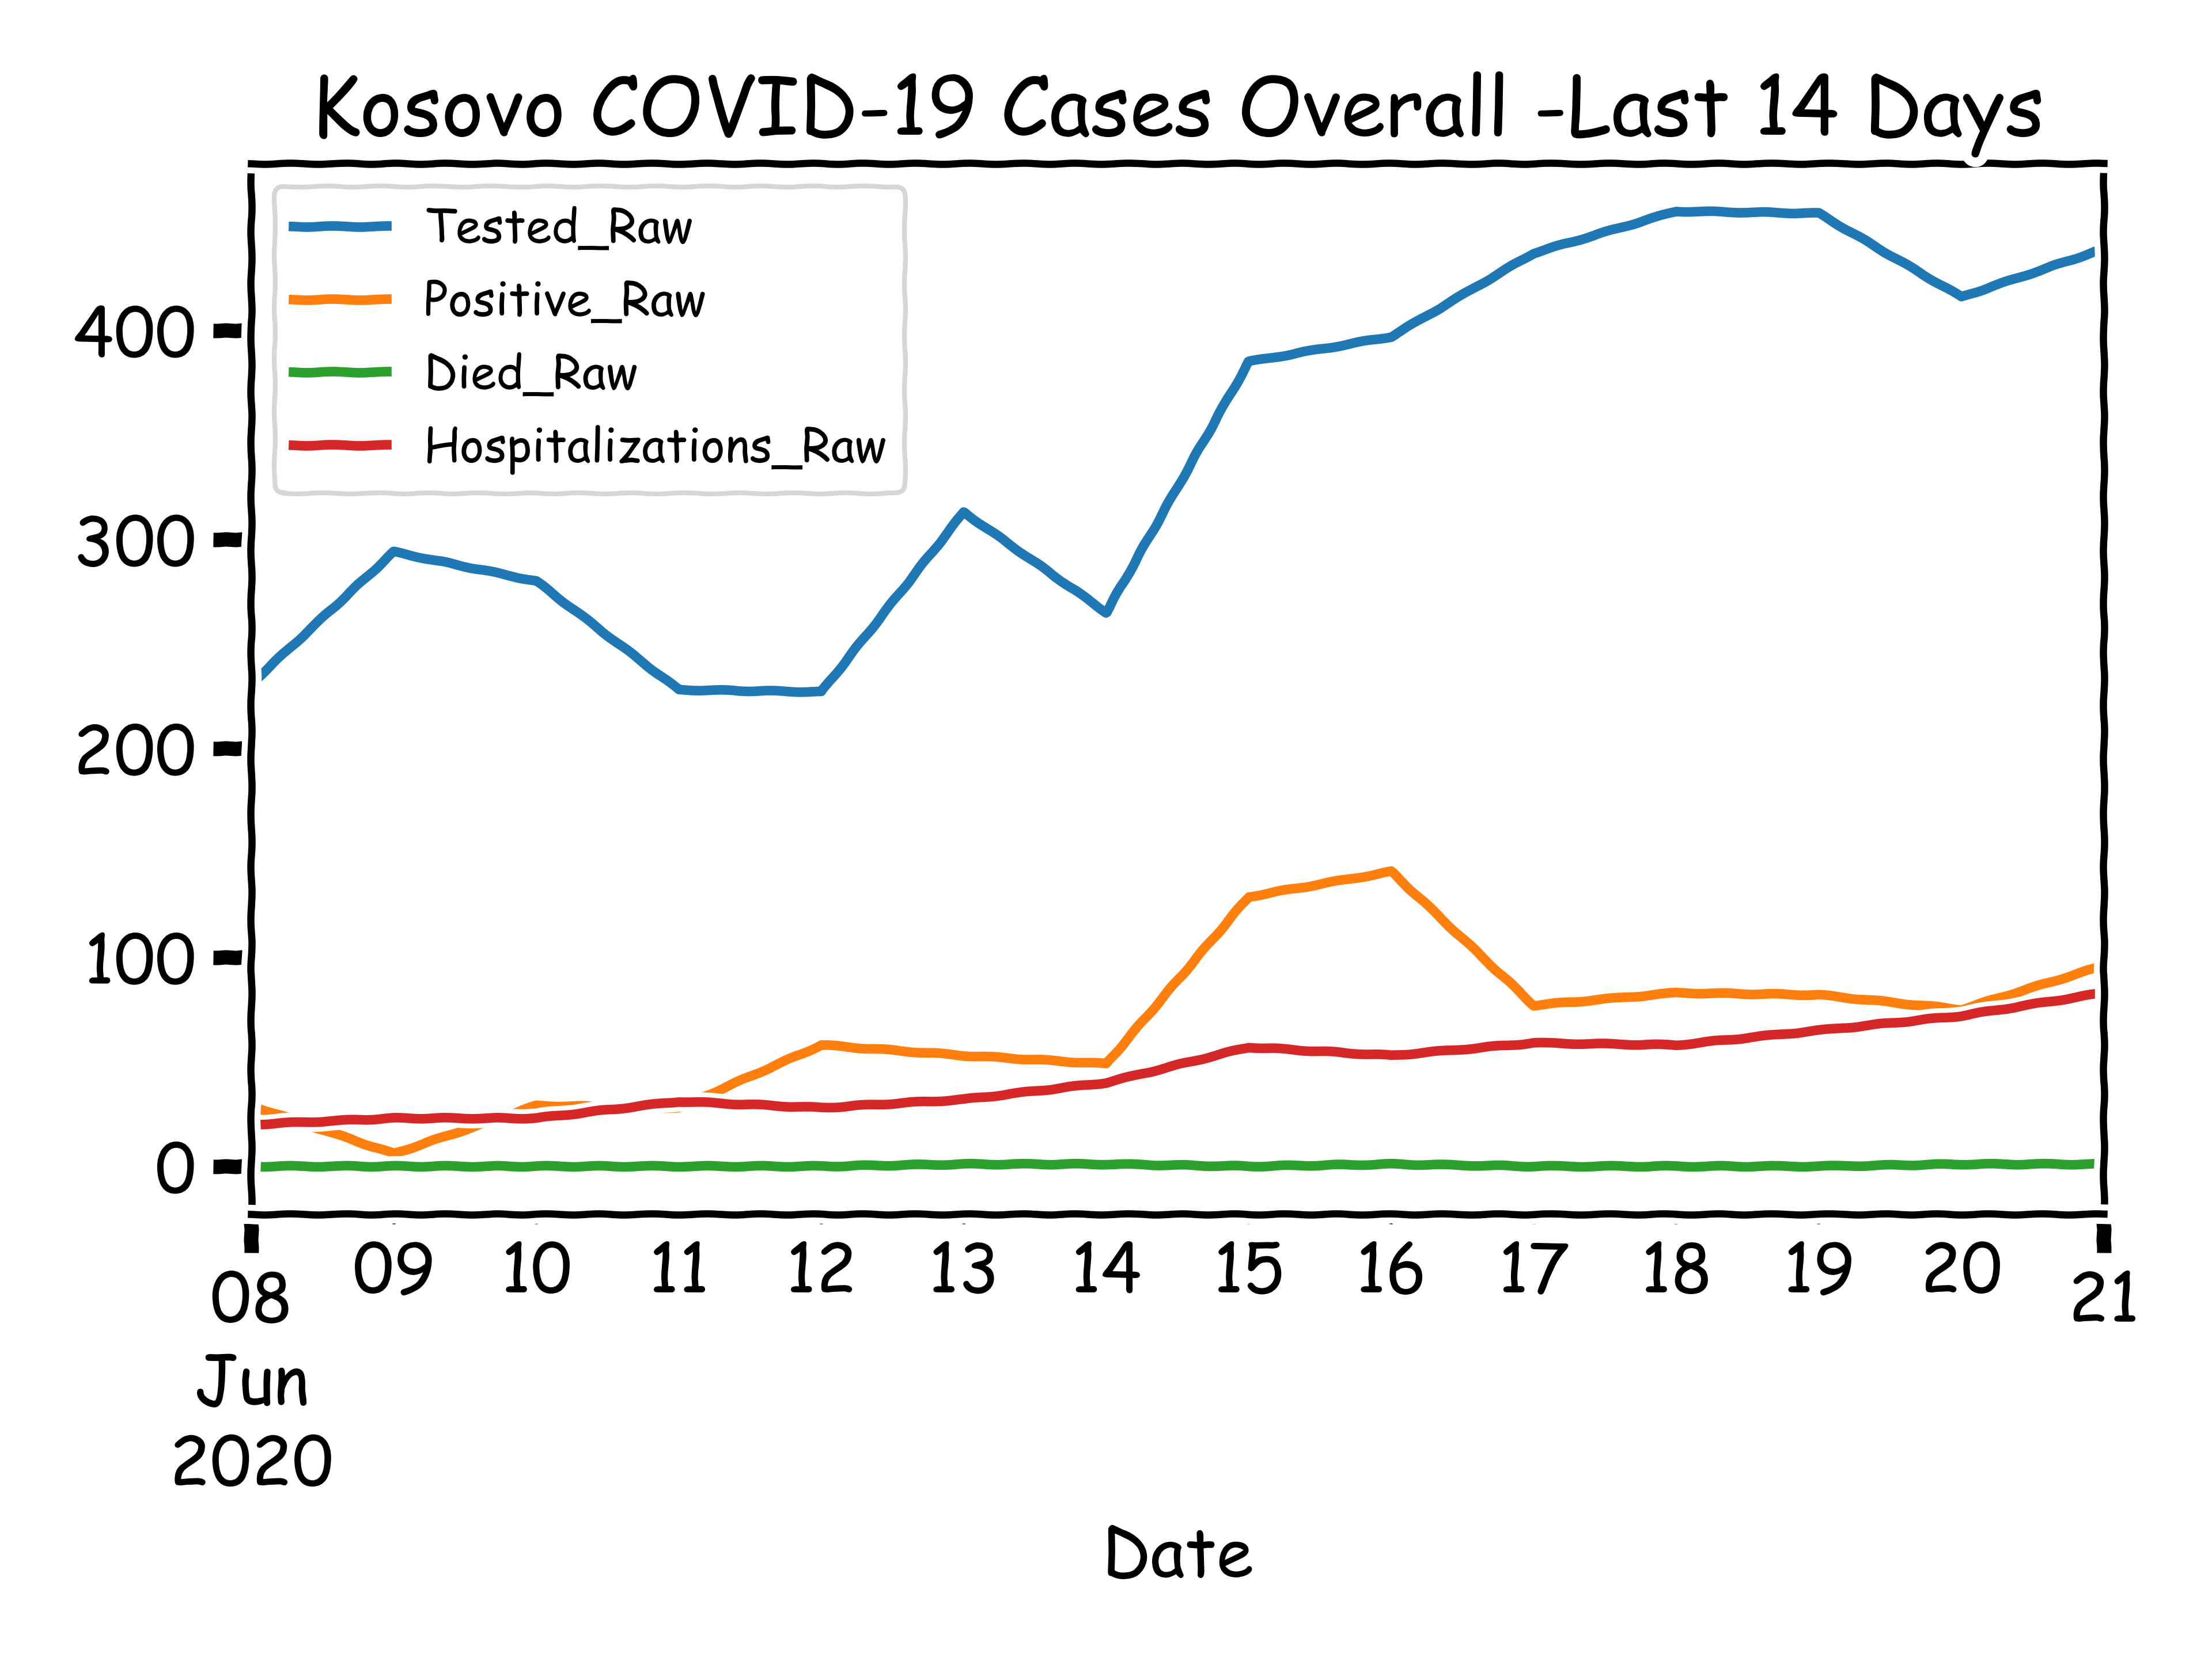
14 Day Picture in Kosovo, Ending June 21
Notes:
14 days after the government eased restrictions, all indicators were headed in the wrong direction except deaths. Death are a lagging indicator, we would expect to see them pick up at some point in the future.

Slide 10
Calculated Data
 | Tested | Positive | Recovered | Died | Hospitalizations
count | 233.000000 | 233.000000 | 233.000000 | 233.000000 | 233.000000
mean | 335.407725 | 71.300429 | 62.605150 | 2.888412 | 101.957082
std | 195.264214 | 71.923120 | 66.416777 | 3.983316 | 175.937998
min | 1.000000 | 0.000000 | 0.000000 | 0.000000 | 0.000000
25% | 201.000000 | 9.000000 | 3.000000 | 0.000000 | 0.000000
50% | 314.000000 | 48.000000 | 35.000000 | 1.000000 | 11.000000
75% | 474.000000 | 118.000000 | 118.000000 | 4.000000 | 114.000000
max | 889.000000 | 276.000000 | 254.000000 | 16.000000 | 926.000000
var | 38128.113216 | 5172.935215 | 4411.188249 | 15.866805 | 30954.179185
skew | 0.021364 | 0.947101 | 0.812954 | 1.505706 | 2.116943
kurt | -0.776542 | -0.196601 | -0.506415 | 1.439248 | 3.916489
mad | 167.621691 | 59.499236 | 57.422498 | 3.129584 | 126.899114

Slide 11
Area at Issue
Notes:
As the new government came to power, it eased restrictions very quickly.

Slide 12
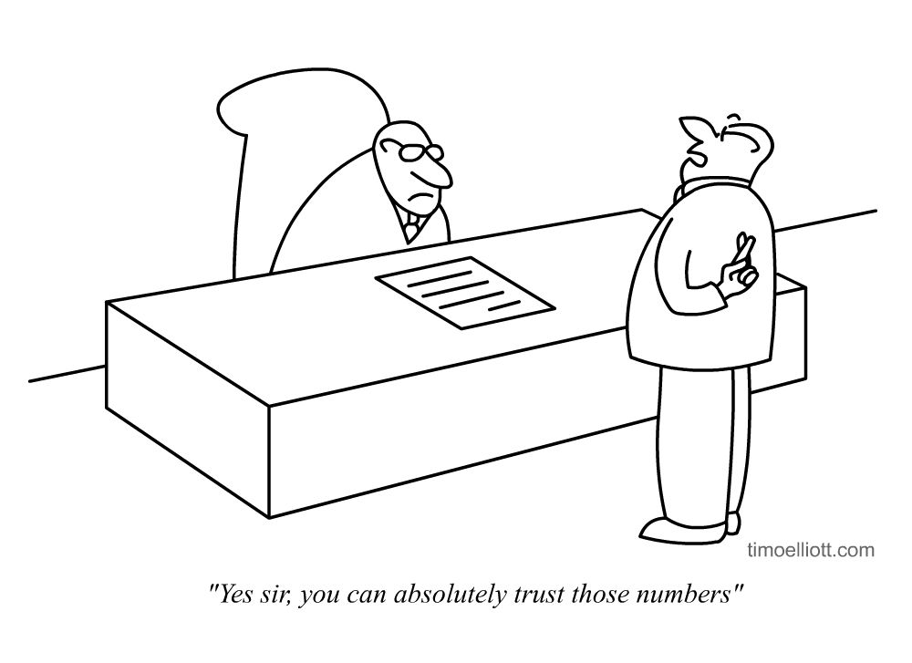
Can we trust the data?
Notes:
The new GoK is less cooperative with our efforts to monitor the situation on the ground. We get a lot of push back when we ask questions about strategy and validity of the data. They are even less precise about collection methodology. The FO asks IRM, is there any way to know if the numbers are truthful and valuable. This sets off a long discussion that can be broken down into two parts. Viability and Reliability.
The questions that start to arise come into forms, active manipulation and limiting unfavorable results. There are other questions about confidence interval and biased sample issues. However, the FO asks us to look specifically at the two most concerning issues. Active manipulation and limiting unfavorable results. We must use two very different tool set to get at the answer to these questions.

Slide 13
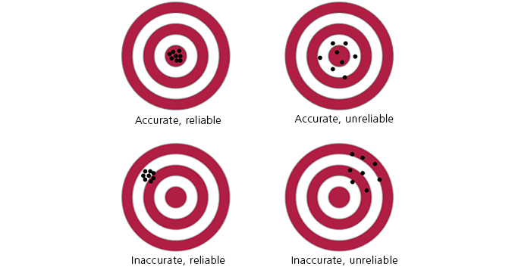
Viability vs Reliability vs Value
Notes:
Reliability and validity are concepts used to evaluate the quality of research. They indicate how well a method, technique or test measures something. Reliability is about the consistency of a measure, and validity is about the accuracy of a measure.

Slide 14
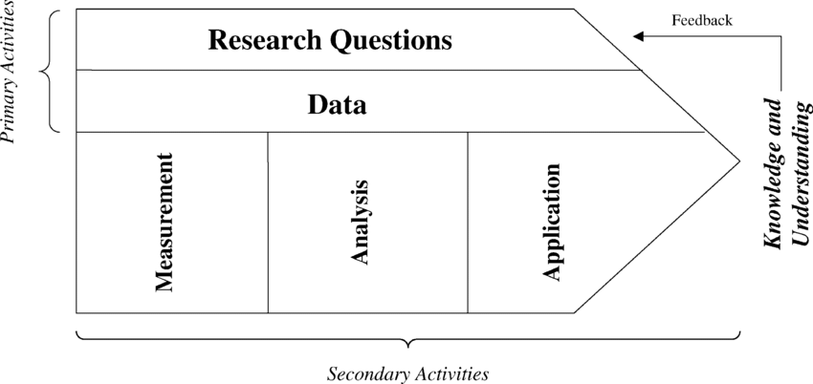
Methodology

Slide 15
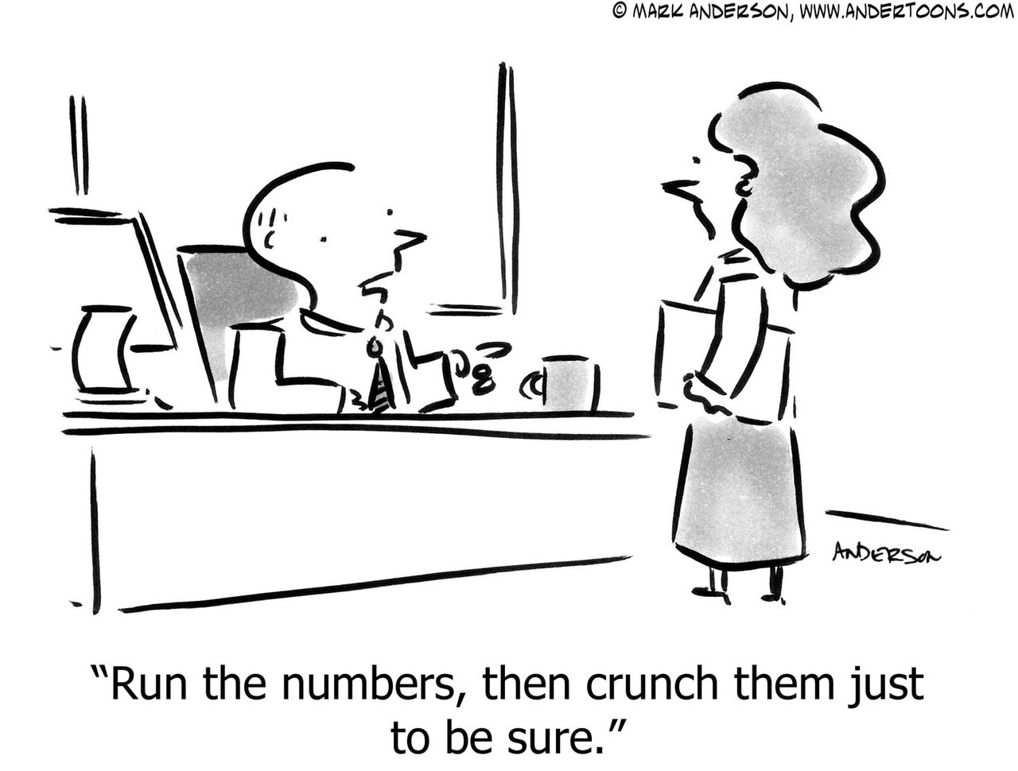
Front Office Request!

Slide 16
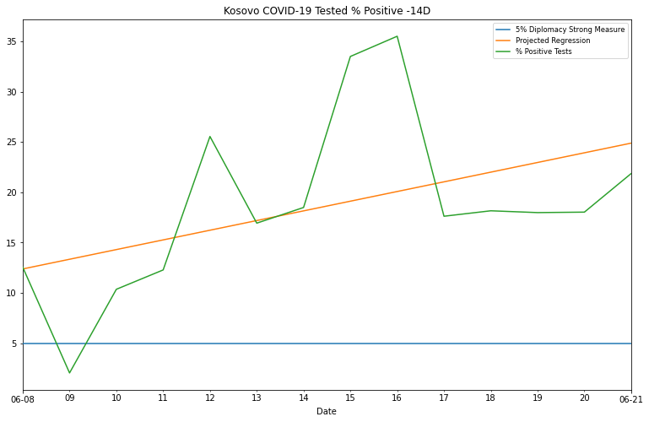
Kosovo 14 Day Percent Positive

Slide 17
Active Cases Daily Swing

Slide 18
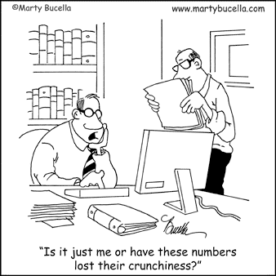
Working with a limited data set

Slide 19
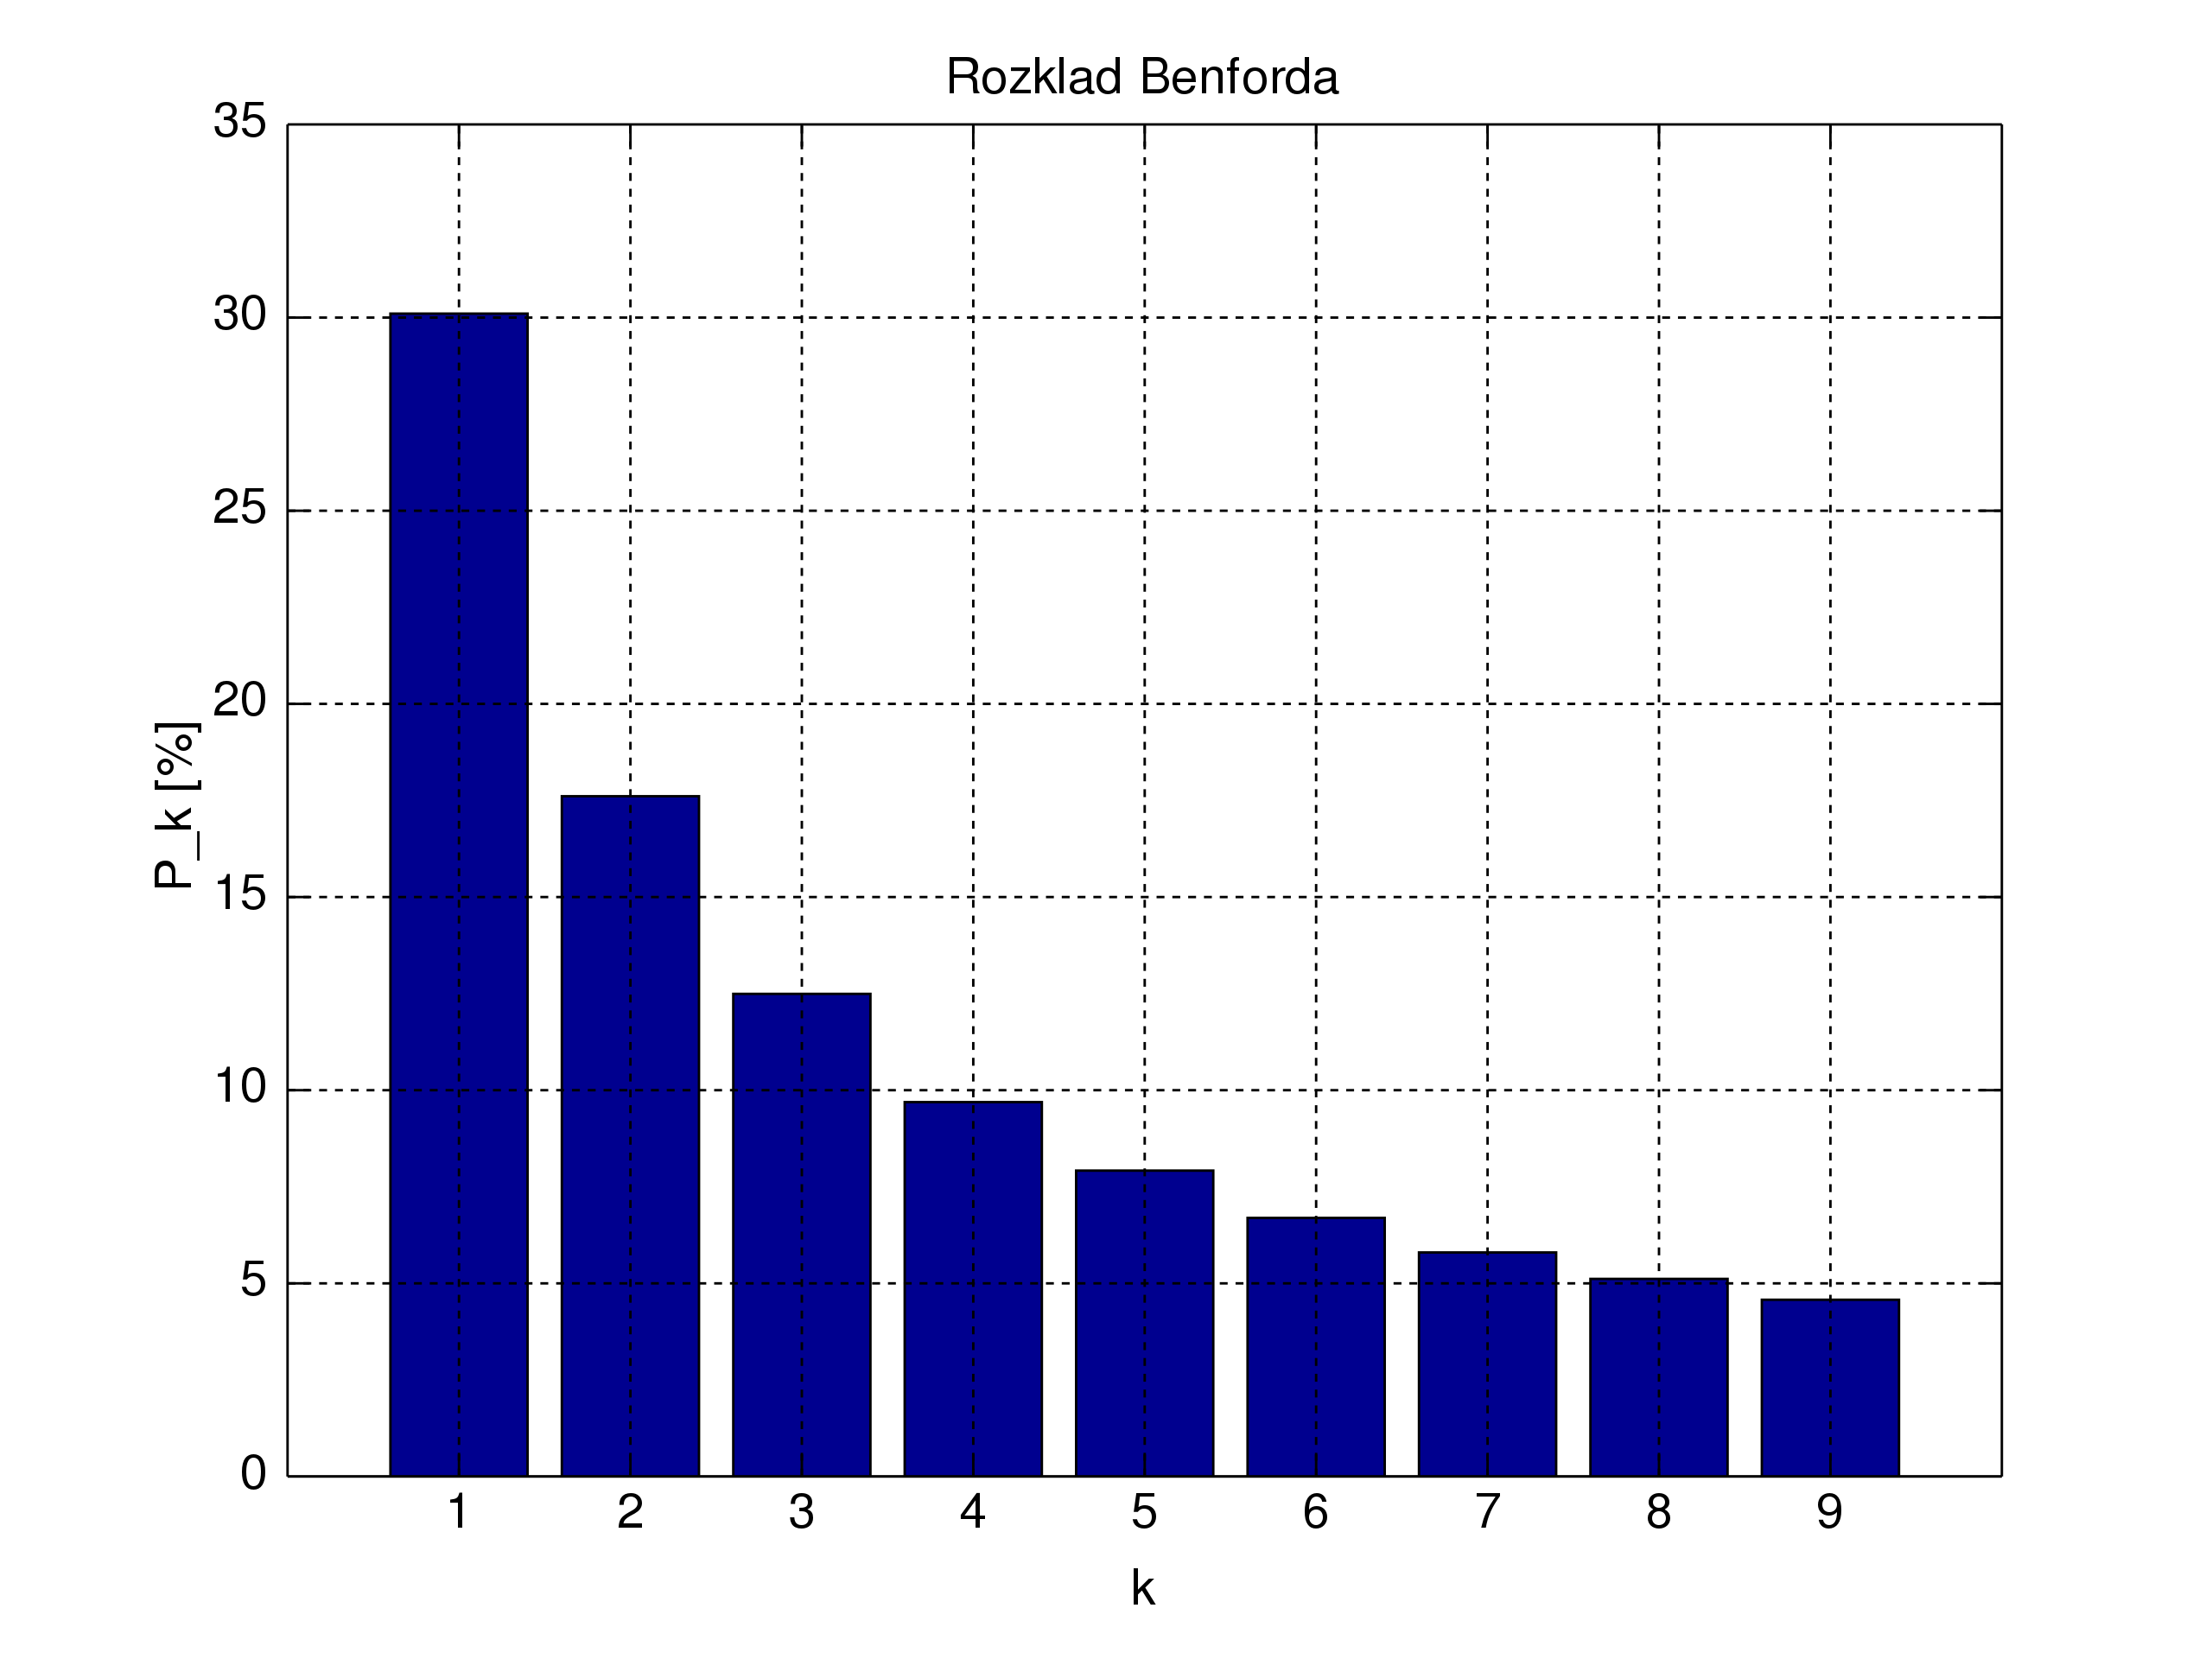
Benford’s Law
Notes:
The law states that in many naturally occurring collections of numbers, the leading digit is likely to be small. For example, in sets that obey the law, the number 1 appears as the leading significant digit about 30% of the time, while 9 appears as the leading significant digit less than 5% of the time. If the digits were distributed uniformly, they would each occur about 11.1% of the time. Benford's law also makes predictions about the distribution of second digits, third digits, digit combinations, and so on.
Frank Albert Benford Jr. was an American electrical engineer and physicist best known for rediscovering and generalizing Benford's Law, a statistical statement about the occurrence of digits in lists of data.
Benford is also known for having devised, in 1937, an instrument for measuring the refractive index of glass. An expert in optical measurements, he published 109 papers in the fields of optics and mathematics and was granted 20 patents on optical devices.
It has been shown that this result applies to a wide variety of data sets, including electricity bills, street addresses, stock prices, house prices, population numbers, death rates, lengths of rivers, and physical and mathematical constants. Like other general principles about natural data—for example the fact that many data sets are well approximated by a normal distribution—there are illustrative examples and explanations that cover many of the cases where Benford's law applies, though there are many other cases where Benford's law applies that resist a simple explanation. It tends to be most accurate when values are distributed across multiple orders of magnitude, especially if the process generating the numbers is described by a power law (which are common in nature).
The discovery of Benford's law goes back to 1881, when the Canadian-American astronomer Simon Newcomb noticed that in logarithm tables the earlier pages (that started with 1) were much more worn than the other pages. Newcomb's published result is the first known instance of this observation and includes a distribution on the second digit, as well. Newcomb proposed a law that the probability of a single number N being the first digit of a number was equal to log(N + 1) − log(N).
The phenomenon was again noted in 1938 by the physicist Frank Benford,[7] who tested it on data from 20 different domains and was credited for it. His data set included the surface areas of 335 rivers, the sizes of 3259 US populations, 104 physical constants, 1800 molecular weights, 5000 entries from a mathematical handbook, 308 numbers contained in an issue of Reader's Digest, the street addresses of the first 342 persons listed in American Men of Science and 418 death rates. The total number of observations used in the paper was 20,229. This discovery was later named after Benford (making it an example of Stigler's law).
In 1995, Ted Hill proved the result about mixed distributions mentioned below.[11][12]
Not to be confused with Benford’s Law of Controversy (Gregory Benford), "Passion is inversely proportional to the amount of real information available."

Slide 20
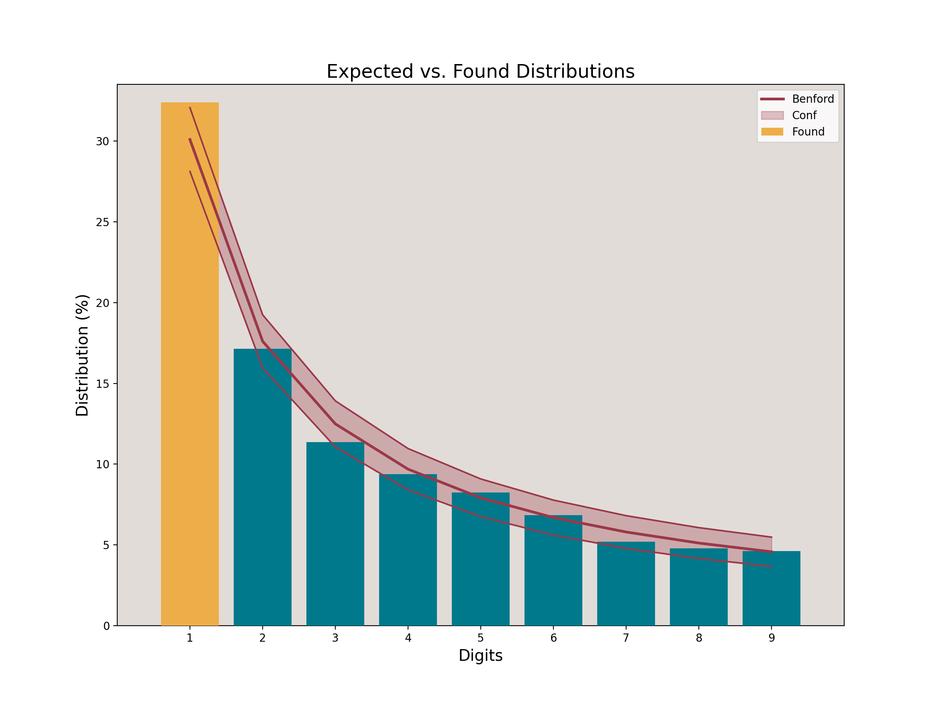
Benford’s Law Analysis
Notes:
This graphic was run using the python Benford analysis tool set with a 99% confidence interval.
############### First Digit Test ###############
Mean Absolute Deviation: 0.006312
0.006000 < MAD <= 0.012000: Acceptable conformity.
For confidence level 90%:
Kolmogorov-Smirnov: 0.023042
Critical value: 0.018660 -- FAIL
Chi square: 14.640889
Critical value: 13.362000 -- FAIL
Critical Z-score:1.645.
The entries with the significant positive deviations are:
Expected Found Z_score
First_1_Dig
1 0.30103 0.324072 3.010433

Slide 21
Number of Deaths

Slide 22
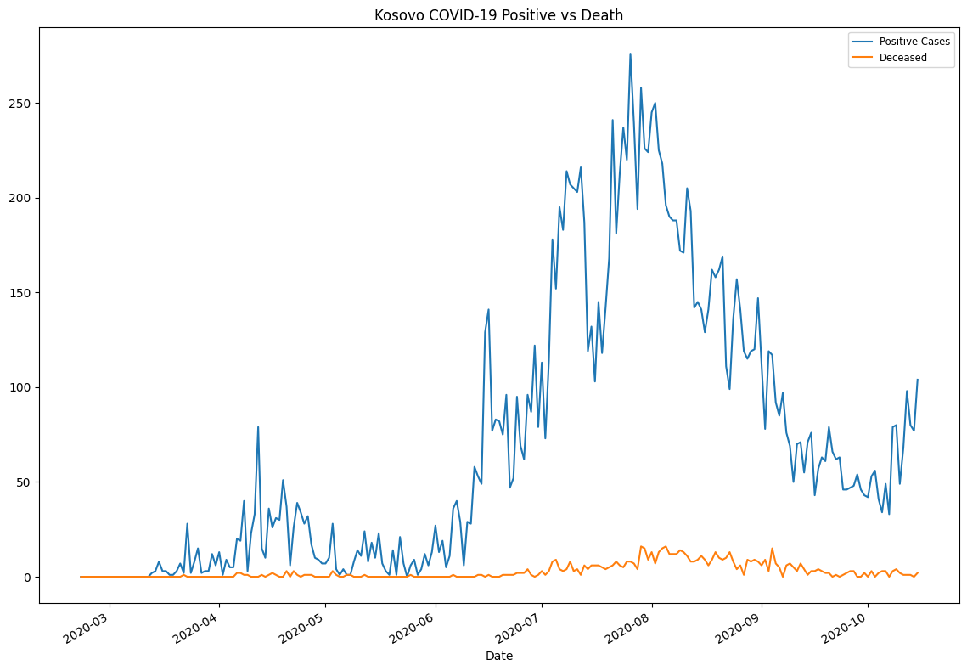
Lagging Indicators: Deaths vs Positive Cases
Notes:
C19 has a roughly 3.4% mortality rate

Slide 23
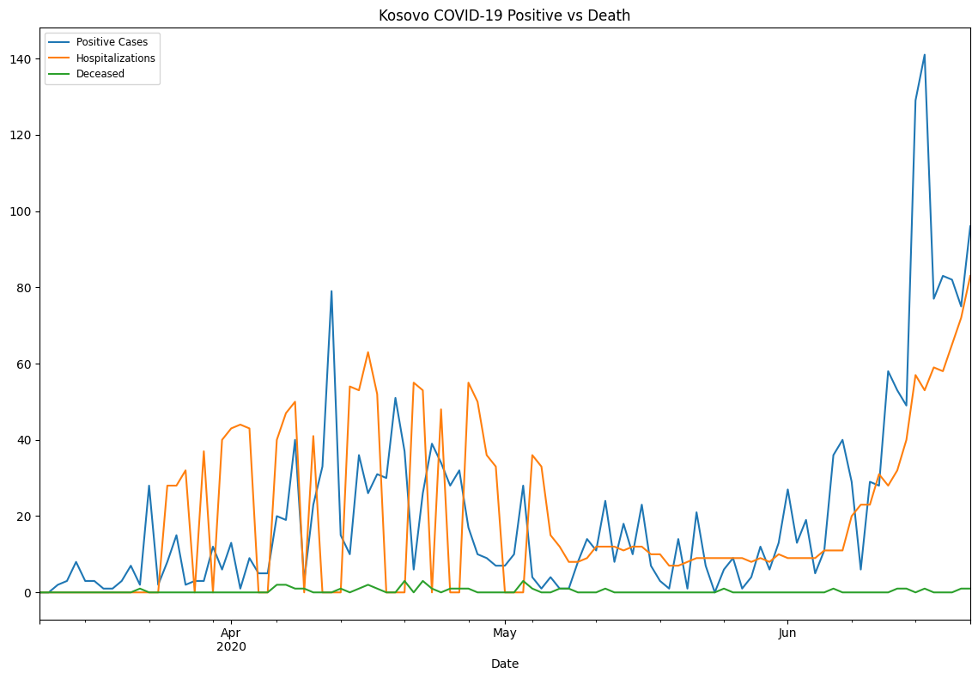
Lagging Indicators: Why not Hospitalizations?
Notes:
C19 has a roughly 3.4% mortality rate

Slide 24

Detour into Python? Time Permitting!

Slide 25
Links!
My GitHub Page
This Presentations Repository

Slide 26
Questions?
?

