Slide 1
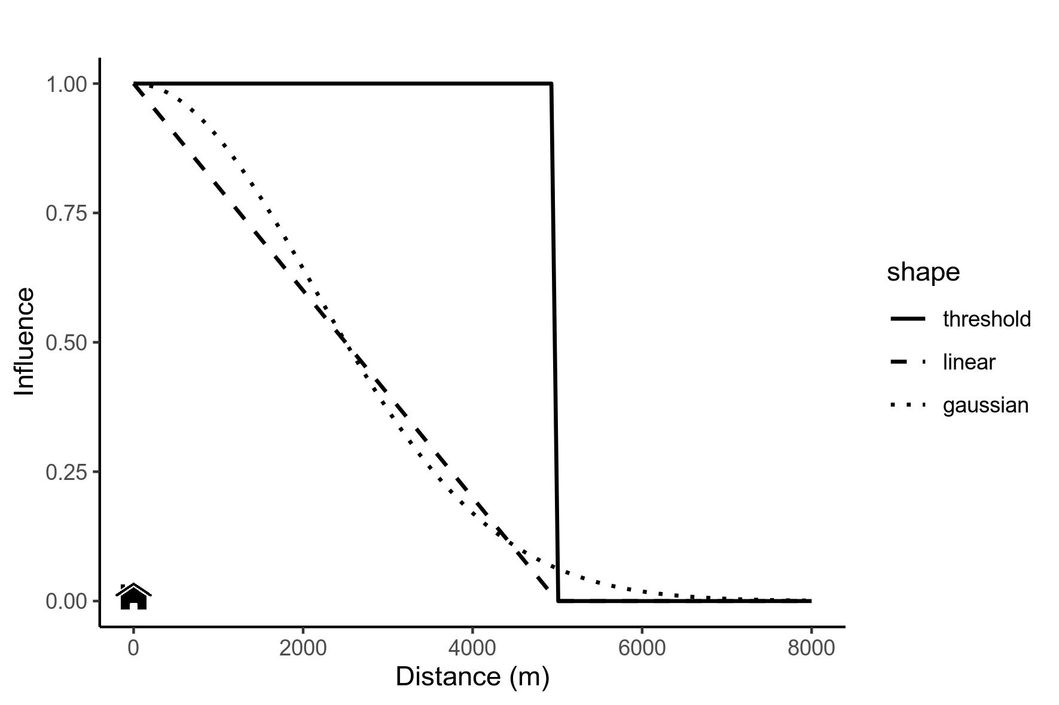
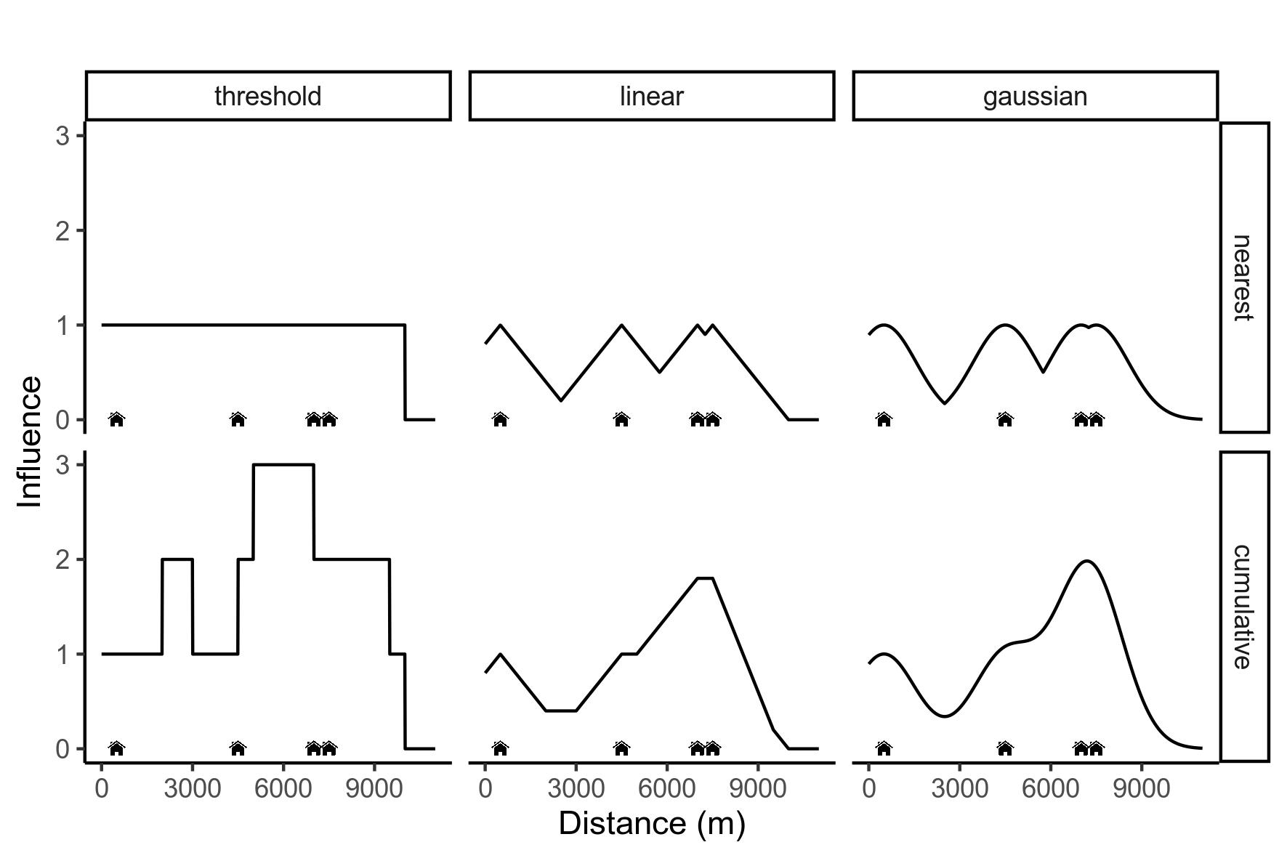
A
B

Slide 2
A
Influence function
Threshold
Linear
Gaussian
Zone of Influence
B

Slide 3
A
Influence function
Influence
Threshold
Linear
Gaussian
Zone of Influence
Distance (m)
B
Influence
Distance (m)

Slide 4
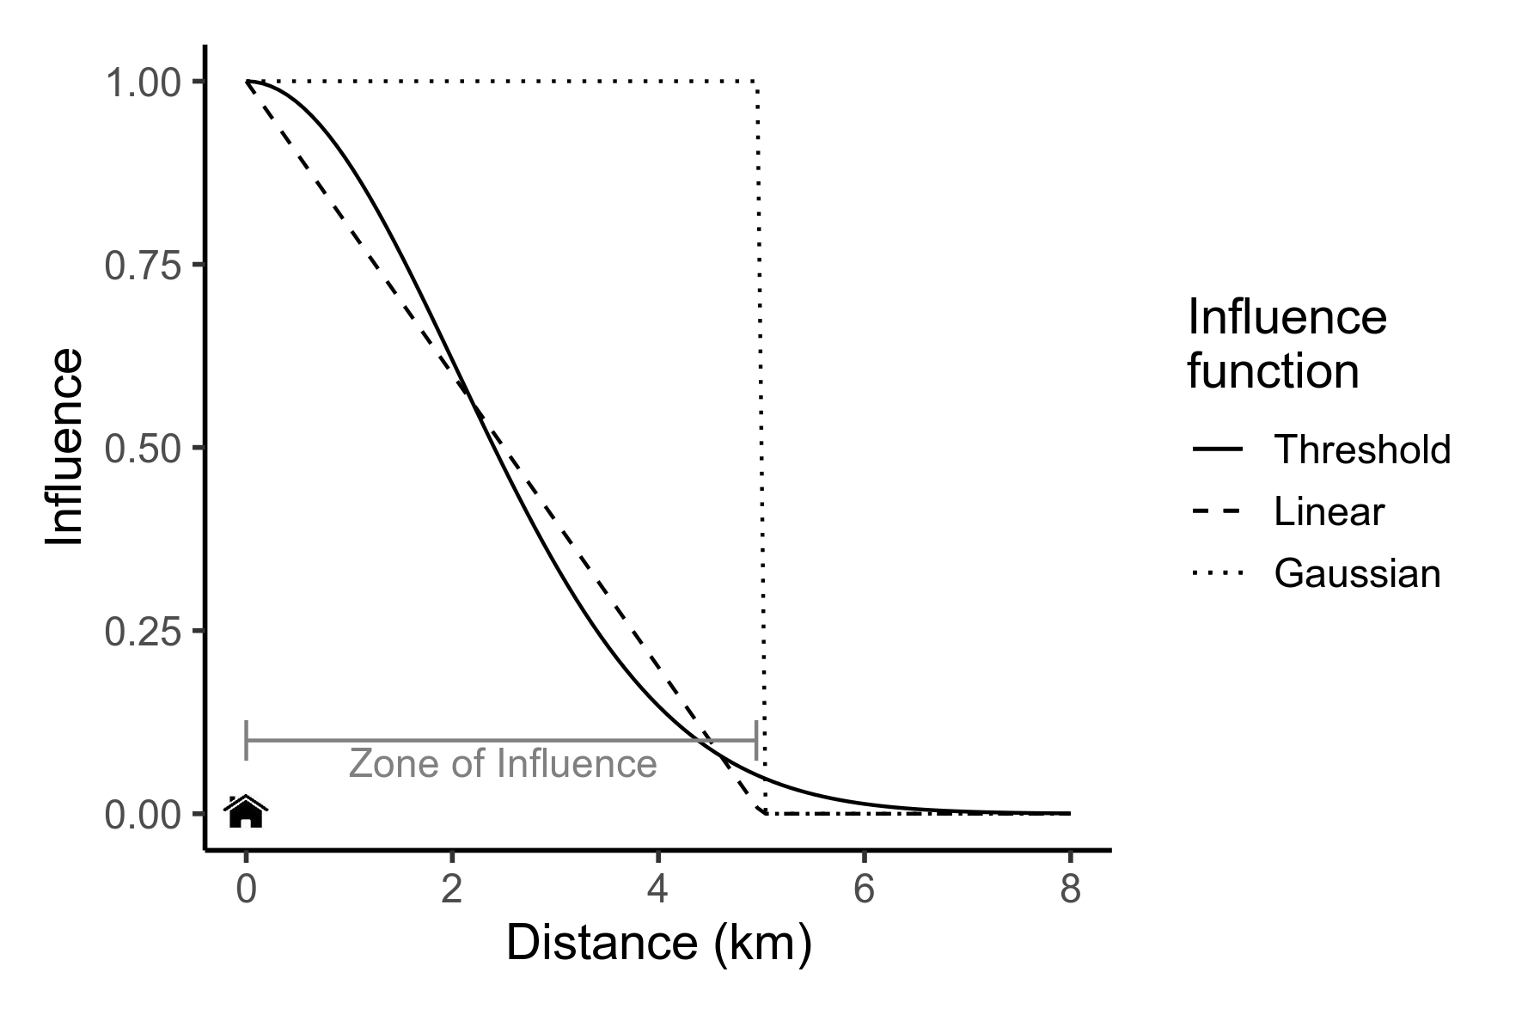
A
B
Influence
Distance (m)

