Slide 1

UNIX - Fundamentals
7
Simple Filters
9
SED
5
The shell
cmp comm diff head and tail …
Inserting
Updating
Deleting
RegEx….
1
UNIX Intro
3
Unix File System
Pattern matching
Escaping Redirecting…
The UNIX OS
The Linux OS
Features of Unix
The file
pwd and cd
mkdir
ls and cp ..
Shell Programming
8
GREP
10
6
The Processes
The character class
The *
The Dot…
condition eval
loops
read
exit status
4
Vi/Vim editors
ps nohup at and batch
2
Unix Commands
Input mode
Saving text
Aborting…
command basics
man
echo
printf …
Biz Nigatu
Software Engineer and Instructor
reckonedforce.com
@bizNigatu

Slide 2
Section 5 – UNIX Fundamentals
Process Basics
The Shell and init
ps: Displaying Process Attributes
The Process Creation Mechanism
Inherited Process Attributes
When You Can’t Use a Separate Process
Process States and Zombies
Signal Handling
Running Jobs in Background (&: No Logging Out, nohup: Log Out Safely)
Job Control
at and batch: Execute Later

Slide 3
Chapter 7 - *** The Process

Slide 4
Process Basics
A process is simply an instance of a running program
Example: when you run the ‘grep’ command, a process named grep is created
grep stands for ‘generalized regular expression parser’
Multiple users can run the same program creating a process of the same program for each user
The shell serves the user while the kernel handles processes
We have seen that files have attributes which we observe with the ‘ls –l’ command – processes also have attributes
The shell is also a process; in our case, it is bash

Slide 5
Process Basics (continued)
Most process attributes are inherited from the parent but a few are not:
The Process-ID (PID) – each process is identified by a unique integer called the PID
The PID is used to control a process such as ‘kill 3270’
The first process is always 0
PID’s never duplicate, e.g. if you kill process 3270, another 3270 will not occur
The Parent PID (PPID) – this is the PID of the parent process
Several child processes can have the same PPID
If you need to kill (stop) all children processes then kill the parent and the children processes will stop

Slide 6
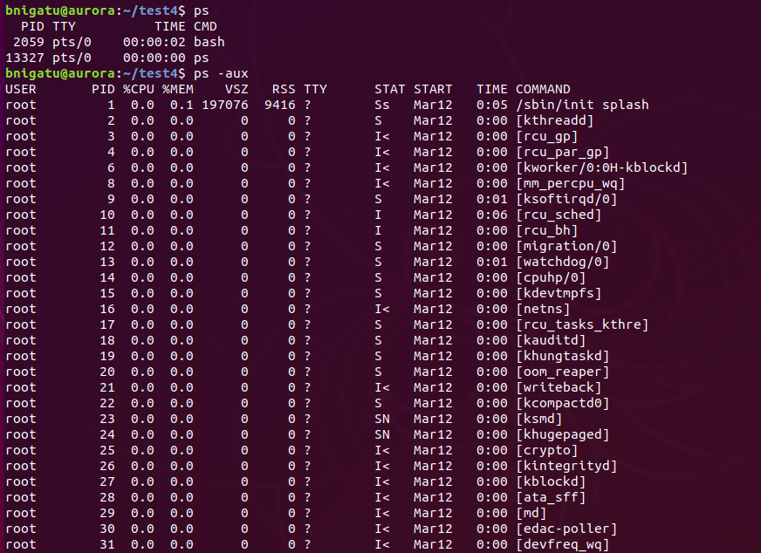
Looks very similar to Windows process table
This is ‘ps –aux’ where a= all excluding processes not associated with the terminal
‘ps –A’ would display ALL processes (POSIX way) including user and system processes

Slide 7
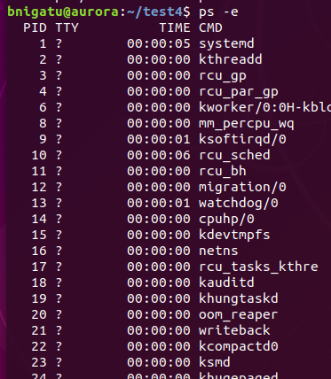
‘ps –e | more’ Command
When you use ‘ps –e’ or ‘ps –A’ , etc., don’t forget to pipe the output to more to see one page at a time:
‘ps –e | more’
TTY=? means there is no terminal output. Such processes are also known as daemons.

Slide 8
System Processes and ‘init’
Looking back at the previous slide, note the question mark ? in TTY – this indicates system processes that have no controlling terminal
A process that is disassociated from the terminal can neither write to the terminal nor read from it
Nor can you press <CTRL-C> to interrupt the process
Such processes are known as daemons and only wake up when they are needed
Examples of daemons are sendmail which handles incoming and outgoing mail, cron which looks at its control file once a minute to decide what it should do, and inetd – TCP/IP won’t run FTP or TELNET without this

Slide 9
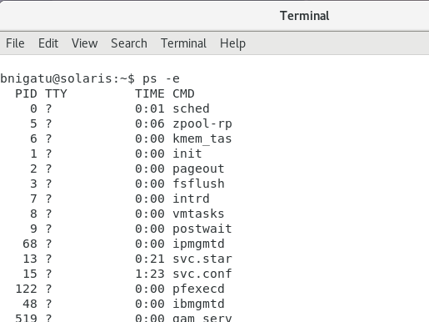
The Shell and ‘init’
In Unix-based computer operating systems, init (short for initialization) is the first process started during booting of the computer system. Init is a daemon process that continues running until the system is shut down. Init is typically assigned process identifier 1.
init

Slide 10
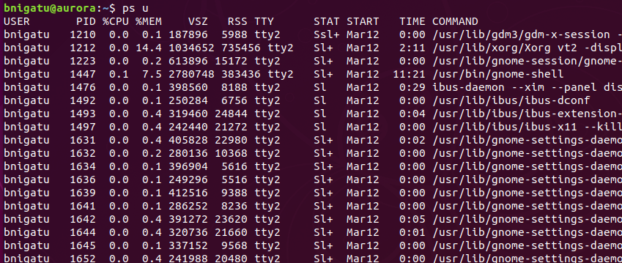
Display User Processes (ps –u)
Full Listing (ps -u) The ps u command approximates to ps –l

Slide 11
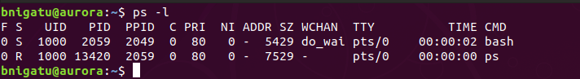
Display Long Listing of Processes (ps –l)
Parent ‘Process ID’; forked child with PID of 32087
Parent Process ID

Slide 12
Process Creation/Execution
Fork – create an identical child process from an existing process; parent and child have different PID
In a typical command line scenario, the existing process is the shell
The shell creates a new process using the fork() system call
The existing process is the parent process and the newly created process is the child process
The child process is a clone
Its code, data and stack segments are a copy of the parent
The return value of fork() in parent and child are different
In the parent process, the return value of the fork system call is the process ID of the child
In the child process, fork returns zero
There isn’t much use in having a copy of the parent – that’s where the exec() system call comes in

Slide 13
Process Creation/Execution
Exec – while forking creates a process, it is not enough to run a new program; that requires the forked child to overwrite its own image with code and data of the new program
Exec will replace the contents of the currently running process with the information from a program
EX: the process the shell follows when launching a new program is to first fork, creating a new process, and then exec, i.e. load into memory and execute, the program binary it is supposed to run
In the Linux kernel, fork is actually implemented by a clone system call
This clone interfaces effectively providing a level of abstraction in how the Linux kernel creates processes
Clone allows for explicitly specifying which parts of the new process are copied into the new process, and which parts are shared between the two processes – allows for the implementation of threads with one interface

Slide 14
Process Creation/Execution
Wait – while child executes new program, the parent normally waits for the child to die then picks up the exit status of the child before it does something else; Example: run ‘cat’ from the shell, shell forks another shell process
There are certain situations when a child process terminates or changes its state
The parent process needs to be made aware of the change of the state or termination status of the child process
Wait is used by the parent process enabling the parent to query the change in state of the child process
Newly forked shell overlays itself with the executable image of ‘cat’ which then runs
Parent waits for ‘cat’ to terminate and then picks up the exit status of child
Fork, Exec, and Wait are named after system calls of the same names

Slide 15
Inherited Process Attributes
When a process is forked or exec’d, the new program has a different PID and PPID than its parent; however, it inherits most of the environment of its parent
Most important inherited attributes are:
Real UID (user ID) and real GID (group ID) of the user running the program
Effective UID and effective GID – generally the same as real but…
Inheritance implies that the child has its own copy of these parameters and can alter the operating environment it has inherited
Modified environment not available to the parent process
Not to be confused with threads

Slide 16
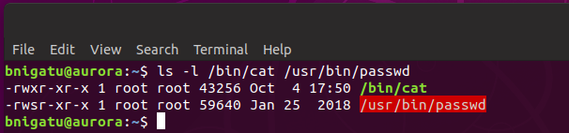
When Real Differs from Effective UID
When /bin/cat is run, the real and effective UIDs of the ‘cat’ process are the same
Notice the bit marked ‘s’ – this is the set-user-id (SUID) bit changes the normal ownership scheme
The real UID is the user; however, the effective UID is root who owns the program

Slide 17
Process States and Zombies
At any instant, processes are in some state
Running (O)
Sleeping (S)
Runnable (R) – in queue to run
Suspended (T) – performed by user, usually with <CTRL Z>
Zombie (Z) – parent didn’t wait for death of child
When a process dies, parent receives child’s exit status from process table and frees process table entry
When parent does not wait (child still alive), process turns into zombie
Zombie’s cannot be killed
Zombie’s reserve slot in process table
If parent dies before child, child becomes an orphan
Kernel makes init the parent of all orphans
When adopted child dies, init waits for its death

Slide 18
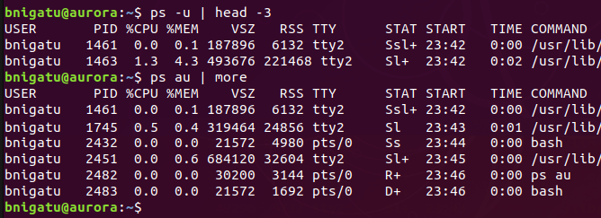
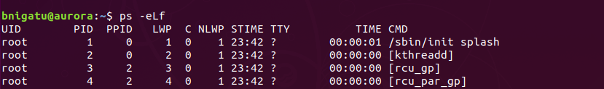
More ‘ps’
‘ps –u’ to show STATE:
‘ps –eLf’ to get information about threads
D =uninterruptible sleep (usually I/O)
R =running or runnable
S =uninterruptible sleep (waiting for event to complete
T =stopped by job control signal
t =stopped by debugger during tracing
Z =defunct “zombie” process
LWP (light weight process (threads)
thread count

Slide 19
Killing a Process
‘kill PID #’ – manually ending a process requires the ‘kill’ command followed by the process ID number
‘kill’ command sends a signal to terminate a process
Can terminate one or more processes such as: ‘kill PID1, PID2, …’
Some programs may (and do) ignore the above so you can use the following to override: ‘kill –s KILL PID#’ (preferred) or ‘kill -9 PID#’ (more common but not preferred)
To kill a login shell requires: ‘kill -9 $$’ or ‘kill –s KILL 0’ which kills all processes including the login shell

Slide 20
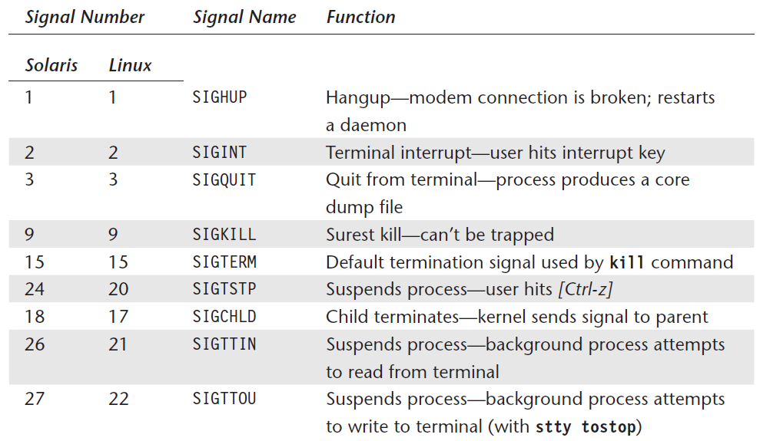
List of Commonly Used Signals

Slide 21
Job Control
Every process belongs to a process group
Each process in the group has the same process group-ID (PGID)
The C, Korn, and Bash shells support job control where every job has a separate PGID
Allows manipulation of process groups separately
A signal sent to a process group affects all processes in the group

Slide 22
Run in Background
The ‘&’ at the end of a program will have it run in the background which means the ‘$’ will return to accept more commands
& requires No Logging Out. It will run as long as the user stay logged in.
Once a program is placed into the background, the PID number will be displayed
Note, as seen in the previous slide, this does NOT mean that all processes associated with the program will be terminated if you kill that PID number
You need to run ‘ps –u’ to identify all processes associated with the program and terminate them as well
You can kill the last background process using kill $!

Slide 23
Run in Background (continued)
Processes running in the background will be terminated once the user logs out of the system
To ensure processes keep running requires ‘nohup’ (no hangup)
Required for non-bash shells
The Bash shell does not require this
Unlike the &, which needs to be affixed only to the end of the command line, nohup needs to be used with each command in a pipeline.
Example:
nohup grep ‘director’ emp.lst | nohup sort &

Slide 24
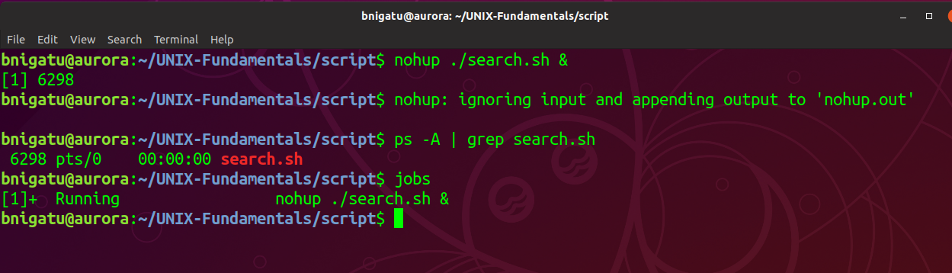
Run in Background (continued)
After running ‘search.sh &’ , I ran ‘ps –u’ to verify the background process was running and exiting the shell
Logout and log back in
Running ‘ps –A | grep search.sh’ showed the background processes still running
Notice the blue arrow – it points to the job number and next to it is the process ID number

Slide 25
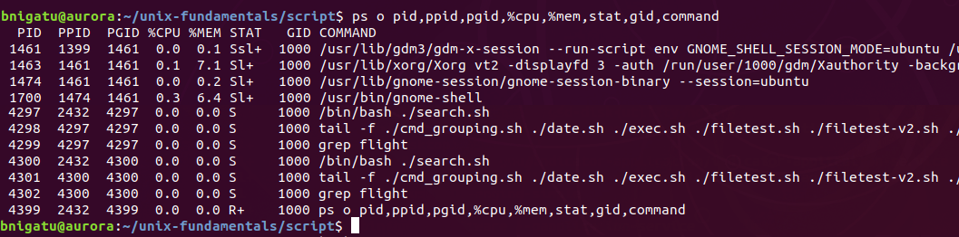
My ‘ps’ Script
You can customize what fields you want to see with ‘ps’ using the ‘o’ option; here is mine:
‘ps o pid,ppid,pgid,%cpu,%mem,stat,gid,command’
Notice these three have the same PGID

Slide 26
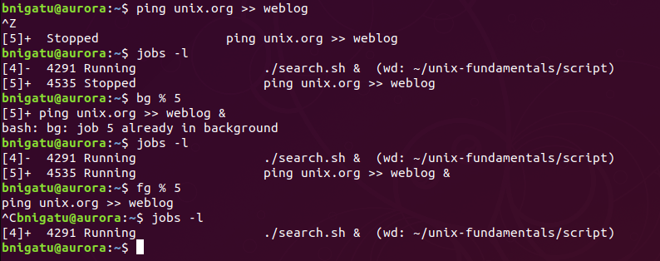
‘fg’ and ‘bg’ Commands
bg : put the recently suspended process in the background
fg : put the recently suspended process in the foreground
Example: Let us try to check if unix.org domain is alive and collect that info to weblog file.
Running the as foreground job
After sometime press <CTRL Z> to suspend the job
bg restart the job as background
fg restart the job as foreground
After sometime press <CTRL C> to terminate the job

Slide 27
‘at’ and ‘batch’: Scheduling Jobs
The ‘at’ command can be used to schedule jobs at a specific time
The ‘at’ command is a one-time execution, e.g. not regular schedule
Arguments are date and time:
The ‘batch’ also schedules jobs for later execution, but unlike with at, jobs are executed as soon as the system load permits.
The ‘batch’ command doesn’t take any arguments but uses an internal algorithm to determine the execution time.
Not all users may be able to use the at and batch commands.

Slide 28

‘at’ and ‘batch’: Example
Schedule for 2:00pm
CTRL-D
List all scheduled jobs
You can use “at -r <job number>“ to remove scheduled job

Slide 29
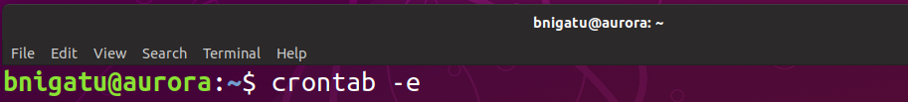
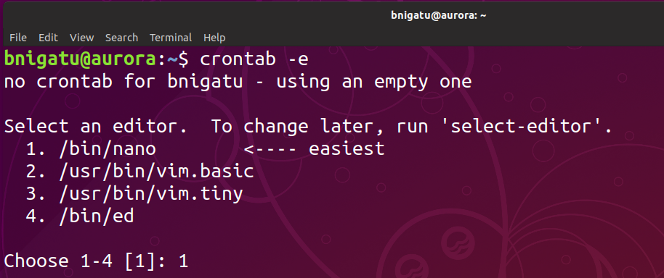
‘crontab’ : For repeated jobs
Edit cron tab
For the first time use crontab will make you choose a default editor

Slide 30
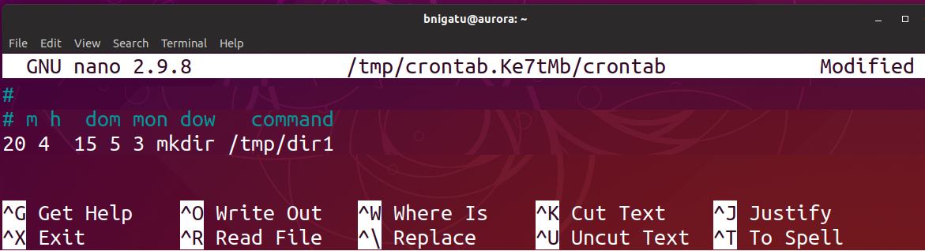
‘crontab’: Example
To create your cron schedules I recommend you use https://crontab-generator.org/
Edit cron job
You can use this to see the content of your cron table

