Slide 1
SecureIM Design and Attacks
Team member:
Chi Zhang | email:zhang.chi12@husky.neu.edu
Yuyang Zhang | email:zhang.yuya@husky.neu.edu

Slide 2
Prerequisite
1. A user knows his username and password.
2. The server knows:
Salted hash of all the user passwords
Server’s RSA public and private key
3. The client knows:
Server port and IP(provided in the cfg file)
Server’s public key

Slide 3
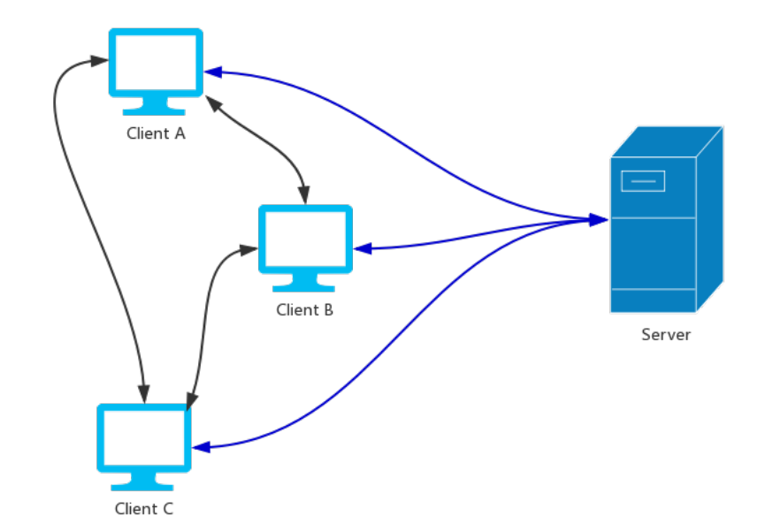
Architecture
Server listens to a port with a TCP server socket. It can manage online and offline users, and help them to authenticate each other.
Client has a TCP connection with the server. Based on the connection, the client can login, logout, get user list from the server and get authorization to talk to other clients.
Client also listens to a port with a UDP server socket. Based on it, clients can exchange messages with each other.
Services like PFS, identity hiding, DoS Protection, etc. are provided

Slide 4
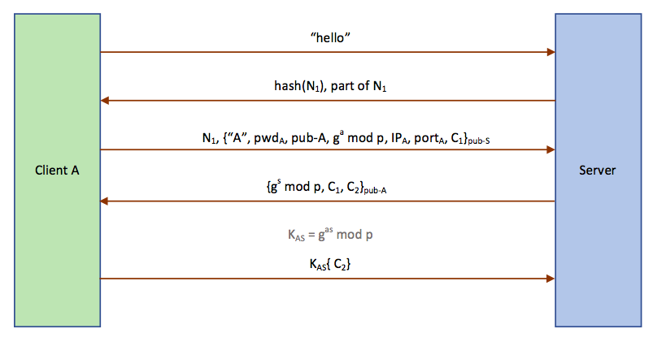
Key-establish Protocol
Client A sends a “hello” message to the server.
Server generates a 128-bit nonce N₁, sends back part of it (the 21-128 bits) and its hash value.
Client A finds N₁ through computations and generates a DH component a.
The server first checks if the value of N₁ is right. If it’s right, it decrypts the data with its private key. C2 is a nonce which confirm A got the right session key
Client A uses its private key to decrypt the message. Now client A and server shares the session key K_{AS} = g^{ab} mod p.
The server decrypts the message with K_{AS}, and confirms C₂ is right.

Slide 5
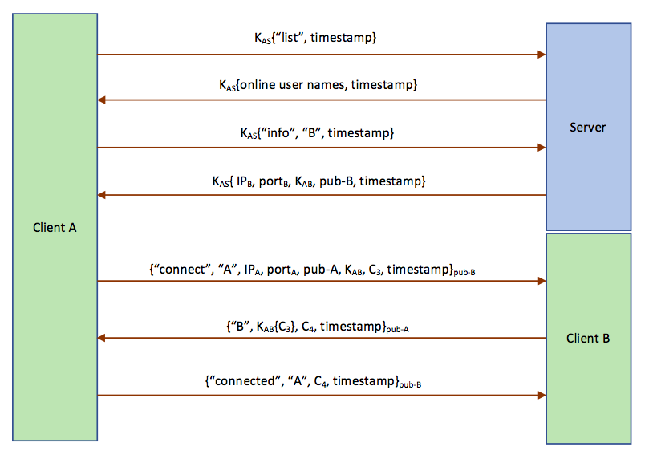
Peer key establishment
Client A sends a “list” message to the server, encrypted with K_{AS}
Server responds with all online user names, encrypted with K_{AS}
Client A sends a “init” message specifying “B” to the server, encrypted with K_{AS}
Server generates K_{AB} for A and B, and send it back together with (IP_{B}, port_{B}, pub-B), encrypt with K_{AS}
Client A creates a “connect” message including (“A”, pub-A, K_{AB}, C₃), encrypts it with pub-B, and sends it to B
Client B decrypts the message with its private key, generates C₄ and encrypts with K_{AB}, and sends it back along with C₃.
Client A decrypts the message with its private key, confirms C₃ is right, and adds B into the authenticated client list. Then it sends back a “connected” message.
Client B decrypts the message with its private key, confirms C₄ is right.

Slide 6
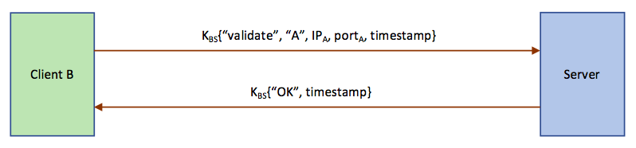
Peer Validation
Note that now client B cannot make sure it’s the real client A, since other clients like C can also claim itself to be A and initiate the above connection request.
client B sends a “validate” message containing A’s information to the server and confirms its identity.
If it is real, then B adds A into the authenticated client list.

Slide 7
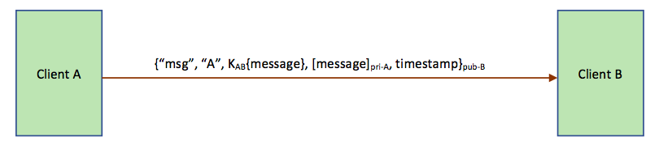
Message Protocol
Client A specifies the type as “msg”, add “A” and the message encrypted with K_{AB}, encrypts the whole message with pub-B, and sends it to client B.

Slide 8
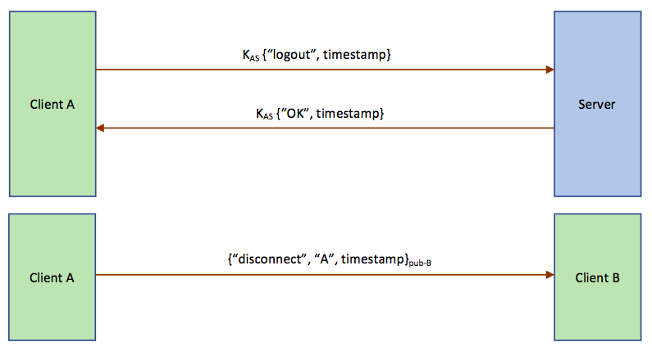
Logout protocol
Client A sends a “logout” message to the server, encrypted with K_{AS}
Then the server removes A from the online user list, deletes all A’s information including K_{AS}, pub-A, etc., and sends backs “ok”
Client A notifies all connected client (in this case only client B) a “disconnect” message and then exits. Client B receives this message and remove A from the authenticated client list.

Slide 9
Additional protection
Password protection
Resistant to denial of service attacks(usage of challenge, timestamp, limited times for password entering)
End-points hiding, PFS(session key would be forgotten after disconnect)

Slide 10
Known vulnerabilities
In our design, we assume the server to be secure and let the server to generate the session key for clients before they authenticate to each other. In such case, if the server is compromised or impersonated, the conversation between clients could be possibly decrypted by the attacker.
To fix this issue, we can improve the protocol as mentioned in the answer to question 4
– perform a separate Diffie-Hellman key exchange between clients.

Slide 11
Attacks against other teams
1. login with username and password not stored by the server
Choudhury-Sean-sean
2. Client session key sent without encryption
Oberstein-Jesse-joberste
3. The authentication protocol vulnerable to a MITM attack,
Diffie-Hellman key exchange not encrypted.
Atluri-Vamsi-vamsi

Slide 12
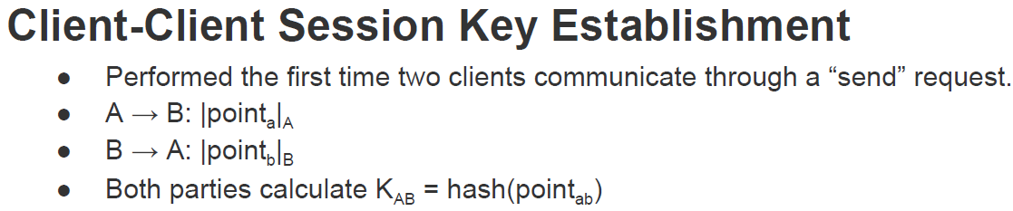
Client session key sent without encryption
In the design by Oberstein-Jesse-joberste, the components for generating session key is not encrypted. Attacker could record the traffic to get the K_{ab} to decrypt their message

Slide 13
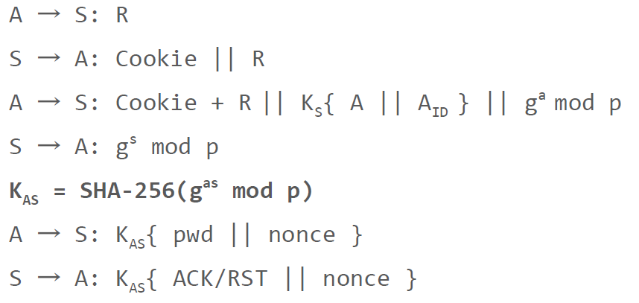
The authentication protocol vulnerable to a MITM attack
In the design by Atluri-Vamsi, the Diffie-Hellman key exchange conversation is not encrypted

Slide 14
Attacks against other teams
4. Sending some mal-form message can cause the server crash
Explicitly mentioned in the final report.
5. Attackers can make replay attack.
no nonce is included in the messages
Driskill-Ceridwen-cdris
6. Does not have proof for the result of Diffie-Hellman key exchange process
7. Denial-of-Service attack toward the server

Slide 15
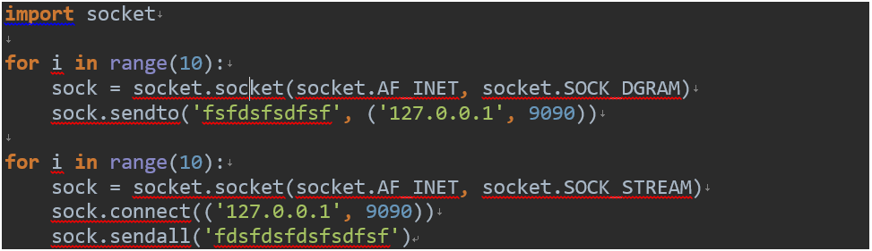
Sending some mal-form message can cause the server crash

Slide 16
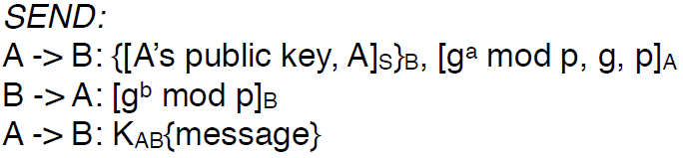
Attackers can make replay attack
In the design by Driskill-Ceridwen, specifically, the attacker can record the authentication session between A and B, and replay the messages to successfully build a connection with B.

Slide 17
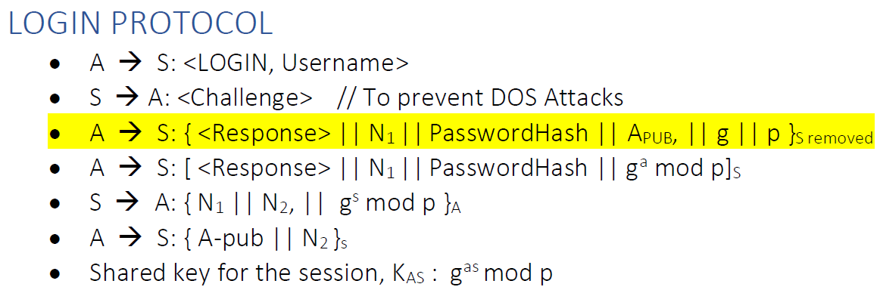
Does not have proof for the result of Diffie-Hellman key exchange process
In the design by Koduru-Ashok, If an attacker intercepts the DH component message and replaces with another recorded message, neither client nor server can know the DH key exchange fails.

Slide 18
Denial-of-Service attack toward the server
Singh-Mahima-mahina
Mahajan-Janhavi

Slide 19
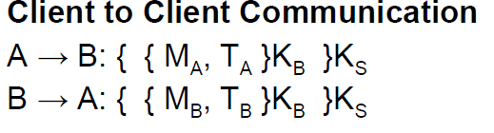
Does not provide PFS
For example, in the design by Yangyang, if the attacker breaks into the server and get K_{s} , all of the communications between the clients would be clear to the attacker.

Slide 20
Cannot run or login to the server following the instructions in README.

Slide 21
Thanks!

