Slide 1
From Thoughts to Words: Exploring Misarticulation in Texts
Sophie Wang
University of Chicago
17 May 2022

Slide 2
Misarticulation
A newly recognized psychological mechanism
High frequency in daily life
Definition:
The subjective sense of not having fully expressed or communicated what one has in mind.
Notes:
do know what to say, just can't articulate in words

Slide 3
Background
Existing literature:
underlying process of information transmission
in communications
Misarticulation:
psychological experience of the communicators themselves

Slide 4
Background
Humans are self-interpreting animals
Function of words
Perspectives of Miscommunication
in association with interpersonal relations
problems in the physical transmission of messages
features of the social context of interaction
psychological perspective of the communicator themselves (new)
Notes:
1. Human are self-interpreting animals
The process of communication is to build a bridge between the communicator and those who the communicator intends to share their inner state with.
2. words play an important role in communication
because of two functions:
1. provide people with a medium to share concepts
2. also create a social reality when concepts are shared by the communicator with others .
People also attempt to select words that can uniquely convey the concept to avoid linguistical ambiguity. Although people do have this motivation, a lot of times we just fail to do so --> miscommunication
4. Misarticulation is a subfield of miscommunication
This is something new and it adds to current knowledge of miscommunication

Slide 5
Research Question
Whether misarticulation is predictable through texts
Why exploring this?
Contribute to the knowledge of (mis)communication
An interdisciplinary study about a novel concept
Notes:
Computational tools have been proven to be very helpful for traditional psychology research. This project uses NLP techniques to explore the psychology of misarticulation

Slide 6
Methods
Online experiment designed using Qualtrics
Process:
Consent form previously approved by the IRB
A set of demographic questions
Randomly assigned to one of the three situations
Think and write responses around 140 words
Rate for three questions --> misarticulation index
Notes:
3 situations (close to daily life, easy to have something relavant in mind):
1. what exactly “makes someone a good parent,”
2. “makes a difficult challenge you experienced in the workplace,” 3. “what you’d want to share with an acquaintance of yours if you were trying to get closer to them
3 Questions:
1) How well did they feel they were able to communicate or express what they had in mind?
2)How well did their words convey, or capture, what they had in mind?
3) To what extent did their words overlap with what they had in mind using 7 graphs of overlapping circles?
so the misarticulation index is a countinous value rangaing from 0 to 6, 0 means... 6 means...

Slide 7
Methods
524 participants hired from Amazon Turk
Text pre-processing: Python NLTK library
Text vectorization: word embedding - - GloVe
Model training: Python Scikit-learn library

Slide 8
Methods
Analysis 1
Prediction model: Support Vector Machine Regression
Analysis 2
Classification model: Logistic Regression
+ 5- fold cross validation

Slide 9
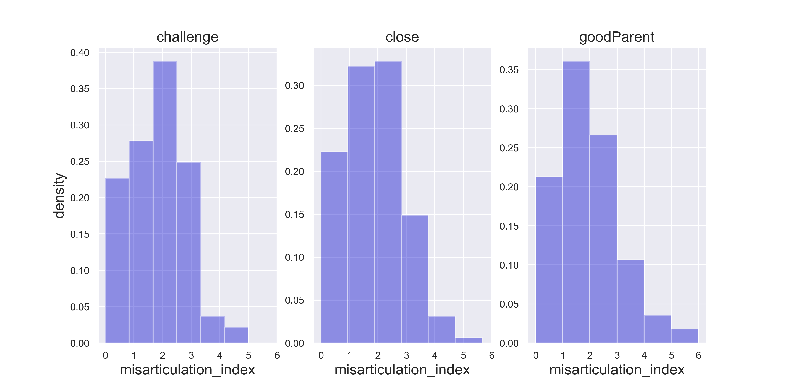
Analysis 1 – Data
Input X: textual responses from each participants (N = 504)
Label y: misarticulation index

Slide 10
Analysis 1 – Findings
Benchmark: random shuffling prior to model training
 | SVR model | random vector shuffle for X | random true value shuffle for y
Mean Absolute Error (MAE) | 0.88 | 0.88 | 0.92
Mean Squared Error (MSE) | 1.26 | 1.21 | 1.20
Does not outperform the benchmark
Notes:
we analyzed two measures, MAE and MSE of the regression model
sensitive to data distribution and can be hard to interpret
We set a benchmark for result comparison
This table shows how the SVR model worked comparing to the benchmark
the first column ... second
MAE and MSE: the smaller the better
we can hardly predict the value of misarticulation index

Slide 11
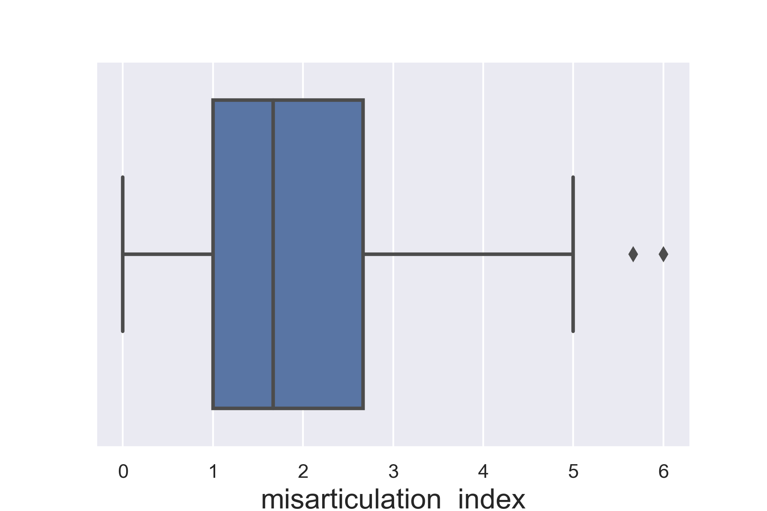
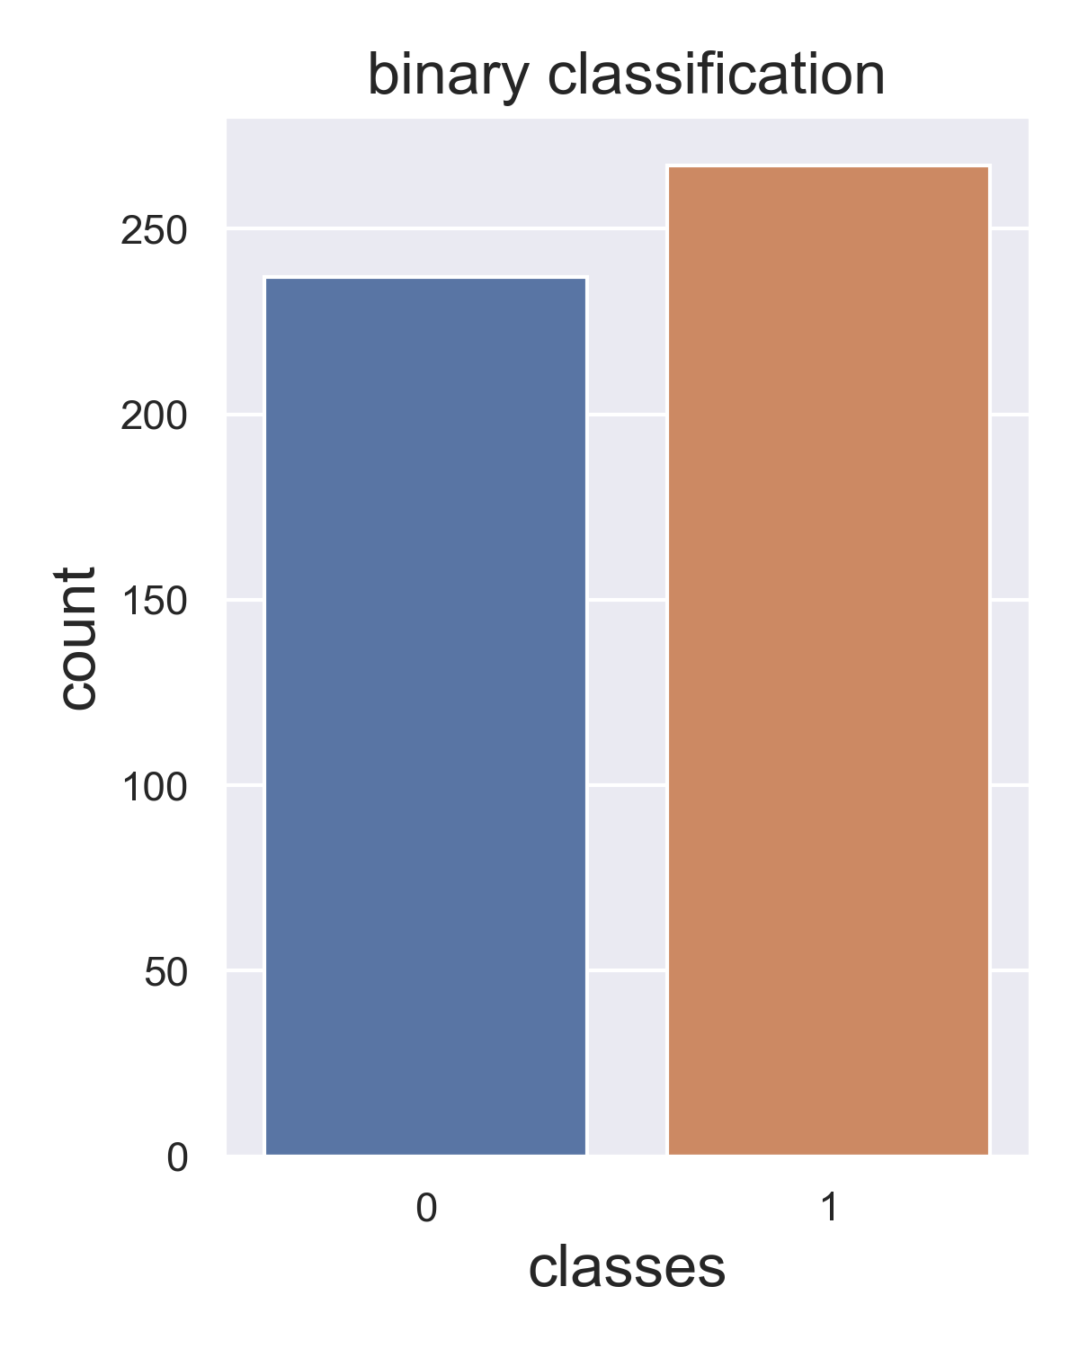
Analysis 2 – Data
Input X: textual responses from each participants (N = 504)
Label y: binary classes (class 0 & class 1)
N_{class_0} = 267 N_{class_1} = 237
Notes:
so we conducted a seperate analysis, which is a classification task
median split, this boxplot on the left shows that the median is around 1.68
sample distribution for the two classes is relatively balanced

Slide 12
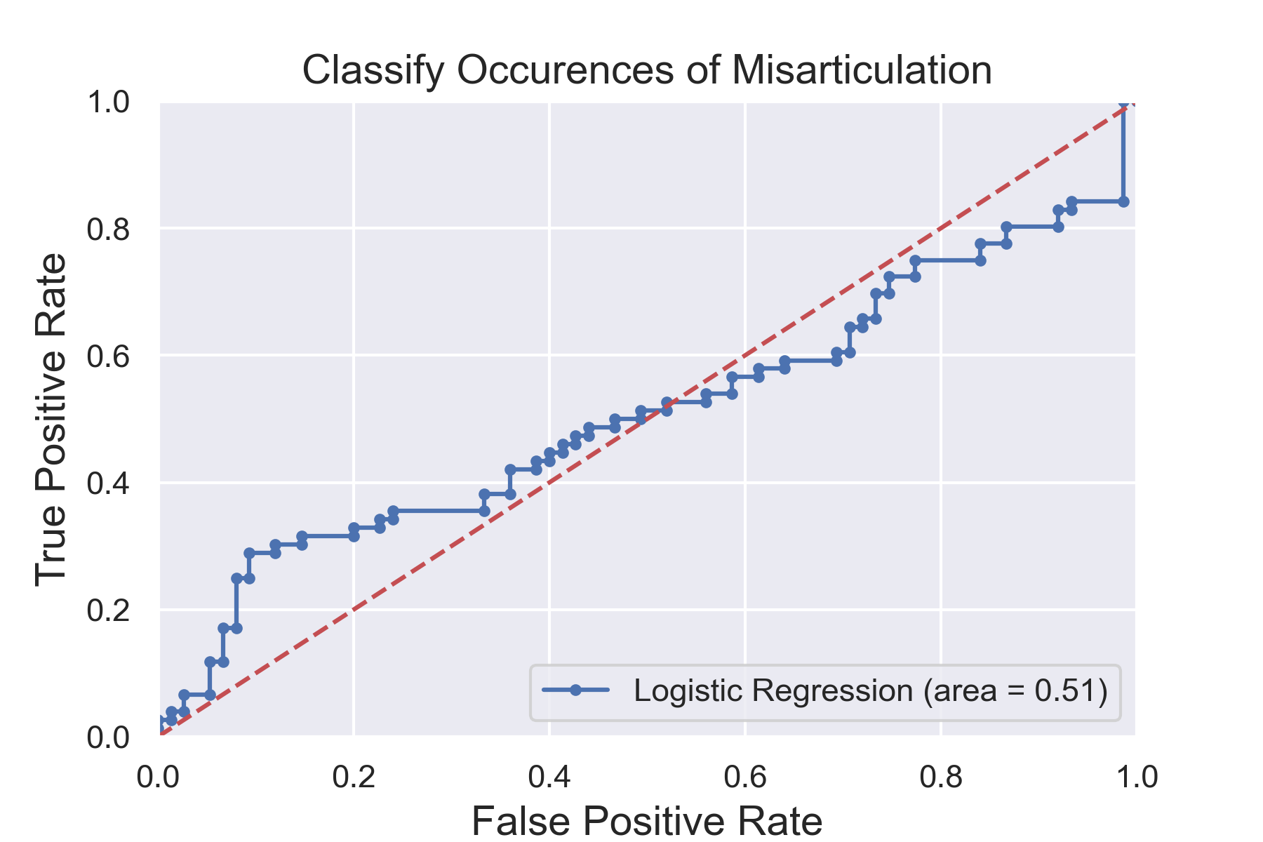
Analysis 2 – Findings
Benchmark: split on the mean value (94% accuracy?)
N_{class_0} = 453, N_{class_1} = 51
Accuracy: 54.30%
Barely has classification power
Notes:
We also set a benchmark for analysis 2: split on the mean value
this benchmark achieved an accuracy of 94%, but does it mean it's good? Actually, no
it's because the sample distribution is completely imbalanced
453 51
the model almost classified everything into class 0
although our logistic regression model doesn't have a distribution issue, the accuracy and ROU AUC are still low

Slide 13
Discussion
Misarticulation can hardly be predicted through texts...
in this current study – an exploration
There are still possibilities for future research on misarticulation
Notes:
This study is the first expploration in this topic, so I believe there are still possibilities for future research

Slide 14
Limitations
Quality of generated data
Perhaps it just naturally doesn’t have enough features to signal misarticulation
Feature representation
Pre-trained word embedding model may accidentally filter out important features
More sophisticated method may help
Notes:
This current study has some limitations and can be improved from these two aspects
First, the failure of the two models may be caused by the quality of the generated data

Slide 15
References
Ferreira, V. S., Slevc, L. R., & Rogers, E. S. (2005). How do speakers avoid ambiguous linguistic expressions? Cognition, 96(3), 263–284. https://doi.org/10.1016/j.cognition.2004.09.002
Jackson, J. C., Watts, J., List, J.-M., Puryear, C., Drabble, R., & Lindquist, K. A. (2021). From Text to Thought: How Analyzing Language Can Advance Psychological Science. Perspectives on Psychological Science. https://doi.org/10.1177/17456916211004899
Levelt, W. J. M. (1999). Models of word production. Trends in Cognitive Sciences, 3(6), 223–232. https://doi.org/10.1016/S1364-6613(99)01319-4
Smith, K.E. (2010). "Chapter One. The Meaning of Meaning". In Meaning, Subjectivity, Society. Leiden, The Netherlands: Brill. doi: https://doi-org.proxy.uchicago.edu/10.1163/ej.9789004181724.i-266.7

Slide 16
Thank you for listening!

