Slide 1

Li-Fi SECURITY SYSTEM here, Security Never Sleeps.....

Slide 2
Table of Contents
Abstract
Apparatus
Introduction
Why Li-Fi?
Methodology
Misconceptions
Limitations
3
4
5
5
5
5
5

Slide 3
ABSTRACT
In today’s real world scenario the main problem for many well-known organizations is security. Eventhough the organizations arranged guards the intruders are finding some or the other way to heist.In this situation there is a high demand of technology in the security field.So,our university has approached us who are in R&D team, for finding a solution. To solve the above problem facing by our university we came up with a solution called “Li-Fi Security System”.

Slide 4
SYSTEM REQUIREMENT SPECIFICATIONS
Laser light
Mirrors
LDR
ESP-32 microcontroller
Buzzers
Arduino IDE

Slide 5
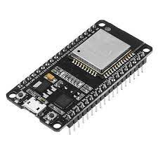
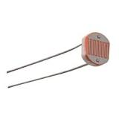
PICTORIAL REPRESENTATION
fig-1

Slide 6
INTRODUCTION
LiFi, short for Light Fidelity, is a game-changing innovation that enables the high-speed transmission of high volumes of data.
It uses light-emitting diodes for data transmission. In other words, it’s a light-based Wi-Fi which uses light instead of radio waves to transmit information.

Slide 7
WHY Li-Fi ?
The present world is dependent on less efficient wireless communication called Wi-Fi which works with radio waves.
According,to fig-2.1 the bandwidth of radio waves is less compared to the all other waves in spectrum.So,this limits the amount of data.

Slide 8
All other waves with higher bandwidth are dangerous to humans and the only safe to use and having higher bandwidth is Visble Light.
Data transmission speed,Data Density, Energy efficiency are the major advantages of LiFi.

Slide 9
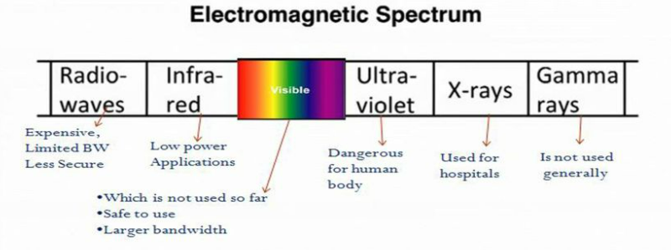

Slide 10
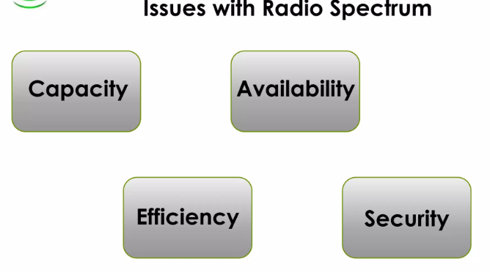

Slide 11
“Li-Fi will never replace Wi-fi”,but it is definetely an viable alternative to the Wi-Fi.
Li-Fi can be used in the areas that are sensitive to the prevailing technology.
The major limitation of Li-Fi is it cannot penetrate through obstacles.
But this limitation is the stepping stone to our project.

Slide 12
We the team of FabLab didn’t limit ourselves to limitations and thought innovatively and devolped the project Security system through Li-Fi
We have used the apparatus mentioned in this slide to build this project.
This project mainly depends on 2L’s those are LDR and LED.

Slide 13
The system will be creating a virtual wall that is not visible to anyone with the help of Led’s.
This virtual wall will be created to restrict the access to prohibited areas.
This product will easily replace the duty of a night shift security guard.
If any tresspasser tries to pass the wall buzzer will start and admin will be notified.

Slide 14
Methodology
Li-Fi systems have two main components: a photodiode and a light source.The photodiode and the light source act as reciever and transceiver to facilitate the transfer of data.
Data is transferred within Li-Fi system through the rapid modulation of light. To convey data through the light source, light is rapidly modulated at speeds imperceivable by the unaided eye.

Slide 15
A microcontroller is attached to the light source, which feeds data into the modulated light. The receiving device, the LDR, receives the light signals and processes them into a series of 1s and 0s.
The LDR processes the information and verfies the embedded data to the data given by light source.

Slide 16
If there is any noise is detected in signal by the ldr,the microcontroller immediately sends a signal to the buzzer and it starts ringing.
In this system the microcontroller we have used is ESP-32.The main reason behind the usage of ESP is for the usage of internet as ESP is a builtin Wi-Fi module.

Slide 17
Internet plays a vital role in our system.
The primary use is to connect the system to database.This helps us to get record of all the information of tresspassers tried to pass through the virtual wall and also how fast did the security responded to off the alarm.

Slide 18
Database Architecture

Slide 19
For instance,there are numerous security systems in our university all round.This leads to connect and depend on multiple Wi-Fi routers.
There are systems which are near the boundaries of university where there is no access to internet.
So,we came up with a solution to put a mesh network with all the ESP-32’s.

Slide 20
ESP-MESH is a networking protocol built atop the Wi-Fi protocol. ESP-MESH allows numerous devices (referred to as nodes) spread over a large physical area (both indoors and outdoors) to be interconnected under a single WLAN (Wireless Local-Area Network).

Slide 21
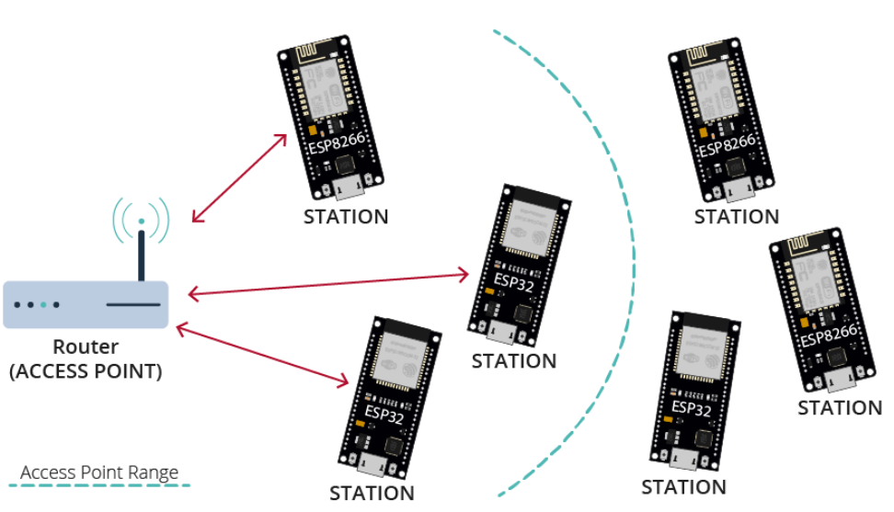
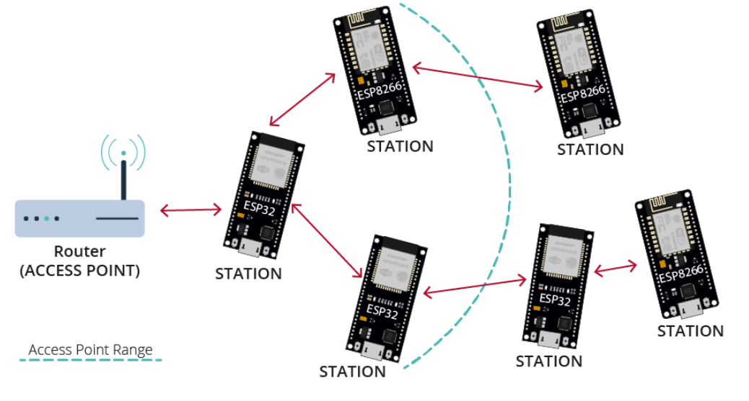
Traditional Wi-Fi Network Architecture
ESP-MESH Network Architecture

Slide 22
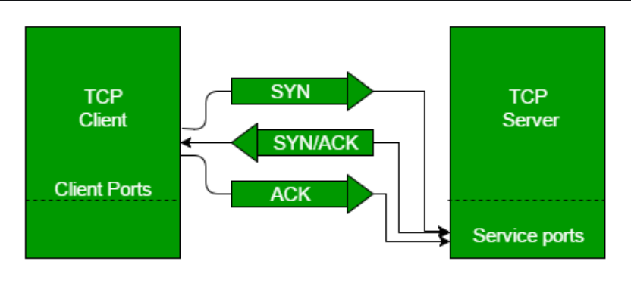
The communication between the microcontrollers is done with the help of TCP-IP protocol.
TCP 3-Way Handshake Process

Slide 23
We have also devolped a dynamic website for this system which is the main backbone for the entire project.
This helps the admin to have a control on the security systems.
Incase of any breakage in the virtual wall of any system.We’ll be notified with a red alert with the location name.

Slide 24
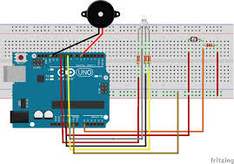
Circuit Diagram

Slide 25
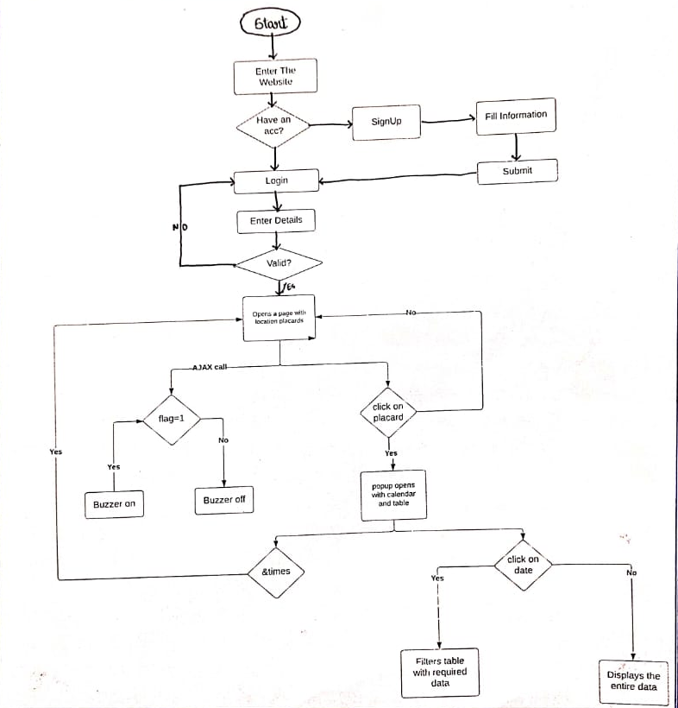
F L O W C H A R T

Slide 26


WORKING OF WEBSITE

Slide 27
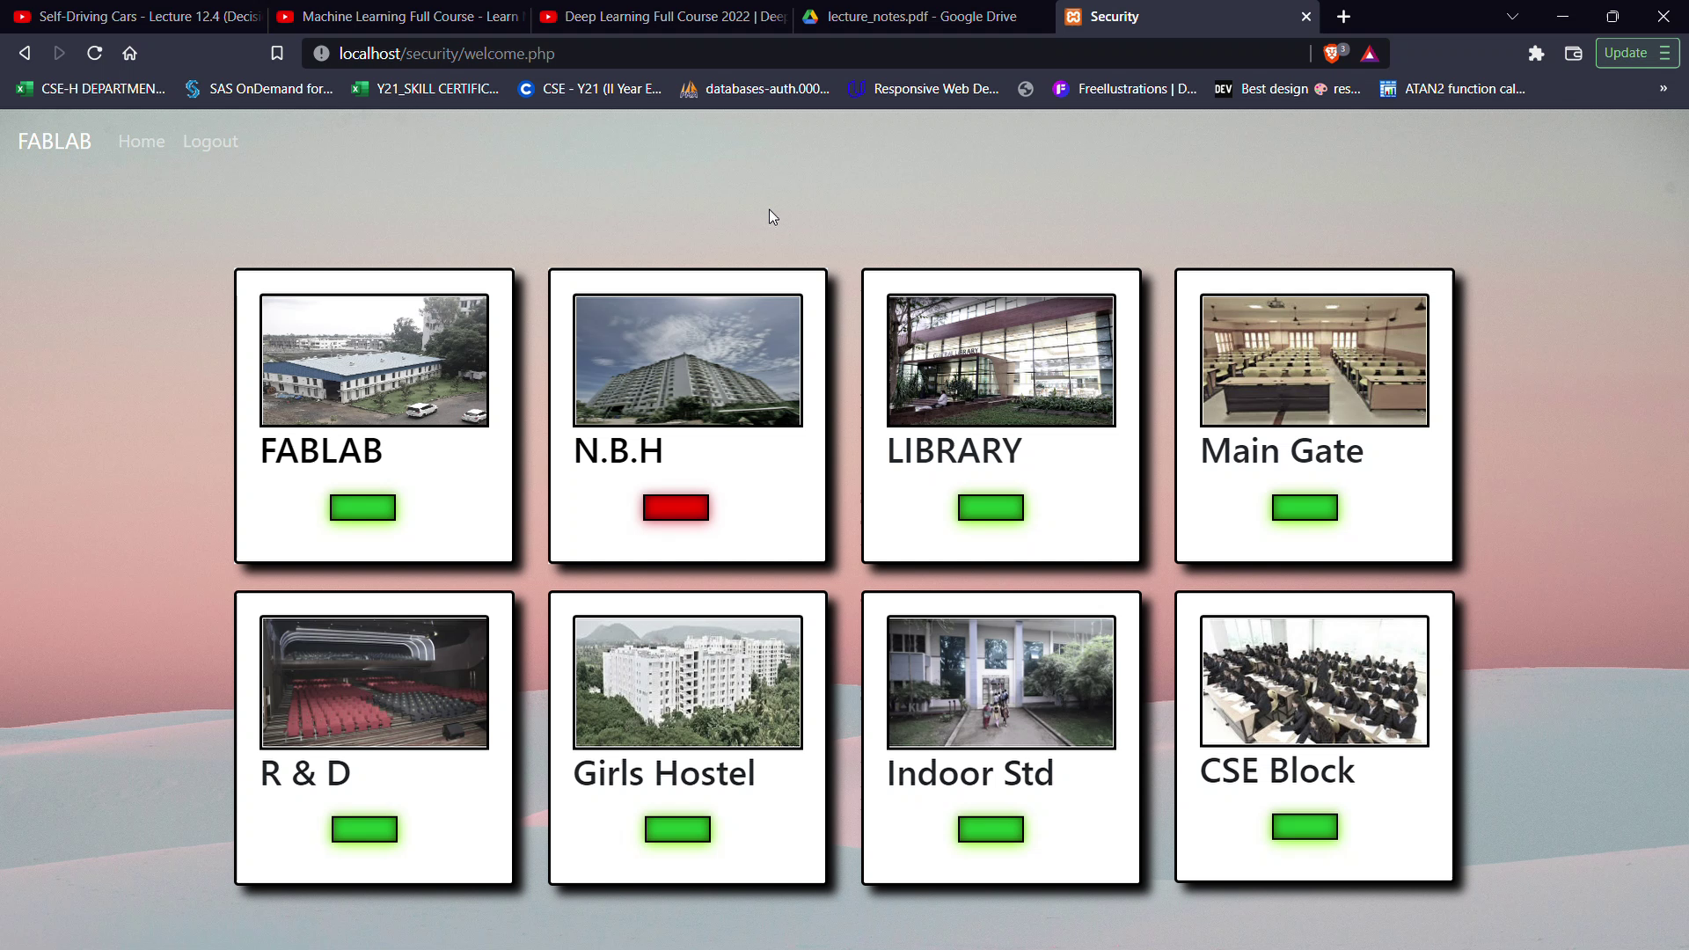

Slide 28
Misconceptions
LiFi won’t work in sunlight
A lot of people seem to think that if a LiFi user is under direct sunlight, it would be difficult for the device the user is carrying to detect LiFi waves due to higher intensity of light coming from the sun.

Slide 29
However, LiFi can fully operate in daylight. LiFi detects the fast changes in light intensity and not on the absolute or slowly varying levels cause by natural disruptions in sunlight. It modulates the light at very high rates and sunlight is constant light and therefore can be filtered out at the receiver. pureLiFi ran tests with their receivers outdoors under 77,000 Lux of sunlight and they worked perfectly fine.

Slide 30
LIMITATIONS
We need to devolp the website in a dynamic way and add some additional features to it.
At present the product is at prototype stage and we need to build it as a real time usable product.

