Slide 1
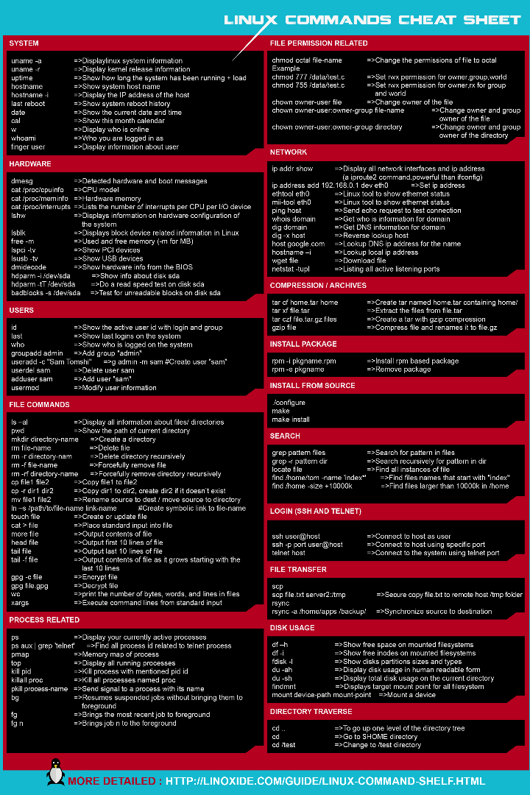

Linux Commands
Linux commands are instructions that you can use in a Linux-based operating system to perform various tasks, such as managing files and directories, interacting with the system, configuring settings, and more. Linux provides a powerful command-line interface (CLI) that allows users to control the system efficiently.

Slide 2
LINUX COMMANDS
ls: List files and directories in the current directory.
Example: ls -l (to list files with detailed information)
2.cd: Change the current directory.
Example: cd /path/to/directory (to navigate to a specific directory)
3.pwd: Print the current working directory.
4.mkdir: Create a new directory.
Example: mkdir my_folder (to create a directory named "my_folder")
5.rm: Remove files or directories.
Example: rm file.txt (to delete a file)
Example: rm -r my_folder (to delete a directory and its contents)

Slide 3
6.cp: Copy files or directories.
Example: cp file.txt /path/to/destination (to copy a file)
7.mv: Move or rename files or directories.
Example: mv file.txt new_location/ (to move a file)
8.cat: Display the contents of a file.
Example: cat file.txt
9.grep: Search for patterns in text.
Example: grep "keyword" file.txt (to search for "keyword" in a file)
10.ps: List running processes.
Example: ps aux (to list all processes)

Slide 4
11.kill: Terminate a process.
Example: kill PID (where PID is the process ID)
12.chmod: Change file permissions.
Example: chmod 755 file.txt (to make a file executable)
13.sudo: Execute a command with superuser privileges.
Example: sudo apt-get update (to update system packages)
14.df: Display disk space usage.
Example: df -h (to show usage in a human-readable format)
15.man: Access the manual pages for a command.
Example: man ls (to get information about the ls command)

Slide 5
16.wget: Download files from the internet.
Example: wget URL (to download a file from a URL)
17.tar: Archive and extract files.
Example: tar -xvf archive.tar.gz (to extract files from a compressed archive)
18.find: Search for files and directories.
Example: find /path/to/search -name "file_name" (to find a file by name)
19.ssh: Securely access remote systems.
Example: ssh user@hostname (to connect to a remote server)
20.ping: Test network connectivity to a host.
Example: ping google.com (to check if you can reach Google's servers)

Slide 6
HISTORY
Linux, a free and open-source Unix-like operating system, traces its origins to the early 1990s when Linus Torvalds, a student in Finland, released the first version of the Linux kernel. Initially just a hobby project, Linux quickly garnered the support of a global community of developers who contributed to its growth and refinement. Combining the Linux kernel with the GNU Project's software tools and utilities, it formed complete operating systems known as GNU/Linux distributions. Over the years, Linux has grown from a grassroots project into a powerful and versatile platform powering everything from servers and supercomputers to smartphones and embedded devices, embodying the principles of open-source collaboration, freedom, and stability. Its impact on the world of computing is profound, with Linux now serving as a cornerstone of modern technology and enterprise infrastructure.

Slide 7
ADVANTAGES
Open Source
Cost-Effective
Stability and Reliability
Security
Customization
Compatibility
Performance
Large Software Ecosystem
Scalability
Long-Term Support (LTS)
Legal and Licensing Flexibility
Energy Efficiency

