Slide 1
Dissertation Proposal: User Interfaces for the Coq Proof Assistant
Benjamin Berman

Slide 2
Outline
My general goals
Theorem Proving with Coq
Briefly go through an example
Survey—evidence of room for improvement
Research Plans
CoqEdit + Extensions
Include some of the evolution of the ideas
Context
Rough timeline for research

Slide 3
General Goals (1/2)
Improve usability of the Coq Proof Assistant
Coq is a tool for developing and checking proofs
Coq and similar tools are being used to formalize general mathematics
Coq and similar tools are playing an important role in the development of more reliable software
It is based on a language using more sophisticated types
One can use it to model and reason about software and hardware specifications and implementations
Coq and similar tools can be used as an educational tool
Students get more-immediate feedback
Machine-checked proofs help ensure that all the necessary details are there when students are trying to understand theorems/proofs
Still somewhat difficult with Coq
Tool needs to be taught
Not always a lot of feedback
Benjamin Pierce’s Software Foundations provides a model

Slide 4
General Goals (2/2)
Improve usability of coding environments
Coq is also a program development tool
You can define functions, declare variables, etc.
You can prove theorems regarding these programs
Surprisingly, the proofs you create correspond to programs
Proof development mechanism becomes an alternative way to develop programs
Coq has many complexities and therefore many opportunities for designing helpful interfaces
Coq’s language pushes at the edges of what is considered practical
By making Coq easier to use, we are expanding the range of practical programming languages

Slide 5
Theorem Proving with Coq
Two main existing user interfaces
CoqIde
Proof General
General idea behind both:
Send “sentences” from text area to the coqtop command prompt
Possibly undo the effects of evaluation
Highlight sentences that have been/are being evaluated
Report results of evaluation in one of two additional windows

Slide 6
Theorem Proving with Coq
An (very simple) example:
Prove that,
(A -> B -> C) -> (A -> B) -> A -> C
where A, B, and C are “Prop”s.
Note that this is equivalent to
(A -> (B -> C)) -> ((A -> B) -> (A -> C))
An un-curryed version, + some extra whitespace, might be most natural:
((A /\ B) -> C) /\ (A -> B))
-> (A -> C)

Slide 7
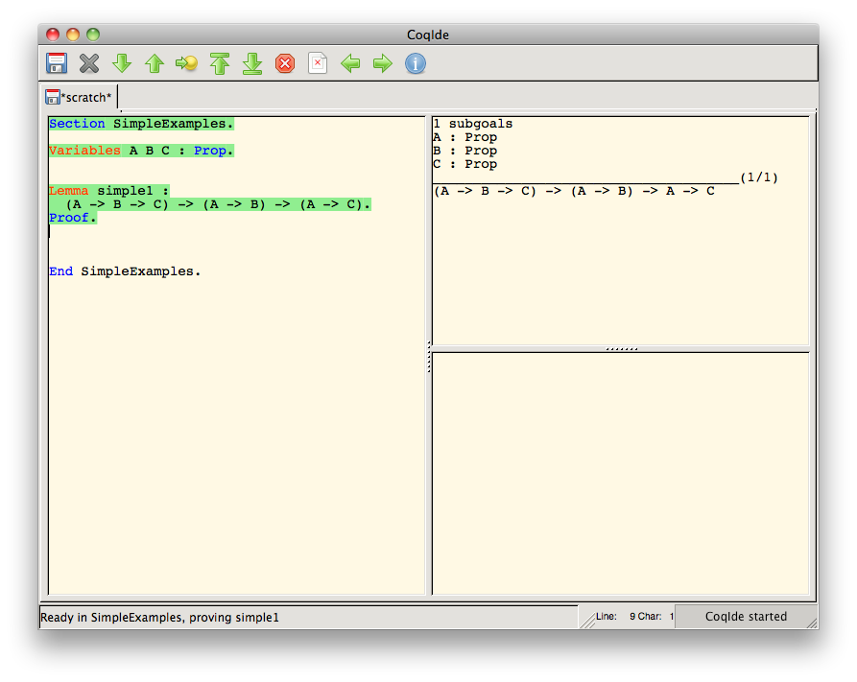
Theorem Proving with Coq: Get Things Set Up

Slide 8

Theorem Proving with Coq: Enter & Evaluate Tactics

Slide 9
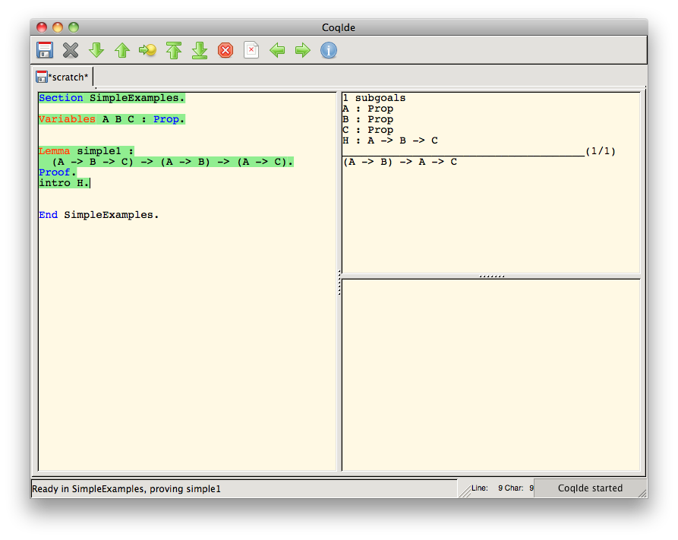
Theorem Proving with Coq: Enter & Evaluate Tactics

Slide 10
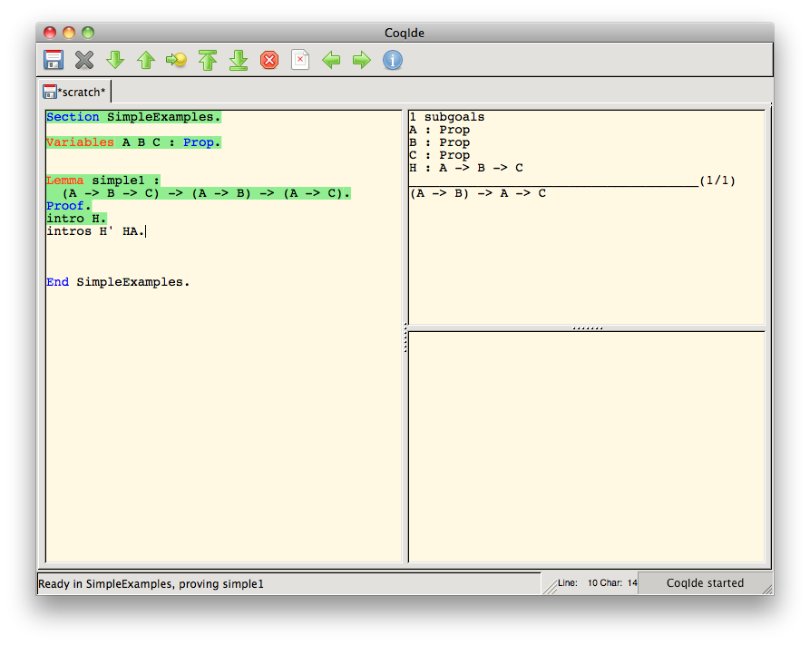
Theorem Proving with Coq: Enter & Evaluate Tactics

Slide 11
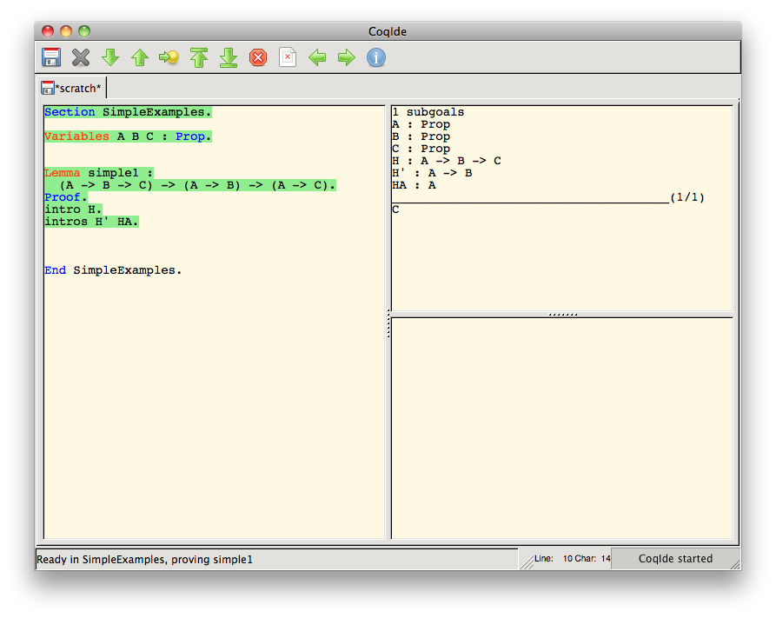
Theorem Proving with Coq: Enter & Evaluate Tactics

Slide 12

Theorem Proving with Coq: Enter & Evaluate Tactics

Slide 13
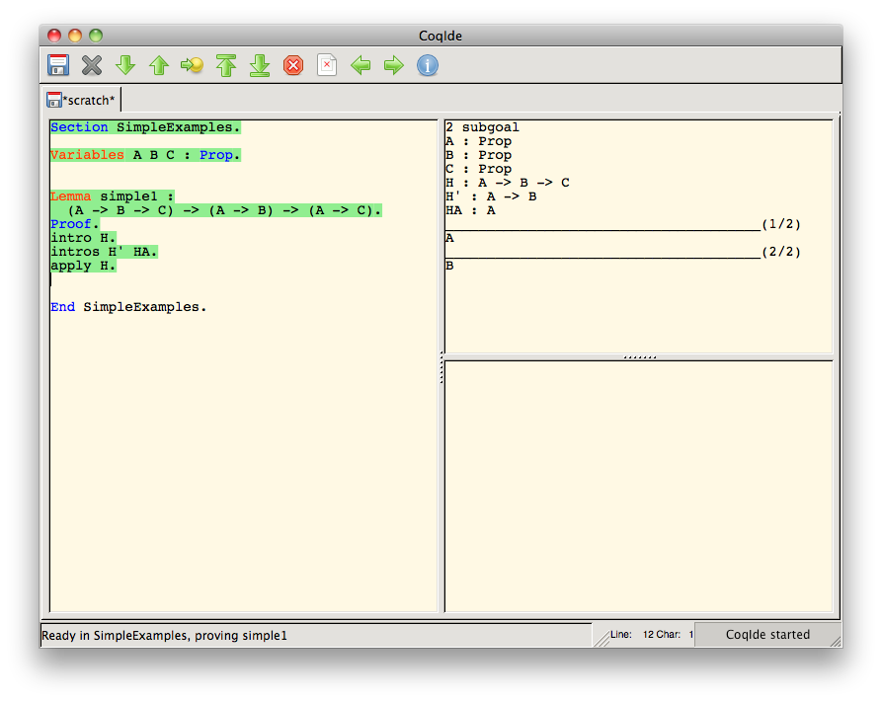
Theorem Proving with Coq: Enter & Evaluate Tactics

Slide 14

Theorem Proving with Coq: Enter & Evaluate Tactics

Slide 15
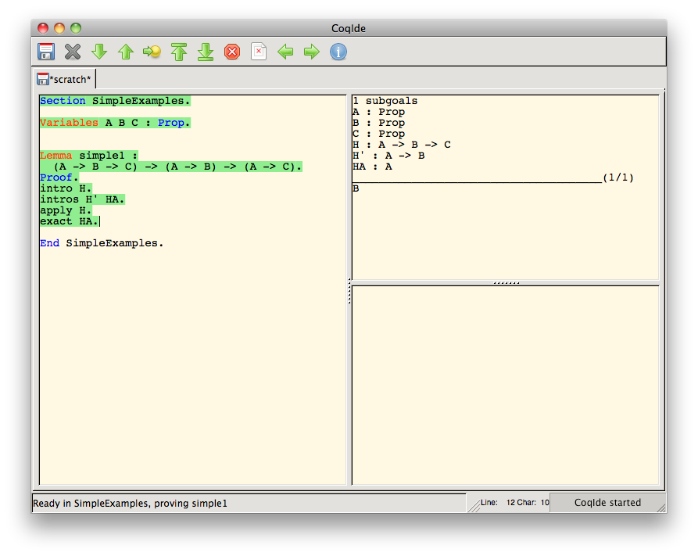
Theorem Proving with Coq: Enter & Evaluate Tactics

Slide 16

Theorem Proving with Coq: Enter & Evaluate Tactics

Slide 17
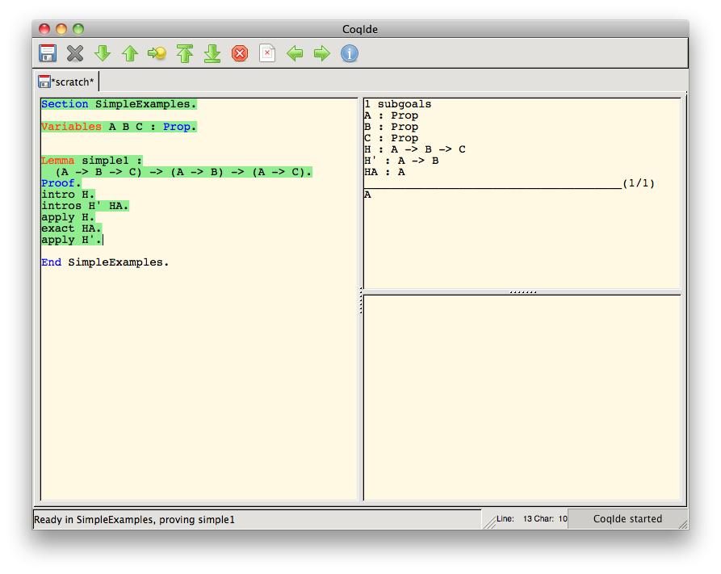
Theorem Proving with Coq: Enter & Evaluate Tactics

Slide 18
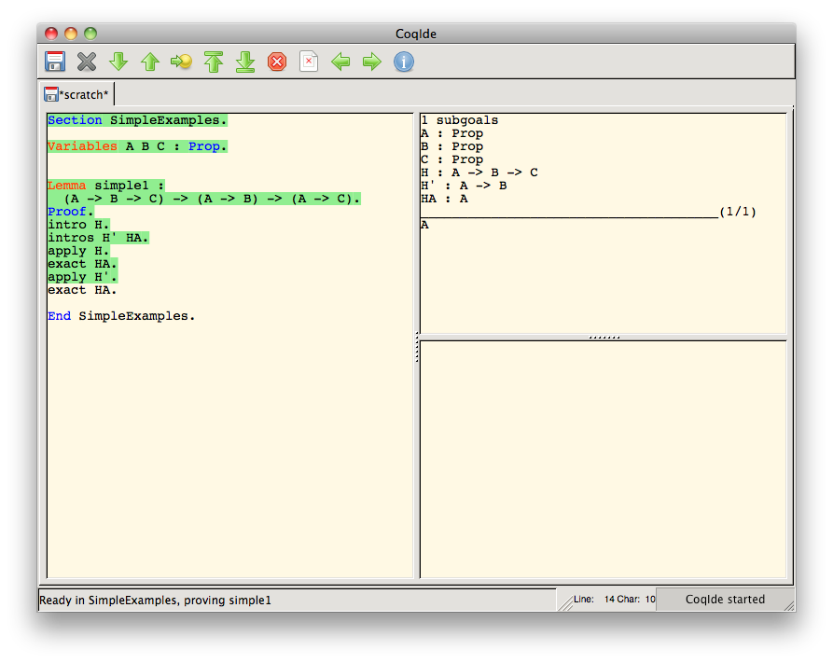
Theorem Proving with Coq: Enter & Evaluate Tactics

Slide 19
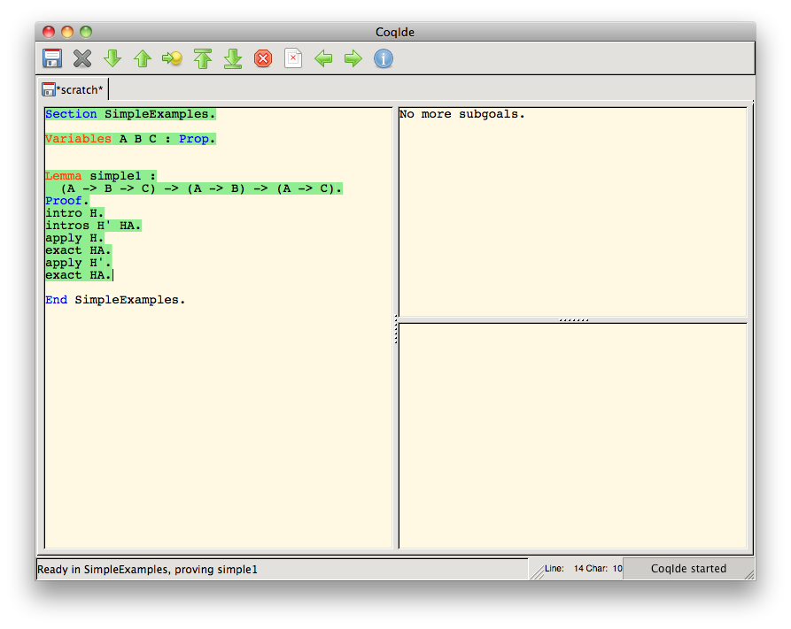
Theorem Proving with Coq: Enter & Evaluate Tactics

Slide 20

Theorem Proving with Coq: Final Check and Saving of Proof

Slide 21
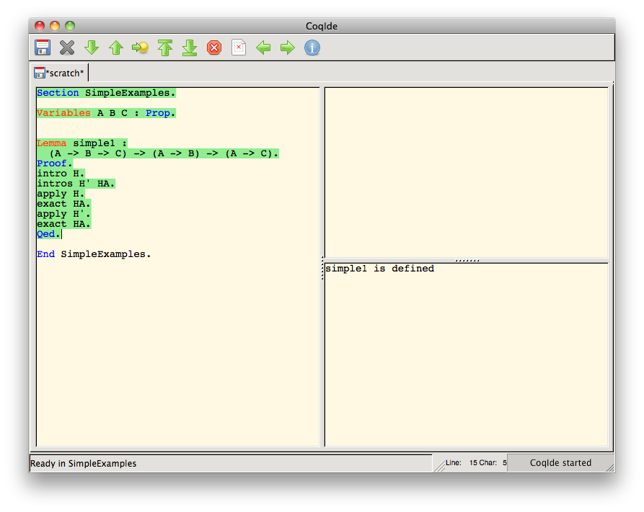
Theorem Proving with Coq: Final Check and Saving of Proof

Slide 22

Theorem Proving with Coq: Closing off the Section

Slide 23
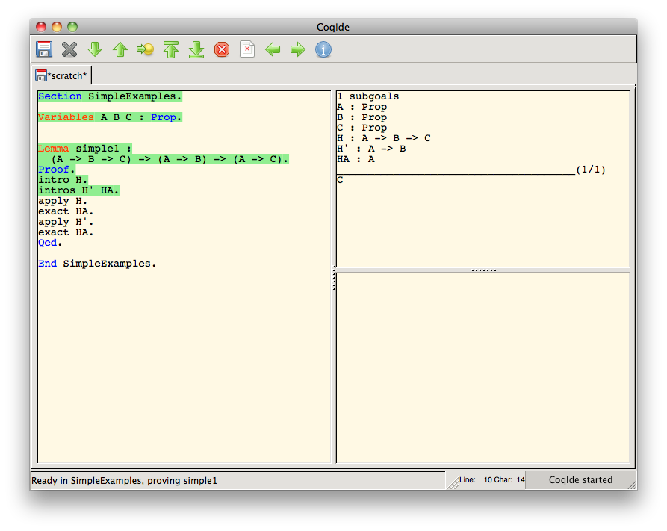
Theorem Proving with Coq: Moving Back

Slide 24
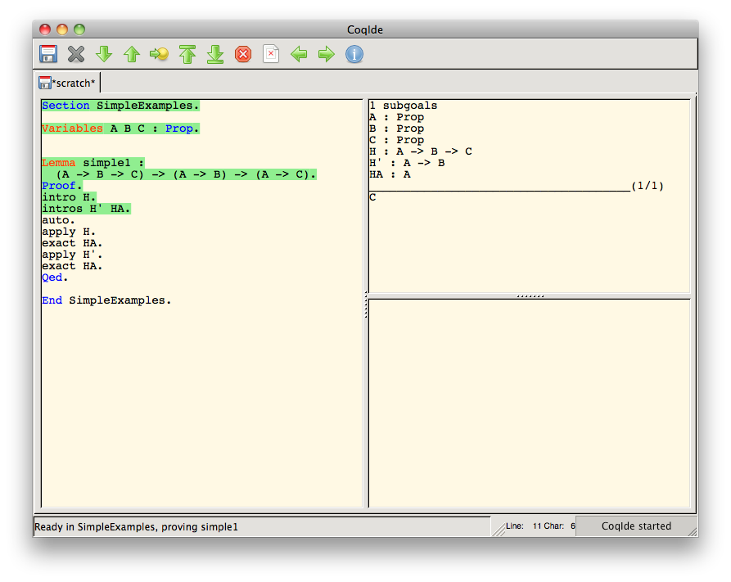
Theorem Proving with Coq: Automatically Proving the Lemma

Slide 25
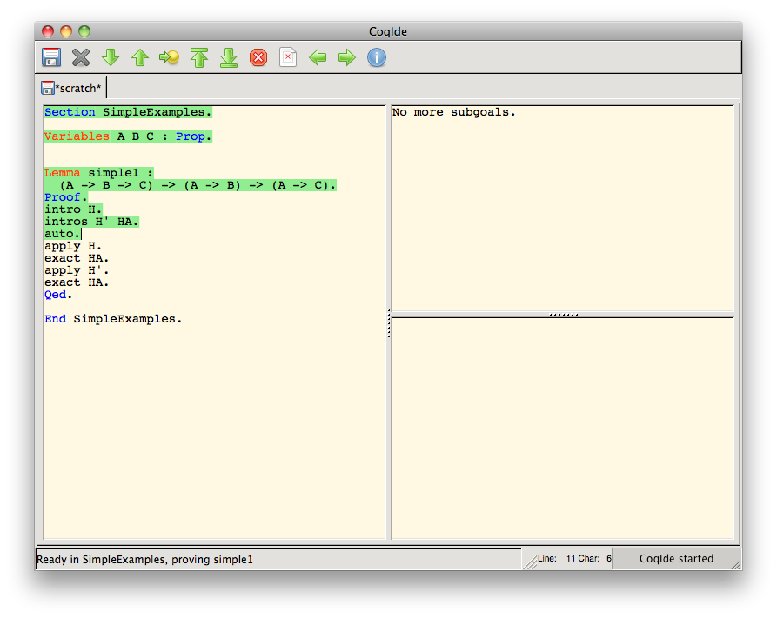
Theorem Proving with Coq: Automatically Proving the Lemma

Slide 26
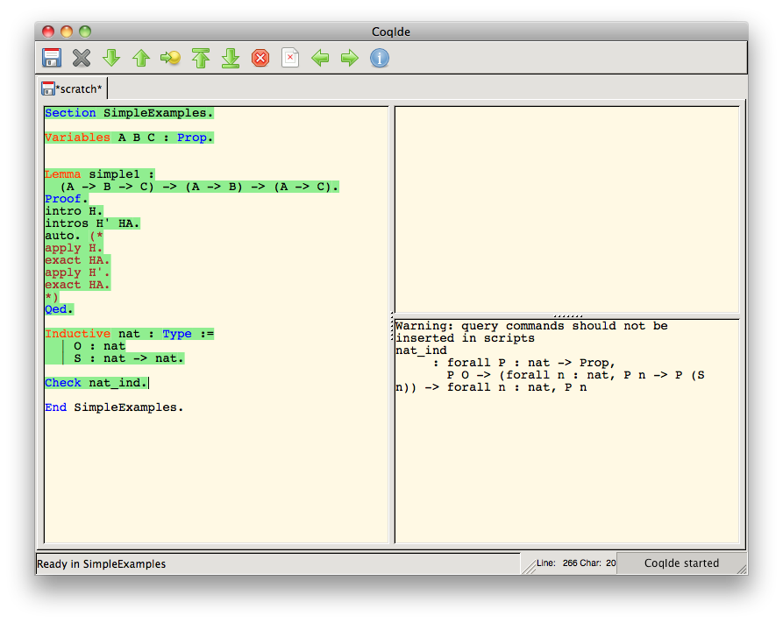
Theorem Proving with Coq: Natural Numbers

Slide 27
What the example shows (or, at least, what it starts to)
One of the big tasks for Coq users is to figure out what these tactics do
This task is challenging for several reasons
There are lots of tactics whose effects are dependent upon the given arguments and goals
Seeing the effects of tactics requires awkward movement through the proof script
There is a lot of black and white that has to be sorted through

Slide 28
Survey
There are lots of other problems to face, including ones for expert users
To verify this, a survey was sent to Coq-Club mailing list subscribers
48 responses
Almost 4,500 words in response to the essay questions

Slide 29
Survey
My general impression from the results:
Appreciation of existing interfaces
Some specific tasks we identified as difficult were indeed perceived as difficult
Many helpful features could be added, in particular:
features seen in programming IDEs, like refactoring
representation of proof structure

