Slide 1
Numpy

Slide 2
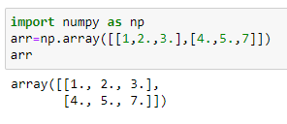
numpy.array() in Python
The homogeneous multidimensional array is the main object of NumPy.
It is basically a table of elements which are all of the same type and indexed by a tuple of positive integers.
The dimensions are called axis in NumPy.

Slide 3
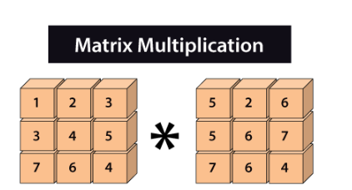
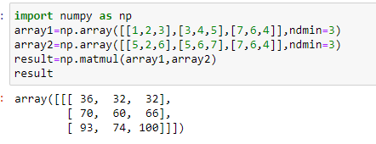

Slide 4
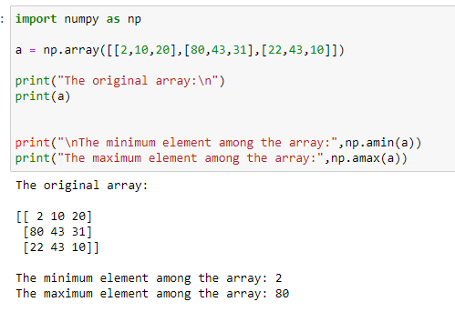
Finding the minimum and maximum elements from the array

Slide 5
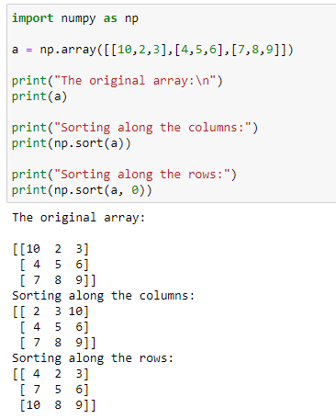
NumPy
Sorting

Slide 6
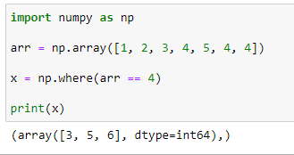
NumPy
Searching

Slide 7
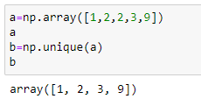
numpy.unique() in Python

Slide 8
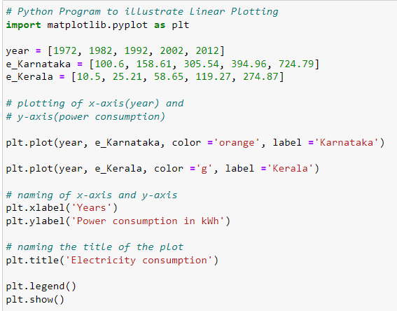

Linear Plot using matplotlib.pyplot

Slide 9
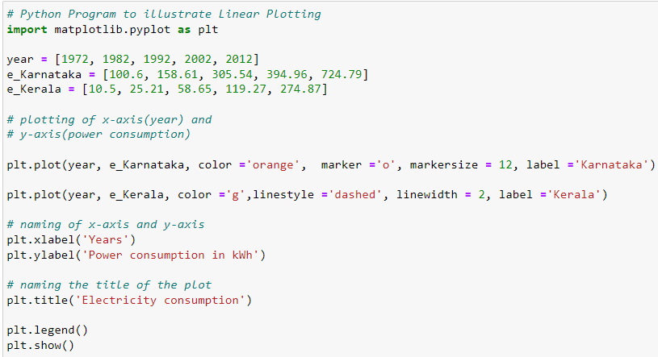


Slide 10
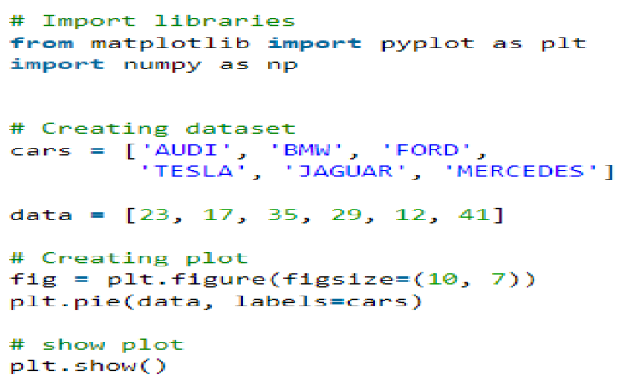
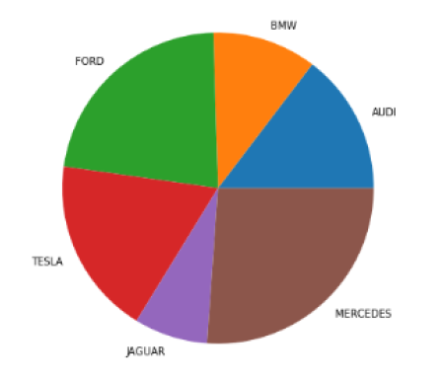
Pie Chart

Slide 11
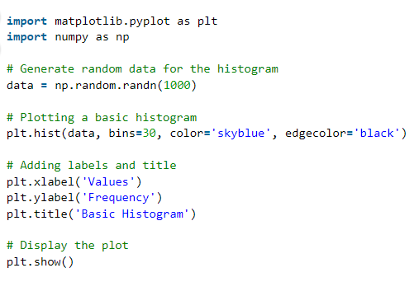
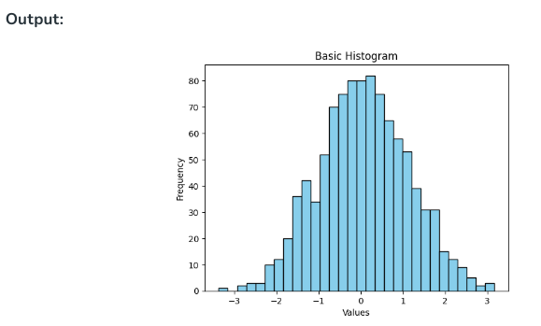
Create a Basic Histogram in Matplotlib

Slide 12
Bar Plot using Matplotlib

Slide 13
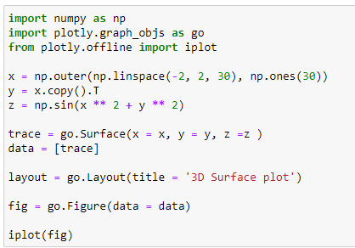
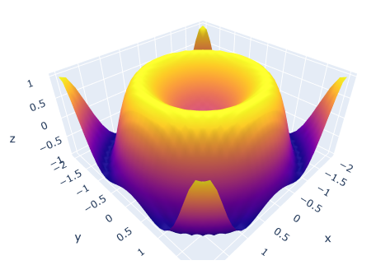
3D Plots using Plotly Libraries

