Slide 1
Comparing Mixing and Evaporation Timescales
Calculating X = tau_evap / tau_mix
2. Calculating cutoff volatility as a function of Dmix and Size at 298 K
3. Calculating cutoff C*(298 K) as a function of T and H2O mole fraction

Slide 2
1a. Calculating X = tau_evap / tau_mix
Problem with units here!
Need to figure out mass inconsistency

Slide 3
1b. Calculating X = tau_evap / tau_mix Assume masses cancel
Problem with units here!
Need to figure out mass inconsistency

Slide 4
All contours are showing log10(X)

Slide 5
2. Calculating cutoff volatility as a function of Dmix and Size at 298 K

Slide 6
3. Calculating cutoff C*(298 K) as a function of T and H2O mole fraction
Use experimental Viscosity
Calculate mixing timescale as a function of T and H2O
Calculate volatility corresponding to evaporation timescale equal to that mixing time scale

Slide 7
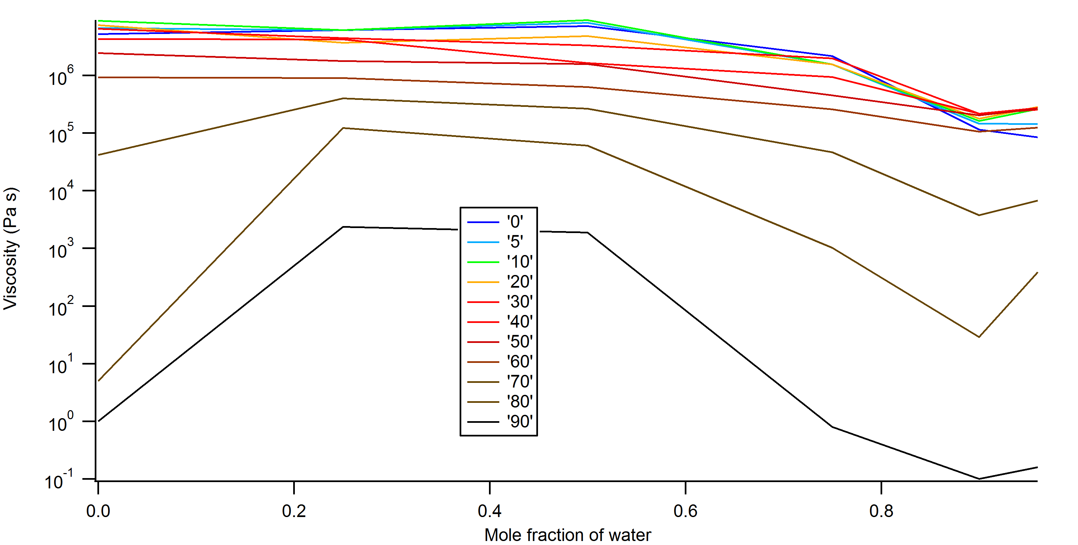
Experimental data. Viscosity as a function of T and H2O

Slide 11
Convert saturation concentration to C*(298 K) with dHvap = 100 kJ/mol

