Slide 1


DBS Day 1
John Cabibbo
jcabibbo@fullsail.com
AIM: jcabibbo@fullsail.com

Slide 2
Day Overview
Introduction to Databases
Types of Databases
Data Types
Basic Constraints
Keys & Indexes
My SQL + Tools
Database Import
SQL Dump
CRUD - Create, Read, Update and Delete

Slide 3
What is a DB (Database)?
Why do we need one? Why not use a text file?
What are the benefits?
Performance
Consistency
Availability
Portability
Security

Slide 4
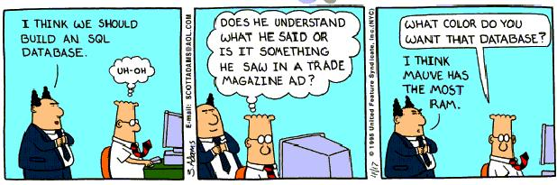
DBS

Slide 5
Relational Databases
Data is stored in tables
Developed in the 70’ & 80’s.
Tables are composed of rows and columns.
Tables are related to other tables through “relationships”
My SQL
Oracle
MS SQL Server

Slide 6
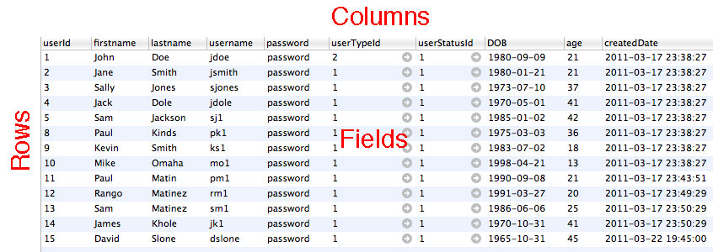
Database Objects
Tables, Rows, Columns & Fields

Slide 7
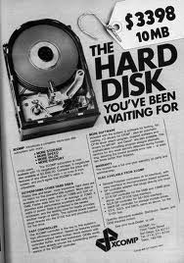
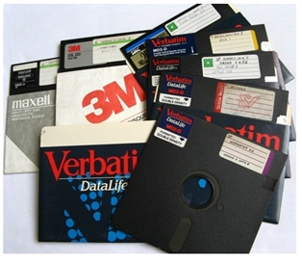
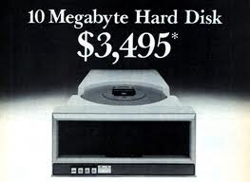

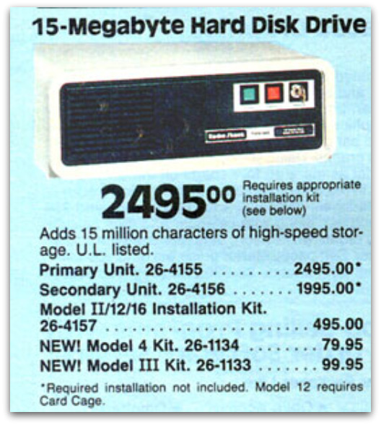
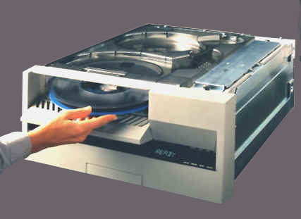
Relational Databases

Slide 8
Non-Relational Databases
Data is stored documents.
Relationships are not defined.
Benefits:Performance
Cons:Disk Space
Couch DB
Mongo
Big Table

Slide 9





Non-Relational Databases

Slide 10
Install GITHUB
Register at https://github.com/
Download the GitHub software.
Email your username to jcabibbo@fullsail.com and I will share my repo.
All labs MUST be submitted through GitHub.
Address: git@github.com:johncabibbo/dbs.git

Slide 11
SSH Key
If you need to generate an SSH key for GitHub, follow the directions below.
cd
ls –al
mkdir –p .ssh
cd .ssh
ssh-keygen -t rsa -C 'jcabibbo@fullsail.com' -N '' –v
ls –al
You will have a file called id_rsa.pub. This is your key.

Slide 12
Using MySQL
Startup MAMP
Download & Install Sequel Pro
http://www.sequelpro.com/
MySQL Workbench
http://wb.mysql.com/
PHPMyAdmin (http://localhost:8888/MAMP/)

Slide 13
Create a Database
Create a DB named “exampleXXXX” through Sequel Pro
Run the MySQL dump file to create tables, keys, indexes (example_Student_database.sql)
The tables are fully optimized.

Slide 14
Table Structure

Slide 15
Field Types
Field Data Types:
Char (Set Length)
Varchar (Variable)
Int
Decimal
Date, Datetime
Text
Bit (0 or 1)
many more…
Reference: http://www.peachpit.com/articles/article.aspx?p=30885&seqNum=7

Slide 16
Basic Constraints
Primary Key Constraint - Must Be unique
Foreign Key Constraint
Not Null
Unique

Slide 17
Keys & Relationships
Google Contacts

Slide 18
Keys & Relationships

Slide 19
Keys & Relationships
Primary Key
Must be unique
Data is indexed
Data type: int & varchar
Foreign Key
Points to a primary key
Forces Values
A key can be a single column or a composite key of multiple columns

Slide 20
Keys & Relationships
A foreign key must point a primary key.
The relationship is enforced.

Slide 21
Database Normalization
In the design of a relational database management system (RDBMS), the process of organizing data to minimize redundancy is called normalization.
Consistent, logical table structure
No quirks (anomalies)
Table design fits analog model
Easy to query
Good performance
Eliminate duplicate data
Forward-compatible

Slide 22
First Normal Form
Eliminate repeating groups in individual tables.
Create a separate table for each set of related data.
Identify each set of related data with a primary key.
Every row*column has exactly one value

Slide 23
First Normal Form
The invoice table does not follow
first normal form. This is the incorrect way to design a table.
The order & orderItem table
combined follow first normal form.

Slide 24
MySQL: ISAM vs INNO
MySQL Only
InnoDB: Row level locking, Transaction support, foreign key
constraints and crash recovery.
MyISAM: Much more conservator approach to disk space
management each MyISAM table store in a separate file.
In MyISAM memory and space usage, full text indexing support, table based locking, bulk insert capabilities and speed are plus factor but crushes recovery would be the horror story.

Slide 25
Auto Example
If you were presented a CVS file with the fields below, how would you create your tables?
VIN, make, model, year, color, engine, A/C

Slide 26
Create a Table
Create a table through SequelPro called: userAuto
Fields: userAutoId, userId, vin, makeId, modelId, year, colorId, engineId, ac

Slide 27
CRUD in SQL
Structured Query Language
There are 4 basic SQL commands:
Select
Insert
Update
Delete
Others: Create, Alter, Drop, Truncate

Slide 28
SQL: Select
Select firstname, lastname from users
Select * from users where username = ‘jdoe’
Select * from users where age < 23
Select firstname, lastname, userEmail
from users
inner join userEmail
on userEmail.userId = users.userId

Slide 29
SQL: Insert
insert into users
(firstname ,lastname, username, password, DOB, userTypeId, userStatusId
) values (
’FIRSTNAME’, ‘LASTNAME’, ‘USERNAME’, ‘PASSWORD’, ‘DOB’, 1, 1
)

Slide 30
SQL: Insert
Why does this fail?
insert into users
(firstname ,lastname, username, password, DOB, userTypeId, userStatusId
) values (
’John’, ‘Smith’, ‘jsmith’, ‘password’, ’03/03/67’, 1, 1
)

Slide 31
SQL: Update
update users set
password = ‘password123’
where userId = ‘YOUR USER ID’
Use the primary key in the where clause.

Slide 32
SQL: Delete
delete from users
where userId = ‘YOUR USER ID’

Slide 33
SQL: Create Table
CREATE TABLE `mailLog` ( `mailLogId` INT NOT NULL AUTO_INCREMENT , `toAddress` VARCHAR(50) NULL ,
`fromAddress` VARCHAR(50) NULL ,
`subject` VARCHAR(50) NULL ,
`createdDate` DATETIME NULL ,
PRIMARY KEY (`mailLogId`)
)ENGINE = InnoDB;

Slide 34
SQL: Alter Table
ALTER TABLE `example`.`mailLog`
ADD COLUMN `mailText` TEXT NULL AFTER `createdDate` ;

Slide 35
SQL Dump
Take a SQL Dump of your database.

