Slide 1
DBS Day 2
John Cabibbo
jcabibbo@fullsail.com
AIM: jcabibbo@fullsail.com

Slide 2
Day Overview
Review Day 1 & Lab 1
Screen Casts
Export / Backup
System Architecture
SQL Joins – Left, Right, Inner Outer
Constraints, Keys, Relationships
Indexes
Explain / Execution Plans / Order of Ops
2nd Normal Form

Slide 3
GitHub
Sign up / Install GitHub
Give your instructor your username.
You will be invited to collaborate in a repo.
Johncabibbo/dbs
Under homework is your directory (first initial lastname). Submit your labs in sub-directories (lab1, lab2 …)
You will be submitting ALL of your labs to this repo.
Submit screen casts as a link to YouTube or other video hosting site.

Slide 4
Review
Types of Databases
Data Types (Char, varchar, Int, tinyInt, bit)
Constraints
Normalization
Select, Insert, Update, Delete
Joins

Slide 5
MySQL: ISAM vs INNO
MySQL Only
InnoDB: Row level locking, Transaction support, foreign key
constraints and crash recovery.
MyISAM: Much more conservator approach to disk space
management each MyISAM table store in a separate file.
In MyISAM memory and space usage, full text indexing support, table based locking, bulk insert capabilities and speed are plus factor but crushes recovery would be the horror story.

Slide 6
Export / Backup
MySQL Dump
Backups to a SQL file
Raw Backup
Your DB must be shutdown
Copy you files from Applications/MAMP/mysql/databaseName
Hot Backups

Slide 7
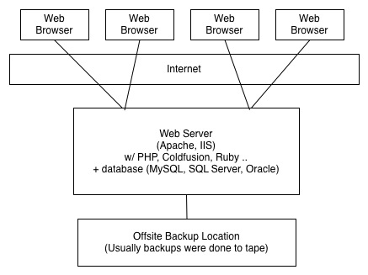
Architecture
Circa 1997

Slide 8
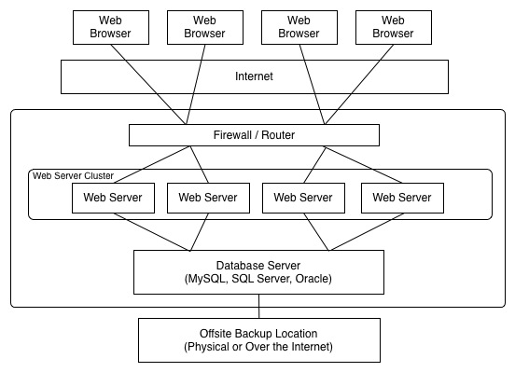
Architecture

Slide 9
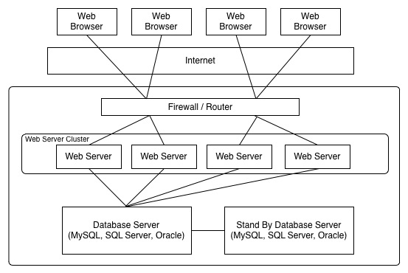
Architecture

Slide 10
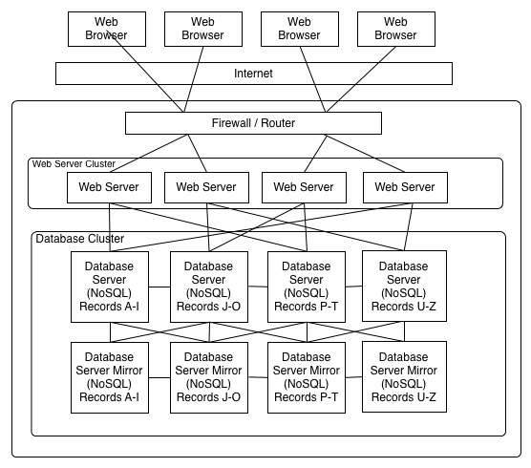
Architecture

Slide 11
Limit
Select firstname, lastname
from users
limit 100;

Slide 12
count
Select count(*) from activityLog;
Select count(orderId) from activityLog;

Slide 13
Joins
Users
UserEmail
UserEmailType

Slide 14
Cartesian Product
Contains event combination of the tables joined. (Cross Join)
SELECT *
FROM users
JOIN userEmail
You may need to use the LIMIT command.

Slide 15
Joins
SELECT *
FROM users
JOIN userEmail
ON userEmail.userId = users.userId
What record set is returned?
http://www.w3schools.com/sql/
http://dev.mysql.com/doc/refman/5.1/en/join.html

Slide 16
Joins
SELECT *
FROM users
JOIN userEmail
ON userEmail.userId = users.userId
JOIN userEmailType
ON userEmailType.userEmailTypeId = userEmail.userEmailTypeId
What record set is returned?

Slide 17
Inner Join
The INNER JOIN keyword return rows when there is at least one match in both tables.
select firstname, lastname, userEmail
from users
inner join userEmail
on userEmail.userId = users.userId

Slide 18
Left & Right Outer Joins
The LEFT JOIN keyword returns all rows from the left table (table_name1), even if there are no matches in the right table (table_name2).
select firstname, lastname, userEmail
from users
left join userEmail
on userEmail.userId = users.userId

Slide 19
Left & Right Outer Joins
The RIGHT JOIN keyword returns all the rows from the right table (table_name2), even if there are no matches in the left table (table_name1).
select firstname, lastname, userEmail
from userEmail
right join users
on users.userId = userEmail.userId

Slide 20


Slide 21
Constraints
PRIMARY KEY
FOREIGN KEY
NOT NULL
UNIQUE
DEFAULT
CHECK – Not in MySQL

Slide 22
Constraints
The CHECK constraint is used to limit the value range that can be placed in a column.
CREATE TABLE Persons ( personId int NOT NULL, LastName varchar(255) NOT NULL, FirstName varchar(255), Address varchar(255), age int, CHECK (age>21) ) ENGINE=INNODB;

Slide 23
Keys
Primary Key
Foreign Key
Either way, a key can be a single column or a composite key of multiple columns. It can be an integer, a varchar or a char.

Slide 24
Primary Key
“What makes this record unique?” “How do I get/change this one thing?”
Natural Keys Some combination of real data that makes a primary key
firstInitial+lastName+DOB
Surrogate Keys Artificial data added to the record for uniqueness
Autoincrement “id” - Identity, GUID, UUID

Slide 25
Natural / Surrogate Keys
A surrogate key is a row identifier that has no connection to the data attributes in the row but simply makes the whole row unique.
It is unique. It does *NOT* have any reason to change. (Incremental Numeric Value)
Natural Key - A natural key is a row identifier composed of data that uniquely describes data using its own attributes. An example of a natural key is social security number or other government issued number.

Slide 26
Natural / Surrogate Keys
artistID | artistName
6 | Shakira
8 | Madonna
11 | Britney Spears
Surrogate
releaseDate | albumTitle
2001-11-13 | Laundry Service
1998-03-03 | Ray Of Light
Natural

Slide 27
Composite Key
releaseDate | artistID | albumTitle
2001-11-13 | 6 | Laundry Service
1998-03-03 | 8 | Ray Of Light
2009-11-08 | 27 | The Fame Monster
2008-11-28 | 11 | Circus
Composite
Natural
Surrogate

Slide 28
Natural Keys
Create a table for states with a natural primary key.

Slide 29
Create Table - Natural Keys
CREATE TABLE states (
state varchar(2) NOT NULL,
stateName varchar(20) NOT NULL,
PRIMARY KEY (state)
) ENGINE=InnoDB DEFAULT CHARSET=latin1;

Slide 30
Alter Table
alter table states
add population int(11) after stateName;

Slide 31
Relationships

Slide 32
Relationships
When a foreign key points to the primary key of another table a relationship is formed.
Types of Relationships:
One to one
One to many
Many to many

Slide 33
Indexes
Indexes are used by the DB to enhance performance & enforce constraints.
Indexes may be composed of 1 or more columns.
More indexes may result in better select performance but may increase insert and update overhead

Slide 34
Indexes
A way to quickly find records with a specific value
“The people in ASL are Alice, Bob, and Chris”
Alternative: Scan through the whole table, looking at every row
Can also be simple or composite
Can be unique (like PKs), or not (like FKs)

Slide 35
Indexes
Searching by an index instead of the entire table is more efficient.

Slide 36
Explain
explain TABLE
explain SQL STATEMENT

Slide 37
Execution Plan
explain
select firstname, lastname, userEmail
from users
left join userEmail
on userEmail.userId = users.userId;

Slide 38
Execution Plan
http://www.devshed.com/c/a/MySQL/MySQL-Optimization-part-1/2/

Slide 39
Execution Plan
id : The # of the SELECT clause, in the same order as the query
Here, both 1 because there is only 1 SELECT
select type : What kind of SELECT?
table : The table being read
type : What kind of JOIN?

Slide 40
Execution Plan
possible keys / key : Which keys, indexes could have been used, or were used?
key len : The number of key parts used
ref : Which columns are compared to the key?
extra : Notes on efficiencies and inefficiencies

Slide 41
Compare Execution Plan
explain select firstname, lastname, userEmail, userEmailType
from users
left join userEmail
on userEmail.userId = users.userId
left join userEmailType
on userEmailType.userEmailTypeId = userEmail.userEmailId
where users.userId = 1
or
where userEmailType = 'home’

Slide 42
Compare Execution Plan
where users.userId = 1
where userEmailType = 'home’

Slide 43
Database Normalization
In the design of a relational database management system (RDBMS), the process of organizing data to minimize redundancy is called normalization.
Consistent, logical table structure
No quirks (anomalies)
Table design fits analog model
Easy to query
Good performance
Eliminate duplicate data
Forward-compatible

Slide 44
First Normal Form
Eliminate repeating groups in individual tables.
Create a separate table for each set of related data.
Identify each set of related data with a primary key.
Every row*column has exactly one value

Slide 45
First Normal Form
The invoice table does not follow
first normal form. This is the incorrect way to design a table.
The order & orderItem table
combined follow first normal form.

Slide 46
2nd Normal Form
A 1NF table is in 2NF if and only if all its non-prime attributes are functionally dependent on the whole of every candidate key.
A functional dependency (FD) is a constraint between two sets of attributes in a relation from a database.
A candidate key of a relation is a minimal superkey for that relation (PK)

Slide 47
2nd Normal Form
Neither {Employee} nor {Skill} is a candidate key for the table. This is because a given Employee might need to appear more than once (he might have multiple Skills), and a given Skill might need to appear more than once (it might be possessed by multiple Employees). Only the composite key {Employee, Skill} qualifies as a candidate key for the table.

Slide 48
2nd Normal Form
A 2NF alternative to this design would represent the same information in two tables: an "Employees" table with candidate key {Employee}, and an "Employees' Skills" table with candidate key {Employee, Skill}:

