Slide 1
CI/CD for NoteJam

Slide 2
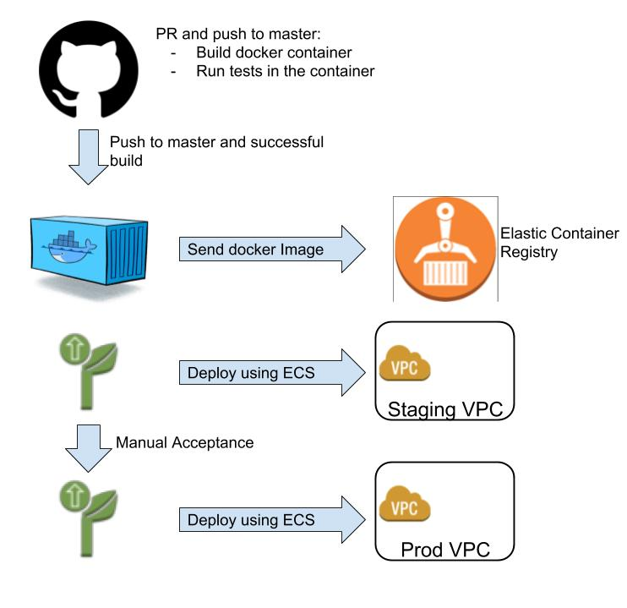
Overview CI/CD

Slide 3
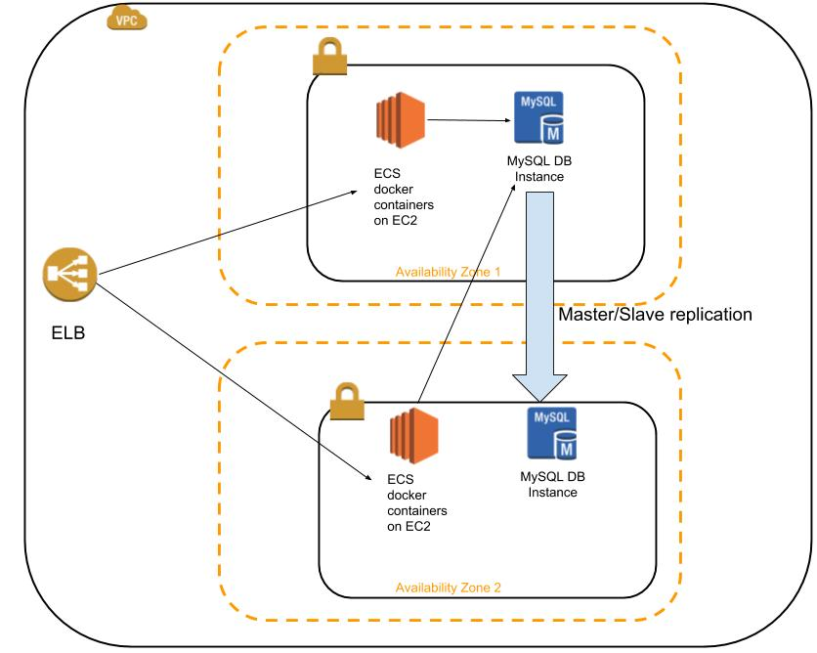
Application Architecture Overview

Slide 4
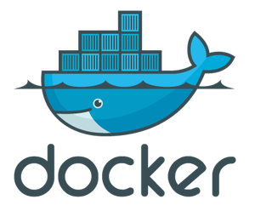



Docker container architecture
worker
worker
socket
worker
worker

Slide 5



Docker Container
Use MySQL as persistent storage
- Get runtime configuration from S3
- Use secure bucket (IAM roles for tasks)
- Creates initial admin user
- Separate configuration for prod and staging
Strore logs using CloudWatch and awslogs

Slide 6
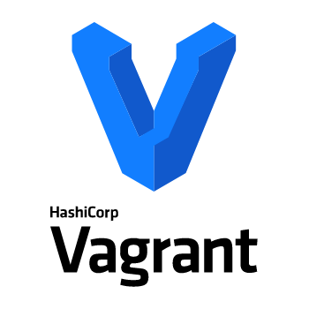
Vagrant for local dev
- Easy to start
- Uniform local development environment
- make tests; make coverage

Slide 7
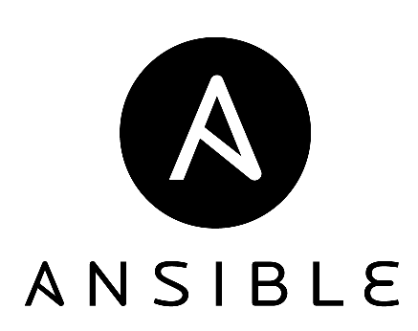
Provisioning scripts Overview
Explained in Readme.md
3 tiers: load balancer, database, web
create_environment.sh - init aws, create staging and prod environments
create_env.yml - create environment with configs from env_configs

Slide 8
Runtime scripts Overview
Explained in Readme.md
db_snapshot.sh - Creates/lists or deletes db snapshot
restore_db_snapshot.sh - Restores database from snapshot
scale_nodes.sh - scale number of nodes

