Slide 1

Managing quartz jobs in a web api
brIan nolan

Slide 2
What is quartz
Quartz.NET is a full-featured, open source job scheduling system that can be used from smallest apps to large scale enterprise systems. https://www.quartz-scheduler.net/
Features
Embed in an application, console app, web app, service
Schedule based on time, number of executions, repeat periodically
Load balancing
Graceful fail-over
Extensible
https://github.com/bnolan001/QuartzScheduler

Slide 3
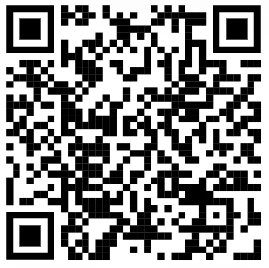
Sample Project
.NET 6 Web API
Two download jobs
Hourly weather observation
Daily forecast
Two Endpoints
View scheduled jobs
Request one-off job execution
https://github.com/bnolan001/QuartzScheduler

