Slide 1
Abstract Connoisseurs
Bryan Nonni, Steve Fassnacht, Alex Fleming

Slide 2
Problem Statement:
Create interactive map of Georgia highlighting areas of interest using only html/css
Requirements:
On load, the webpage is a image of Georgia with small icons for each area of interest over their relative true geographic locations
Inputs
1. User hovers the cursor over an icon
2. User clicks on expanded image
3. User moves cursor away from icon
Outputs
An Image and corresponding to the area of interest being hovered expands on top of background
Onclick bring info to front
Bring image and info behind background

Slide 3
Design
Background image is a minimalistic map of Georgia
Small icons show where the areas of interest are
Hovering on an icon will trigger the onHover attribute for the corresponding image
Page loads with image dimensions and area description with z-index behind background
onHover attribute will bring to front image for the area of interest
onClick of image, info comes to front
Moving curser away deactivates the onHover attribute, resetting the image and description to z-index behind background

Slide 4
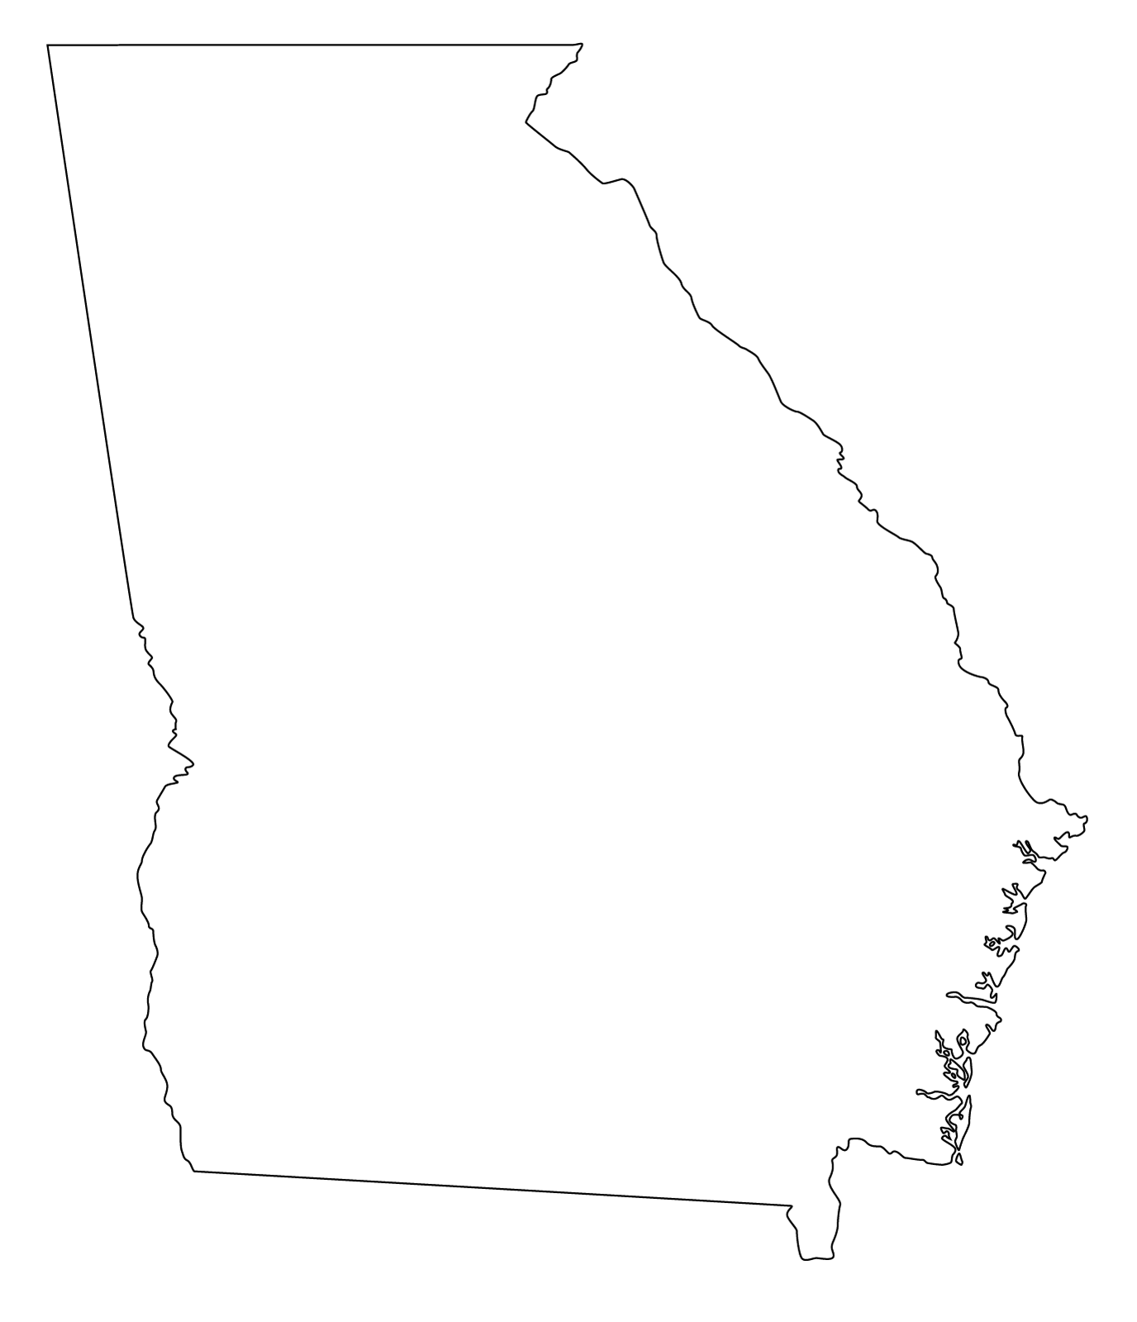
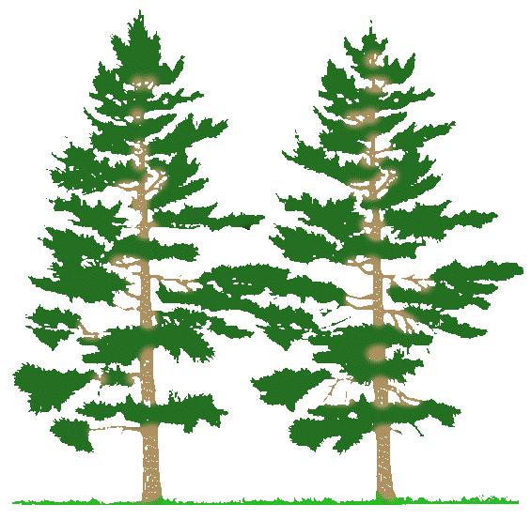
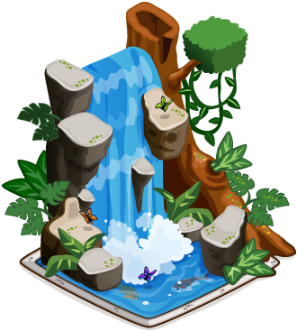







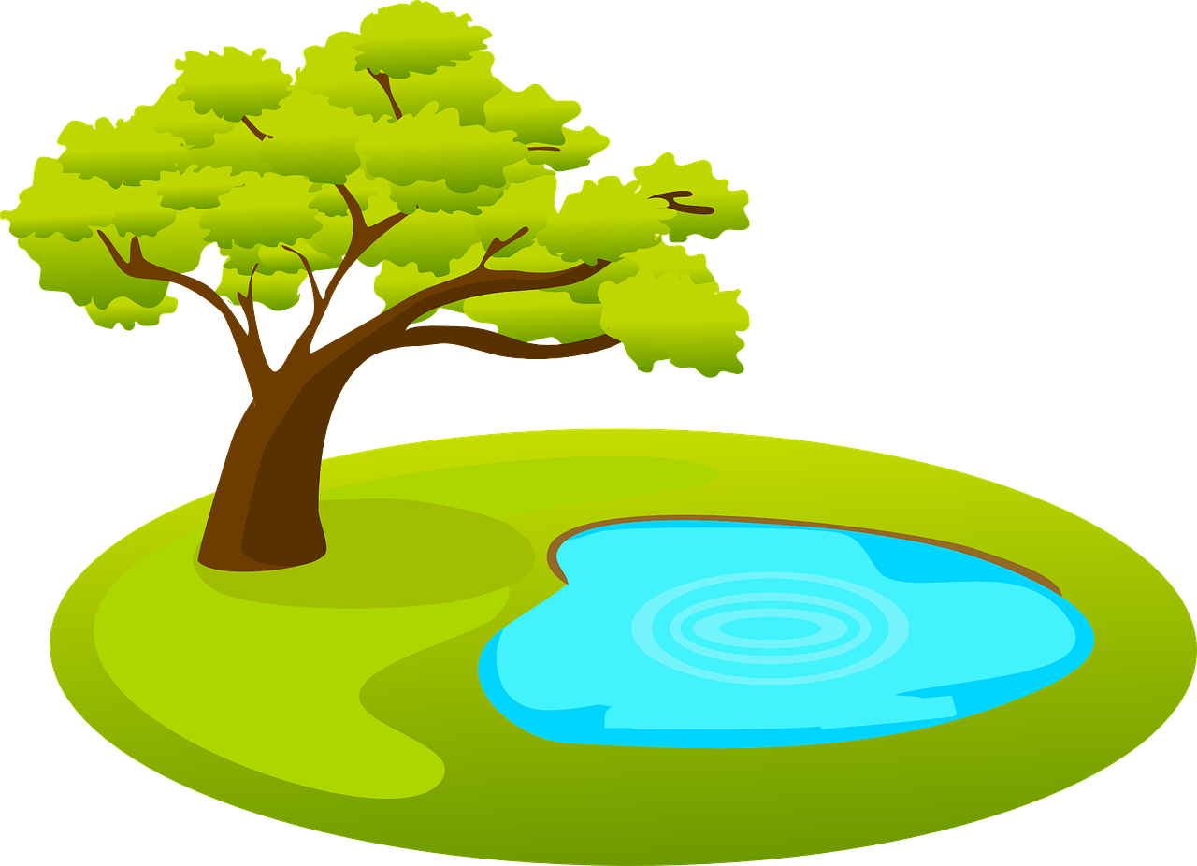
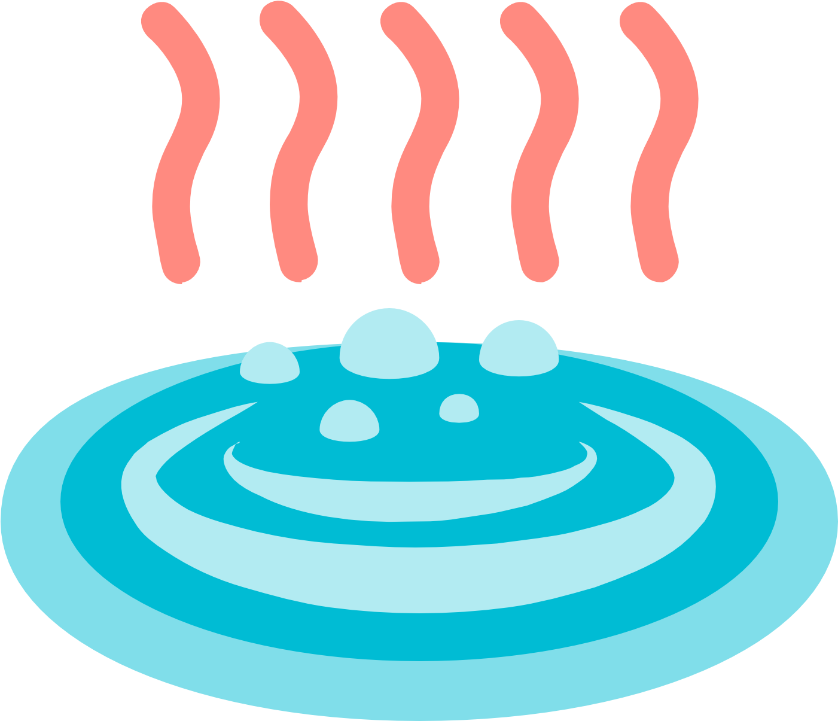

User Interface
Chattahoochee forest
Chattahoochee river
Red Top Mountain
Savannah
Providence Canyon
Macon
Radium Springs
Tallulah Gorge
Okefenokee Swamp
Warm Springs
Atlanta
Augusta

Slide 5
Class Diagram

