Slide 1
F(un)*Society00
BY:
Bryan Nonni, jimmy petit homeis, Jordan aletraris, noah de joya

Slide 2
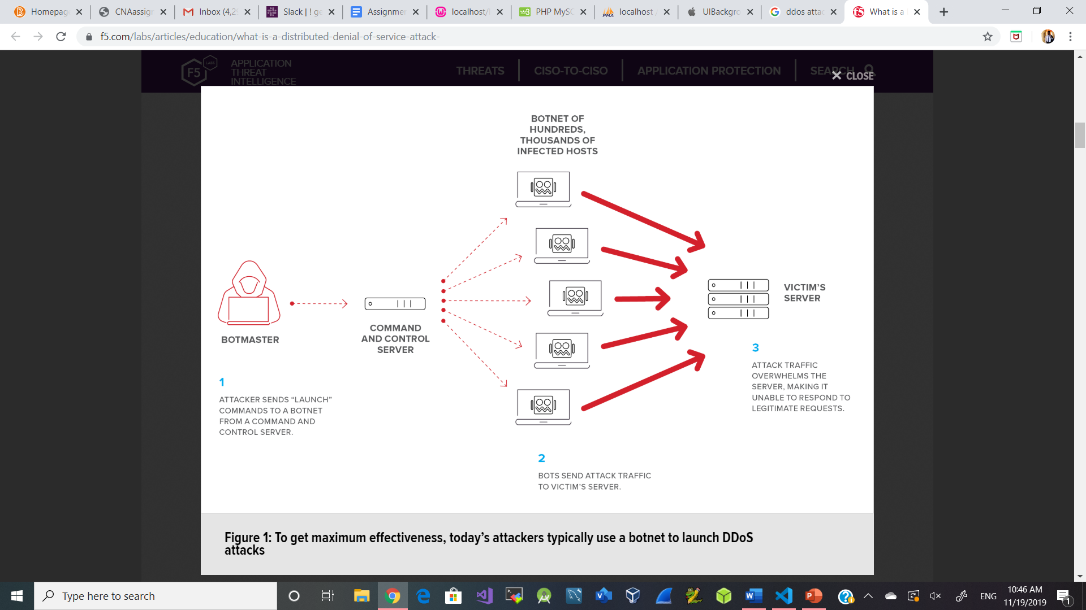
Distributed Denial-of- Service Attack
DDOS

Slide 3
What is a Distributed Denial-of-Service Attack?
As the name implies, a denial-of-service attack is an attempt by attackers to keep users from accessing a networked system, service, website, application, or other resource. The attack typically makes a system slow to respond, or it can disable the system entirely.
An attack that originates from a single source is called simply a denial-of-service (DoS) attack. However, far more common today are distributed denial-of-service (DDoS) attacks, which are launched at a target from multiple sources but coordinated from a central point. Distributed attacks are larger, potentially more devastating, and in some cases more difficult for the victim to detect and stop.

Slide 4
How does a DDOS Attack work?
Most DDoS attacks are designed to consume all available network bandwidth or resources on a target network, system, or website. The attacker uses one of many available methods and tools to flood the target with a barrage of malicious or nuisance requests, or to abuse a protocol or inherent vulnerability in such a way that the system can no longer respond to requests. The effects of a DDoS attack are a bit like having the entrance to a concert venue suddenly swarmed by busloads of troublemakers with counterfeit tickets. The legitimate ticket-holders, standing in an orderly line, would never get inside.

Slide 6



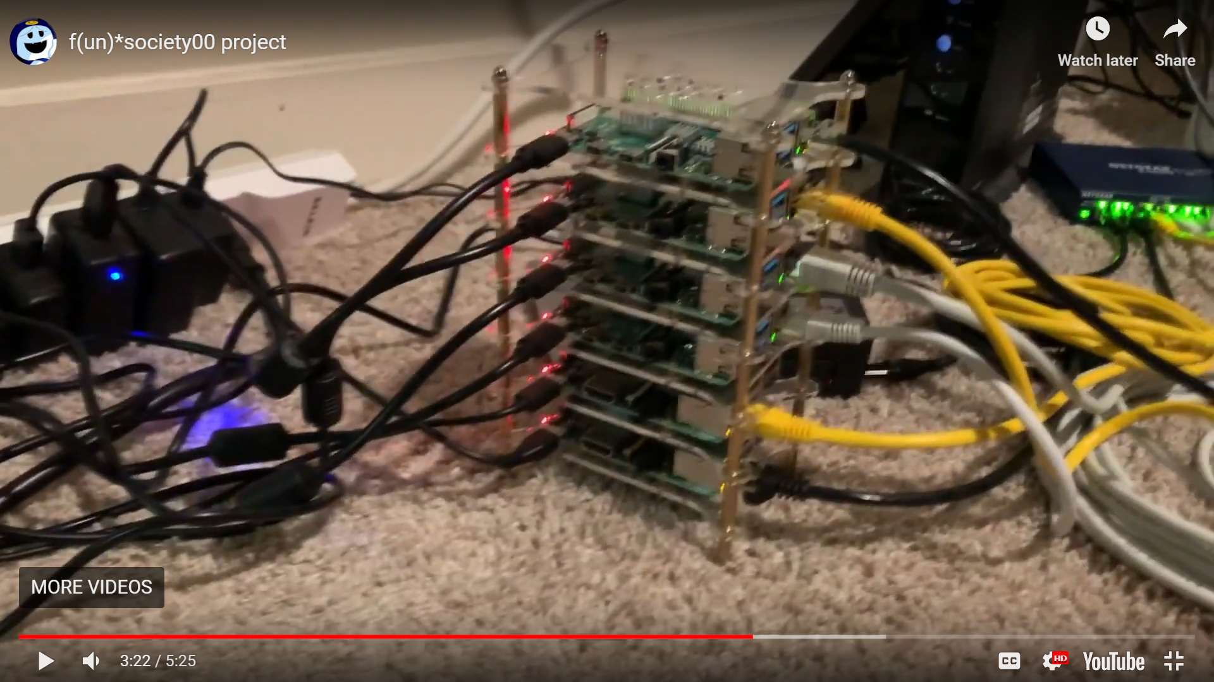

Description & Purpose of Our Project
Operation WulfDoS is an attempt to DDoS attack an intentionally vulnerable Linux OS running on Raspberry Pi: RasPwn.
WulfDoS uses a Beowulf Cluser to execute a simulated DDoS Attack on the RasPwn SSID.
Knowledge obtained from Operation WulfDoS:
  Better understanding TCP vs UDP
  How to Build an HPC cluster
  How to perform a DoS attack (TCP & UDP)
  Cores vs. Threads
  Hyperthreading

Slide 7
The main functionality is about executing DoS script across a 6-pi Beowulf Cluster
Hardware
Software
Packages
3x Raspberry Pi 3
5x Raspberry Pi 4
1x 2TB Seagate External Hard drive
1x Netgear multi-port ethernet splitter
1x Raspberry Pi Tower Case
Linux
Raspbian Lite (Debian CLI)
Slurm (Slurmd, Slurm-Client, Slurmctl)
Munge
NFS Kernel Server
Sockets
NTPUpdate
Programming Languages
Python
Bash/Shell Scripting

Slide 8
Are you guys ready to watch the fun?

Slide 9



Slide 10
Thank you !!!

