Slide 1

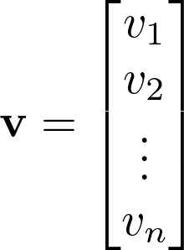



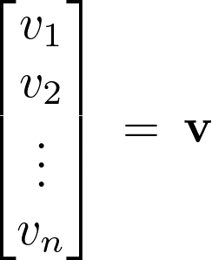

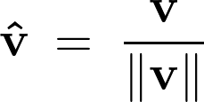
u
v
u
v

Slide 2

u
v

Slide 3



b
a
b
b
a
a

Slide 4


b
b
a
a

