Slide 1
On Egenvalues and Eigenvectors
of Square Matrices

Slide 2
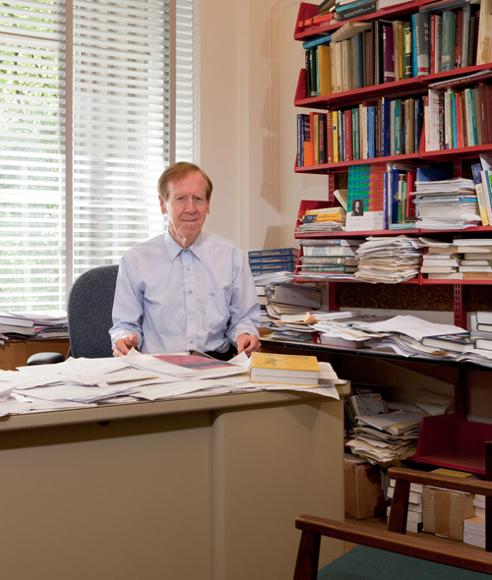
Eigenvalue and Eigenvector
http://ocw.mit.edu/courses/mathematics/18-06-linear-algebra-spring-2010/tools/
http://web.mit.edu/18.06/www/Demos/eigen-applet-all/eigen_sound_all.html
MIT, Linear Algebra (18.06)
Instructor:
Prof. Gilbert Strang
Professor of Mathematics, Massachusetts Institute of Technology
(MIT)
Ref: Gilbert Strang. 18.06 Linear Algebra, Spring 2010. (Massachusetts Institute of Technology: MIT OpenCourseWare), http://ocw.mit.edu (Accessed). License: Creative Commons BY-NC-SA

Slide 3
Eigenvalue Demonstrations (MIT)
Eigenvalue Demonstrations
The demonstrations below employ Java® applets with voice-over narration to show some Eigenvalue concepts.
Demo 1 - This 3-minute demo shows eigenvectors of 2 by 2 matrices
The demo is also broken into 7 independent pieces:
Part 1
Part 2
Part 3
Part 4
Part 5
Part 6
Part 7
Demo 2 - Powers A^{n}V lead toward the top eigenvalue/eigenvector
Ref: Gilbert Strang. 18.06 Linear Algebra, Spring 2010. (Massachusetts Institute of Technology: MIT OpenCourseWare), http://ocw.mit.edu (Accessed). License: Creative Commons BY-NC-SA

Slide 4
Mini-lectures on Eigenvalues
Mini-lectures on Eigenvalues
The mini-lectures with voice-over narration below help to explain some key Eigenvalue concepts.
Full Lecture (all eight together)
Or view individually (about 2 minutes each)
det(A-\lambda I)=0
Eigenvectors and Trace
Powers
Diagonalization
Differential Equations
Symmetry
Positive Definite
SVD
Ref: Gilbert Strang. 18.06 Linear Algebra, Spring 2010. (Massachusetts Institute of Technology: MIT OpenCourseWare), http://ocw.mit.edu (Accessed). License: Creative Commons BY-NC-SA

