Slide 1
Lists and Vectors
Assignment 5 CMPR 131, Professor Quach
Team members: Ben Halpern, Itz Rodriguez, Tony Cheng, Jose Chavez, Thien Nguyen, Jesus Sierra

Slide 2
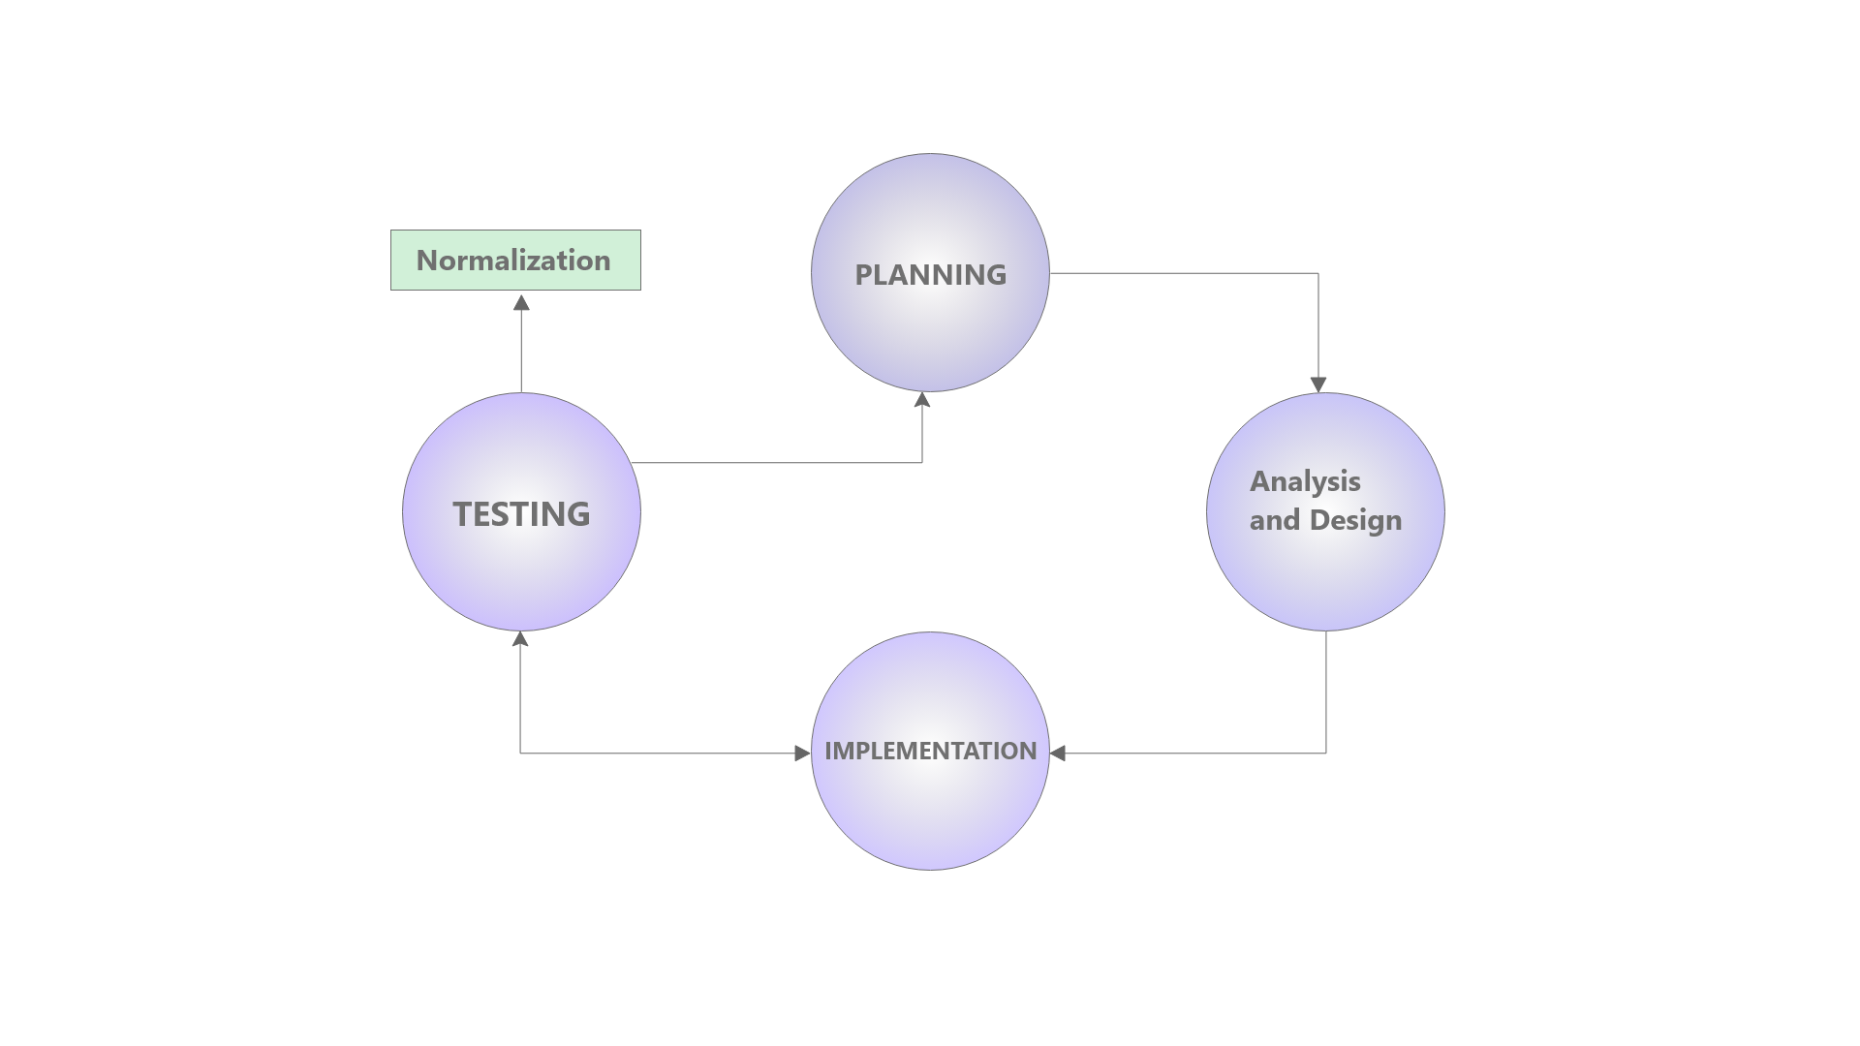

Life cycle
Design/Plan
Flow of the code
Coding
Implementation of the design phase
Testing
Testing the boundary values of the code to look for errors
Finalizing
Normalizing the code to match coding conventions and turning off debugging checks inside the code
Notes:
Image reference: https://www.google.com/url?sa=i&url=https%3A%2F%2Fwww.roberthalf.com%2Fblog%2Fsalaries-and-skills%2F6-basic-sdlc-methodologies-which-one-is-best&psig=AOvVaw3vD8ef4j_GTPYU5hwl0Y_o&ust=1634611382618000&source=images&cd=vfe&ved=0CAsQjRxqFwoTCPC6_4j40vMCFQAAAAAdAAAAABAD

Slide 3
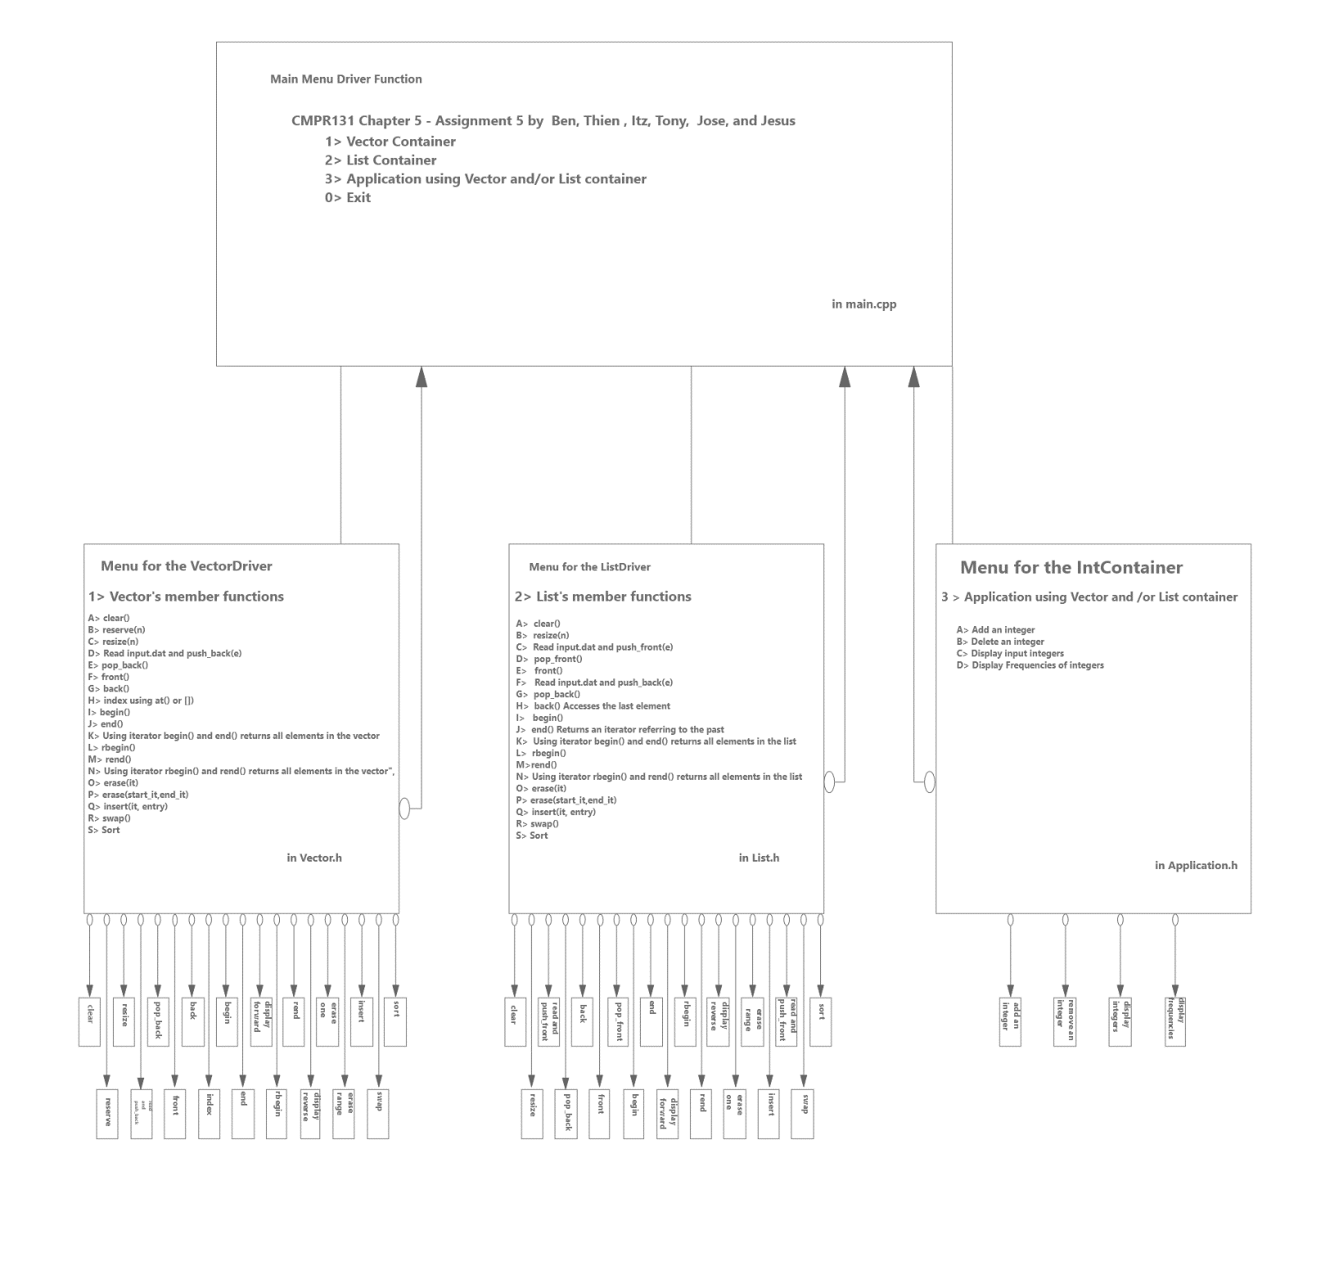
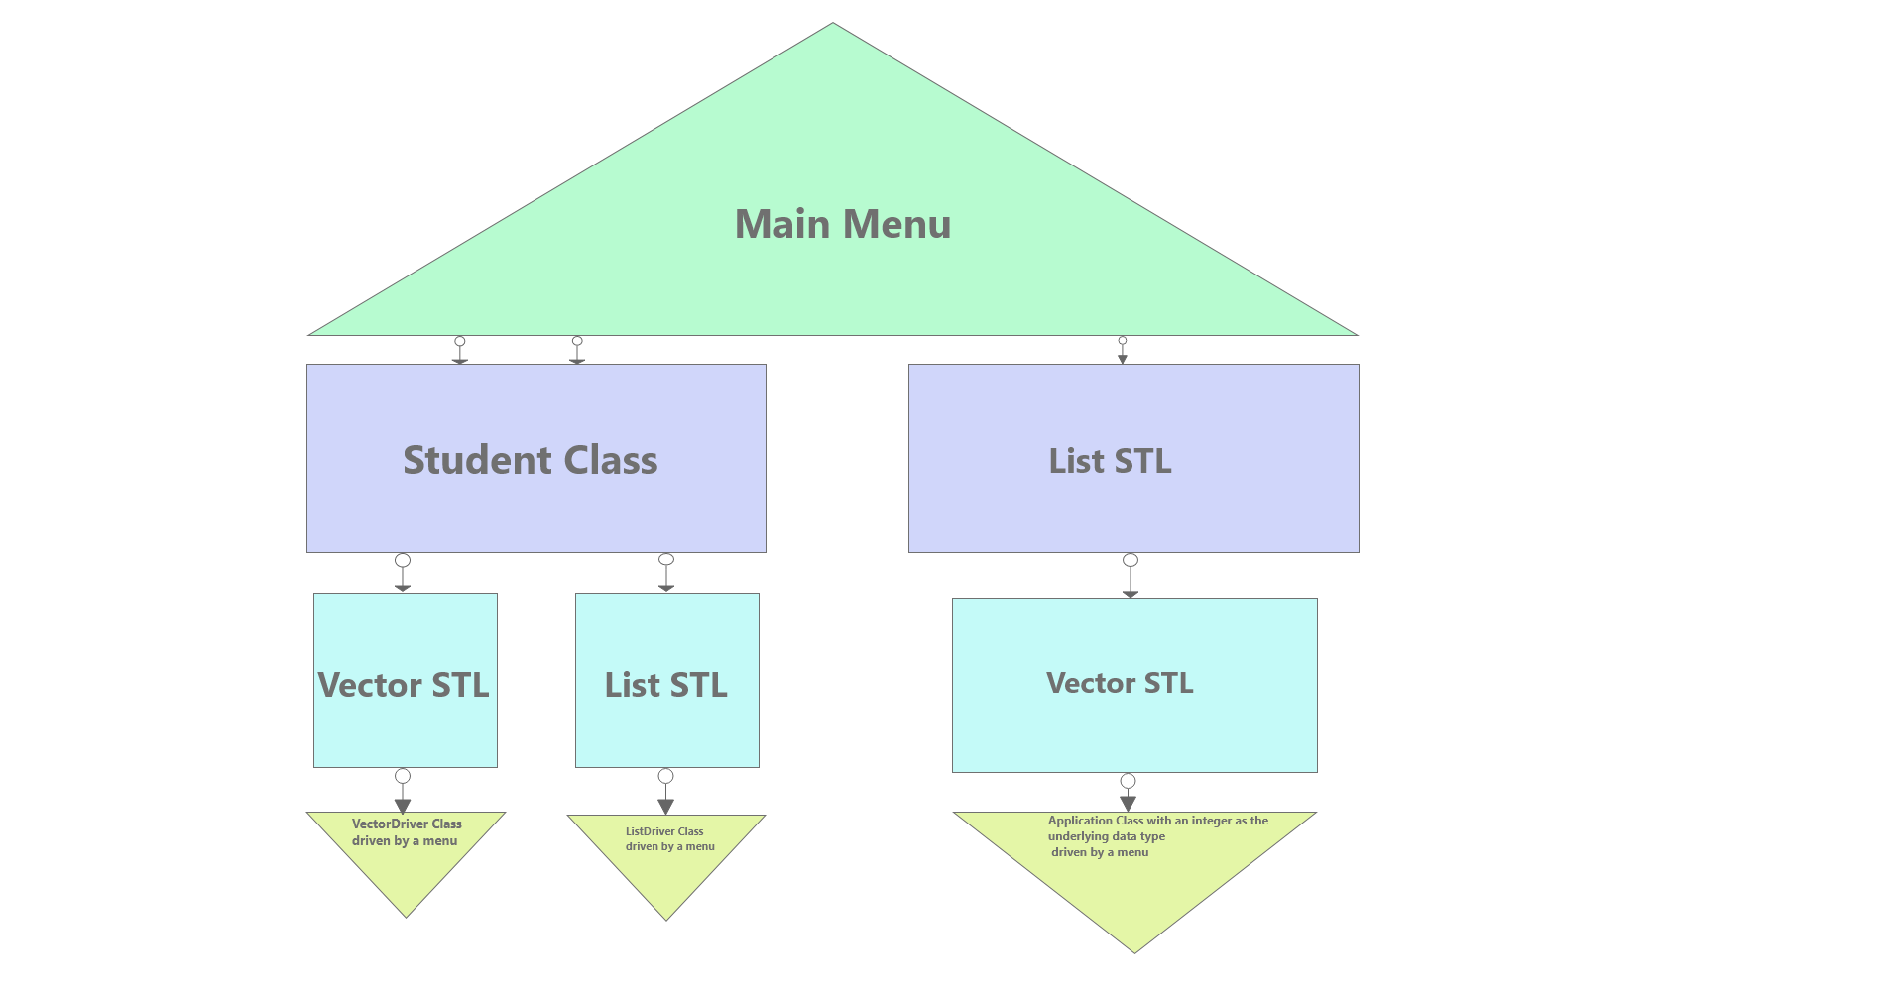
UML and Hierarchy Chart

Slide 5
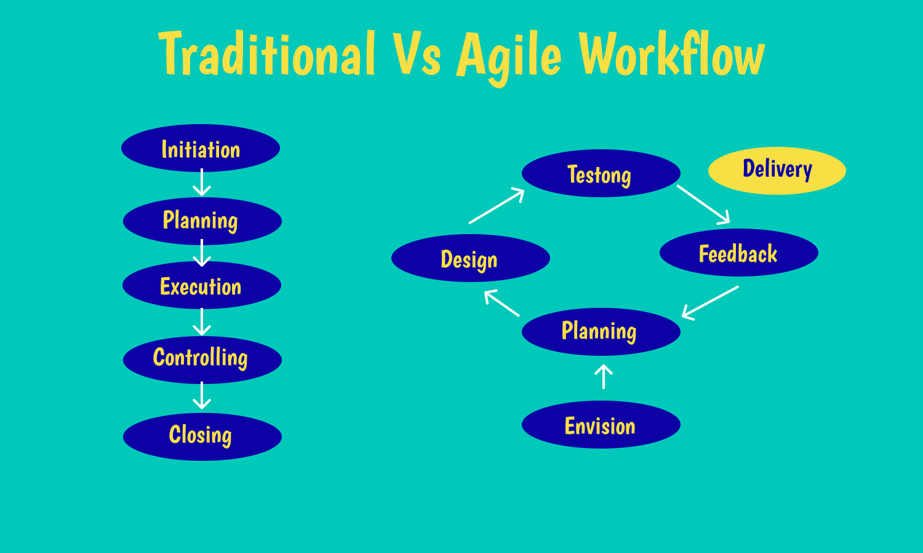
Workflow
Agile
What is an agile workflow
How are tasks divided
How does this improve efficiency
Notes:
Image reference:
https://www.google.com/url?sa=i&url=https%3A%2F%2Fhygger.io%2Fguides%2Fagile%2Fproject-management%2Fworkflow%2F&psig=AOvVaw2-rRcQLZL1pHS5Cjw0UqFL&ust=1634611307548000&source=images&cd=vfe&ved=0CAsQjRxqFwoTCIjW_en30vMCFQAAAAAdAAAAABAD

Slide 6
Student Class
Holds demographic information (Name, School Level, GPA)
Underlying data type for the vector and list classes
Name of student:
String value holding the name
School Level:
Four Levels : [0]Freshman, [1]Sophomore, [2]Junior, [3]Senior
GPA of the student:
Double value
Operator Overloads:
<, >, <=, >= , ==, !=, <<, >>

Slide 7
Vectors
Constructors
VectorDriver()
initializes default vector
Accessors
getSizeOfVector(), irReturn(), irEnd(), irBegin(), iReturn(), iEnd(), iBegin(), frontOfVector(), backOfVector(), indexOfVector()
Mutators
sortVector(), swapVector(), insertEntry(), reserveVector(), clearVector(), resizeVector(), pushBackToVector(), popBackVector(), eraseFromVector(), eraseRangeVector()
Methods
clearMethod(), reserveMethod(), resizeMethod(), readFileMethod(), popBackMethod(), frontMethod(), backMethod(), indexMethod(), iterBegin(), iterEnd(), iterReturn(), iterRBegin(), iterREnd(), iterRReturn(), iterErase(), eraseVectorRangeMethod(), iterInsert(), swapMethod(), iterSort(), vectorMenuOption(), vectorIsEmptyMethod()

Slide 8
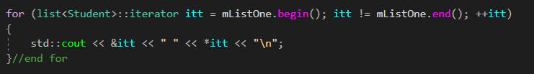
Lists
Constructors
ListDriver()
Accessors
emptyCheck(), displayAll_reverse(), showFront(), showBack(), showRbegin(), showRend(), showBegin(), showEnd(), begin(), end(), rend(), rbegin()
Mutators
clear(), resize(), readFrontNPopulate(), pop_front(), showFront(), readBackNPopulate(), pop_back(), showBack(), showBegin(), showEnd(), displayAll(), showRend(), showRbegin(), begin(), end(), erase(), erase(begin, end), insert(), swap(), sort(), emptyCheck()
There are overloaded methods that have an overloaded method as a mutator and accessor.

Slide 9

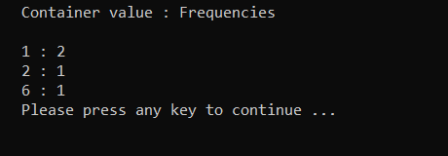
Application IntContainer Class
Private Members
list<vector<int>> mListVector
Methods
mutators
void addNumber()
void removeNumber()
Accessors
void displaySet()
void displayFrequencies()

Slide 10
Summary
What we learned?
What difficulties we faced?
How we overcome those difficulties?
What we took away from this project?
Github implementation.
Team communication.
Notes:
simple and descriptive names.

Slide 11
Image Sources
https://www.google.com/url?sa=i&url=https%3A%2F%2Fhygger.io%2Fguides%2Fagile%2Fproject-management%2Fworkflow%2F&psig=AOvVaw2-rRcQLZL1pHS5Cjw0UqFL&ust=1634611307548000&source=images&cd=vfe&ved=0CAsQjRxqFwoTCIjW_en30vMCFQAAAAAdAAAAABAD

