Slide 1

Title: Early Wildfire Detection and Analysis using Machine Learning
Theme: Satellite fire data + weather for fire intensity estimation

Slide 2
EL Phase-I
Presentation Outline
Introduction
Literature Review
Problem Definition
Objectives
Methodology
Proposed Outcomes
Timeline of the project
SDG Alignment
Conclusion
References

Slide 3
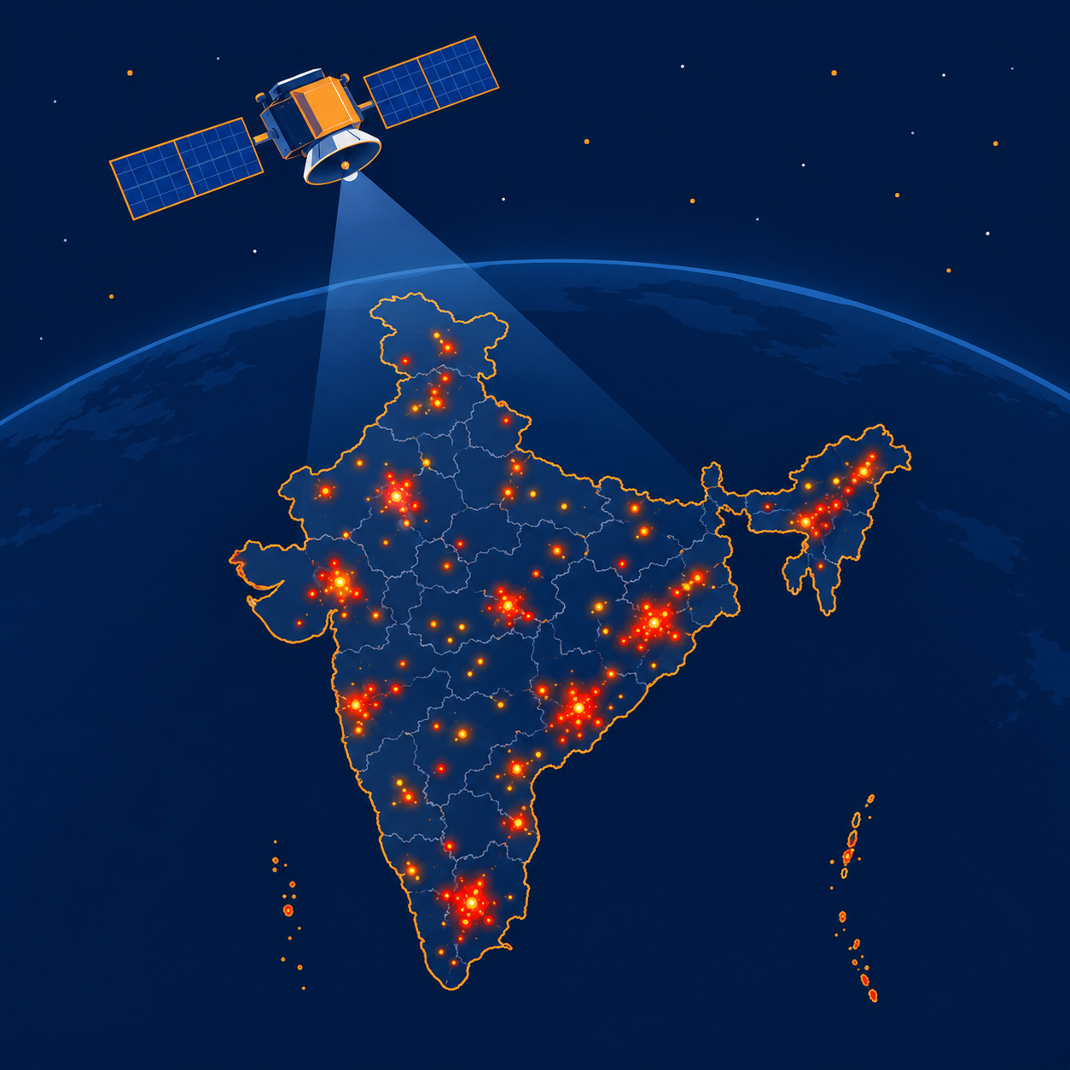
Introduction
Overview: Wildfires damage forests, air quality and livelihoods. NASA satellites (MODIS, VIIRS) detect active fires and report Fire Radiative Power (FRP, in MW), a proxy for fire intensity.
Why it matters: India records a very large number of satellite-detected fires every year, mostly in the dry season. [Add one cited statistic here]
Gap: Fire detections and weather data are public but separate and hard for non-experts to use together.
This project: Join Indian fire detections with daily weather, train an ML model to estimate FRP, and present it in an interactive dashboard.
Note: Educational prototype, not an official forecast. FRP is not burned area.
Fig. 1: VIIRS satellite detects fire hotspots over India; each carries an FRP value.

Slide 4
Literature Review
Study | Focus / Method | Key finding | Relevance to this project
Giglio et al. (2016) | MODIS Collection 6 active fire detection algorithm | Improved detection and fewer false alarms; reports FRP per fire pixel | Defines the MODIS fire points and FRP
Schroeder et al. (2014) | VIIRS 375 m active fire product | Finer resolution than MODIS; better at small, low-intensity fires | Source of our VIIRS (NOAA-20, Suomi NPP) detections
Wooster et al. (2005) | Fire radiative energy from satellite FRP | FRP and its time integral relate to biomass burned | Justifies FRP as an intensity proxy
Jain et al. (2020) | Review of ML in wildfire science | ML is widely used; most work targets occurrence, susceptibility and spread | Shows the gap: intensity estimation is less covered
Breiman (2001) | Random forest algorithm | Ensemble of trees; robust, does not overfit as trees are added, gives variable importance | Our regression model and feature importance
Trend: shift from threshold rules to ML that combines satellite data with weather. Framework: supervised regression, weather features to log(1+FRP). Gap: few open, interactive tools estimate fire intensity for India from weather.

Slide 5
Problem Definition
Problem: Satellite fire data and weather data exist separately. There is no simple open tool that links them to show how weather conditions relate to fire intensity in India.
Context:
  India has varied climate zones and distinct fire seasons.
  FIRMS data is free but raw, and needs joining and cleaning before it is useful.
Significance:
  Without such a tool, the link between weather and fire intensity stays unexplored for students and the public.
  Gap: no reproducible pipeline from raw detections to an easy-to-read intensity estimate.

Slide 6
Objectives
Main objective: Build an ML-based dashboard that estimates wildfire intensity (FRP) over India from satellite and weather data.
Specific objectives:
  Collect NASA FIRMS fire detections for India and join them with Open-Meteo weather data.
  Compare Random Forest and XGBoost models to predict FRP and report the error (MAE).
  Build a Streamlit dashboard with a map, input sliders and a risk band.
  Build an ESP32 + DHT22 + MQ-135 sensor unit and show its live readings in the dashboard (software and ML first, then hardware).
Contribution: An open, reproducible pipeline and dashboard that runs offline once data is cached.

Slide 7
Methodology
Design: Quantitative, supervised ML plus an IoT sensor unit.
Data collection:
  NASA FIRMS VIIRS fire points for India (lat 8-35, lon 68-97): lat, lon, date, FRP, confidence, brightness.
  Open-Meteo Historical API: temperature, humidity, wind and 7-day rain per fire date and location (cached).
  Live: ESP32 + DHT22 + MQ-135 send TEMP,HUMIDITY,SMOKE over USB serial.
Data analysis:
  Clean and join; train on 2024, test on 2025; XGBoost on log(1+FRP); report MAE and R2; feature importance.
Tools: Python, pandas, scikit-learn, XGBoost, Streamlit, GitHub, Arduino/PlatformIO.
Note: FRP is a satellite intensity proxy, not burned area in hectares.

Slide 8
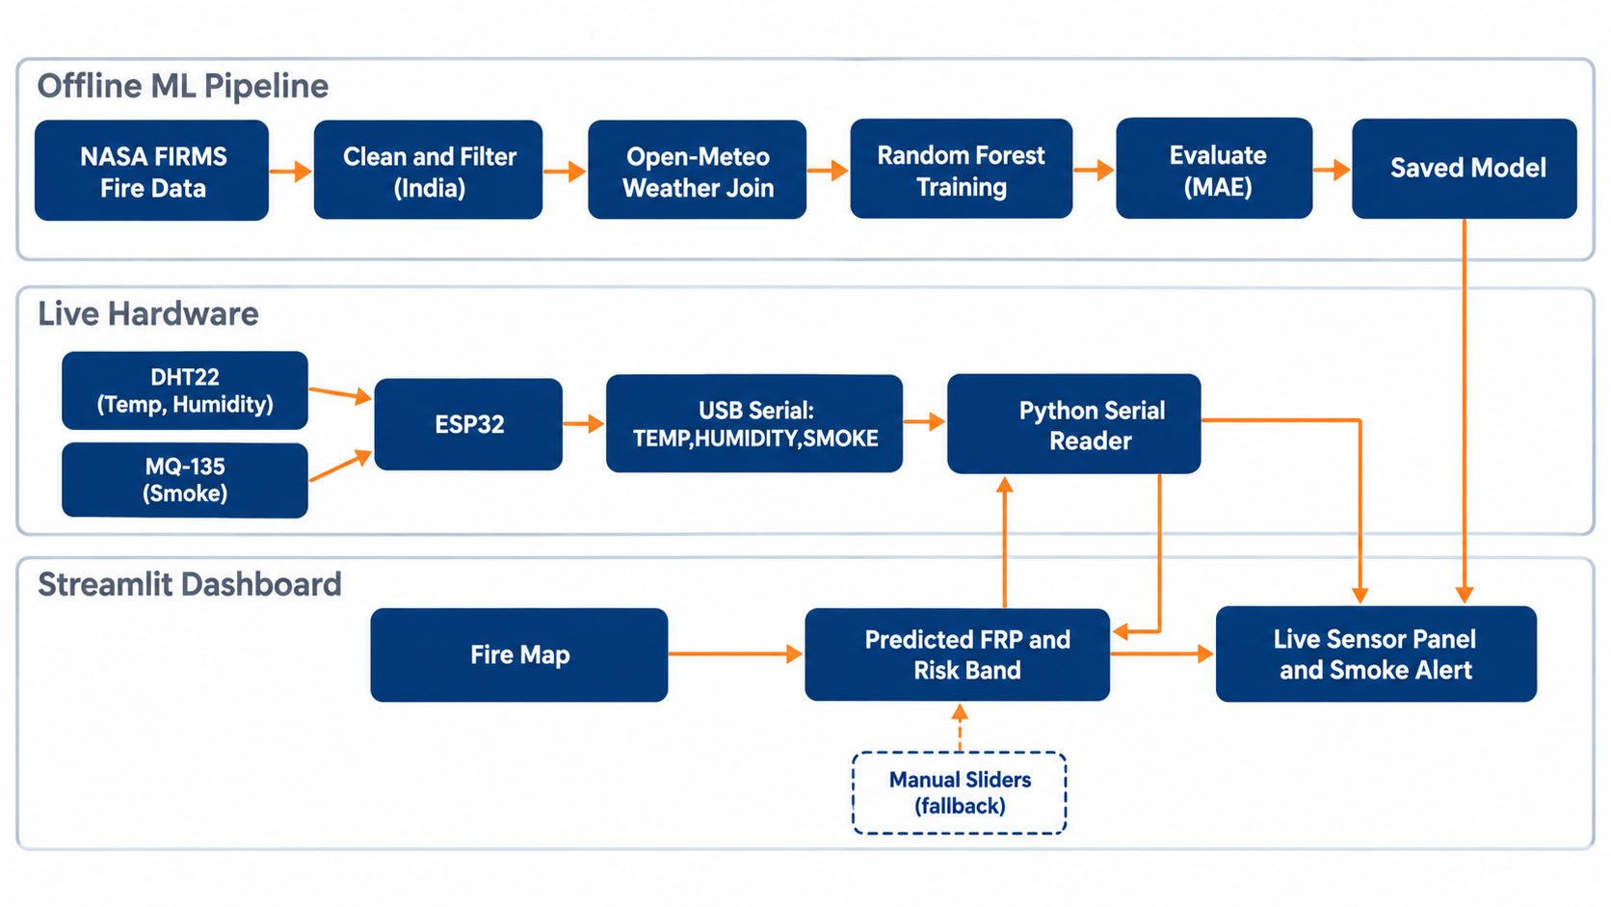
Methodology
Fig. 2: System architecture - ML pipeline, ESP32 sensor unit and Streamlit dashboard

Slide 9
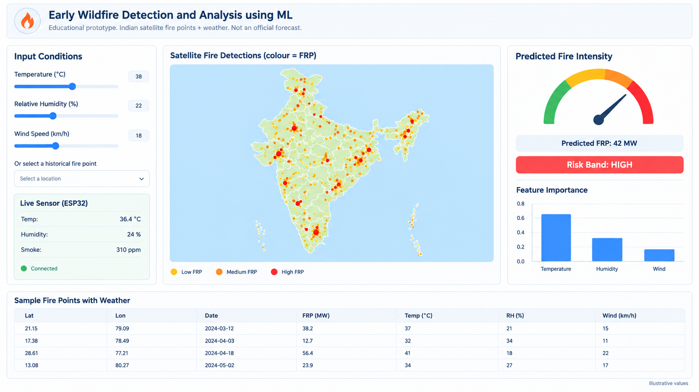
Proposed Outcomes
Expected results:
  Joined India fire + weather dataset.
  Trained model: MAE 4.01 MW vs 4.72 MW for a median guess.
  Working dashboard: map, sliders, predicted FRP/risk band.
Potential impact:
  Easy way to explore how weather relates to fire intensity.
Future directions:
  State filters, vegetation/terrain data, other models, real-time alerts.
Fig. 3: Dashboard layout. Left: weather sliders and live ESP32 panel. Centre: fire map. Right: predicted FRP, risk band and feature importance. Bottom: sample fire points with weather.

Slide 10
Timeline of the project
Done - Data: FIRMS cleaning and weather join, 1.9 million fire points.
Done - ML: Models compared, final model tested on unseen 2025 fires.
Done - Software: Streamlit dashboard, runs offline with no sensor.
In progress - Simulation: ESP32 sketch working in Wokwi, dashboard link next.
Next - Hardware: Wire and flash the ESP32, DHT22 and MQ-135 unit, calibrate.
Next - Reporting: Evidence screenshots, report and conference paper.

Slide 11
SDG Alignment
SDG 13 Climate Action: Supports 13.1 and 13.3 by showing how heat, dryness and wind relate to fire intensity.
SDG 15 Life on Land: Supports 15.2 by showing where and when intense vegetation fires occur.
SDG 11 Sustainable Cities: Contributes to 11.5 with a low-cost local smoke alert demonstration.
SDG 3 Good Health: Contributes to 3.9 through simple local air-quality awareness.

Slide 12
Conclusion
Summary: We link satellite fire detections with weather to estimate fire intensity and present it in an interactive dashboard.
Final thoughts: Open data and simple ML make fire patterns easier to understand.
Next steps: Test the live Wokwi link, build the real ESP32 sensor unit and draft a conference paper.

Slide 13
References
Breiman, L. (2001). Random forests. Machine Learning, 45(1), 5-32.
Giglio, L., Schroeder, W., & Justice, C. O. (2016). The collection 6 MODIS active fire detection algorithm and fire products. Remote Sensing of Environment, 178, 31-41.
Jain, P., et al. (2020). A review of machine learning applications in wildfire science and management. Environmental Reviews, 28(4), 478-505.
Schroeder, W., et al. (2014). The new VIIRS 375 m active fire detection data product. Remote Sensing of Environment, 143, 85-96.
Wooster, M. J., et al. (2005). Retrieval of biomass combustion rates and totals from fire radiative power observations. Journal of Geophysical Research, 110, D24311.
NASA FIRMS. https://firms.modaps.eosdis.nasa.gov/
Open-Meteo Historical Weather API. https://open-meteo.com/

Slide 14
Expected Outcome by the end of First Year
Conference publication: Paper in IEEE format covering the pipeline, model results and dashboard.
Research proposal: Extend to state-level analysis with more data layers (vegetation, terrain).
Journal publication: After further validation and comparison with other models.
Patent: Not planned; reconsider only if the sensor-to-ML integration proves novel.

Slide 15


