Slide 1

Title: Early Wildfire Detection and Analysis using Machine Learning
Theme: Satellite data, weather and live sensors for next-day fire and severity prediction

Slide 2
EL Phase-I
Presentation Outline
Introduction
Literature Review
Problem Definition and Objectives
Methodology and Architecture
ML Models and Results
Dashboard and Outcomes
Collar Demo and Progress
Timeline and SDG Alignment
Limitations and Conclusion
References

Slide 3
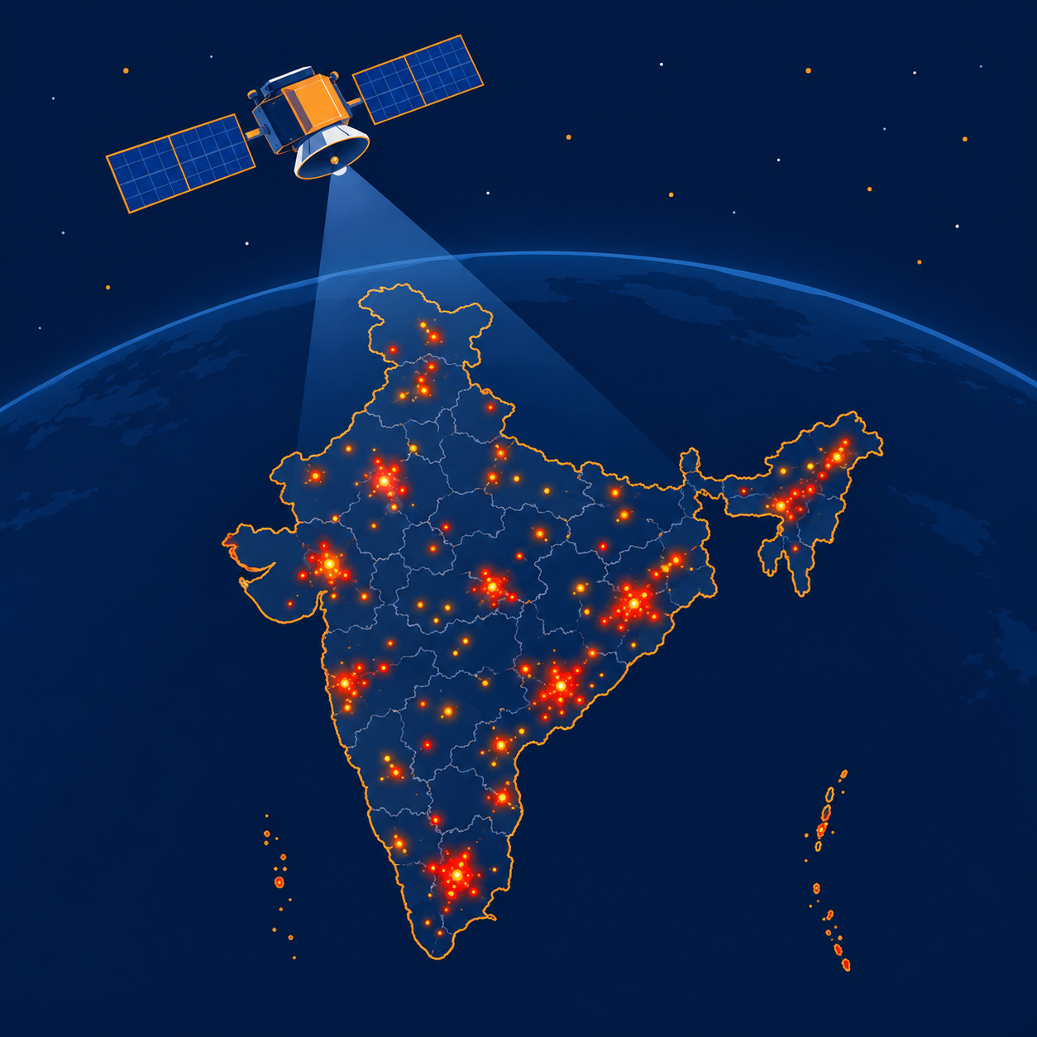
Introduction
Overview: Wildfires damage forests, air quality and livelihoods. NASA satellites (MODIS, VIIRS) detect active fires and report Fire Radiative Power (FRP, in MW), a proxy for fire intensity.
Why it matters: India records a very large number of satellite-detected fires every year, mostly in the dry season. This project holds 989,226 vegetation fire detections for 2024 alone (NASA FIRMS).
Gap: Fire detections and weather data are public but separate and hard for non-experts to use together.
This project: Joins Indian fire detections with weather, trains ML models to predict next-day fire and estimate severity, and shows them on a live dashboard fed by an ESP32 sensor unit.
Note: Educational prototype, not an official forecast. FRP is not burned area.
Fig. 1: VIIRS satellite detects fire hotspots over India; each carries an FRP value.

Slide 4
Literature Review
Study | Focus / Method | Key finding | Relevance to this project
Giglio et al. (2016) | MODIS Collection 6 active fire detection algorithm | Improved detection and fewer false alarms; reports FRP per fire pixel | Defines the MODIS fire points and FRP
Schroeder et al. (2014) | VIIRS 375 m active fire product | Finer resolution than MODIS; better at small, low-intensity fires | Source of our VIIRS (NOAA-20, Suomi NPP) detections
Wooster et al. (2005) | Fire radiative energy from satellite FRP | FRP and its time integral relate to biomass burned | Justifies FRP as an intensity proxy
Jain et al. (2020) | Review of ML in wildfire science | ML is widely used; most work targets occurrence, susceptibility and spread | Shows the gap: intensity estimation is less covered
Breiman (2001) | Random forest algorithm | Ensemble of trees; robust, does not overfit as trees are added, gives variable importance | Baseline compared with XGBoost for severity
Trend: shift from threshold rules to ML that combines satellite data with weather. Framework: supervised classification and regression on weather, place and fire history. Gap: few open, interactive tools estimate fire intensity for India from weather.

Slide 5
Problem Definition and Objectives
Problem: Satellite fire data and weather data exist separately, with no simple open tool linking them to show fire risk and intensity in India.
Context: India has varied climate zones and distinct fire seasons. FIRMS data is free but raw, and needs joining and cleaning.
Gap: No reproducible pipeline from raw detections to an easy-to-read prediction.
Main objective: Build an ML dashboard that predicts next-day fire and estimates severity (FRP) over India.
Specific objectives:
  Collect NASA FIRMS fire detections and join them with Open-Meteo weather data.
  Train XGBoost models for fire tomorrow and severity, and report their accuracy against baselines.
  Build a Streamlit dashboard with an India map, predictions and risk bands.
  Build an ESP32 + DHT22 + MQ-135 sensor unit and show live readings on the map, using simulated animal collars for the demo.
Contribution: An open, reproducible pipeline and dashboard that runs offline with no sensor attached.

Slide 6
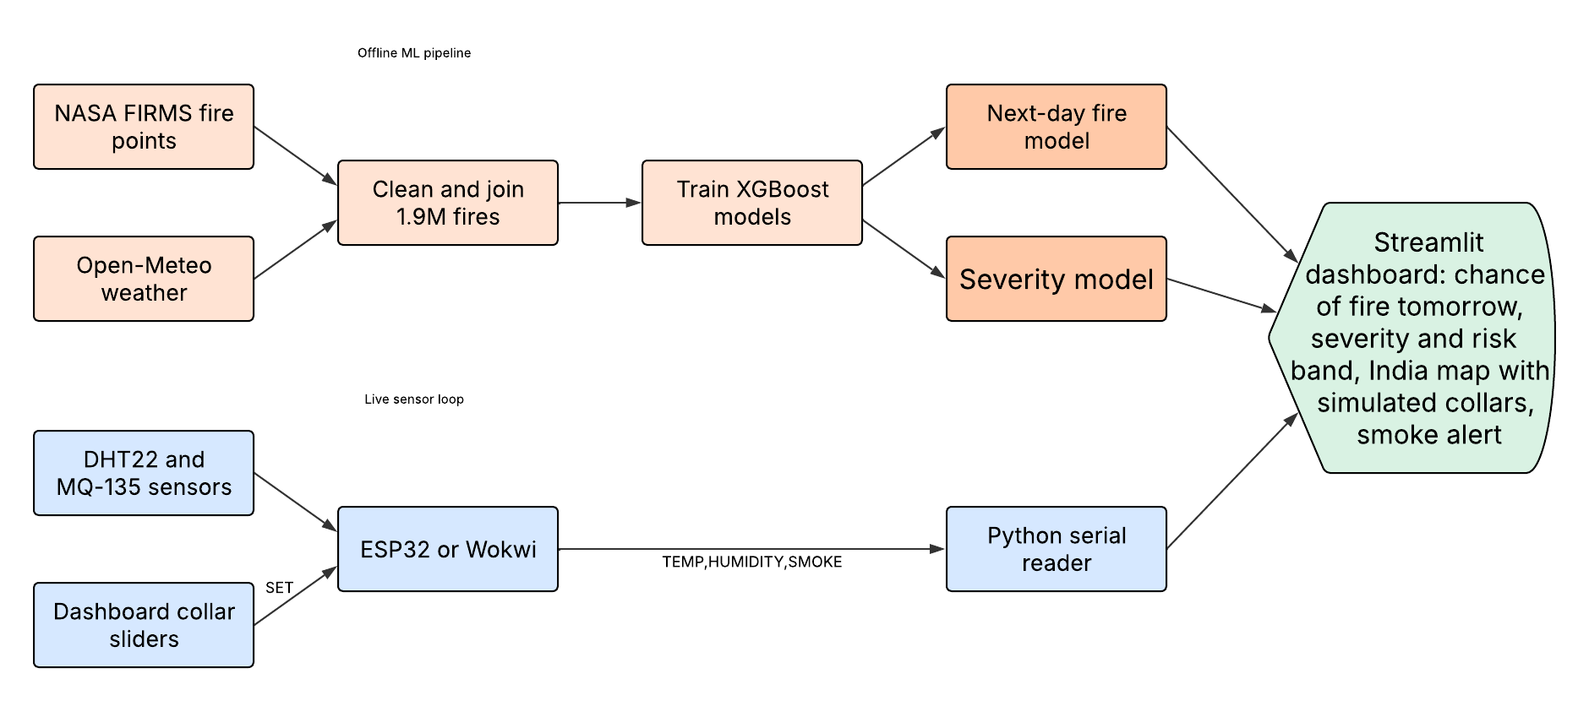
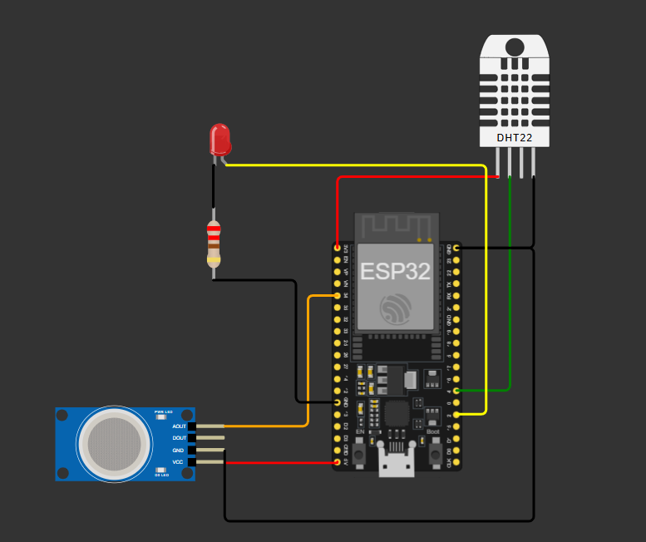
Methodology and Architecture
Design: Supervised ML plus an IoT sensor unit.
Data: NASA FIRMS VIIRS fire points (lat 8-35, lon 68-97) and Open-Meteo hourly weather, cached per grid cell.
Live: ESP32 + DHT22 + MQ-135 send TEMP,HUMIDITY,SMOKE over USB serial, in Wokwi or on real hardware.
Tools: Python, pandas, scikit-learn, XGBoost, Streamlit, GitHub, Arduino/PlatformIO, Wokwi.
Fig. 2: System architecture (left). Fig. 3: ESP32 circuit in the Wokwi simulator (right).

Slide 7
ML Models and Results
Task | Measure | Model | Compared with
Any fire tomorrow | ROC-AUC | 0.93 | 0.92 (cell and month average)
Large fire tomorrow | PR-AUC | 0.63 | 0.51 (cell and month average)
Severity (FRP) | Typical error | 4.01 MW | 4.72 MW (median guess)
Dataset: 4.1 million cleaned detections; 1.9 million joined with weather; 130,140 cell-days for next-day prediction.
Inputs: Temperature, humidity, wind, 7-day rain, air dryness, fire weather index, month and location, plus day or night for severity and fires in the last 7 days for next-day prediction.
Severity model: Random Forest and two XGBoost models compared on held-out 2024 dates; monotonic XGBoost chosen.
Next-day models: Two XGBoost classifiers: any fire, and large fire (15 MW or more).
Testing: 80/20 split holding out whole weeks, plus 2025 as a harder test. Fire history stops at yesterday, so no future data leaks in.
Risk bands: 27.2% of fires in the HIGH band were large, against 1.1% in LOW.
Key finding: Recent fires are the strongest input. Weather adds a smaller, real signal.

Slide 8
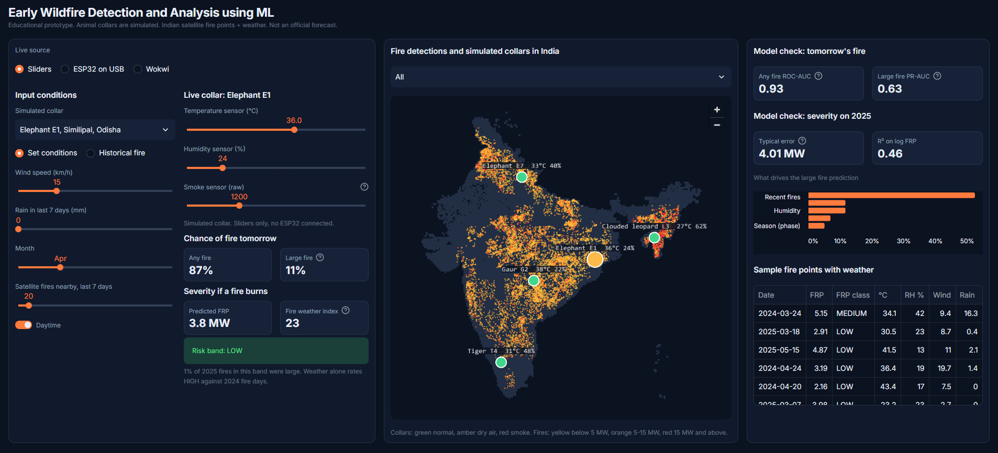
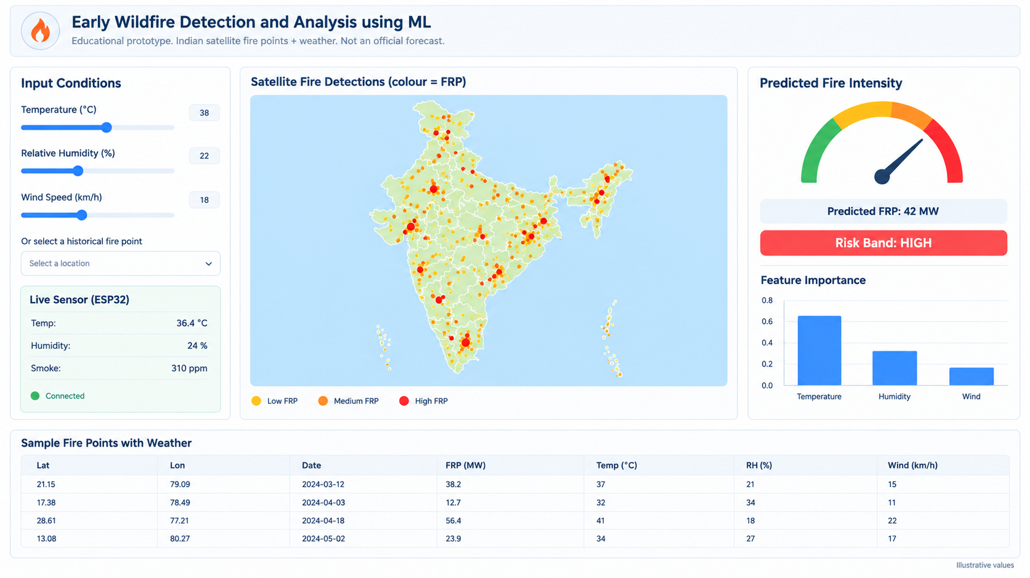
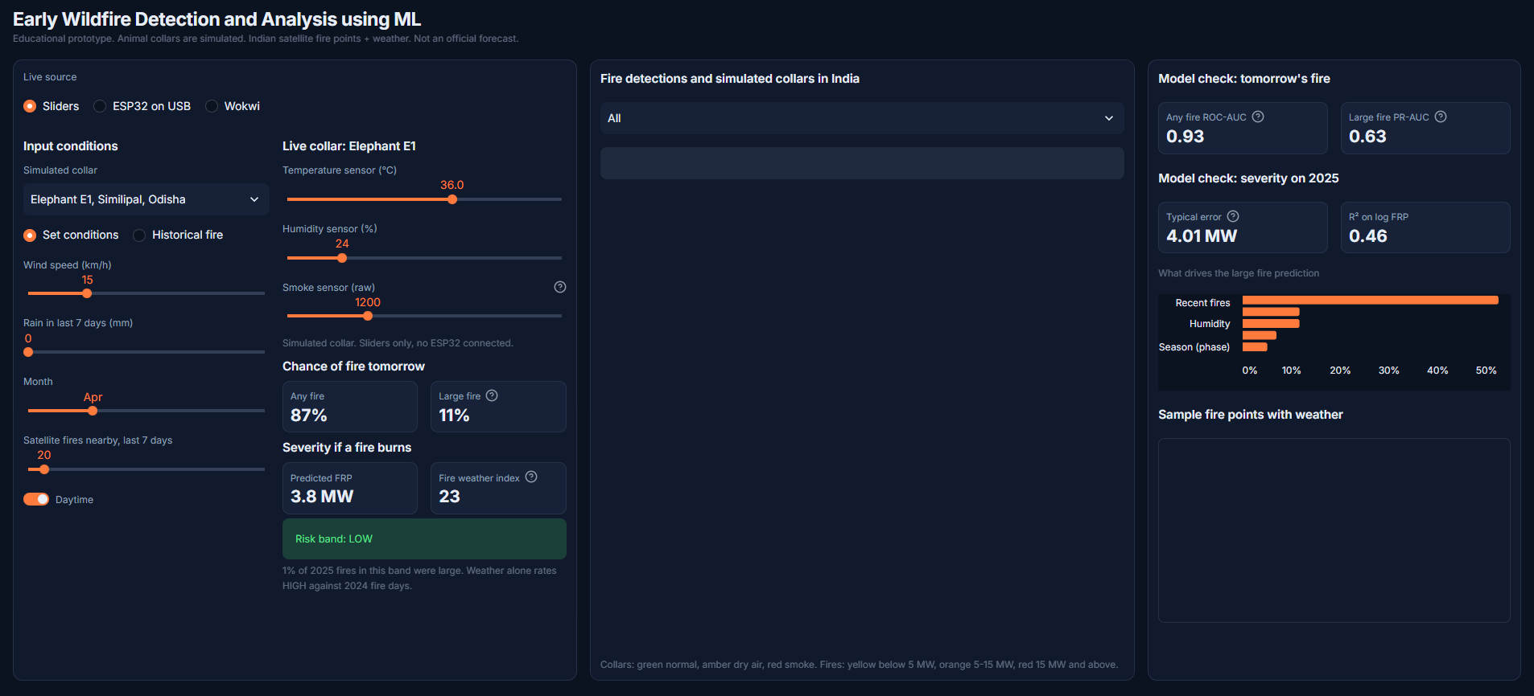
Dashboard and Outcomes
Expected results:
  Joined India fire and weather dataset.
  Next-day and severity models with reported accuracy.
  Working dashboard with India map and live collars.
Potential impact:
  Shows how satellite, weather and sensor data can support early warning.
Future directions:
  Fuel and terrain data, all of India, real field sensors, harm estimates.
Fig. 4: Real dashboard. Left: inputs, live collar and predictions. Centre: India map with simulated collars. Right: model checks.
Live on screen: chance of any fire and large fire tomorrow, predicted FRP, risk band and fire weather index.
Map: India only, drawn from local data, with five simulated collars and fires coloured by FRP.

Slide 9
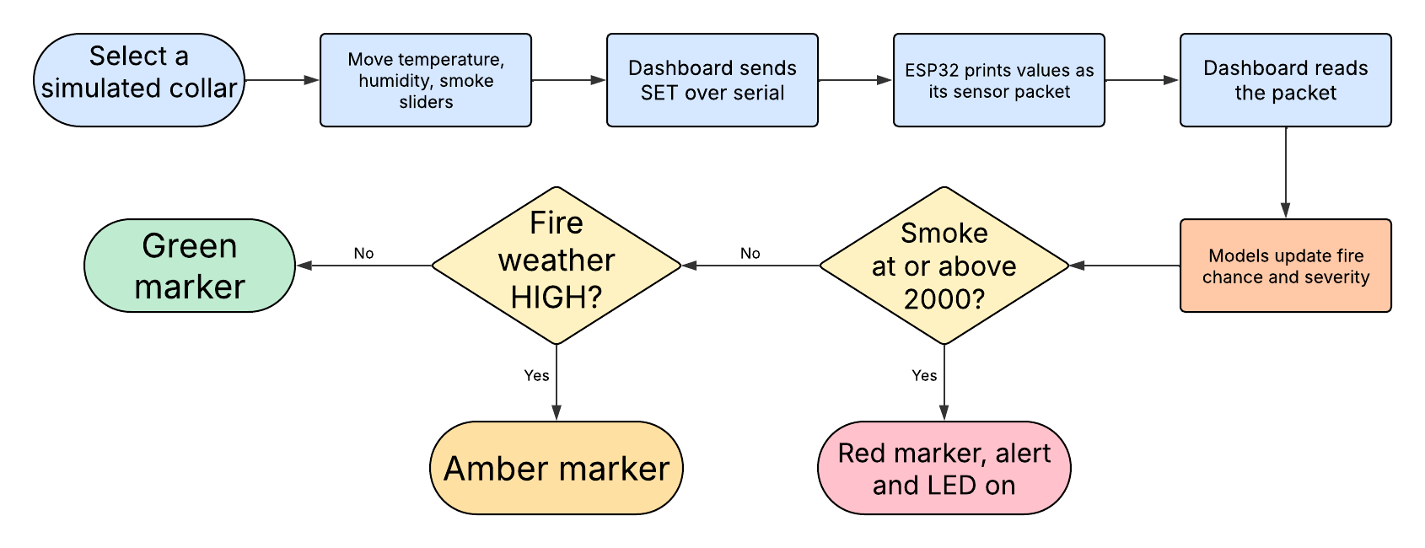
Collar Demo and Progress
Idea: Each collar would report local heat, dryness and smoke. No real animal carries this hardware.
Data and models: Vegetation fires kept, weather cached for 180 cells, models trained and tested against baselines.
Dashboard: One-screen layout with an India-only map that works offline and resizes with the window.
Wokwi: Runs at real-time speed, and live readings reached the dashboard.
Quality: 52 automated tests, with key logic deliberately broken to confirm the tests catch errors.

Slide 10
Timeline and SDG Alignment
Timeline
Done - Data: FIRMS cleaning and weather join.
Done - ML: Next-day and severity models trained and tested.
Done - Software: Streamlit dashboard, runs offline.
In progress - Simulation: Wokwi linked live; collar sliders in final test.
Next - Hardware: Wire, flash and calibrate the ESP32 unit.
Next - Reporting: Evidence, report and conference paper.
SDG alignment
SDG 13 Climate Action: Supports 13.1 and 13.3 by showing how heat, dryness and wind relate to fire.
SDG 15 Life on Land: Supports 15.2 by showing where and when intense vegetation fires occur.
SDG 11 Sustainable Cities: Contributes to 11.5 with a low-cost local smoke alert demonstration.
SDG 3 Good Health: Contributes to 3.9 through simple local air-quality awareness.

Slide 11
Limitations and Conclusion
Limitations:
  Weather covers the 180 busiest 1 degree cells, 2024-25 only.
  A fire means a satellite detection, so small or cloud-covered fires are missed.
  It mostly forecasts that fire activity continues. Harm is not predicted.
  Real collars need GPS, long battery life, radio links, permits and veterinary oversight.
Conclusion: Linking satellite detections with weather predicts next-day fire and severity, shown live on an India dashboard.
Next steps: Build and calibrate the real ESP32 unit and finish the collar demo.
Expected outcome by the end of first year:
  Conference paper in IEEE format, and a proposal extending to state-level analysis with vegetation and terrain data.
  Journal paper after further validation. Patent not planned unless the sensor-to-ML integration proves novel.

Slide 12
References
Breiman, L. (2001). Random forests. Machine Learning, 45(1), 5-32.
Fosberg, M. A. (1978). Weather in wildland fire management: the fire weather index. Conference on Sierra Nevada Meteorology.
Giglio, L., Schroeder, W., & Justice, C. O. (2016). The collection 6 MODIS active fire detection algorithm and fire products. Remote Sensing of Environment, 178, 31-41.
Jain, P., et al. (2020). A review of machine learning applications in wildfire science and management. Environmental Reviews, 28(4), 478-505.
Schroeder, W., et al. (2014). The new VIIRS 375 m active fire detection data product. Remote Sensing of Environment, 143, 85-96.
Wooster, M. J., et al. (2005). Retrieval of biomass combustion rates and totals from fire radiative power observations. Journal of Geophysical Research, 110, D24311.
NASA FIRMS. https://firms.modaps.eosdis.nasa.gov/
Open-Meteo Historical Weather API. https://open-meteo.com/
Thank You

