Slide 1
Canteen Management System
Presented by Binish Adhikari

Slide 2
Introduction
Web-based Application(that manage canteen in the system)
Student can order food through online
This system is also for time management of the student.
Customized menu planning
Student information

Slide 3
Objectives
To order different food available according to the individual’s desire.
To reduce waiting time for students by easy access of ordering food and delivering it.
To keep track of each orders and its details.
To develop an appropriate, effective and efficient system to the students.

Slide 4
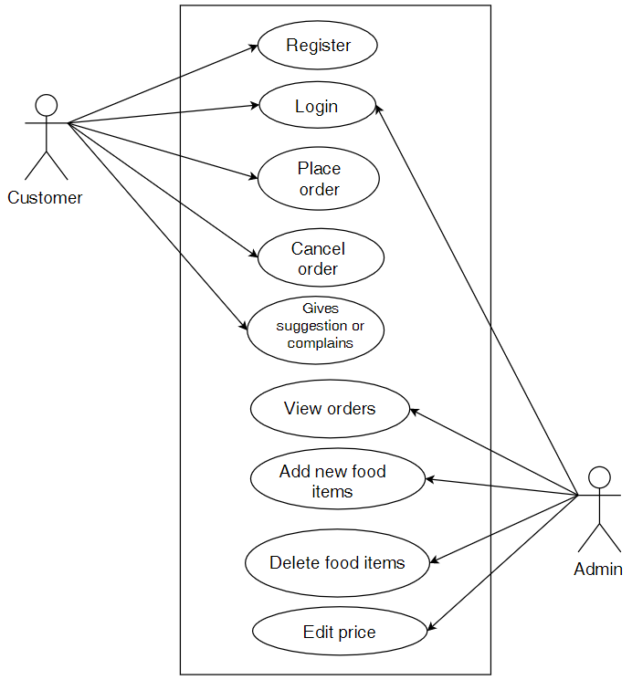
Use case diagram

Slide 5
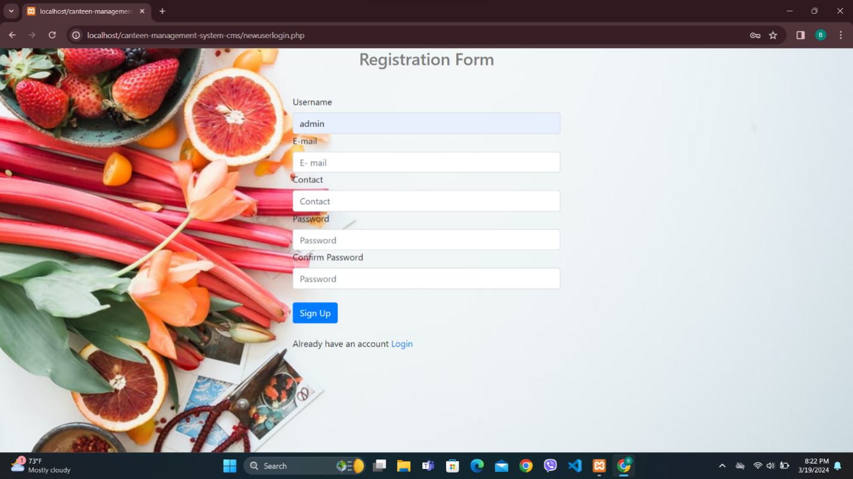
Login page

Slide 6
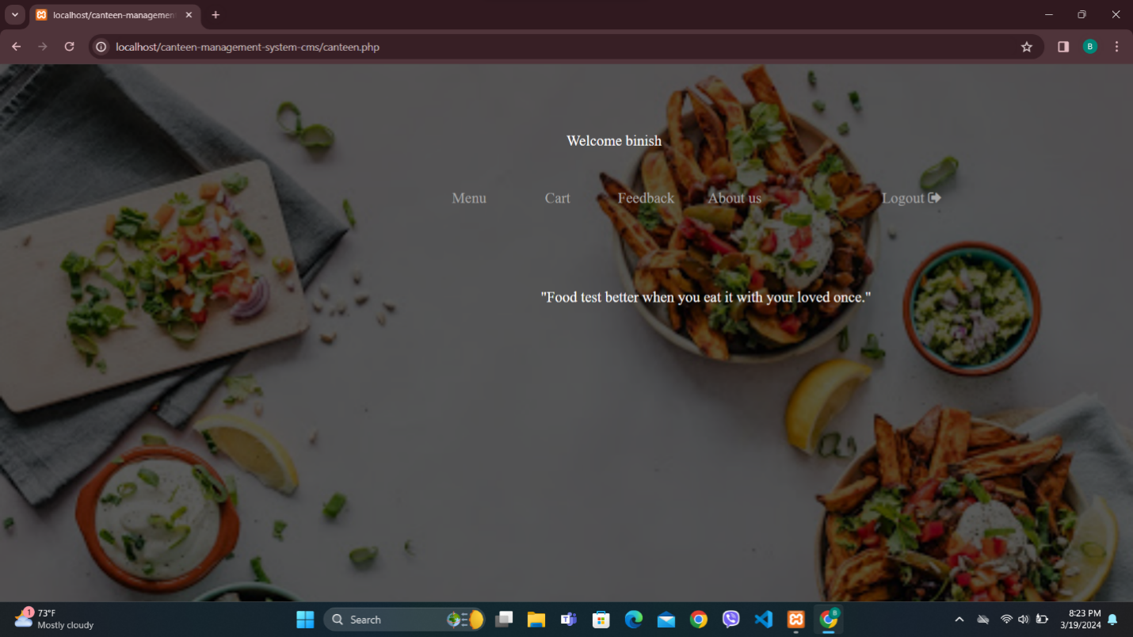
Home page

Slide 7
Conclusion
Our project is concerned on providing a web application that can keep record of the Student, data entry into database and then maintaining those data, keeping a track of the billing. After the completion of our project it should allow student to sign up or login, display the menu and order the food. This system can also be used in Restaurants, Cafeteria, Etc. The system is expected to be acceptable as well as reliable. The results obtained through the developed system shows that it can be used to automate the existing canteen management system.

