Slide 1
🌸 AI-POWERED LEARNING PROJECT
CodeBloom AI
A Smart Programming Tutor for Multi-Language Code Explanation
An AI-powered code explainer built with Flask, Ollama and CodeMirror.
Presented by: B N SAI SUMANA SRI • Roll no: 24691A28E9
Let's make code bloom! ✨
CODEBLOOM AI • PROJECT PRESENTATION
01

Slide 2
01 • THE PROBLEM
Why CodeBloom AI?
Learning code can feel overwhelming.
• Beginners struggle to follow code line by line.
• Predicting program output takes practice.
• Error messages and unfamiliar syntax can be confusing.
• Saved explanations are useful for revision.
Pixel says: one line at a time!
CODEBLOOM AI • PROJECT PRESENTATION
02

Slide 3
02 • OBJECTIVES
Our mission
EXPLAIN
ILLUMINATE
Turn source code into learner-friendly explanations.
Show line numbers and syntax colors.
PREDICT
REMEMBER
Present an AI-generated expected-output preview.
Save and restore explanations from browser history.
CODEBLOOM AI • PROJECT PRESENTATION
03

Slide 4
03 • TECHNOLOGY STACK
The technology garden
Frontend
HTML • CSS • JavaScript
Editor
CodeMirror 5 • line numbers • syntax modes
Backend
Python • Flask • API endpoints
AI runtime
Ollama • llama3.2:3b (development setup)
Persistence
localStorage • browser-local history
CODEBLOOM AI • PROJECT PRESENTATION
04

Slide 5
04 • SYSTEM FLOW
How it works
1
2
3
4
5
USER
→
EDITOR
→
FLASK API
→
OLLAMA AI
→
RESULT
Select language + enter code
CodeMirror formats code
Frontend sends /api/explain
Model generates explanation
Explanation + predicted output
Important: the output panel is an AI prediction, not program execution.
CODEBLOOM AI • PROJECT PRESENTATION
05

Slide 6
05 • CORE FEATURES
What can CodeBloom do?
✦ AI-generated code explanation
✦ Python • Java • JavaScript • C • C++
✦ Line numbers + syntax highlighting
✦ Sample programs for quick testing
✦ Browser-local explanation history
✦ Restore old explanations
✦ Download explanation as text
✦ Separate expected-output preview
✦ Dark UI with purple/pink accents
CODEBLOOM AI • PROJECT PRESENTATION
06

Slide 7
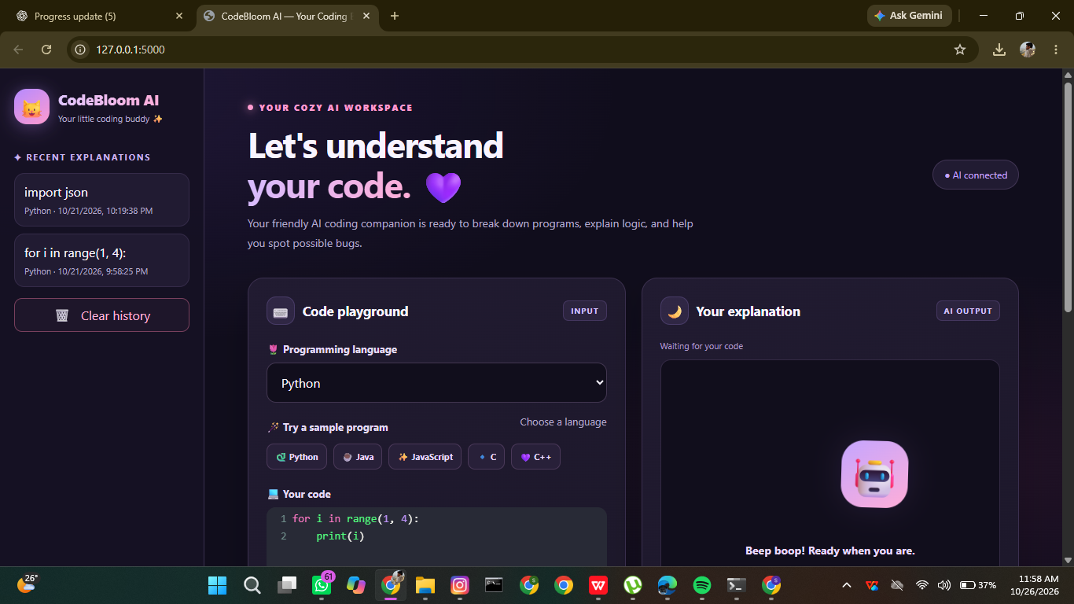
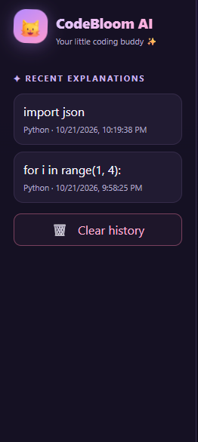
06 • INTERFACE DESIGN
A cozy dark-mode experience
REAL APP PREVIEW
Recent explanations • browser-local history
CODEBLOOM AI • PROJECT PRESENTATION
07

Slide 8
07 • VALIDATION
What we've tested
Reported passing checks
✓ Responsive interface
✓ Explanation and history saving
✓ Restore a history item
✓ Download explanation text
✓ Line numbers and sample loading
✓ Explain-code flow
✓ Language-specific highlighting
Final browser re-check recommended before demo.
CODEBLOOM AI • PROJECT PRESENTATION
08

Slide 9
08 • LIMITATIONS
Honest boundaries
What to remember
• AI explanations can be incorrect or incomplete.
• Expected output is predicted, not verified by execution.
• History is stored locally in the current browser.
• The current prototype is not a secure code-execution sandbox.
• Production use needs more testing, security review, and deployment work.
CODEBLOOM AI • PROJECT PRESENTATION
09

Slide 10
09 • FUTURE SCOPE
Next blooms 🌱
SAFE RUN
CODE REVIEW
PRACTICE
Isolated code execution sandbox
Bug, readability and security suggestions
AI-generated quizzes and exercises
PIXEL STATES
EDITOR PRO
RELEASE
Thinking, success and error reactions
Font size, focus mode and resizable panels
Automated tests and deployment hardening
CODEBLOOM AI • PROJECT PRESENTATION
10

Slide 11
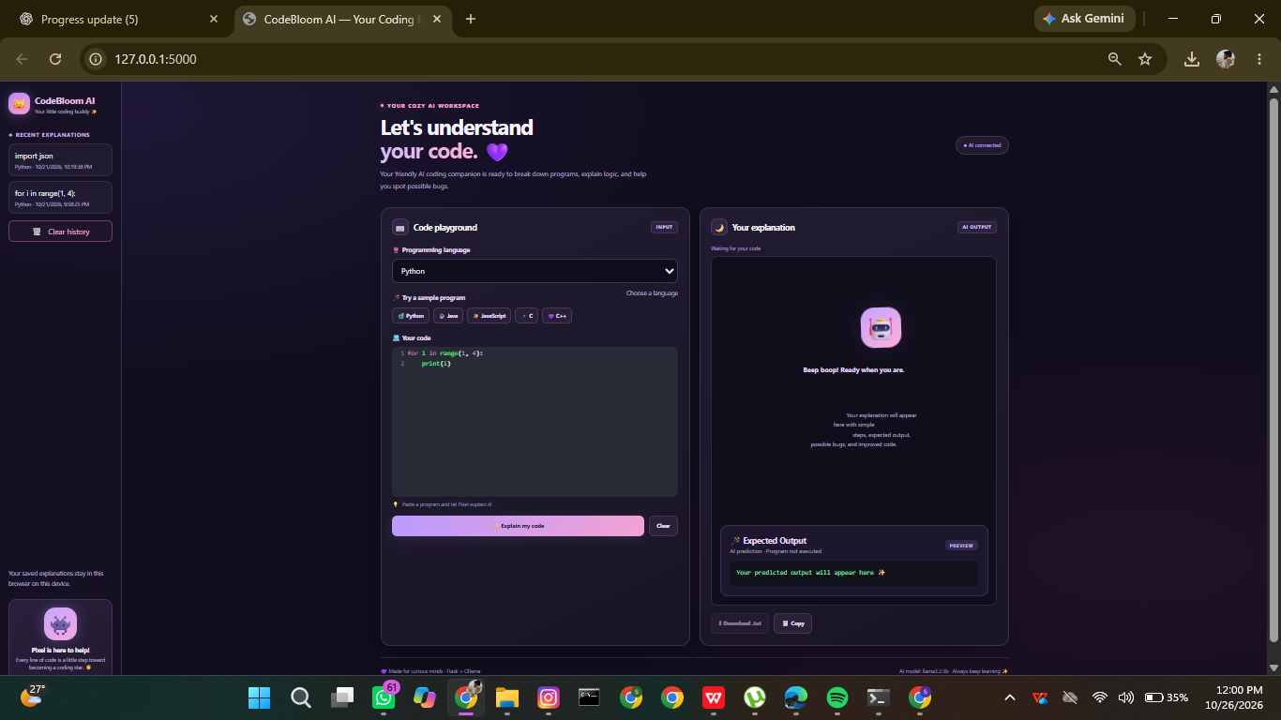
10 • DEMONSTRATION
Live demo: 90-second walkthrough
1. Open the app and show the dark interface.
2. Choose Python and load a sample.
3. Explain the code and show the structured response.
4. Point out the expected-output prediction label.
5. Restore the explanation from history.
6. Download the explanation text.
DEMO TIP
Keep a small sample program ready, then show the explanation and AI-predicted output.
CODEBLOOM AI • PROJECT PRESENTATION
11

Slide 12

Every line is a chance to learn.
CodeBloom AI brings together a local AI model, a practical code editor, and a friendly learning interface. The current prototype is ready for a guided demonstration, with testing and security work still needed before production use.
Thank you! Questions? 🌸
CODEBLOOM AI • PROJECT PRESENTATION
12

