Slide 1
Pushdown Model Generation for Malware Deobfuscation
Nguyen Minh Hai
Ho Chi Minh City University of Technology (HCMUT), Vietnam
with Quan Thanh Tho (HCMUT)
in Collaboration with Mizuhito Ogawa (JAIST)
March 2015

Slide 2
Agenda
Overview of BE-PUM
Obfuscation Techniques
  Indirect Jump
  Overlapping Instruction
  Self-modifying Code
  Encryption
  Structured Exception Handler
  Anti-Debugging
  Anti-Emulation
Conclusions
1

Slide 3
Overview of BE-PUM
2

Slide 4
BE-PUM
BE-PUM - Binary Emulation for Pushdown Model
Apply pushdown model generation of binary code
  Apply concolic testing (dynamic symbolic execution) to handle indirect jump
  Apply on-the-fly model generation for handling self-modifying code
  Focus on obfuscation techniques which are used in malware and packer tools.
3

Slide 5
Obfuscation Techniques
4

Slide 6
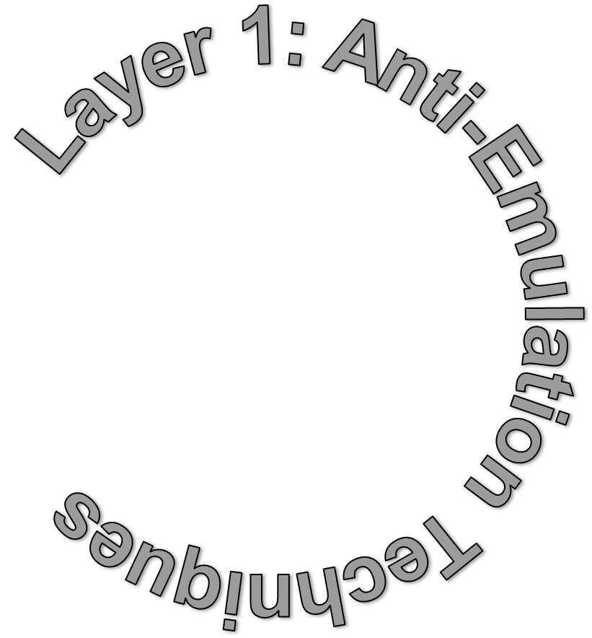
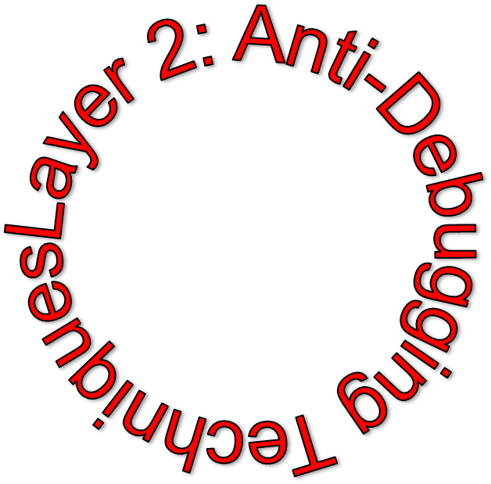


Motivation
Multi-layer Malware

Slide 7
Motivation
Obfuscation techniques are used in software for protecting against cracking, reverse engineering.
Obfuscation techniques are used in malware for protecting against automatic detection and analysis of malicious code.
Our goal: build a tool for handling most of obfuscation techniques: Indirect Jump, Self-modifying code, SEH, Encryption, Anti-Debugging, Anti-Emulation.
5
Notes:
In software development, obfuscation is the deliberate act of creating obfuscated code, i.e. source or machine code that is difficult for humans to understand.
Programmers may deliberately obfuscate code to conceal its purpose (security through obscurity) or its logic, in order to prevent tampering, deter reverse engineering, or as a puzzle or recreational challenge for someone reading the source code.
Programs known as obfuscators transform readable code into obfuscated code using various techniques.

Slide 8
Indirect Jump
Idea: store the target address of JUMP instruction in register or memory location
Require simulation of executing x86 instructions and Windows API
JMP EAX
?????
6

Slide 9
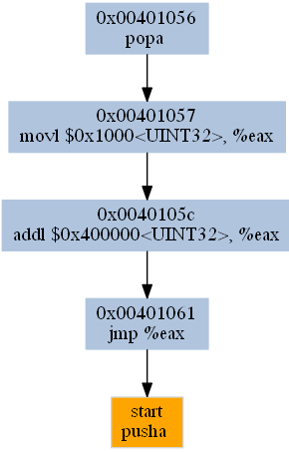
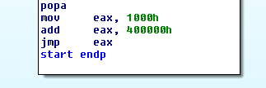
Indirect Jump (cont.)
Virus.Win32.Aztec
00401057 . B8 00100000 MOV EAX,1000
0040105C . 05 00004000 ADD EAX, 00400000
00401061 . FFE0 JMP EAX
IDA Pro
BE-PUM
7

Slide 10
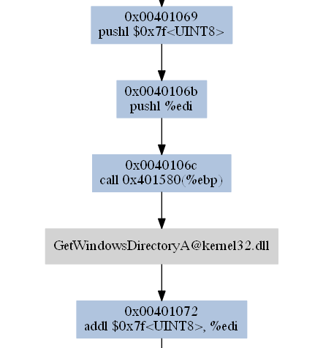
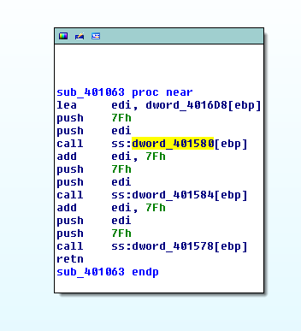
Indirect Jump (cont.)
Virus.Win32.Aztec: look for base address of kernel32 and store address of API in memory location.
8

Slide 11
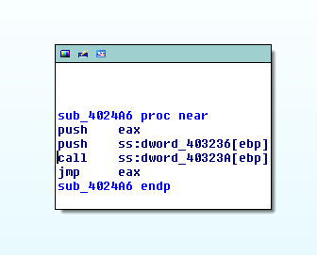
Indirect Jump (cont.)
Virus.Win32.Addson.1559
004024A6 50 PUSH EAX ; “SetCurrentDirectoryA”
004024A7 FFB5 36324000 PUSH SS:[EBP+403236] ; “Kernel32 Handle”
004024AD FF95 3A324000 CALL SS:[EBP+40323A] ; “GetProcAddress”
004024B3 FFE0 JMP EAX
IDA Pro
9

Slide 12
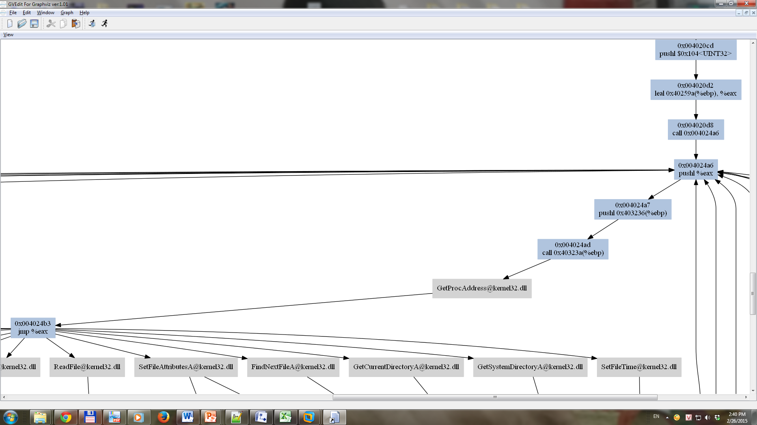
Indirect Jump
Demo

Slide 13
Overlapping Instruction
00437002 E8 03000000 CALL 0043700A
00437007 E9 EB045D45 JMP 45A074F7
HLLW.Rolog.f
Junk code modifies the return address.
00437002 CALL 0043700A
0043700D RETN
Code
0043700A POP EBP
0043700B INC EBP
0043700C PUSH EBP
11

Slide 14
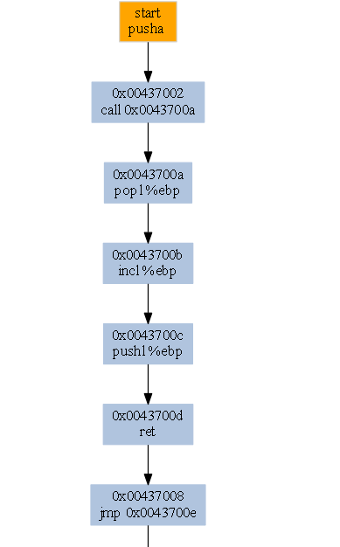

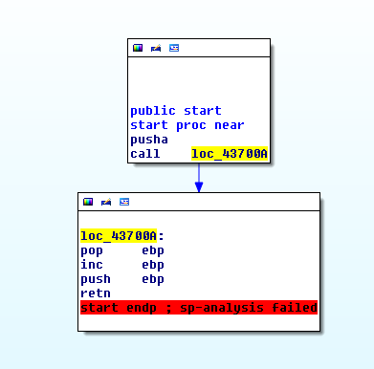
Demo
IDA Pro
BE-PUM
12

Slide 15
Self-Modifying Code
Virus.Win32.Seppuku.1606 : Self-Modifying Code
004010E5 MOV EAX,DWORD PTR SS:[EBP+401489]
004010EB STOS DWORD PTR ES:[EDI]
EDI = 401067
00401646 E8 B5F9FFFF CALL 00401000
00401646 E8 00000000 CALL 0040164B
13

Slide 16
Decryption
Email-Worm.Win32.Kickin.d : Self-decryption
ecx was set to 0CAh
0060933A mov ecx,0ca
00609345 lods byte ptr ds:[esi]
00609346 xor al,ah
00609348 inc ah
0060934A rol ah,2
0060934D add ah,90
00609350 stos byte ptr es:[edi]
00609351 loopd 00609345
Decryption loop
00609223 pop ebp
00609224 push 3d
00609226 mov byte ptr ds:[esi+9cccd0e5],dh
0060922C retn 8d9e
0060922F pxor mm5,mm3
00609232 dec ecx
00609233 fiadd word ptr ds:[ecx+80a6b31]
00609223 call 00609228
00609228 mov ebx, [ebp+402705]
0060922E add ebx,28
00609231 pop eax
00609232 sub eax,ebx
00609234 mov [ebp+40270d],eax
14

Slide 17
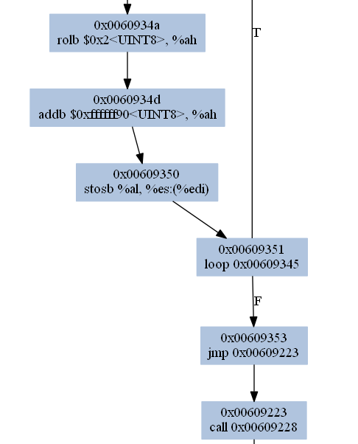
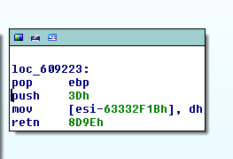
Demo
BE-PUM
IDA Pro
15

Slide 18
SEH
SEH - Structured Exception Handler
Used to handle error in running code
Malware uses this method to intentionally cause a change in the execution flow
push offset SEH_Handler
push dword ptr fs:[0]
mov fs:[0],esp
16
Notes:
Eva.a : exception occurrence is obfuscated.
As Windows standard, fs:[0] initially points to the system exception handler.
New frame pushed at 00401012 and modified at 00401015.
At 00401018, access violation (inc at 00000000).
Win32 PE executables can set up a so-called SEH (Structured Exception Handler). Most runtime code, and several viruses use this method to trap errors, but it can also be used to intentionally cause a change in the execution flow. Viruses insert their SEH and create a fault condition, causing the exception handler to be run instead. The first virus really in ‘in-the-wild’ installing multiple exception handlers was W32/Magistr.A to confuse AV emulators.

Slide 19
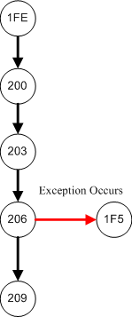
SEH (cont.)
004011FE xor edx, edx
00401200 push dword ptr [edx]
00401203 mov dword ptr [edx], esp
00401206 inc dword ptr [edx]
00401209 lea esi,dword ptr [ebp+401943]
edx = 0
Set up SEH
Exception occurs!
17

Slide 20
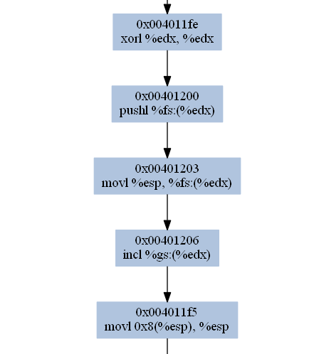
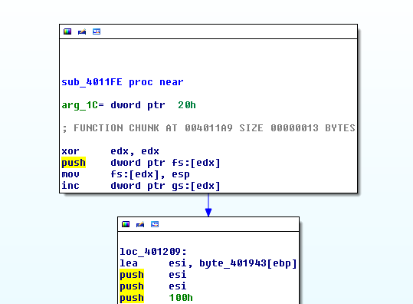
SEH (cont.)
Demo
IDA Pro
BE-PUM
18

Slide 21
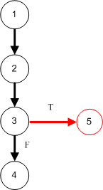
Anti-debugging
Use NtGlobalFlag field which exists at offset 0x68 in the PEB (Process Environemnt Block)
PEB is a structure created in process initialization
PEB contains data necessary to the execution of a process.
Used by ExeCryptor
1: mov eax, fs:[30h] ;PEB
;check NtGlobalFlag
2: cmp byte [eax+68h], 70h
3: jne being_debugged
4: jmp real_code
being_debugged:
5: call ExitProcess
19
Notes:
What is PEB: Process Environment Block
Simulate PEB structure
using symbolic execution value

Slide 22
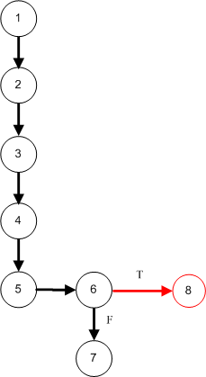
Anti-debugging (cont.)
Use the process default heap to find presence of debugging artifacts
1: mov eax, fs:[30h] ;PEB
;get process heap base
2: mov eax, [eax+18h]
3: mov eax, [eax+0ch] ;Flags
4: dec eax
5: dec eax
6: jne being_debugged
7: jmp real_code
being_debugged:
8: call ExitProcess
20
Notes:
Solution: Simulate PEB structure using symbolic execution value

Slide 23
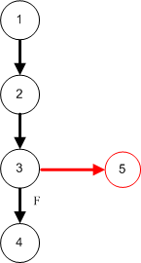
Special APIs
The kernel32 IsDebuggerPresent() function was introduced in Windows 95.
It returns TRUE if a debugger is present
1: call IsDebuggerPresent
2: test al, al
3: jne being_debugged
4: jmp real_code
being_debugged:
5: call ExitProcess
21
Notes:
Solution: On-demand Symbolic Execution for APIs

Slide 24
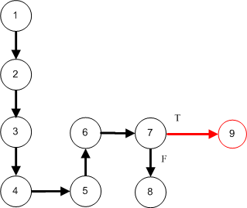
Special APIs (cont.)
Use kernel32 CheckRemoteDebuggerPresent() function
1: push eax
2: push esp
3: push -1 ;GetCurrentProcess()
4: call CheckRemoteDebuggerPresent
5: pop eax
6: test eax, eax
7: jne being_debugged
8: jmp real_code
being_debugged:
9: call ExitProcess
22
Notes:
Other APIs: NtQueryInformationProcess, NtQuerySystemInformation, NtQueryObject, SetInformationThread...
Determines whether the specified process is being debugged.
Solution: On-demand Symbolic Execution for APIs

Slide 25
Time Attack
Malware target on specific date.
  E.g. CodeRed malware use Windows API GetSystemTime
Solution: On-Demand Symbolic Execution for Windows API
  The return value is symbol value (instead of real execution with JNA)

Slide 26
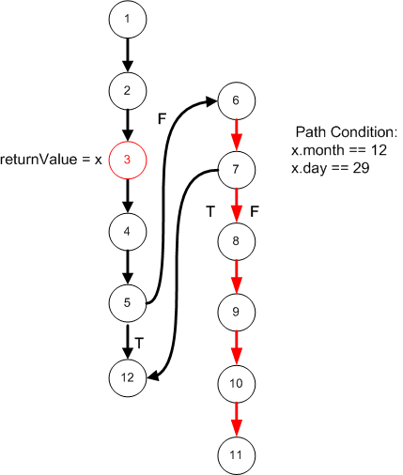
Demo
Win32.Voltage
1: lea eax,[ebp + SYSTEMTIME]
2: push eax
3: call [ebp + GetLocalTime]
4: cmp word ptr [ebp+wMonth],12 5: jne NoPayLoad
6: cmp word ptr [ebp +wDay],29
7: jne NoPayLoad
8: push eax
9: push eax
10: push 0h
11: call [ebp + MessageBox]
NoPayLoad:
12: Call ExitProcess

Slide 27
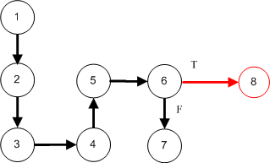
Execution Timing
Based on an idea: there is a significant delay between the executions of the individual instructions in debugger mode compared to normal execution.
1: call GetTickCount
2: xchg ebx, eax
3: call GetTickCount
4: sub eax, ebx
5: cmp eax, 1
6: jnb being_debugged
7: jmp real_code
being_debugged:
8: call ExitProcess
24
Notes:
Solution: On-demand Symbolic Execution for APIs

Slide 28
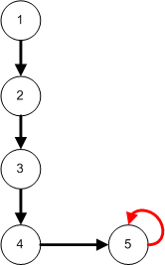
Exception
Using exceptions to alter the value of eip
An effective anti-debugging technique
Used by packer PECompact
1: xor eax, eax
2: push offset l3
3: push dw fs:[eax]
4: mov fs:[eax], esp
l1:
5: call l1
l2:
6: jmp l3
l3:
7: pop eax
25

Slide 29
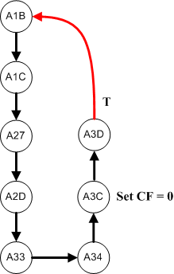
Exception (cont.)
Used in packer Telock
00407A1B PUSHAD
00407A1C CALL 00407A27
00407A27 PUSH DWORD PTR FS:[0]
00407A2D MOV DWORD PTR FS:[0],ESP
00407A33 PUSHFD
00407A34 OR DWORD PTR SS:[ESP],100
00407A3B POPFD
00407A3C CLC
00407A3D JNB SHORT 00407A1B
26
Notes:
Stack overflow

Slide 30
Stalling Code
The main idea is to delay the execution of malicious activity in very long time.
Stalling code make automated analysis systems to give up on a sample.
27

Slide 31
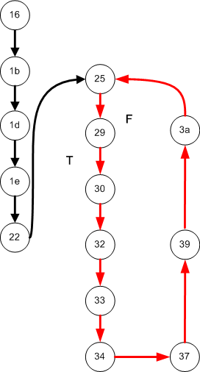
Stalling Code (cont.)
0x00406016: movl %ecx, $0x1951<UINT32>
0x0040601b: movl %eax, %ecx
0x0040601d: clc
0x0040601e: jae 0x00406022
0x00406022: addl %esi, $0x33<UINT8>
0x00406025: leal %eax, 0x67(%ecx,%eax,4)
0x00406029: call 0x00406030
0x00406030: xorb (%esi), %al
0x00406032: incl %esi
0x00406033: popl %edx
0x00406034: jmp 0x00406037
0x00406037: aam $0x9<UINT8>
0x00406039: decl %ecx
0x0040603a: jg 0x00406025
28

Slide 32
Invalid API parameters
Attacker will intentionally pass known invalid parameters to the function, and expecting an error code to be returned
push 1
push 1
call Beep
call GetLastError
;ERROR_INVALID_PARAMETER (0x57)
push 5 ;sizeof(l2)
pop ecx
xchg edx, eax
mov esi, offset l2
mov edi, esi
l1: lodsb
xor al, dl
stosb
loop l1
...
l2: db 3fh, 32h, 3bh, 3bh, 38h
;secret message
29
Notes:
This leads to a vulnerability, whereby an attacker will intentionally pass known invalid parameters to the function, and expecting an error code to be returned. In some cases, this error code is used as a key for decryption. Any emulator that fails to return the error code will not be able to decrypt the data.
Solution: On-demand Symbolic Execution for APIs

Slide 33
GetProcAddress
Attacker will intentionally pass known invalid parameters to the function, and expecting no function address to be returned.
Any emulator that returns an address in such a situation will be revealed
push offset l1
push 12345678h ;illegal value
call GetProcAddress
test eax, eax
jne being_debugged
...
l1: db "myfunction", 0
30
Notes:
Solution: Simulate Windows APIs

Slide 34
Undocumented instructions
An anti-malware emulator might fail to support undocumented instructions or undocumented encodings of documented instructions
Solution: Capstone disassembly
(http://www.capstone-engine.org/)
0040F0D0 > $ 0F6FE0 MOVQ MM4,MM0
0040F0D3 . E8 06000000 CALL 0040F0DE
31

Slide 35
Packer
Bullet-proof jacket for software (and malware also):
  Against Cracks
  Against KeyGens
  Against Stolen serial number
  Against Unauthorized use
Self-modifying Code + SEH + Encryption + Anti-Debugging +
Anti-Emulation + ...
Packer
32

Slide 36
Demo
Target on Telock 0.9.8
Still going on work.
33

Slide 37
Detection of Obfuscation Techniques
Method: observe the diffrences between results of BE-PUM and IDA Pro to locate obfuscation code.
IDA Pro
DOT file (CFG)
Equal
Binary
Files
Compare
! Equal
BE-PUM
DOT file (CFG)
Automatic Comparison
34
DOT is a plain text graph description language which is used for describing graphs.
Notes:
ince syntactical methods are confused by obfuscation techniques whereas BE-PUM precisely rebuilds a CFG

Slide 38
Demo
IDA Pro
BE-PUM
35

Slide 39
Conclusion
BE-PUM is able to deal with obfuscation techniques
Show better result compared with IDA Pro (and Jakstab also)
Limitation:
  Limited set of supported x86 instructions and Windows APIs
  Missing loop invariant
36

Slide 40
Q&A

