Slide 1

Ho Chi Minh City University of Technology
Faculty of Computer Science and Engineering
Packer Detection with BE-PUM
GVHD: PGS.TS. Quản Thành Thơ
ThS. Lê Đình Thuận
ThS. Nguyễn Minh Hải
SVTH: Đỗ Duy Phong
Notes:
1

Slide 2
Outline
Motivation
Packer detection via Header
Packer detection via Techniques
Model Checking
Overview of packer techniques
Packer detection using Model Checking
Future Works

Slide 3
Motivation
401000 nop
Real OEP
401000 push eax
OEP
Packer
Analyze with bypassing all the packer’s techniques
Analyze without bypassing all the packer’s techniques
404252 jmp 401000
404252 call ExitProcess
Bypass all the techniques of packers
Generate CFG of packed file accurately
Notes:
3

Slide 4
Motivation
Packer ?
Identify the packer techniques and packer techniques frequency
Detect the packers accurately by symbolic model checking
Real OEP
Malware
Notes:
4

Slide 5
Scope
Unpack totally Fastpack, FSG, MEW, MPRESS, PECompact, UPack, Armadillo, PELock, PESpin, Themida, VMProtect, ASPack, ASProtect, NPack, PETite, UPX, Yoda, TELOCK.
Detect packers via header signature
Identify the packer techniques and frequency of techniques
Detect supported packers using model checking
Notes:
5

Slide 6
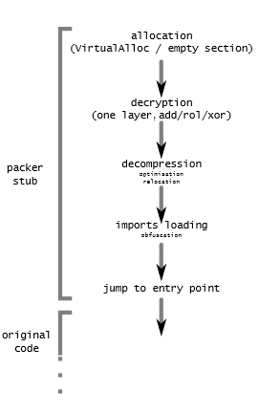
Packer
General aims of packers:
Reduce size of binary file
Anti – reversing
Protect the licensed software
Notes:
6

Slide 7
BE-PUM
BE-PUM (Binary Emulator for Pushdown Model Generation)
Generates models on binary code of file.
Processed obfuscation techniques, as well as handling packer’s techniques.
Currently, BE-PUM supported 26 packers.
Notes:
7

Slide 8
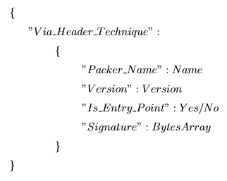
Packer detection via Header
Popular approach (PEID, CFF Explorer)
Limitation:
Mutable signature
Obfuscate the location of header
Notes:
8

Slide 9
Packer detection via Techniques
push 401040 push DWORD ptr fs:[0] mov DWORD ptr fs:[0],ESP
Identify packer techniques
BE-PUM’s Control Flow Graph
Convert BE-PUM’s CFG to SMV Model
push REG/IMM push DWORD ptr fs:[0] mov DWORD ptr fs:[0],ESP
SMV Model
Identify packer techniques’s patterns
Express specifications in CTL/LTL formula
CTL/LTL formula
NuSMV
Packer ? (YES or Unknown)

Slide 10
Model Checking
Model checking is an automated technique that, given a finite state model of system M and a formal property φ, verifies whether this property hold for that model.
M |= φ

Slide 11
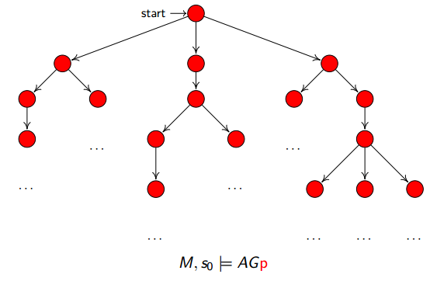
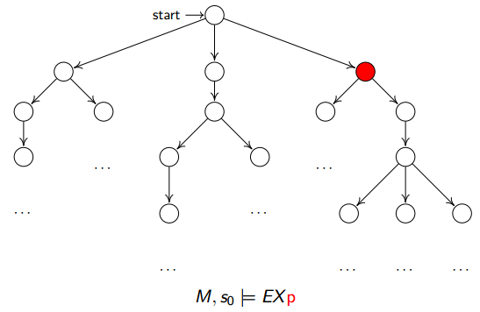
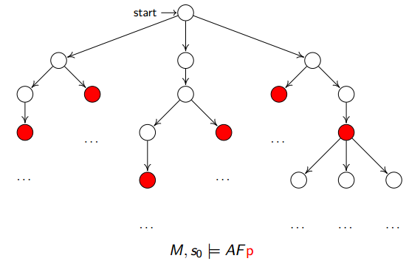
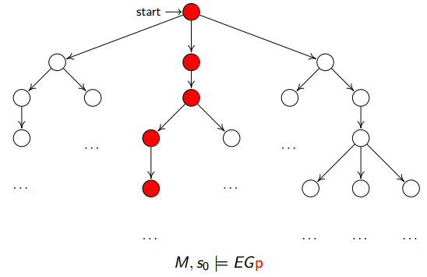
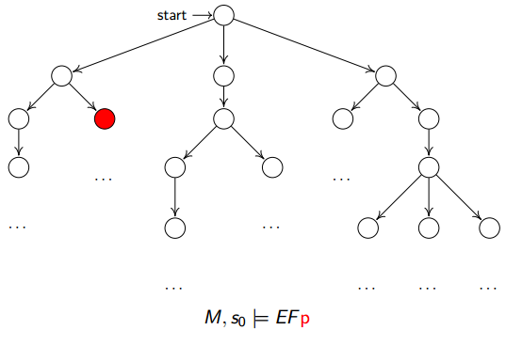
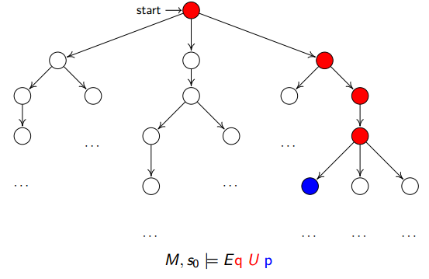
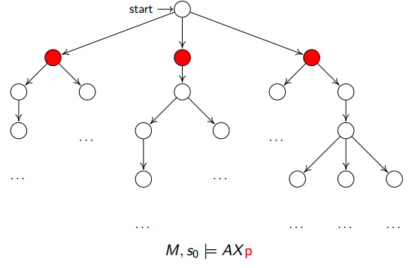
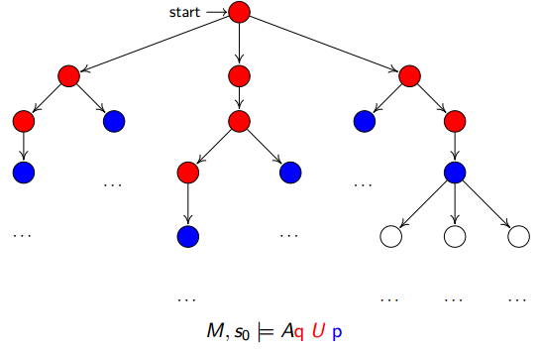
CTL Syntax & Semantics
State formula: Φ ::= true | p | (¬Φ) | (Φ1 ∧ Φ2) | Aφ | Eφ Path formula: φ ::= XΦ | Φ1UΦ2

Slide 12
Overview of packer techniques
6 groups of techniques :
Code placing obfuscation: Code layout
Self-modification code: Dynamic code
Instruction obfuscation: Indirect jump
Anti-tracing: Structural exception handling and 2 Special APIs
Arithmetic Operation: Obfuscated constants and Checksumming
Anti-tampering: Checksumming, Timing check, Anti-debugging, Anti-rewriting and Hardware breakpoints

Slide 13
Code placing obfuscation
Code layout
Overlapping blocks
Overlapping functions
Code chunking

Slide 14
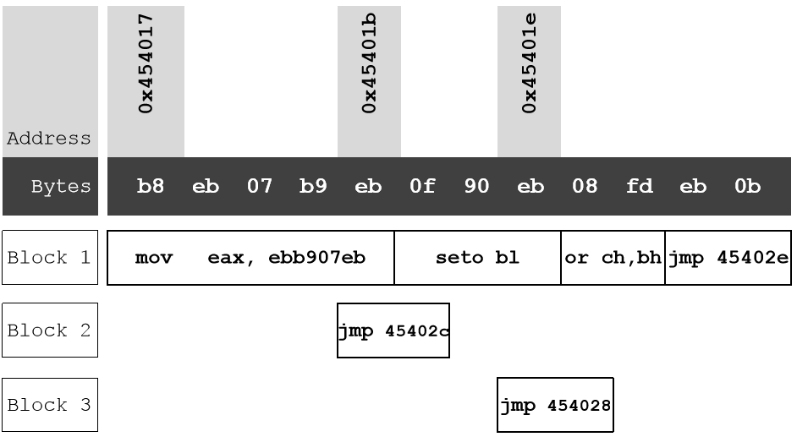
Overlapping blocks
Overlapping instruction in blocks
One block ended by jump or conditional jump instruction
Notes:
14

Slide 15
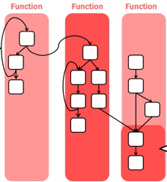
Overlapping functions
One function started by instruction at location as destination of call instruction, ended by return instruction

Slide 16
Code chunking
40446B JMP 40446E
...
40446E STC
...
404474 JMP 404477
...
404477 JMP 40447A
...
40447A JMP 40447D
...
40447D NOP
Divide code into adjacent blocks
One block ended by jump instruction

Slide 17
Self – modification code
Dynamic code
Overwriting
Packing/Unpacking

Slide 18
Code overwriting
404863 MOV [ECX+1], EAX
...
40487A RETN
40487B MOV EAX,12345678
Overwrite existing code with new code
Overwrite one byte to several kilobytes (decryption)
404863 MOV [ECX+1], EAX
...
40487A RETN
40487B MOV EAX,F04035DD
Notes:
18

Slide 19
Packing/Unpacking
404067 CALL 40406C
40406C POP EBP
40406D SUB EBP, 40286C
404073 MOV ECX, 40345D
404078 SUB ECX, 4028C6
...
404092 LODS BYTE [EDI]
404093 ROR AL, 0DB
...
4040C3 STOS BYTE [EDI]
4040C4 LOOPD 404092
Similar to Encryption/Decryption
Reduce size of file, protect code

Slide 20
Instruction obfuscations
Indirect jump
Indirect call
Indirect jump
Notes:
20

Slide 21
Indirect jump
Indirect call
call ptr[eax]
Indirect jump
jmp eax
or
push eax
ret
4042A1 LEA EAX, DWORD [EDX]
4042A3 PUSH EAX
4042A4 RETN
Notes:
21

Slide 22
Anti - tracing
Structural exception handling
2 Special APIs

Slide 23
Structural exception handling
404116 PUSH 4022E3
40411B PUSH DWORD FS[0]
404122 MOV DWORD FS[0], ESP
...
40421E MOV BYTE DS[EDI], AL
Obfuscate the control flow by causing an exception
Exception can be occurred by zero division, read/write memory violation, interrupt (INT3, INT68), single step (trap flag, debug registers)

Slide 24
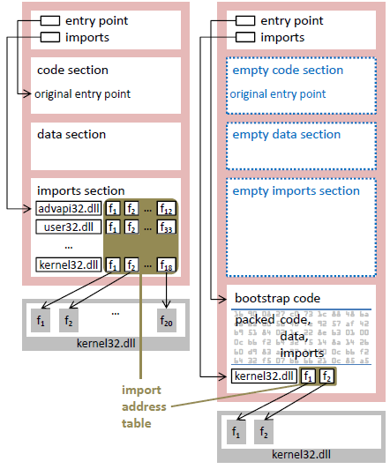
Two special APIs
kernel32.LoadLibrary and kernel32.GetProcAddress

Slide 25
Arithmetic operation
Obfuscated constants
Checksumming

Slide 26
Obfuscated constants
404C4B MOV EAX, DWORD [EBP + 40D280]
404C51 PUSH EAX
404C52 XOR EAX, 7DCC805B
404C57 SUB EAX, 2A5DA2BD
Replace an constant value with many arithmetic instructions
Harder to understand code (anti - debugging)
Notes:
26

Slide 27
Checksumming
4047F5 XOR EAX, EAX
4047F7 LODS BYTE [EDI]
4047F8 XOR AL, DL
4047FA SHR EAX, 1
404806 INC EAX
404812 JG 4047F5
...
404C4B MOV EAX, DWORD [EBP + 40D280]
404C51 PUSH EAX
404C52 XOR EAX, 7DCC805B
404C57 SUB EAX, 2A5DA2BD
404C63 JNZ 40527B
Integrity checking (CRC checking)
Notes:
27

Slide 28
Anti - tampering
Checksumming
Timing check
Anti-debugging
Anti-rewriting
Hardware breakpoints
Notes:
28

Slide 29
Timing check and Anti - debugging
Timing check: kernel32.GetTickCount, kernel32.GetSystemTime, kernel32.GetLocalTime or using RDTSC instruction
Anti – debugging: kernel32.IsDebuggerPresent, kernel32.CheckRemoteDebuggerPresent, kernel32.NtQueryInformationProcess, kernel32.NtQuerySystemInformation and kernel32.NtQueryObject
Notes:
29

Slide 30
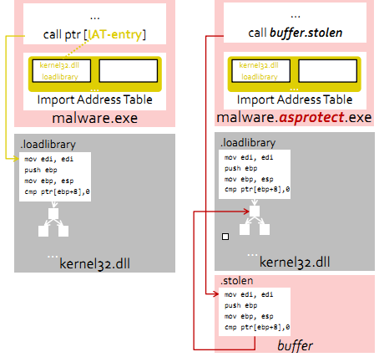
Anti - rewriting
Consists of Stolen bytes and Checksumming
Stolen bytes
Notes:
30

Slide 31
Hardware breakpoints
40408C INT3
40408D NOP
40408E MOV EAX, EAX
404090 STC
...
404099 CLC
...
40409E CLD
...
4040A3 NOP
Use 4 debug registers: DR0,DR1,DR2,DR3
Causing SINGLE_STEP_EXCEPTION
Notes:
31

Slide 32
SMV Model
State A state s is a structure:
addr
mnem depends on addr
op:
name depends on addr
type depends on name
Notes:
32

Slide 33
Example
addr=0x00401000 mnem=pushl op1.name=r_eax op1.type=reg
0x00401000 pushl %eax
addr=0x00401001 mnem=jmp op1.name=i_401003 op1.type=imm
00401000 push EAX
0x00401001 jmp 0x00401003
00401001 jmp 00401003
00401003 mov EAX, 0
0x00401003 movl $0x0<UNIT32>,%eax
addr=0x00401003 mnem=movl op1.name=0 op1.type=zero op2.name=r_eax op2.type=reg
Notes:
33

Slide 34
Limitation
The actual value of registers. Example: mov EBX,0 mov EAX,EBX
Indirect memory access. Example: xchg DWORD ptr DS:[EAX],EBX
BE-PUM just supported 26 packers
Analysis process reaches timeout Result True: original binary code is truly a packer. False: unknown.

Slide 35
Future Works
Identify accurately packer techniques’s patterns.
Support more packers, that is, support more packer techniques.
Finding the real OEP of packed file by packer detection via frequency of techniques.

Slide 36
References
[1] Kevin Roundy, Paradyn Project, “A survey of Obfuscations in Prevalent Packer Tools”, March 26th 2012
[2] Ange Albertini, “Packers”, April 5th 2010
[3] Nguyen Minh Hai, Mizuhito Ogawa and Quan Thanh Tho, “Pushdown Model Generation of Malware”, June 24th 2006
[4] Quan Thanh Tho, with Nguyen Minh Hai, in collaboration with Mizuhito Ogawa, “BE-PUM: Binary Emulation for Pushdown Model Generation, a tool for under approximated model generation”, March 2015

Slide 37
THANK YOU !

