Slide 1
BE-PUM: Binary Emulation for Pushdown Model Generation
A tool for under-approximated model generation
Quan Thanh Tho
Ho Chi Minh City University of Technology (HCMUT), Vietnam
with Nguyen Minh Hai (HCMUT)
in Collaboration with Mizuhito Ogawa (JAIST)
March 2015

Slide 2
Agenda
Motivation
Running Examples
CFG and Pushdown Model
BE-PUM
Experiments
Conclusions

Slide 3
Motivation

Slide 4
Malwares
Malware (malicious software) – a real threat
  Virus
  Trojan horse
  Keylogger
How to deal
  Signature detection (Industry approach)
  Emulation (Sandbox approach)
  Model generation (Formal approach)

Slide 5
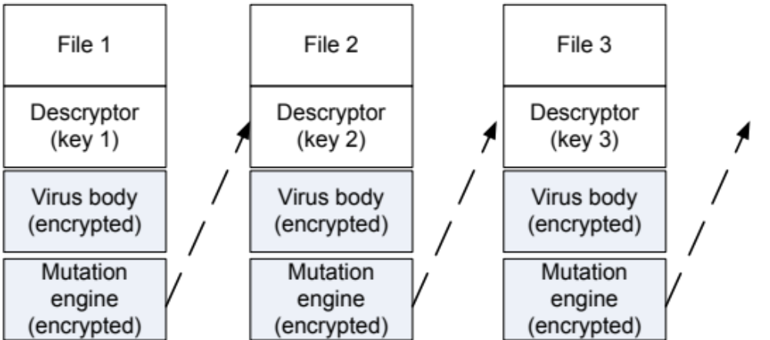
Polymorphic Virus
It can changes its bodies (hence its signature) in infinite variants
Mutation applies

Slide 6
Issues
Signature-based = Failed
Sandbox-based
  Heavy cost
  Virus may have different behaviors (at different time points)
  Virus may even detect sandbox environment
Model Checking
  Model Generation
  Model Verification

Slide 7
Typical approach
Control Flow Graph (CFG) is generated as the model
  One program location is mapped a node
  Decide all of destinations when branching
Things are more difficult with sophisticated binaries:
  Self-modification code
  Indirect jump

Slide 8
Control Flow Graph
Choices of many tools (CodeSurfer/x86, McVeto, JakStab, BIRD, Renovo, Syman, BINCOA/OSMOSE)
00
0A
Hexa | Instructions
0x00401000 | cmp eax, 0
0x00401003 | jle 0x0040100d
0x00401005 | mov eax, 0x00401001
0x0040100a | jmp 0x00401015
0x0040100c | halt
0x0040100d | mov eax, 0x00401018
0x00401012 | sub eax, 5
0x00401015 | sub eax, 1
0x00401018 | 0x0040100c
03
18
0D
05
0A
12
15

Slide 9
Self-modification code
One location is modeled as a node in the CFG
00401001 EB 00 JMP SHORT 0040101A
00401003 B8 19104000 MOV EAX, 00401019
00401008 8000 0A ADD BYTE PTR DS:[EAX],0A
0040100B EB F4 JMP SHORT 00401018
0040100D E8 01000000 CALL <kernel32.ExitProcess>
00401001 EB 0A JMP SHORT 00401024
00401003 B8 19104000 MOV EAX, 00401019
00401008 8000 0A ADD BYTE PTR DS:[EAX],0A
0040100B EB F4 JMP SHORT 00401018
0040100D E8 01000000 CALL <kernel32.ExitProcess>

Slide 10
Indirect Jump
00
Hexa | Instructions
0x00401000 | cmp eax, 0
0x00401003 | jle 0x0040100d
0x00401005 | mov eax, 0x00401001
0x0040100a | jmp 0x00401015
0x0040100c | ret
0x0040100d | mov eax, 0x00401018
0x00401012 | sub eax, 5
0x00401015 | sub eax, 1
0x00401018 | jmp eax
03
18
0d
05
0a
12
15

Slide 11
Over-approximation approach
00
Hexa | Instructions
0x00401000 | cmp eax, 0
0x00401003 | jle 0x0040100d
0x00401005 | mov eax, 0x00401001
0x0040100a | jmp 0x00401015
0x0040100c | halt
0x0040100d | mov eax, 0x00401018
0x00401012 | sub eax, 5
0x00401015 | sub eax, 1
0x00401018 | jmp eax
......
03
18
0D
05
0A
12
15

Slide 12
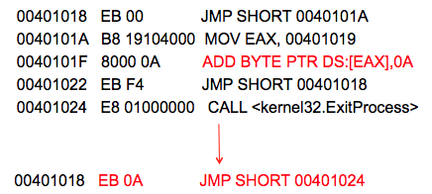
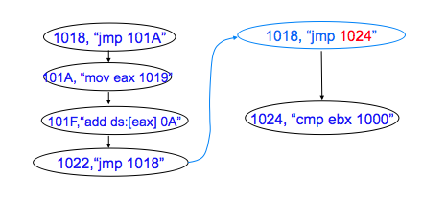
Our choice
Model nodes are distinguished not merely by locations, but something more

Slide 13
Our choice
States are distinguished not merely by locations, but something more
The model is under-approximated (sound) with possibly maximal coverage (as complete as possible)
  Less complexity
  No false positive
“Any execution path in the model must have an actual counterpart in the original program”

Slide 14
How to do
We trace all of possibly feasible execution paths
How to do
  Simulate the execution sequence
  Using symbolic value together with concrete value when simulating
    When we are confused about the next node due to symbolic values, using while-box testing to produce concrete values accordingly
    Testing ensures under-approximation while maximizing coverage

Slide 15
Running Examples

Slide 16
Running Example
Hexa | Instructions
0x00401000 | cmp eax, 0
0x00401003 | jle 0x0040100d
0x00401005 | mov eax, 0x00401001
0x0040100a | jmp 0x00401015
0x0040100c | halt
0x0040100d | mov eax, 0x00401018
0x00401012 | sub eax, 5
0x00401015 | sub eax, 1
0x00401018 | jmp eax

Slide 17

Running Example
Hexa | Instructions
0x00401000 | cmp eax, 0
0x00401003 | jle 0x0040100d
0x00401005 | mov eax, 0x00401001
0x0040100a | jmp 0x00401015
0x0040100c | halt
0x0040100d | mov eax, 0x00401018
0x00401012 | sub eax, 5
0x00401015 | sub eax, 1
0x00401018 | jmp eax
eax = α

Slide 18

Running Example
Hexa | Instructions
0x00401000 | cmp eax, 0
0x00401003 | jle 0x0040100d
0x00401005 | mov eax, 0x00401001
0x0040100a | jmp 0x00401015
0x0040100c | halt
0x0040100d | mov eax, 0x00401018
0x00401012 | sub eax, 5
0x00401015 | sub eax, 1
0x00401018 | jmp eax
eax = α

Slide 19
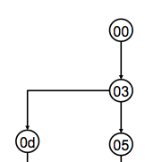
Running Example
Hexa | Instructions
0x00401000 | cmp eax, 0
0x00401003 | jle 0x0040100d
0x00401005 | mov eax, 0x00401001
0x0040100a | jmp 0x00401015
0x0040100c | halt
0x0040100d | mov eax, 0x00401018
0x00401012 | sub eax, 5
0x00401015 | sub eax, 1
0x00401018 | jmp eax
eax <0
eax = α
eax >=0

Slide 20
Running Example
00
jmp to α?
Hexa | Instructions
0x00401000 | cmp eax, 0
0x00401003 | jle 0x0040100d
0x00401005 | mov eax, 0x00401001
0x0040100a | jmp 0x00401015
0x0040100c | halt
0x0040100d | mov eax, 0x00401018
0x00401012 | sub eax, 5
0x00401015 | sub eax, 1
0x00401018 | jmp eax
eax = α
03
18
0d
05
0a
12
15
Convert symbolic value of α into a concrete value
Use white-box testing to under-approximate α

Slide 21
Test-case Generation
eax = α
00
eax = α
00
Test-case-2 = -7
Test-case-1 = 5
03
18
03
18
α <= 0
α >= 0
α <= 0
α >= 0
0d
05
0d
05
α >= 0
0a
0a
α >= 0
α <= 0
12
15
12
15

Slide 22
Enlarging the Model by Testing Result
Hexa | Instructions
0x00401000 | cmp eax, 0
0x00401003 | jle 0x0040100d
0x00401005 | mov eax, 0x00401001
0x0040100a | jmp 0x00401015
0x0040100c | halt
0x0040100d | mov eax, 0x00401018
0x00401012 | sub eax, 5
0x00401015 | sub eax, 1
0x00401018 | jmp eax
Simulation Snapshot
eax=0x0040100C;
start=0x00401000;
return=0;
address=0x0040100C;
00
0c
Test-case-1
Test-case-2
03
18
0d
05
0a
12
15

Slide 23
  Model node = { (location, instruction) }
  States = { (location, instruction, path condition) }
  Operational semantics
    Ensure that 00→03→05→0a→ 15→18→0C NEVER occurs
00
0c
03
18
0d
05
0a
12
15

Slide 24
Pushdown Model

Slide 25
From CFG to Pushdown Model
Hexa | Instructions
0x00401000 | cmp eax, 0
0x00401003 | jle 0x0040100d
0x00401005 | push eax
0x0040100a | jmp 0x00401015
0x0040100d | mov eax, 0x00401018
00
03
Stack (S)
Memory (M)
05
0A
Register (R)
Flag(F)
0D
1 - Program (CFG) = {k,asm}
2 – Memory Model = (M,S,R,F)
03
05
Push rule: ((k,asm),ε) → ((k’,asm’),ω)
Pop rule: ((k,asm), ω) → ((k’,asm’), ε)
Internal rule: ((k,asm), ε) → ((k’,asm’), ε)
03
0D
3 – Pushdown Transition Rules
00
03
Push rule
0D
05
0A

Slide 26

Operational Semantics Rules
00
Env(M,S,R,F) → Env’(M’,S’,R’,F’)
03
0D
05

Slide 27
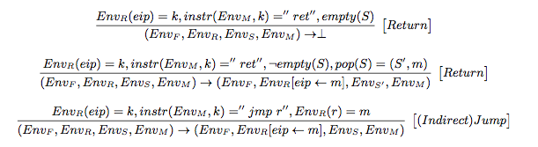


Some samples of x86 operational semantic

Slide 28
Model Generation
Current State
(k,asm, pre-cond)
Confusing instruction (Indirect jump, System Call…)
“Static” instructions
Symbolic-valued
Symbolic Execution
(k,asm, pre-cond)
Concrete-valued
Symbolic Execution
(k,asm, pre-cond)
Next Config.
(k’,asm’, pre-cond’)
_x000e_Not converged yet

Slide 29
Do the right thing in right time
When symbolic?
  Anti-simulator
  Anti-debugging
When concrete
  Indirect jump
  API

Slide 30
Roadmap to the Tool
Pushdown Model
=
CFG + Memory Model + Operational Rules
Model Generation
Binary Emulation
BE-PUM (Binary Emulation for PUshdown Model Generation)

Slide 31
BE-PUM

Slide 32
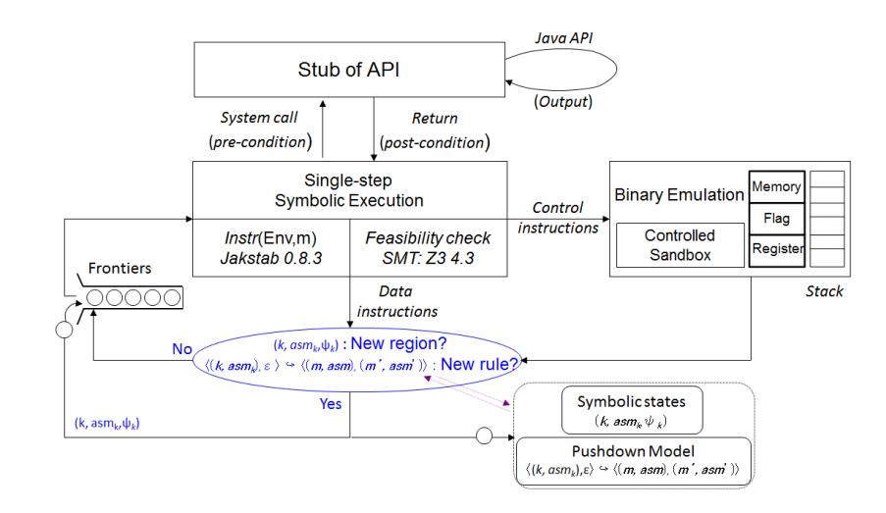

Slide 33
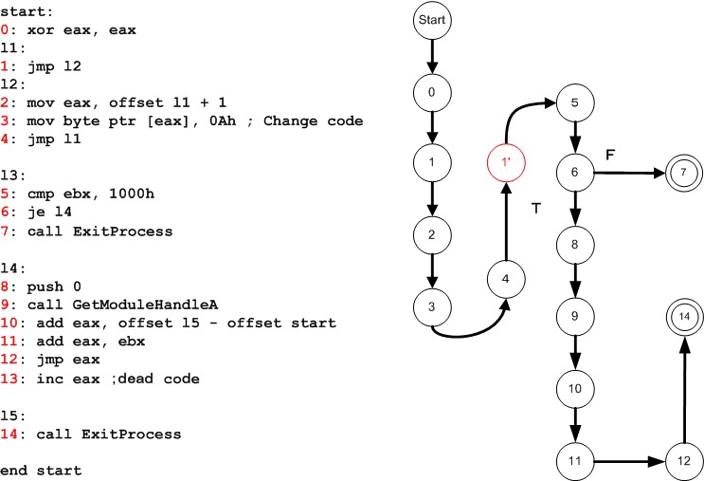
Example

Slide 34
Self-Modifying Code
start:
0: xor eax, eax
l1:
1: jmp l2
l2:
2: mov eax, offset l1 + 1
3: mov byte ptr [eax], 0Ah ; Change code
4: jmp l1
l3:
5: cmp ebx, 1000h
0, “xor eax, eax”
1, “jmp 2”
2,“mov eax, offset l1 + 1”
3,“jmp 1”
1, “jmp 5”
5, “cmp ebx, 1000h”

Slide 35
Indirect Jump
ebx = α
l3:
5: cmp ebx, 1000h
6: je l4
7: ｃall ExitProcess
l4:
8: push 0
9: call GetModuleHandleA
10: add eax, offset l5
- offset start
11: add eax, ebx
12: jmp eax
13: inc eax ；ｄｅａｄ coｄe
l5:
14: call ExitProcess
end start
05
Path Condition ᴪ₁ :
α <> 1000h
06
Path Condition ᴪ₂
α == 1000h
07
Z3
08
Test-case Ω₁ :
[α = 1000]
09
12
10
11

Slide 36
Simulation
ebx = 1000h
l3:
5: cmp ebx, 1000h
6: je l4
7: ｃall ExitProcess
l4:
8: push 0
9: call GetModuleHandleA
10: add eax, offset l5
- offset start
11: add eax, ebx
12: jmp eax
13: inc eax ；ｄｅａｄ coｄe
l5:
14: call ExitProcess
end start
05
06
07
08
14
09
12
10
11
Run test-case with our simulation framework
Check whether the result is the new area.

Slide 37
Overlapping Instructions
00406002 E8 02000000 CALL 00406009
00406007 E8 00E80000 CALL 0041480C
00406009 E8 00000000 CALL 0040600E
0040600C 0000 ADD BYTE PTR DS:[EAX],AL
0040600E 5E POP ESI
02
02
IDA Pro
07
09
0C
0E
BE-PUM
0E

Slide 38

Features
Adopt Pushdown Model (and emulate it)
  M is represented as 8-bit vectors.
  R,S and F are represented as 32-bit vectors
  120 instructions covered, selected from a real of 4000 malwares collected from VX Heaven
  (http://vx.netlux.org)
On-the-fly Model Generation (concolic testing)

Slide 39

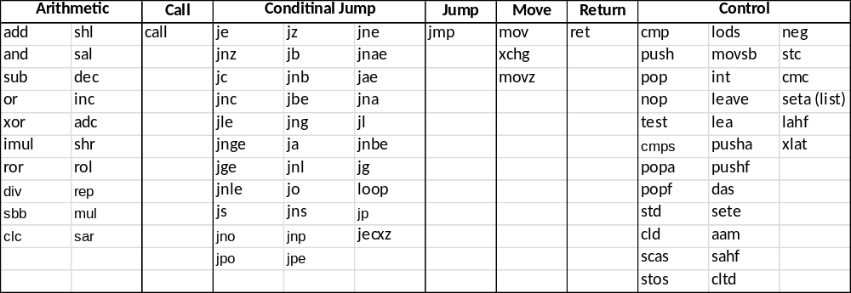
Strategy for covered instruction selection
Instruction statistics collected from virus samples
Full list of supported instructions

Slide 40
Supported 79 Windows APIs
Kernel32.dll: _lwrite, accept, bind, CloseHandle, closesocket, connect, CopyFile, CreateFile, CreateFileMapping, CreateProcess, CreateThread DeleteFile, ExitProcess, FindClose, FindFirstFile, FindNextFile, FreeEnvironmentStrings, GetCommandLine, GetCurrentDirectory GetCurrentProcess, GetEnvironmentStrings, GetFileAttributes, GetFileSize, GetFileType, gethostbyname, gethostname, GetLastError GetLocalTime, GetModuleFileName, GetModuleHandle, GetProcAddress, GetStartupInfo, GetStdHandle, GetSystemDirectory GetSystemTime, GetTickCount, GetVersion, GetVersionEx, GetWindowsDirectory, HeapAlloc, HeapCreate, HeapDestroy, HeapFree, HeapReAlloc, IsDebuggerPresent, listen, LoadLibrary, lstrcat, lstrcmp, lstrcpy, lstrlen, MapViewOfFile, MoveFile, PeekMessageA, ReadFile, recv, RegCloseKey, RegOpenKeyEx, RegSetValueEx, send, , SetCurrentDirectory, SetEndOfFile, SetFileAttributes, SetFilePointer, SetHandleCount, shutdown, socket ,UnmapViewOfFile, VirtualAlloc, VirtualFree, WaitForSingleObject, WinExec, WriteFile, WSACleanup, WSAStartup
User32.dll: MessageBox, SendMessage, FindWindow, PostMessage.
Simulate API using JNA

Slide 41
Experiments

Slide 42
Comparison with some others
BE-PUM current tool: precise models (CFG) generated from real malwares
  Indirect jumps (now)
  Self-modification (now)
  Decryption (now)
  SEH (now)
Experiments
  Compare the CFG with those generated by Jakstab and IDA Pro

Slide 43
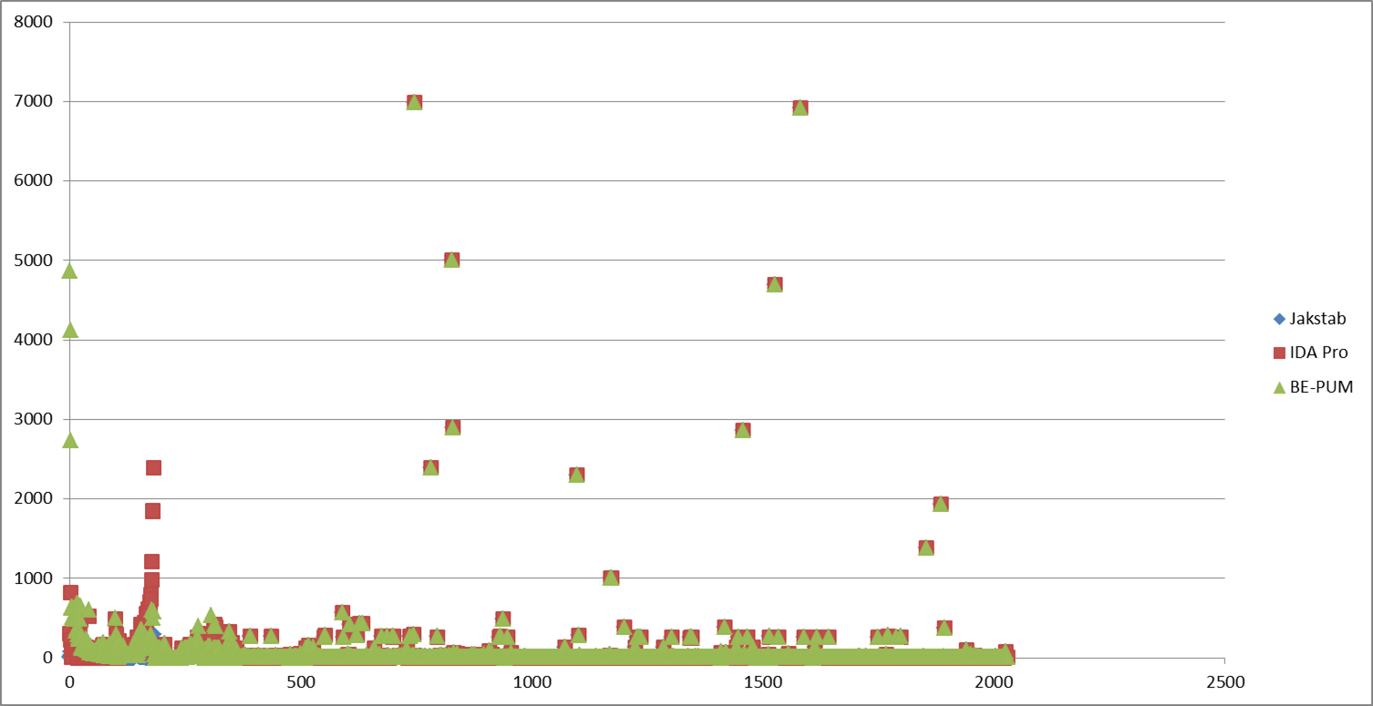
Experiments on 2028 malwares
Jakstab, IDApro, BE-PUM
Number of nodes
ID

Slide 44
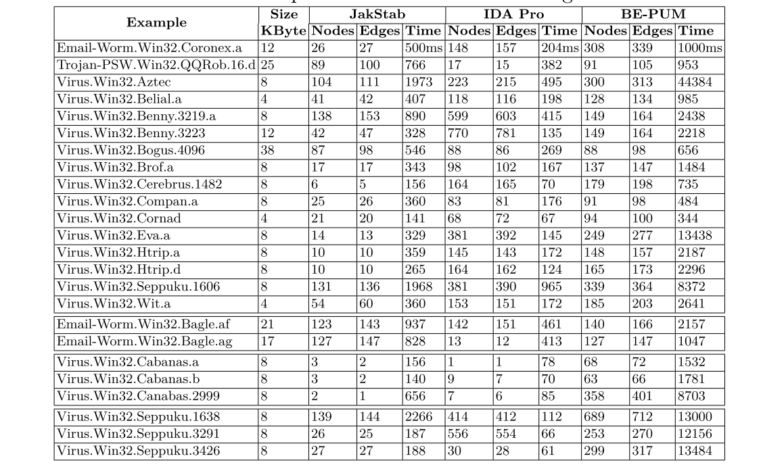
Experiment statistics

Slide 45
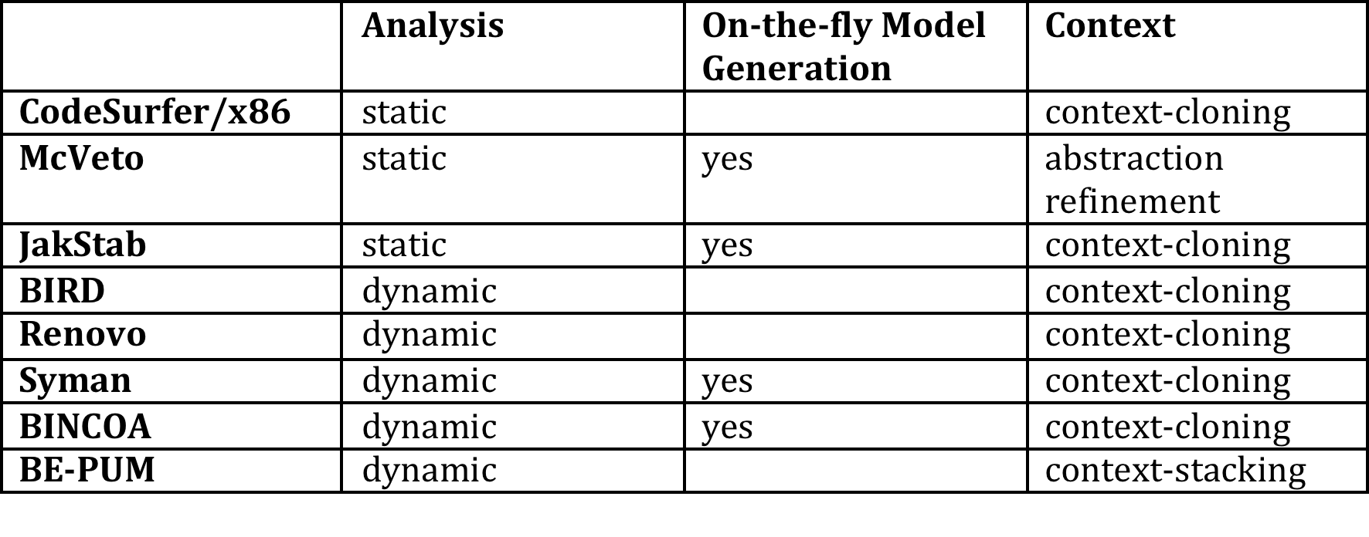
Related Works

Slide 46
Remarks
BE-PUM plays the roles of both model generation and model emulator for binaries
  Model Generation: on-the-fly manner, with concolic technique
    Missing piece: Loop invariant (handled by looping many many times if needed)
  Emulator
    A “symbolic sandbox”

Slide 47
Conclusion
BE-PUM is to deal with malwares
  Show better tracing abilities than state-of-the-art tool
  Can deal with self-modification
    State = (k,asm); i.e. (k,asm) and (k,asm’) are distinguished
    Operational semantics rules applied on binaries, to deal with encryption-decryption

Slide 48
Future Work
Using pushdown model checking to recognize viral behavior patterns
Apply LTL model-checking as reachability on PDS
Apply WPDS for data flow (removing infeasible paths)

Slide 49
JNA
Java Native Access is a community-developed library
JNA allows Java programs to call native shared libraries
Steps to apply JNA in BE-PUM
  Library Mapping
  Function & Type Mapping
  Get arguments from BE-PUM’s stack
  Get result and store it into BE-PUM’s system

Slide 50
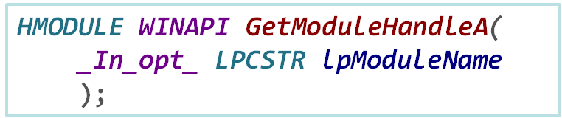
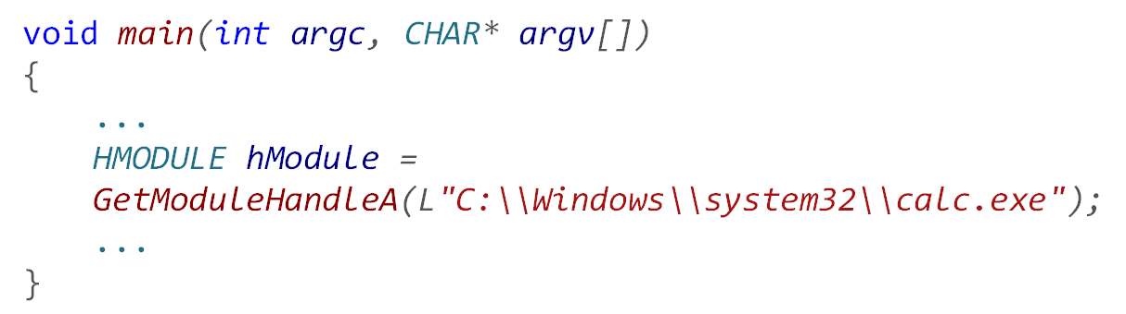
A running example
C++ code
PUSH OFFSET Cpp.??_C@_1DK@EOENOGGL@?$AAC?$AA?3?$AA?2...
;pModule = "C:\Windows\system32\calc.exe"
CALL DWORD PTR DS:[<&KERNEL32.GetModuleHandleA>]
;GetModuleHandleA
Assembly

Slide 51
Get arguments from BE-PUM’s stack
A running example
Top Stack
012C
319C
4bytes
…
PUSH OFFSET Cpp.??_C@_1DK@EOENOGGL@?$AAC...
......
Start
with
012C319C
address
"C:\Windows\system32\calc.exe"

Slide 52
Get arguments from BE-PUM’s stack
A running example
Top Stack
CALL DWORD PTR DS:[<&KERNEL32.GetModuleHandleA>]
…
After
pop
Value x1 = stack.pop();
012C
319C
......
Start
with
012C319C
address
Get this string from x1 address
"C:\Windows\system32\calc.exe"

Slide 53
Get result and store it into BE-PUM’s system
A running example
Top Stack
…
After
pop
Value x1 = stack.pop();
012C
319C
Make method call
HMODULE hModule =
Kernel32.GetModuleHandle( )
......
Start
with
012C319C
address
Get this string from x1 address
"C:\Windows\system32\calc.exe"

Slide 54
Get result and store it into BE-PUM’s system
A running example
Top Stack
Register
…
hModule’s
value
After
pop
HMODULE hModule
EAX
012C
319C
…
EBX
......
Return value will be putted in eax register.
Start
with
012C319C
address
…
ECX
…
EDX
"C:\Windows\system32\calc.exe"

